Slide 1
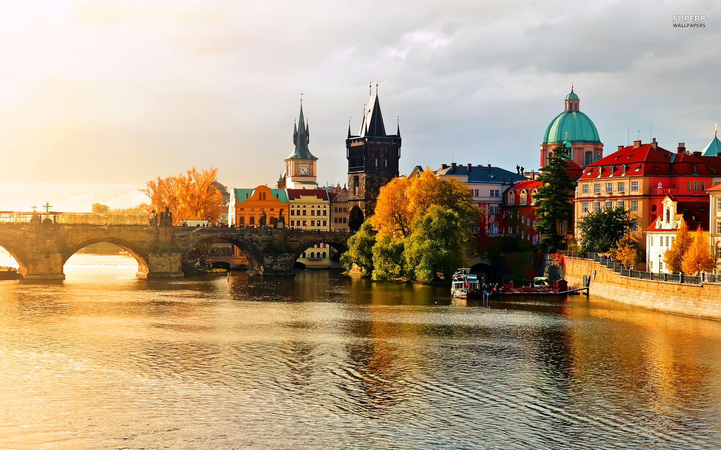
Prague

Slide 2
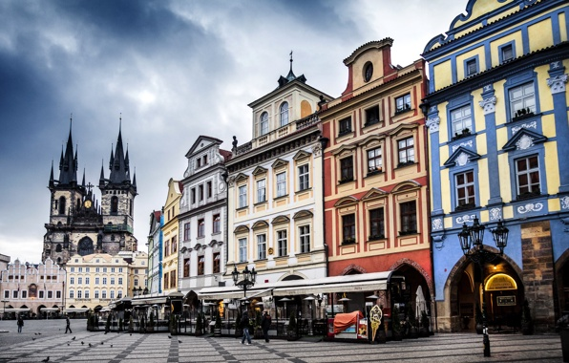
Prague has a lot of interesting places.
It‘s considered one of the most beautiful cities in central Europe

Slide 3
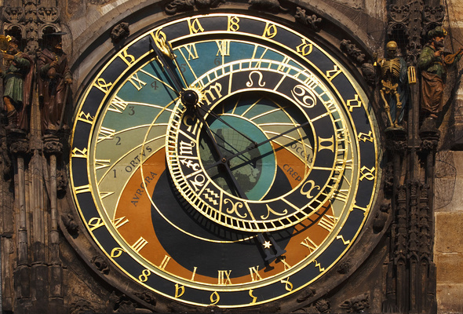
The prague astronomical clock
The clock was first installed in 1410, making it the third-oldest astronomical clock in the world and the oldest one still operating.

Slide 4
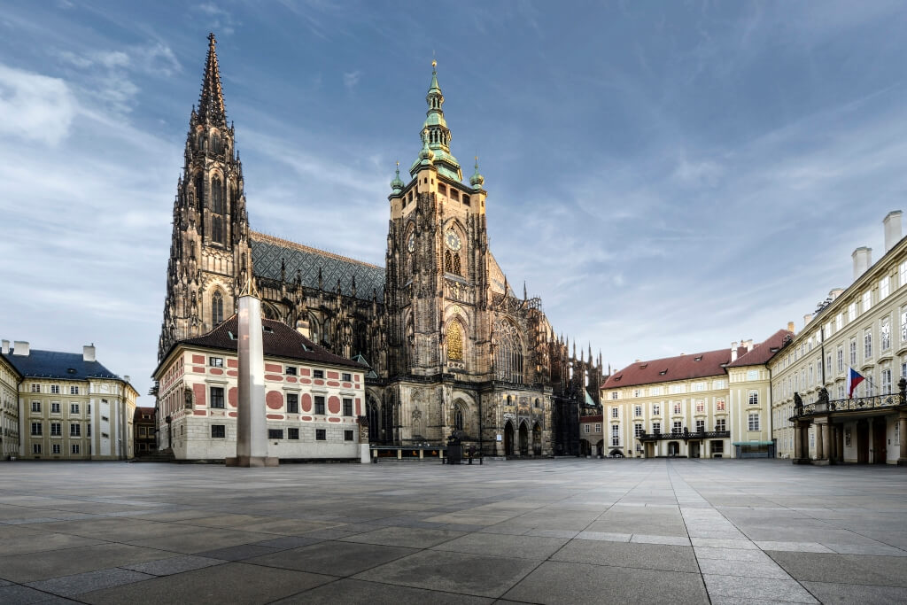
The Prague castle
Dating from the 9th century and the official residence of the President of the Czech Republic. The castle was a seat of power for kings of Bohemia, Holy Roman emperors, and presidents of Czechoslovakia. The Bohemian Crown Jewels are kept within a hidden room inside it.

