Slide 1
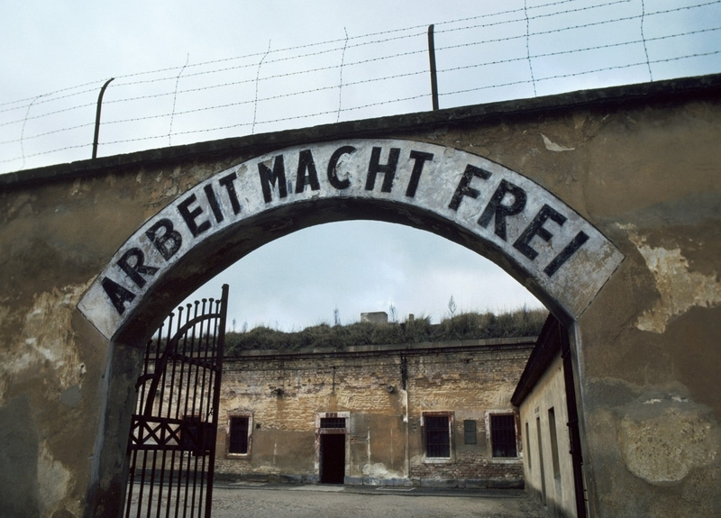
Terezín

Slide 2
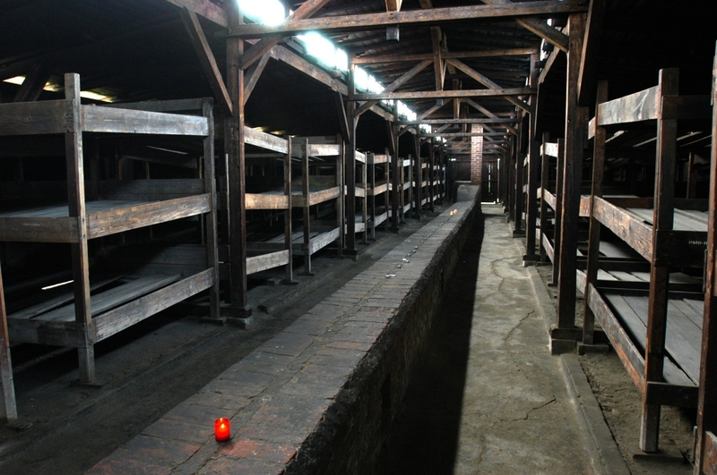
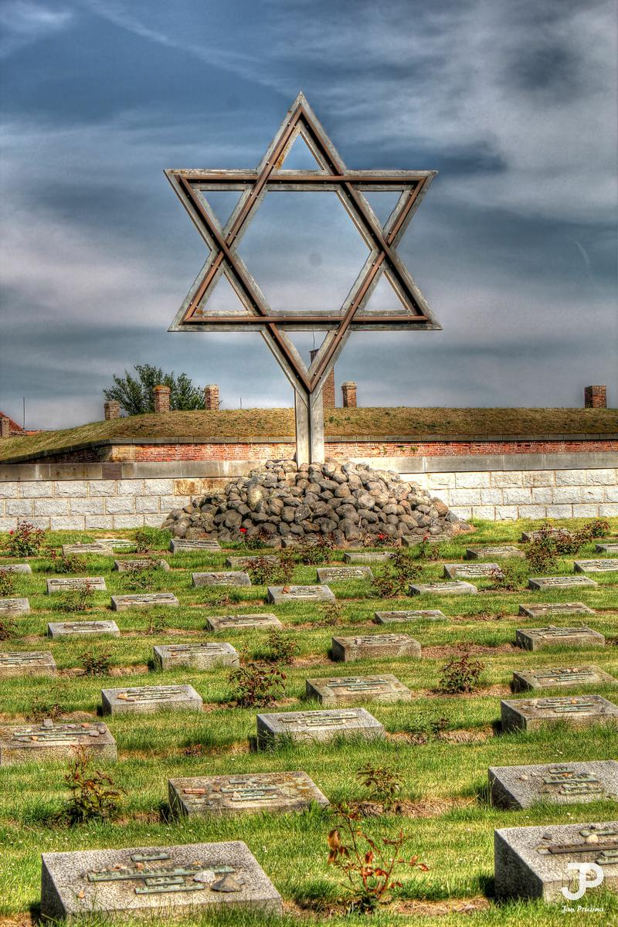
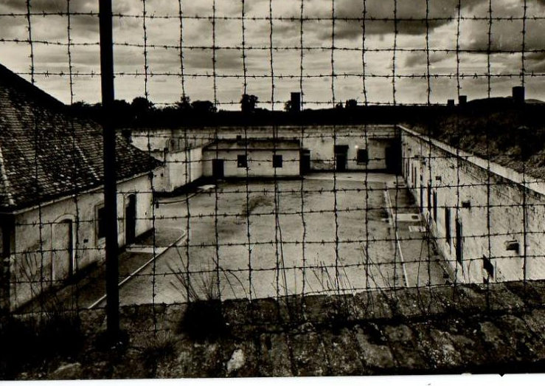
-Terezín is a small town near Litoměřice.
-In the past Terezín was a big prison and then concentration camp for Judes.

Slide 3
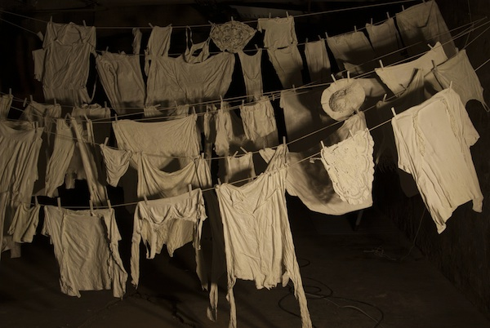
In the present is Terezín ordinary town and turist center. There are lot of expositions and exhibitions from 2nd Word War.

Slide 4
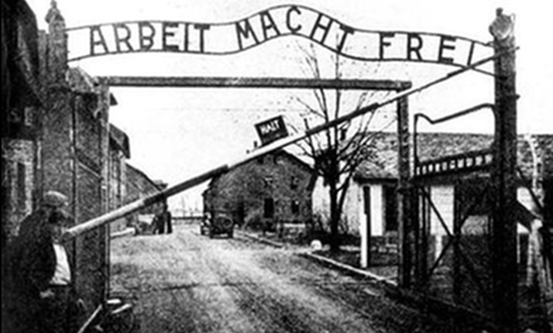
It is worth seeing , but it´s too sad for weak character.

