Slide 1
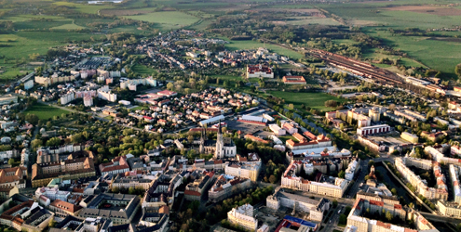
Olomouc

Slide 2
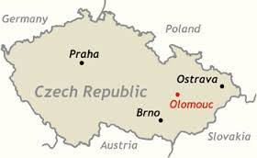
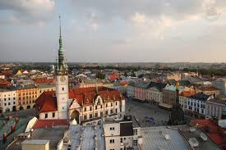
Olomouc is a city in Moravia, in the east of the Czech Republic.
Located on the Morava River, the city is the ecclesiastical metropolis and historical capital city of Moravia.
The city has about 102,000 residents, and its larger urban zone has a population of about 480,000 people.

Slide 3
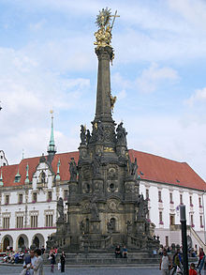
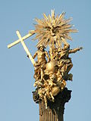
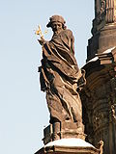
Holy Trinity Column in Olomouc
built in 1716–1754 in honour of God
In 2000 it was inscribed on the UNESCO
World Heritage List
The column is dominated by gilded copper
sculptures of the Holy Trinity accompanied
by the Archangel Gabriel on the top and the
Assumption of the Virgin beneath it.

