Slide 1
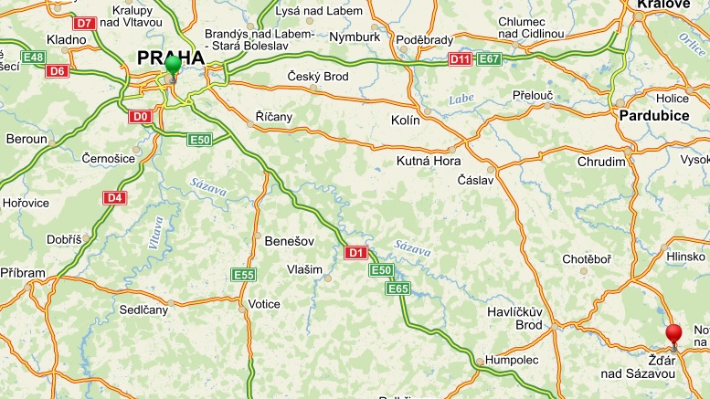
Žďár nad Sázavou

Slide 2
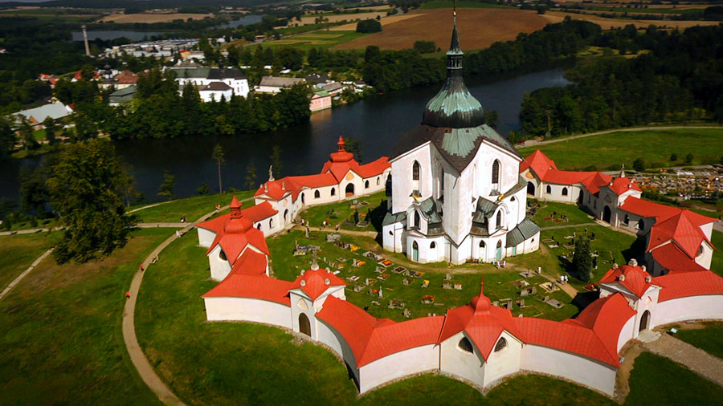
Žďár nad Sázavou was originally a market town. Today the city plays host to
several cultural and social events.
The Pilgrimage Church of St John of Nepomuk at Zelená Hora
was inscribed in the UNESCO List in 1994
The pilgrimage church, dedicated to St. John of Nepomuk, was built in the early 1820s.
It is the finest work of the architect Jan Blažej Santini and is the most original
example of the so-called baroque gothic style.
It was built on a five-pointed star plan and is surrounded by a cemetery and cloisters.

Slide 3
