Slide 1
INCLUSIVE EDUCATION
IN OUR SCHOOL

Slide 2
The children in our school have different backgrounds, needs, interests, and abilities.
In order to effectively teach the children in our case, teachers and activities need to be as diverse as they are.
There are many disadvantaged students because of critical socially and economically situation. We have some students with special needs or comes from very poor families, which dealing with subsistence agriculture and livestock without having any job.

Slide 3
The success of students with disabilities or those from disadvantaged backgrounds, such as our students, in more inclusive settings, depends on meeting both their academic and social and emotional needs. In turn, this requires a school climate that is a psychologically inclusive space, in which all students understand each other better, feel safe and supported, have positive relationships and are more respectful and acceptable. to each other.

Slide 4
BENEFITS OF INCLUSION
Inclusion helps children:
to be compassionate, respectful, and appreciative.
learn that people are more alike than they are different.
reject stereotypes about what people with disabilities are like.
have experiences they might otherwise miss.

Slide 5
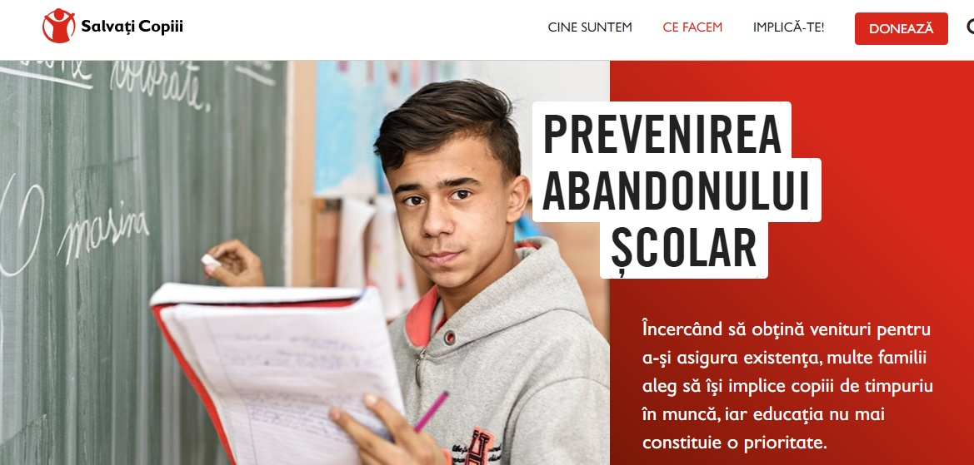
SAVE THE CHILDREN SALVAȚI COPIII
For the last 3 years, our school has partnership with the Save the Children Organization , in which we carry out volunteer activities on topics of social and educational inclusion.

Slide 6
