Slide 1
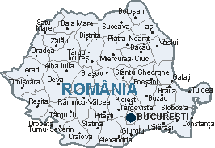
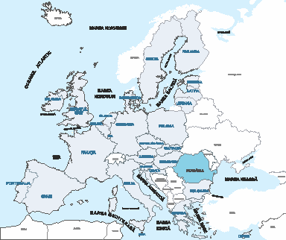
” LEARNING BY DOING”
My surrounding-pedestrian path
România
Titlul proiectului: Learning by doing
Codul proiectului: 2018-1-UK01-KA201-048116,
Beneficiar: Scoala Gimnaziala Dumbrava- structura Rachita, Timis
Perioada de implementare: septembrie 2018– august 2020

Slide 2
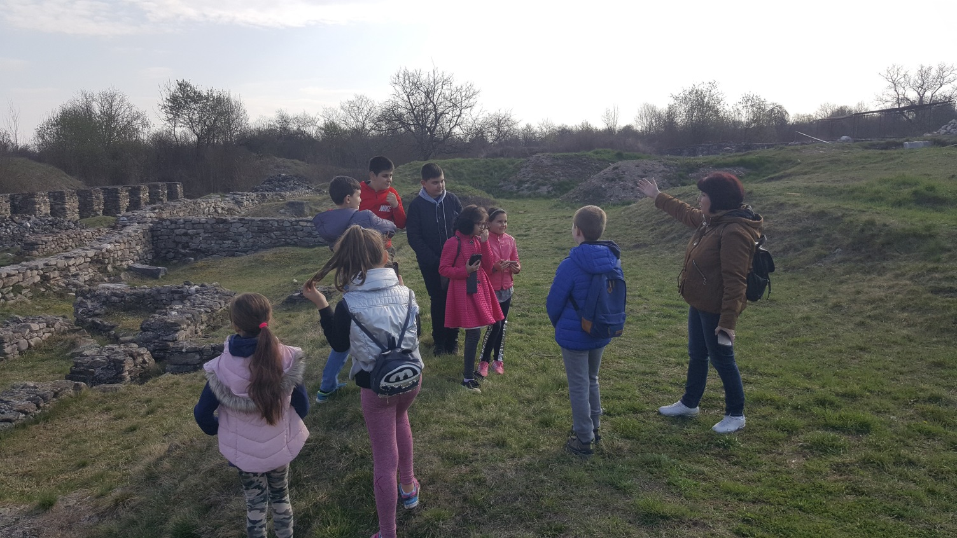
Functional history from stoneage, trouble corner where group of students go and try to find out the tasks;

Slide 7
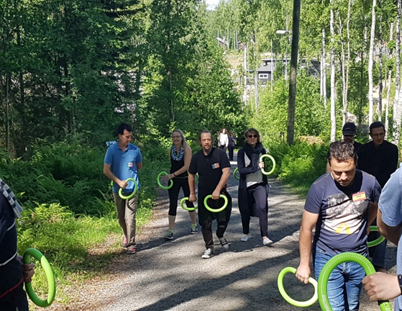
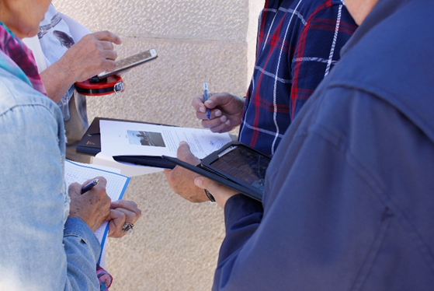
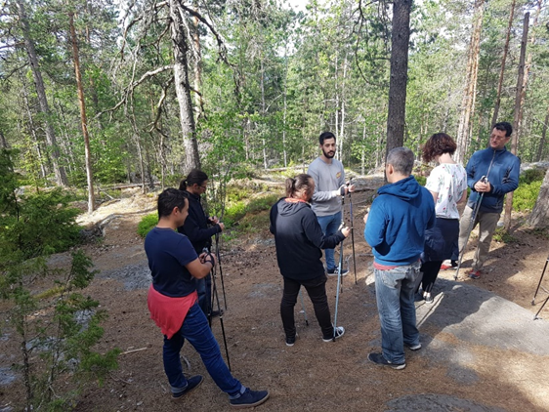
Studying math
in the forest /nature
(distances, localization, altitude)

Slide 10
Thank you!

