Slide 1
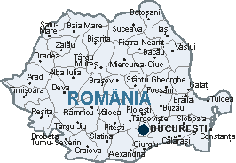
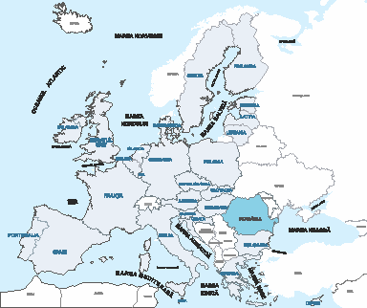
” LEARNING BY DOING”
BLUE FLAG ACTIVITY
România
Titlul proiectului: Learning by doing
Codul proiectului: 2018-1-UK01-KA201-048116,
Beneficiar: Scoala Gimnaziala Dumbrava- structura Rachita, Timis
Perioada de implementare: septembrie 2018– august 2020

Slide 2
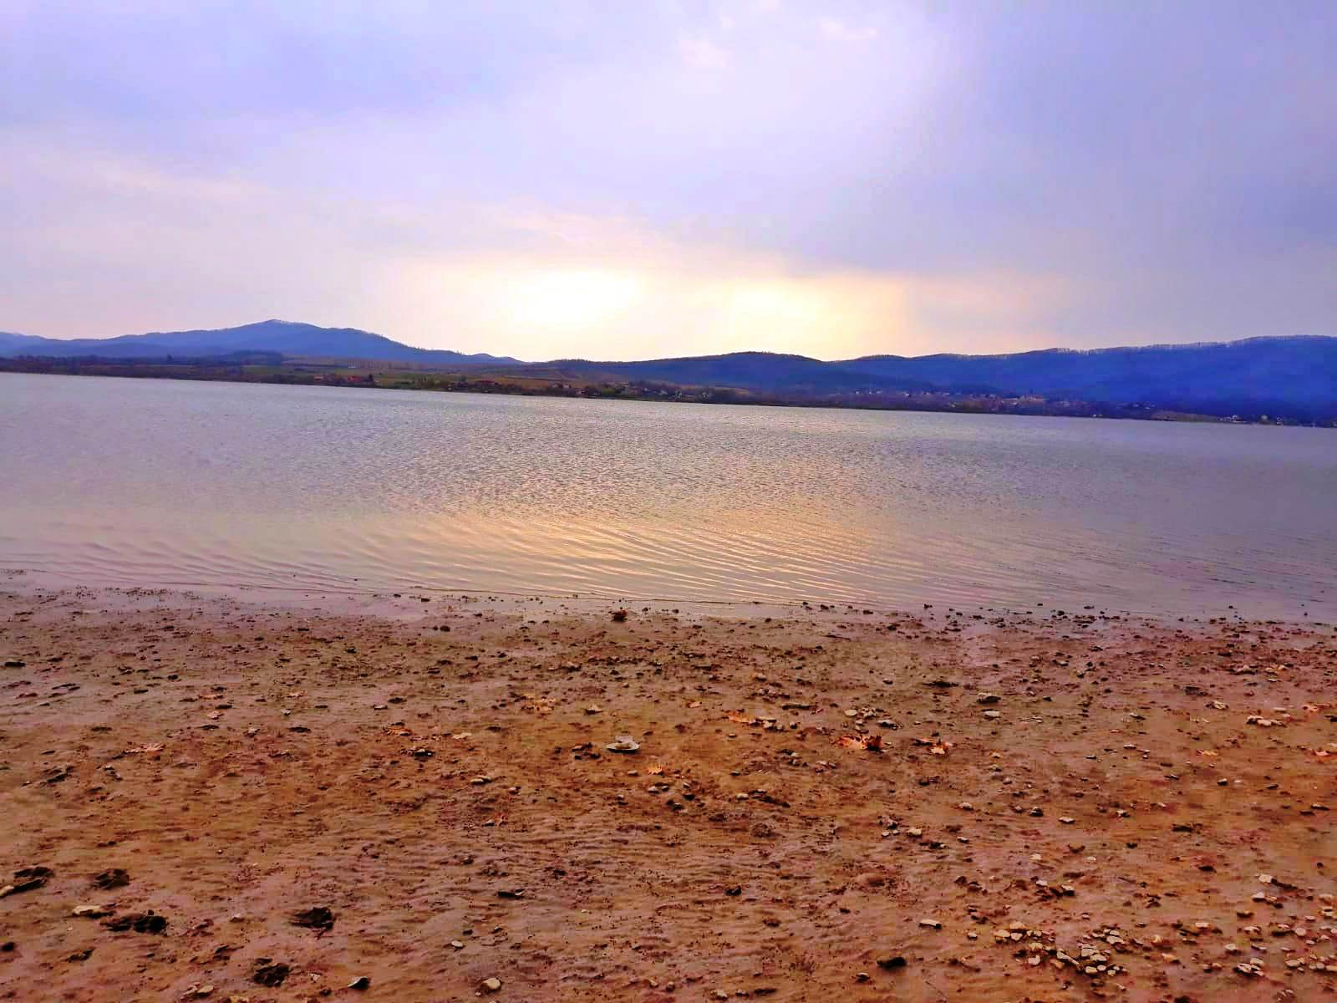
Surduc Lake is a construction made during communism. Lake Surduc is a reservoir lake with an area of 460 hectares. It is located in west part of Timis County, (south-eastern part of Poiana Rusca), at a distance of about 100 km from Timisoara and 10 k m from our school , in a very large area beautiful .

Slide 3
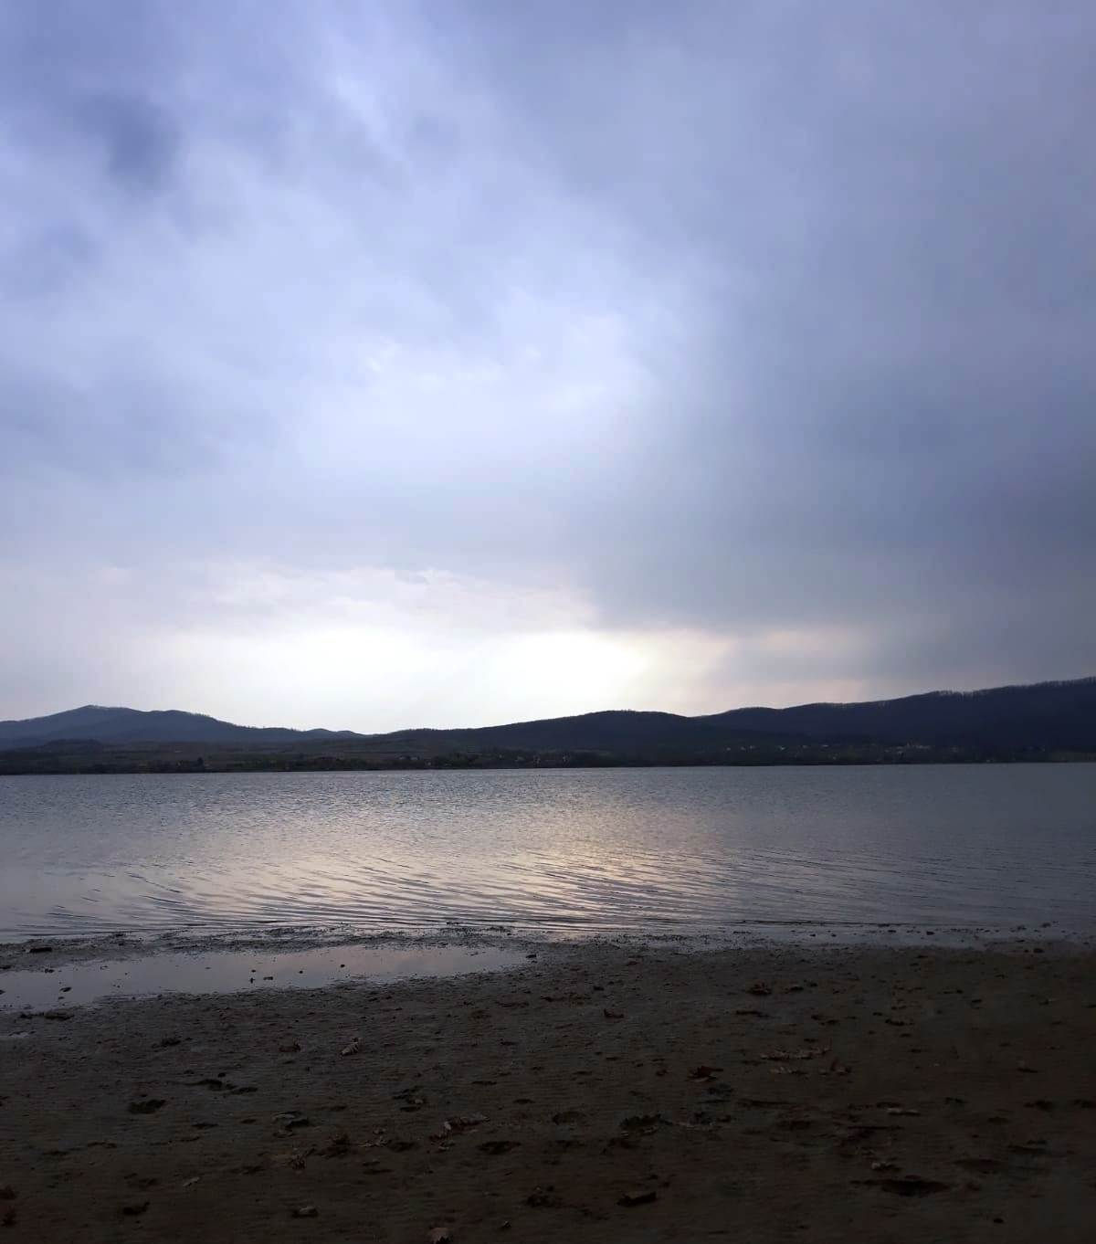
. The dam and Surduc Lake feeds drinking water and industrial water to Timişoara and puts the turbines of a micro-hydropower station in motion. The dam is the narrowest barrage in Romania, relative to the volume of water in which you can admire the immense lake, along with the wonderful surroundings for hunting, recreation, or fishing.

Slide 4
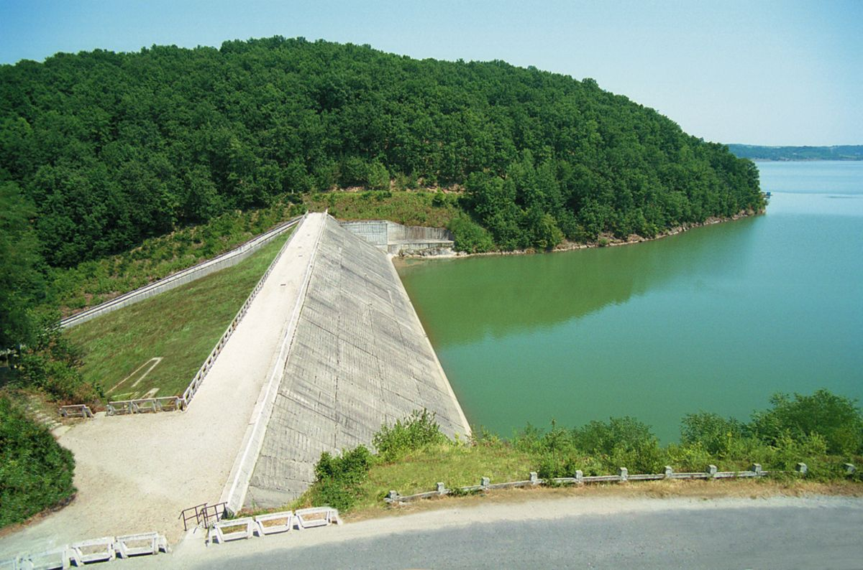
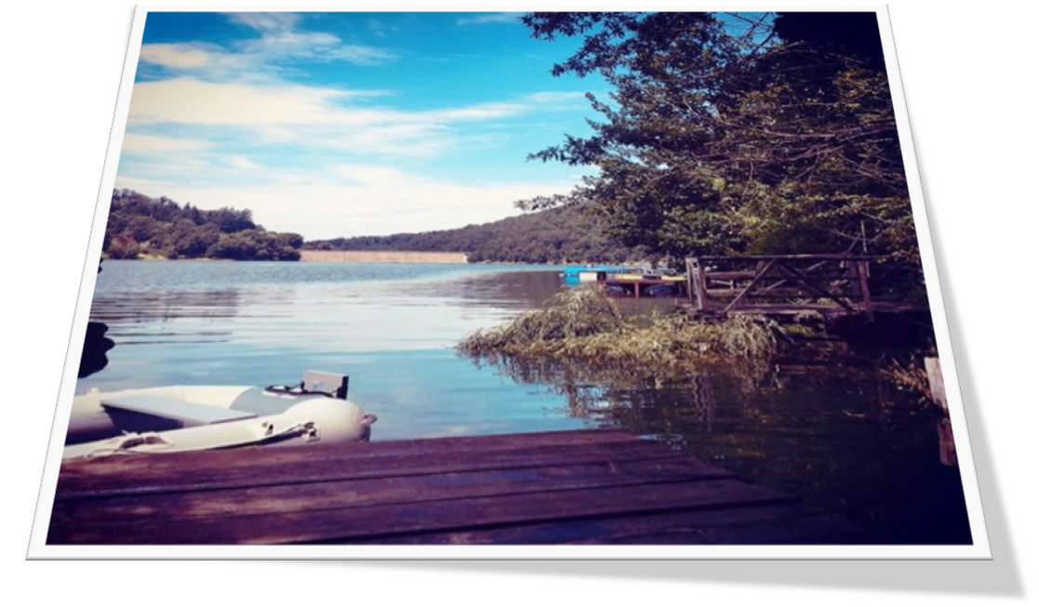
The main purpose of the accumulation lake is to provide drinking water to the Timişoara area, to protect against floods, to produce electricity.

Slide 5
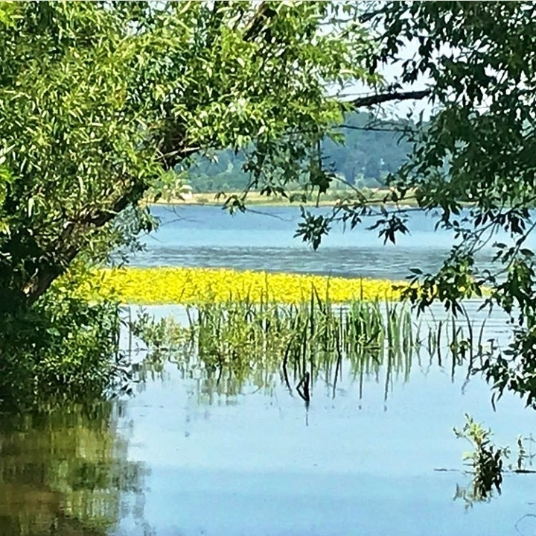
Lake Surduc is a protected area of national interest, a 362-hectare mixed nature reserve. Of course, Lake Surduc also has a tourist purpose, as the water of the lake does not freeze, thousands of aquatic birds are sheltered here during the winter, where lovers of fishing and leisure can enjoy at leisure

Slide 6
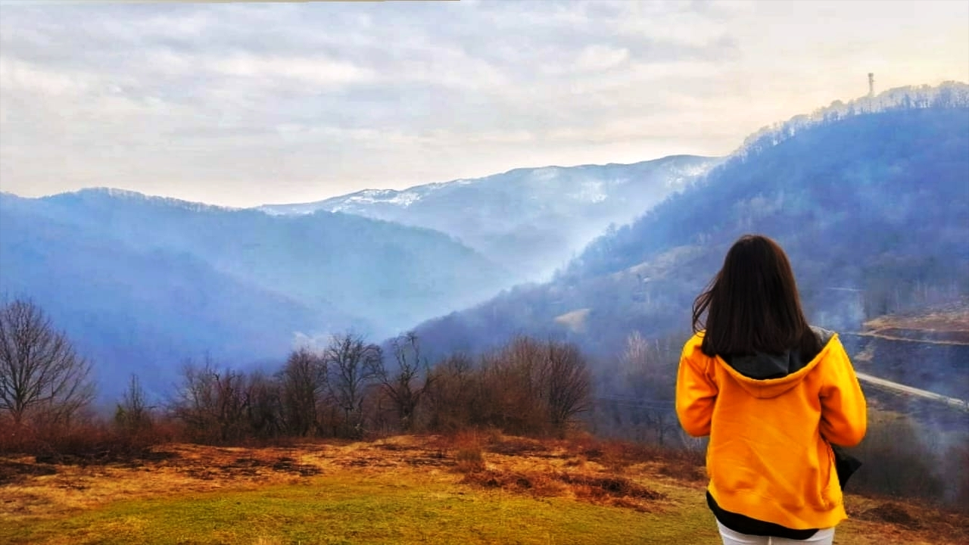
On a mountain path with breathtaking landscapes, with tall fir trees and snow covered mountains, tourists reach the mouth of the lake. The gloss of blue and clear water attracts you to stop and relax.

Slide 7
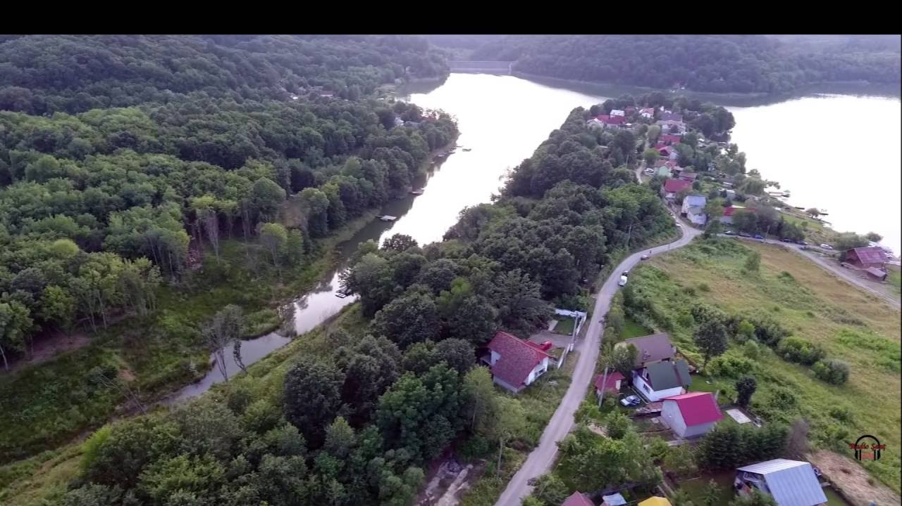
From the hill you can admire the whole view: the Surduc Lake, the valley village and the Poiana Rusca Mountains, covered by forests, which rise behind the lake, or the Nădrag Valley, and down of the mountains, the lake opens the Caransebes place, behind which the Semenic Mountains and Buzias hills are visible.

Slide 8
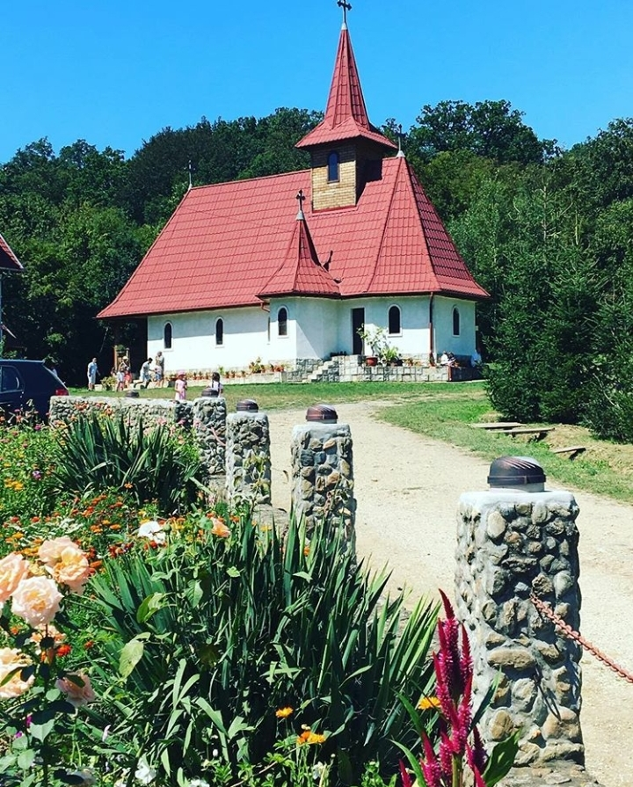
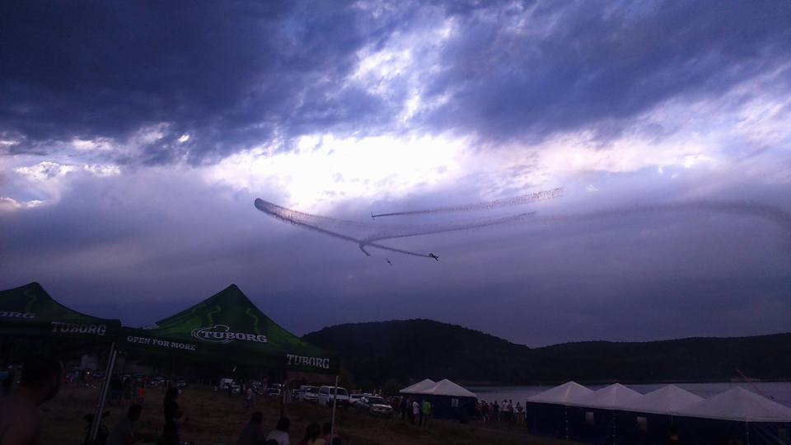
On the shore of the lake there is a beach area, but this tourist attraction is not sufficiently publicized. There are no guides to take the tourists to the wooden churches. Near the lake lies the Fardea Monastery, a newly established monastic settlement. Once a year, Surduc is hosting the AeroNautic Show Festival - dedicated to the air and nautical domains.

Slide 9
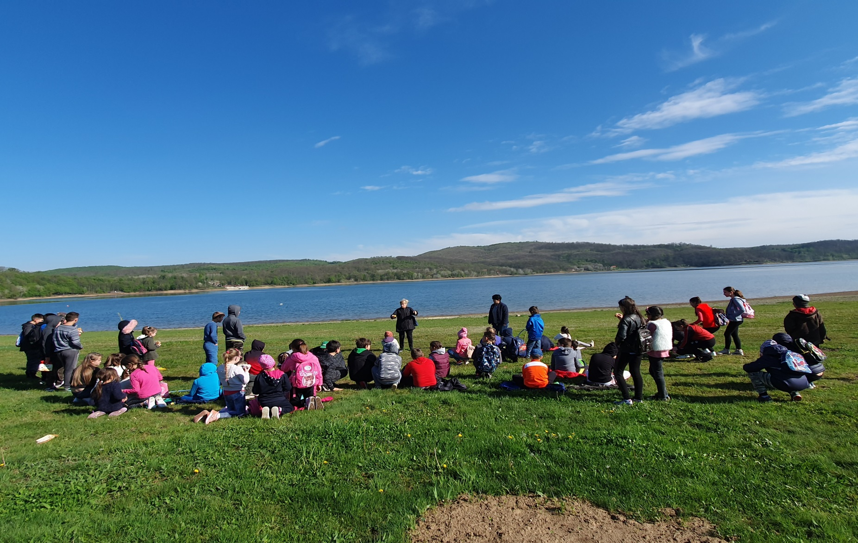
Our students visited this lake. We made research about water and fish. We compared lakes with rivers and Danube Delta or Black sea.

Slide 10
Pupils prepaired portofolios about this activity.

Slide 16
After work we played games in nature.

