Slide 1
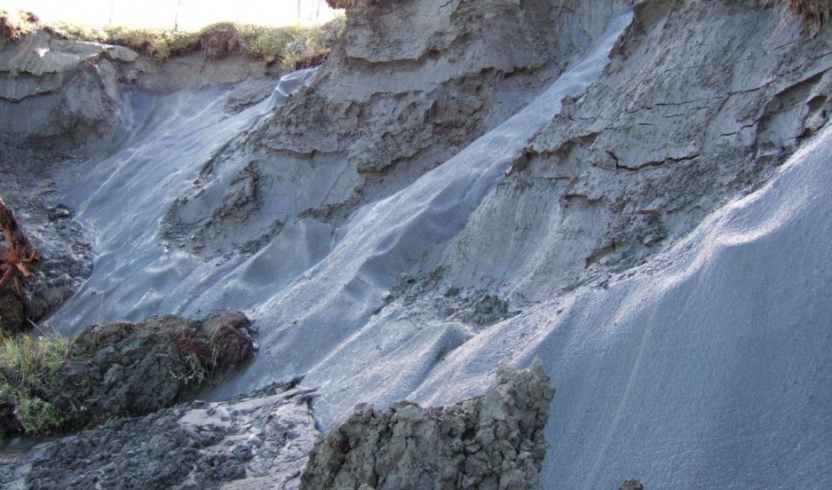
PERMA FROST
Made by: Anna, Elina and Kristine

Slide 2
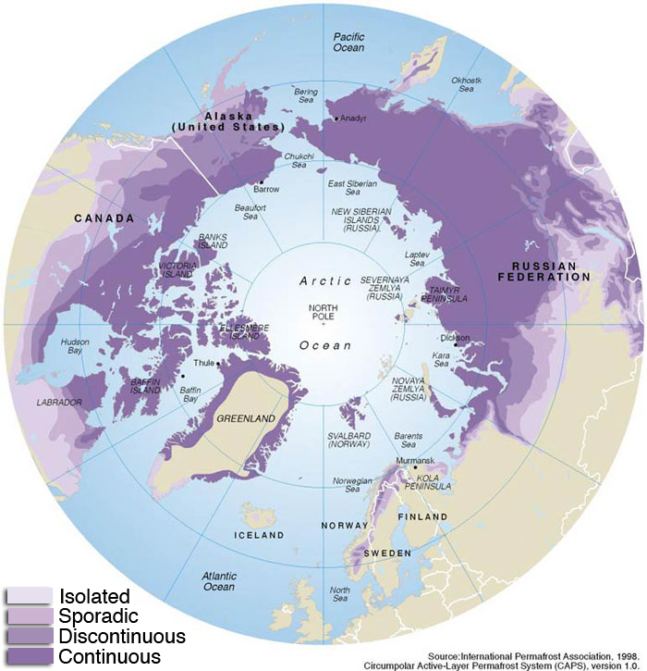
What is perma frost?
Ground or soil
Below the freezing point of water (0º)
2 or more years
The permafrost is melting because of globalwarming
This is where the permafrost is today

Slide 3
What will happen if the perma frost melts?
Mountain walls get held together because of the permafrost, so when it melts, the mountain can race.
The ground becomes unstable.
House and buildings can collapse
Extinct viruses and parasites can grow to life again
Perma frost stores massive amounts of carbon
As a result of climate change, permafrost is at risk of melting
Releasing the stored a form of powerful heat-trapping gasses

Slide 4
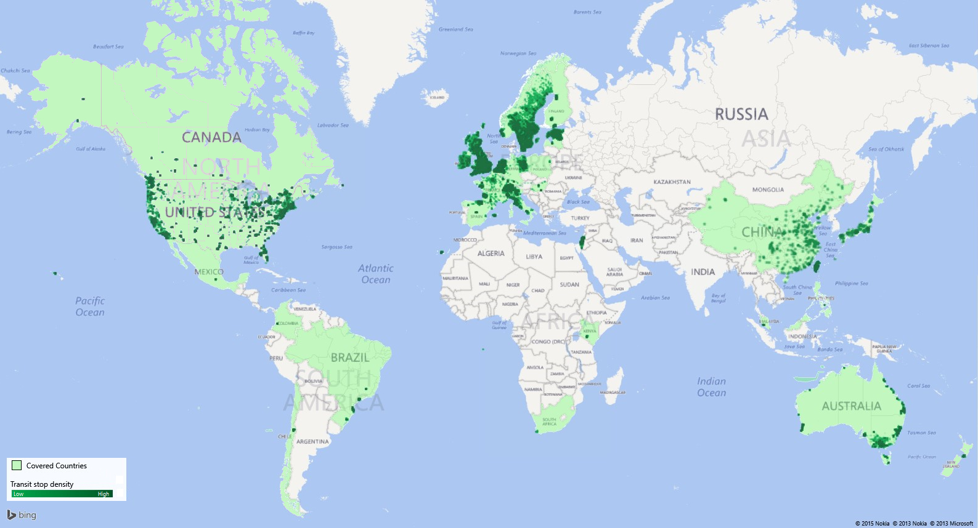
covered countries in 30 years from now.

Slide 5
sources
https://www.siu.no/For-media/nyheter-fra-diku/Hva-skjer-naar-permafrosten-tiner
https://en.wikipedia.org/wiki/Permafrost
https://forskning.no/klima/2012/08/smeltende-permafrost-truer-klimaet

