Slide 1


Slide 2
What do I do to respect the planet ?
I always recycle at home, in fact, I have a trash container for each type of waste (paper, plastic, glass and organic materials).
I also joined the project in the province of Arezzo and Florence according to which they are planning to install new automated baskets, which can only be opened with a card, in order to push people to leave less waste outside the baskets.

Slide 3
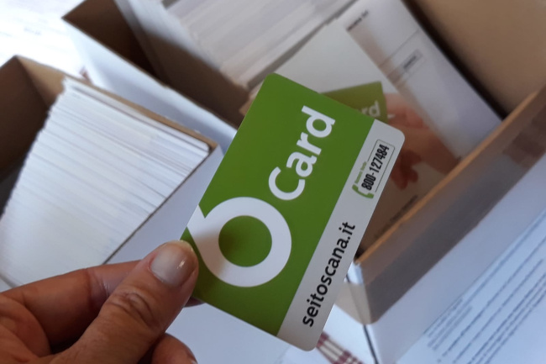
Here is the card

Slide 4
What do I do to respect the planet ?
Also the choice of the food we eat can be crucial to respect our Planet ... Let’s go and see what we can find in the fridge …

Slide 5
My fridge
My fridge is divided into three parts: at the top there are a lot of cold cuts, like ham or salami. Dairy products, such as parmesan slices, cheese and mozzarella, are placed in the lower part. The vegetables are contained at the bottom of the fridge, in the transparent boxes in order to better preserve them. In the side door we find sauces (mayonnaise and ketchup) and drinks (water, coca and fruit juice). Finally, the freezer contains meat, chicken, fish and all sorts of food.

Slide 6
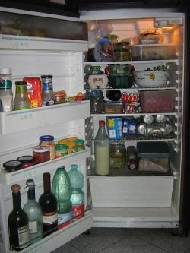
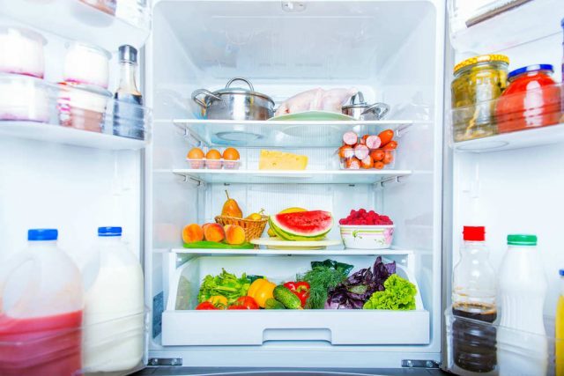
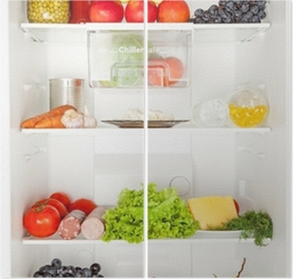

Slide 7
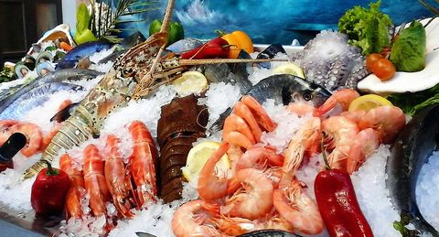
What products do we need to buy?
To respect the planet, we must buy local products, that is to say they are produced in our country, they are called «0 Km products» . The CO2 emission is reduced becouse they don’t need to be transported in a long distance, they are healthier so they do not hurt us. To recognize them we have to check where they come from. We also can prefer fresh and unwrapped products with plastic.
Seafood from Italian sea

Slide 8
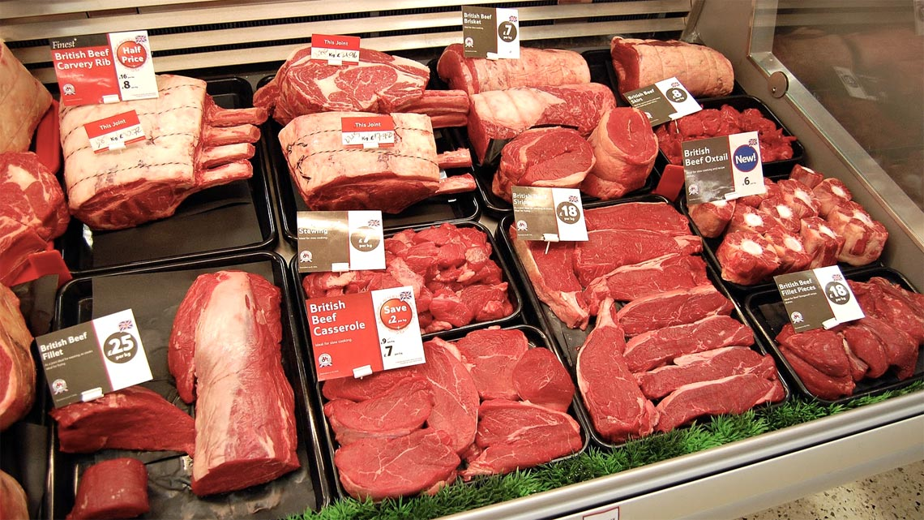
Every country has its typical production

Slide 9
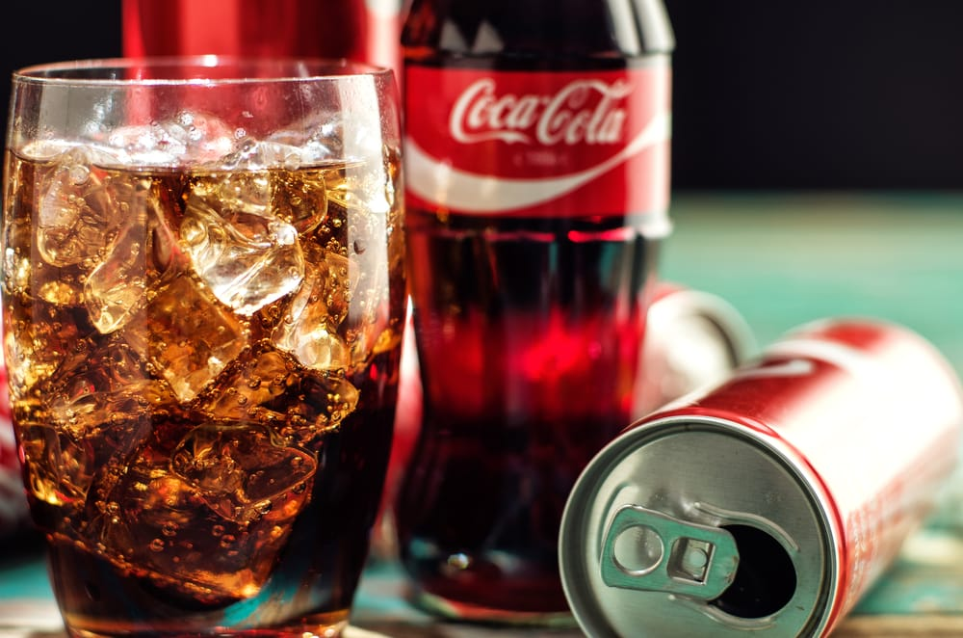
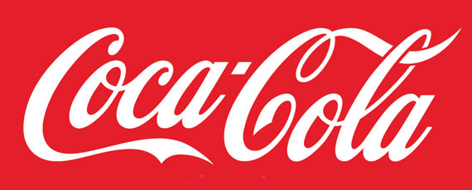
The most bought in the world
The most popular product,
known and certainly the
most appreciated,
is coca-cola, a sparkling
and sweet drink that is
dangerous for your health
becauseit contains an
exaggerated amount
of sugar.

Slide 10
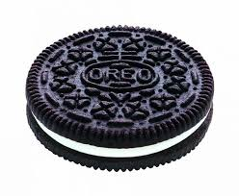
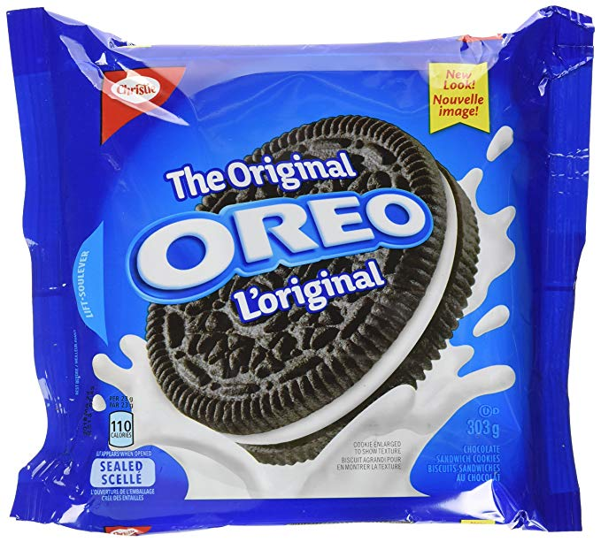
OREO
Oreo is the commercial name of an internationally renowned biscuit, produced and marketed by Mondelēz International through different companies. The biscuit consists of two circular biscuits made from flour, palm oil and rapeseed, 4.6% cocoa, and a soft inner layer (defined as creams and not as cream because it does not contain milk) and flavored with vanilla. Since the beginning of its marketing, more than 490 billion Oreo cookies have been sold, making it the best-selling biscuit of the twentieth century.

Slide 11
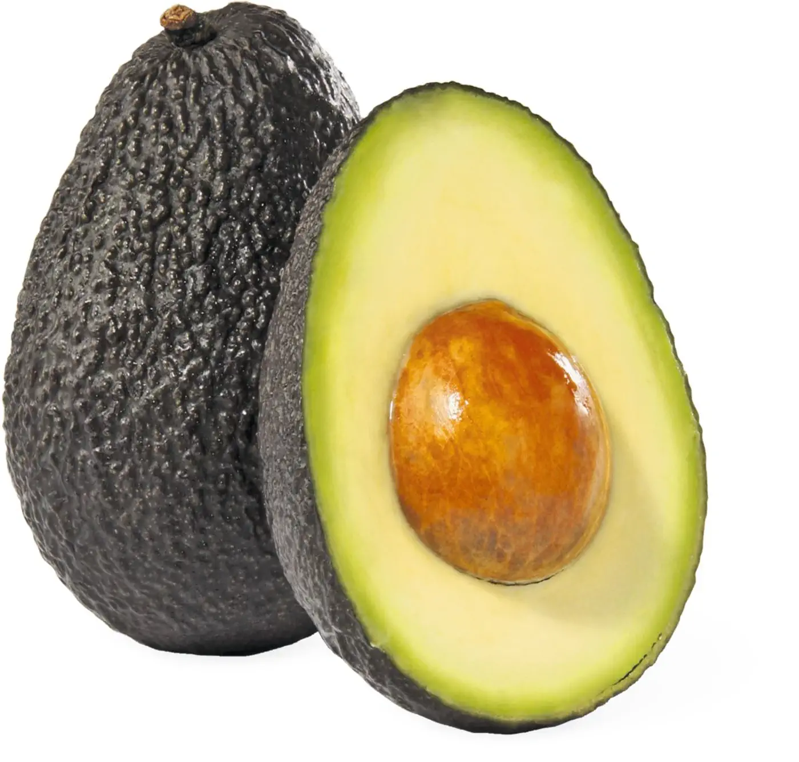
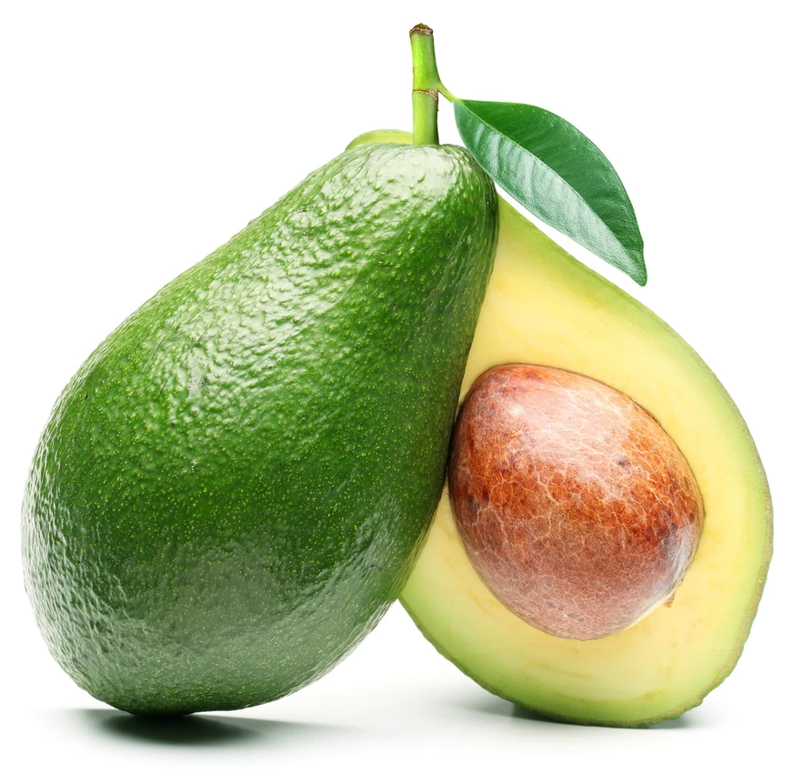
The avocado
The avocado is a tropical fruit native to Mexico and the most-purchased fruit in the world. it is very good for health and in Italy it grows only in the southern regions of Sicily.

Slide 12
Questi sono prodotti molto pubblicizzati ma responsabili di inquinamento

Slide 13
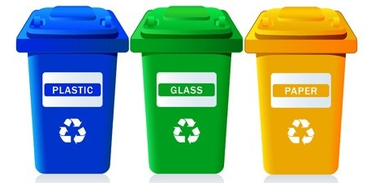
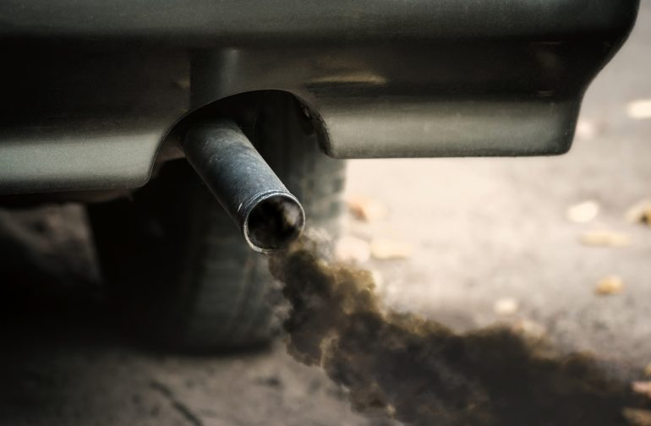
Marco Nichols
In short, the planet is our greatest resource and to preserve it, we must follow many rules in order not to pollute or damage it:
Recycle
buy fresh food and 0 km,
and most importantly, reduce transportation such as cars and buses.
Edoardo Pinna

