Slide 1
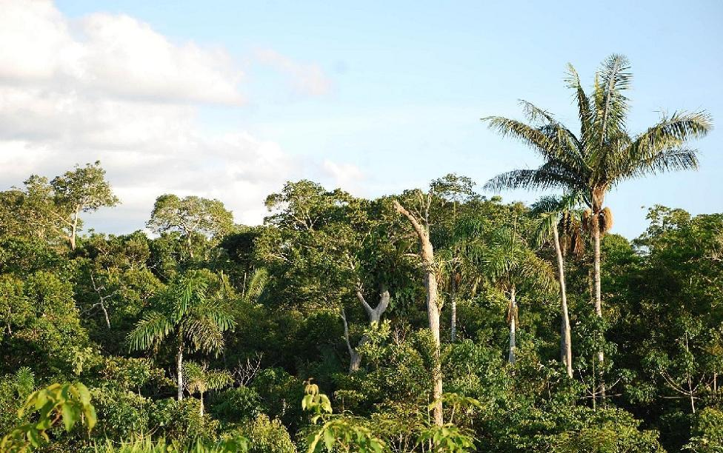
tropical forests Kinga Oleksiewicz
.

Slide 2
CO2
According to the latest reports from the world of science, tropical forests are already at such a level of degradation that instead of absorbing harmful amounts of carbon dioxide, they emit them themselves and on a large scale. Research conducted by scientists has shown that these forests with their emission of 425 teragrams per year already exceed the amount of greenhouse gases generated throughout the year by traffic in the United States.

Slide 3
Oxygen
oxygen in tropical forests is produced by plants and trees found in it. oxygen produced by amazon accounts for 20% of oxygen all over the world. Tropical forests are starting to produce CO2, which is harmful carbon dioxide.

Slide 4
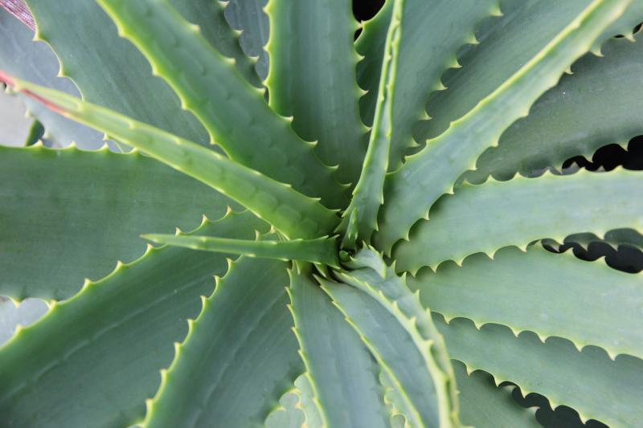
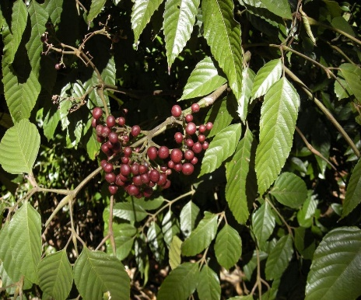
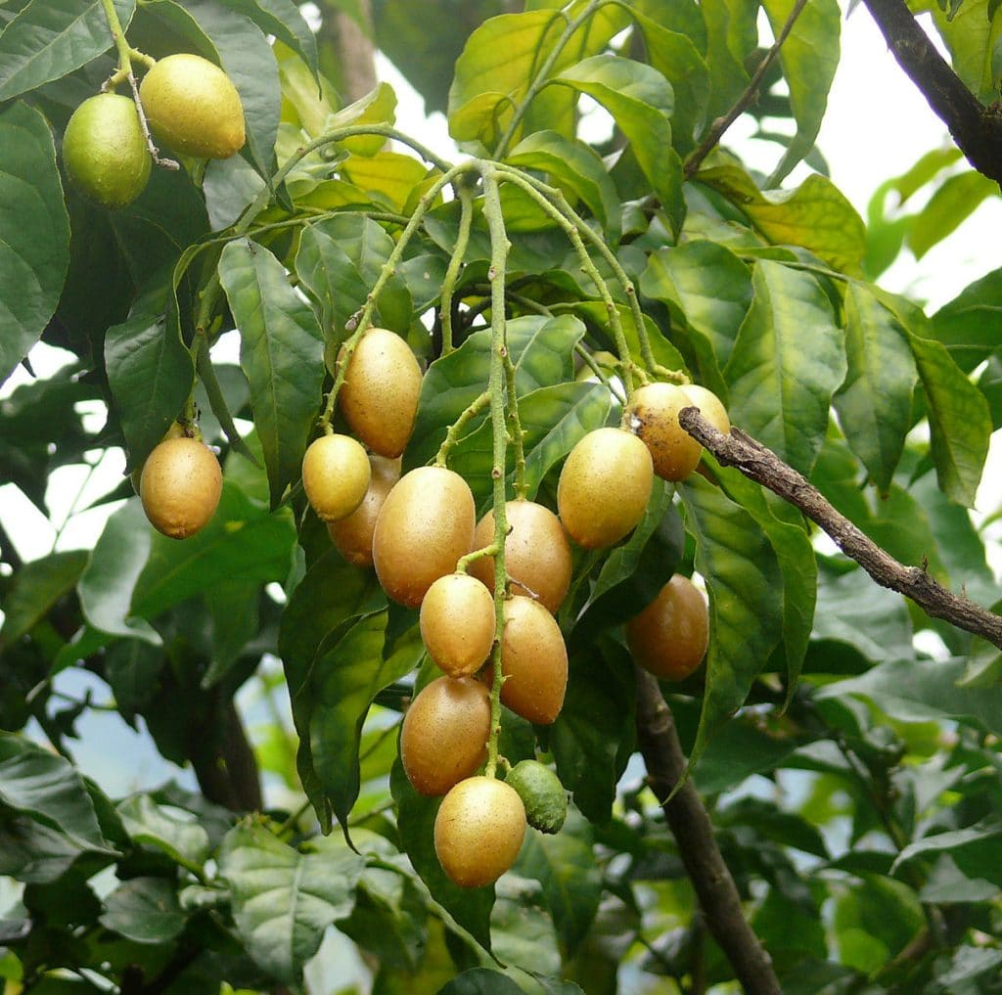
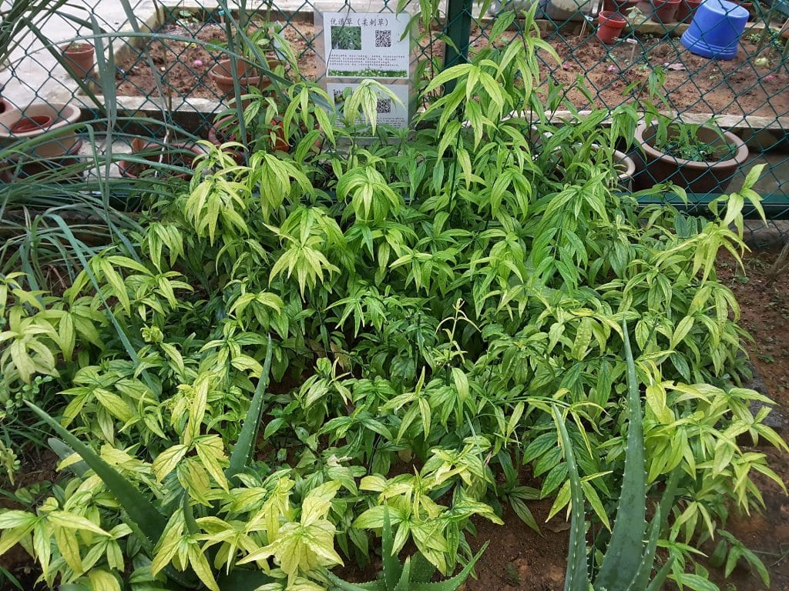
Medicine
in tropical forests there are also medicinal plants, for example:
- Aloe
-Bandicoot Berry
-Sabah Snake Grass
-Fool’s Curry Leaf
-Seven Star Needle

Slide 5
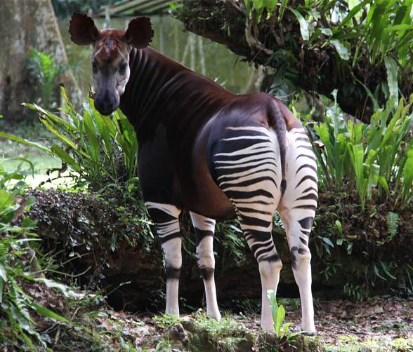
Animals
In the humid tropical equatorial forests, the planet's greatest diversity of land plants and animals meet. New species are constantly being discovered, and certainly many remain unknown. It is said that in the equatorial forest it is easier to meet one hundred different species of trees than one hundred trees of one species.

Slide 6
extinction
Every year, 500 to 1000 species of animals and plants die off,. If this rate of devastation does not decrease, the jungle will soon disappear from the face of the earth. With her, a whole bunch of pets and plants will be gone forever.

Slide 7
Farming
The areas of equatorial forests are inhabited by tribes that deal with hunting, gathering and farming - they are African Pygmies and Bantu, Malay Semangs, Papuans from New Guinea, South American Indians and others. The vegetation of humid equatorial forests provides products such as cinnamon, pepper, cloves and noble wood species: mahogany, ebony, balsa and rosewood. Drug-related substances are collected from various tropical plants. In the place of cut down rainforests, people establish banana, sugarcane, coffee and coconut palm plantations.

