Slide 1
what does a supermarket look like ? What are the most common products we buy? How are they packed?
*** Our supermarkets offer any sort of food you want
*** you find everything you need there
*** products are in plastic paper or glass containers
*** Products are wrapped with attractive colors
Momar diop

Slide 2
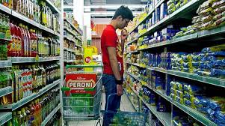
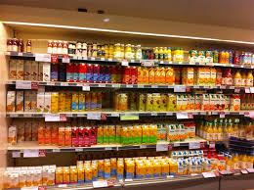
Here we have some examples of the most advertised products we find in a supermarket

Slide 3
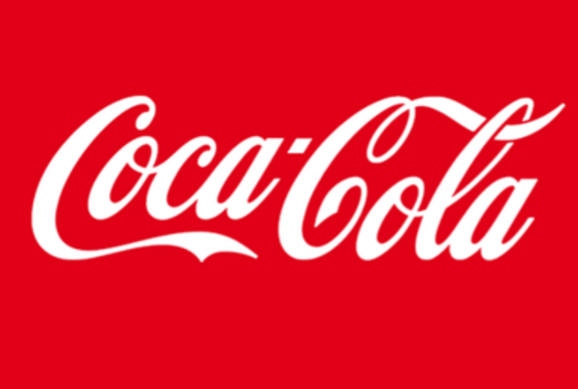
Coca Cola was created in the United States
one of the largest bottling plants in Italy is located in the province of Caserta

Slide 4
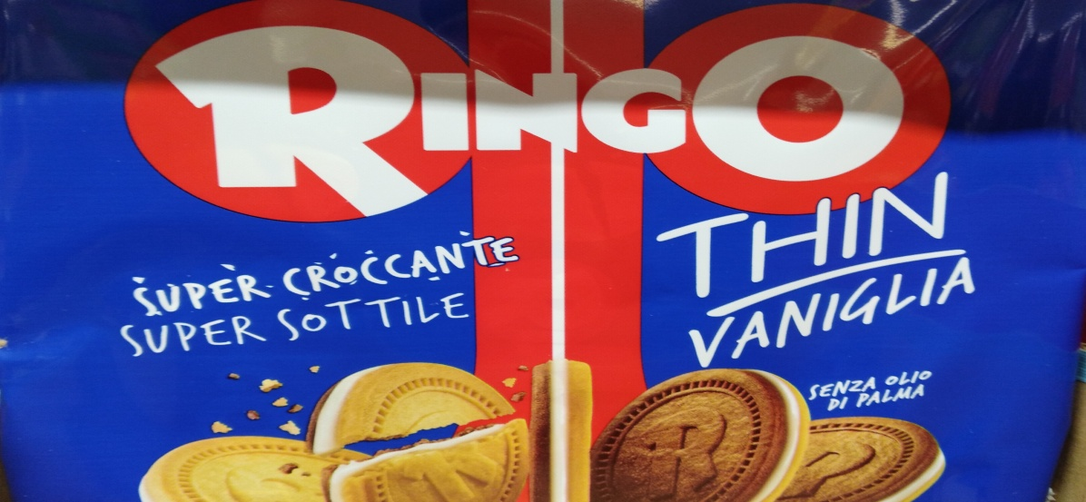
The ringo biscuits
the Ringos were created by a company located in Pavia in Italy in 1967
They are composed of two biscuits, matched with a cream and chocolate layer

Slide 5
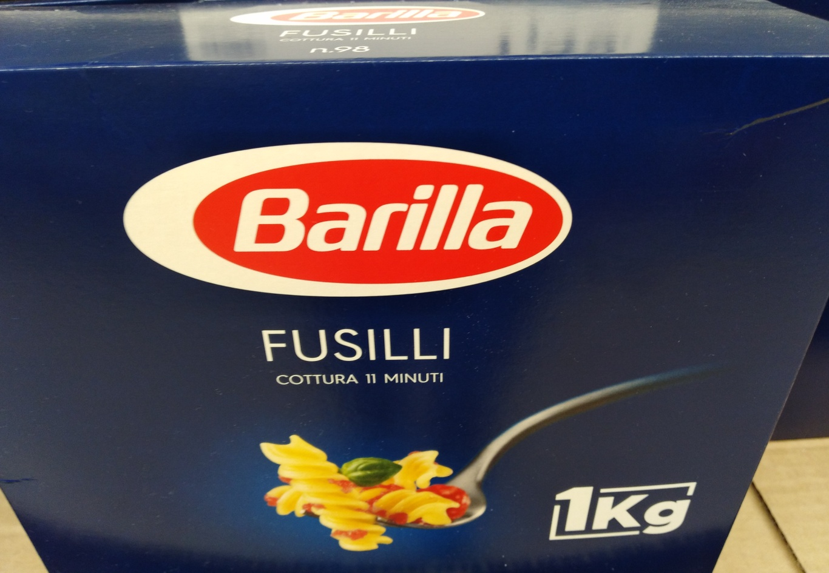
Pasta Barilla
Barilla Pasta is produced by a multinational company founded in 1877 in Parma. Today it sells all around the world.

Slide 6
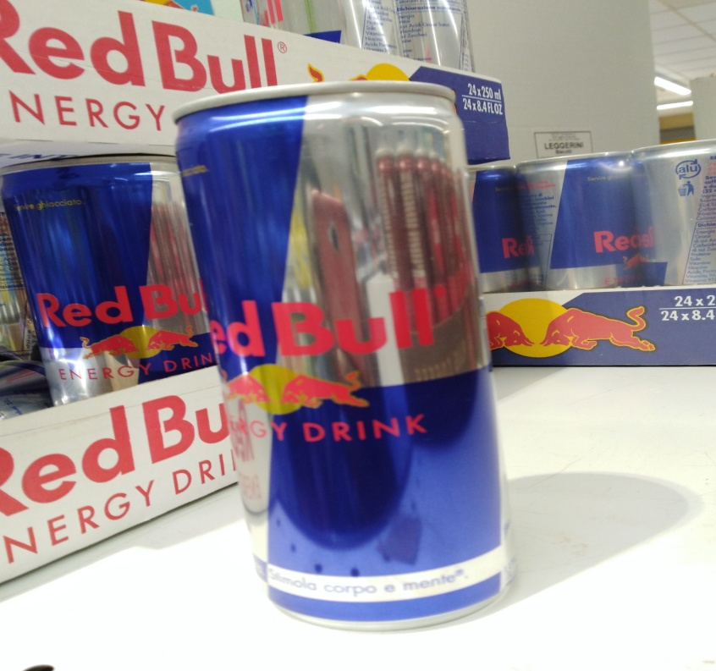
RED BULL
Red Bull, an energy drink produced by the Austrian company of the same name Red Bull Ghmb from Salzburg

Slide 7
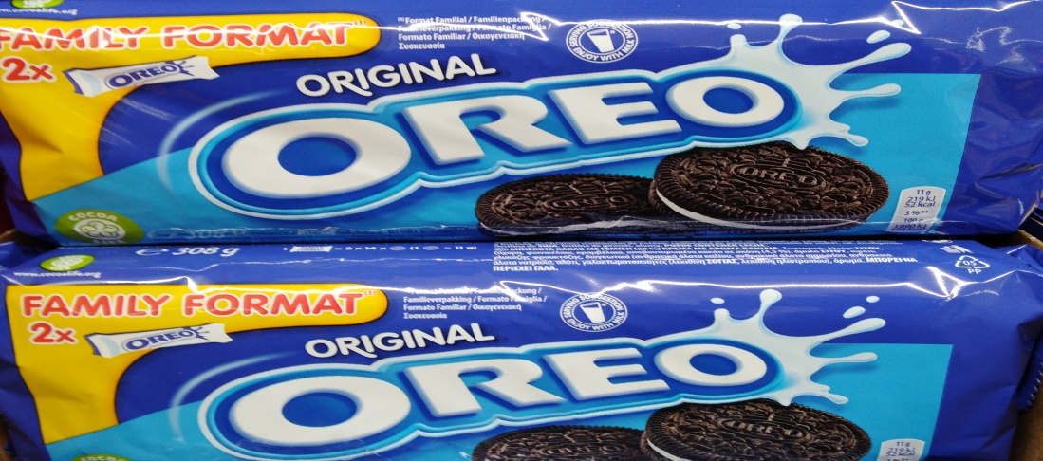
The oreo
Oreo is the commercial name of a famous biscuit created in the United States in 1912 . Oreo is an internationally renowned biscuit, produced and marketed by Mondelēz International through different companies.

Slide 8
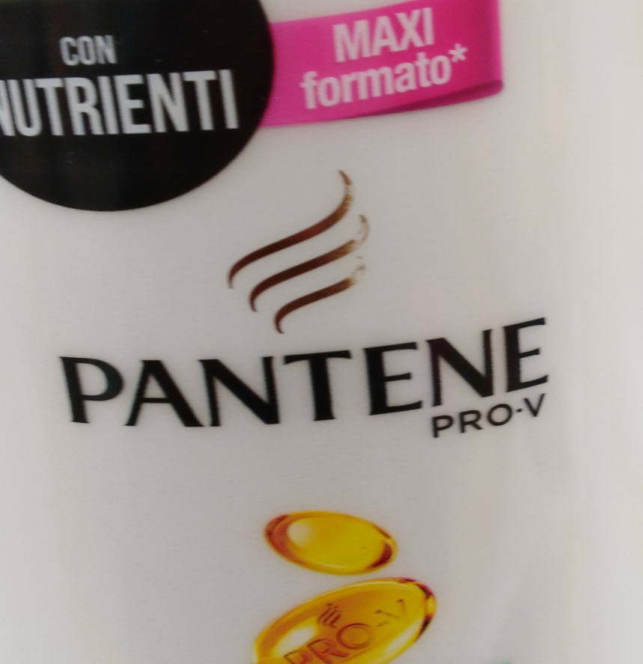
Pantene shampoo
Pantene is an English company headquartered in Switzerland.

Slide 9
Fruits vegetables spices nuts
They can grow very near or far away but they are in the store
We can find every sort of fruit, vegetable, spice or herb from different country of the world in a supermarket

Slide 10
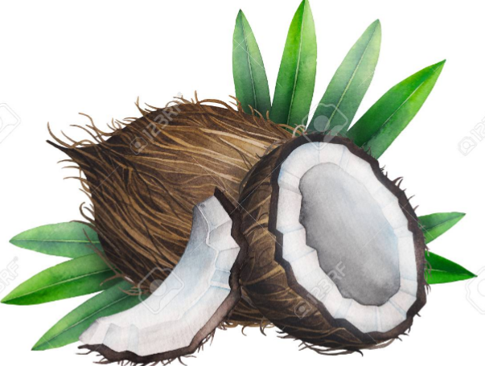
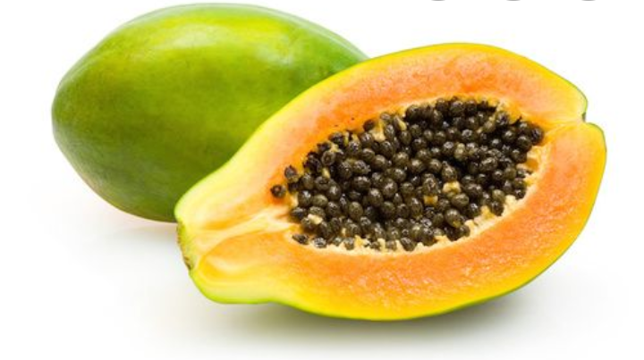
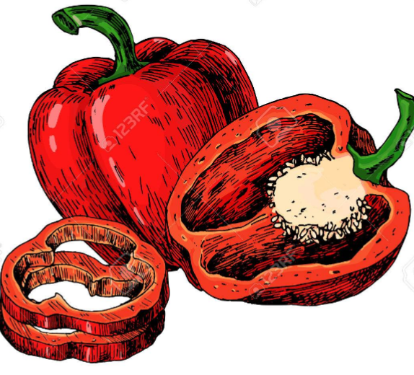
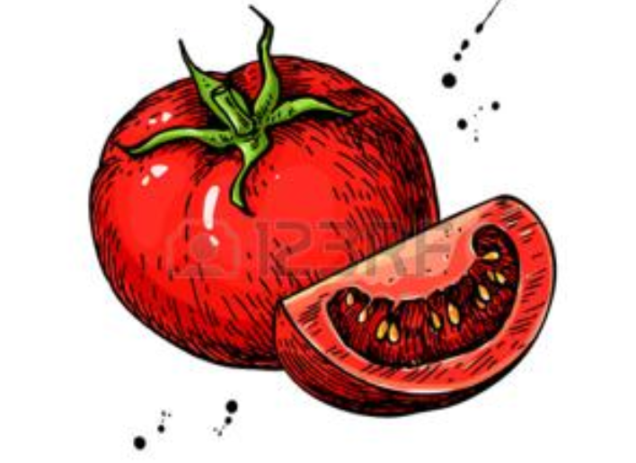
Pictures fruits and vegetables

Slide 11
Plastic
Many of these products are wrapped with plastic. Offshore plastic production rose from 15 million in 1964 to more than 310 million
86 million tons of plastics sail in our oceans
The man also eats plastic. Up to 2000 tiny fragments are ingested per week, which is about 5 grams, the equivalent weight of a credit card. On average, they weigh more than 250 grams a year.

Slide 12
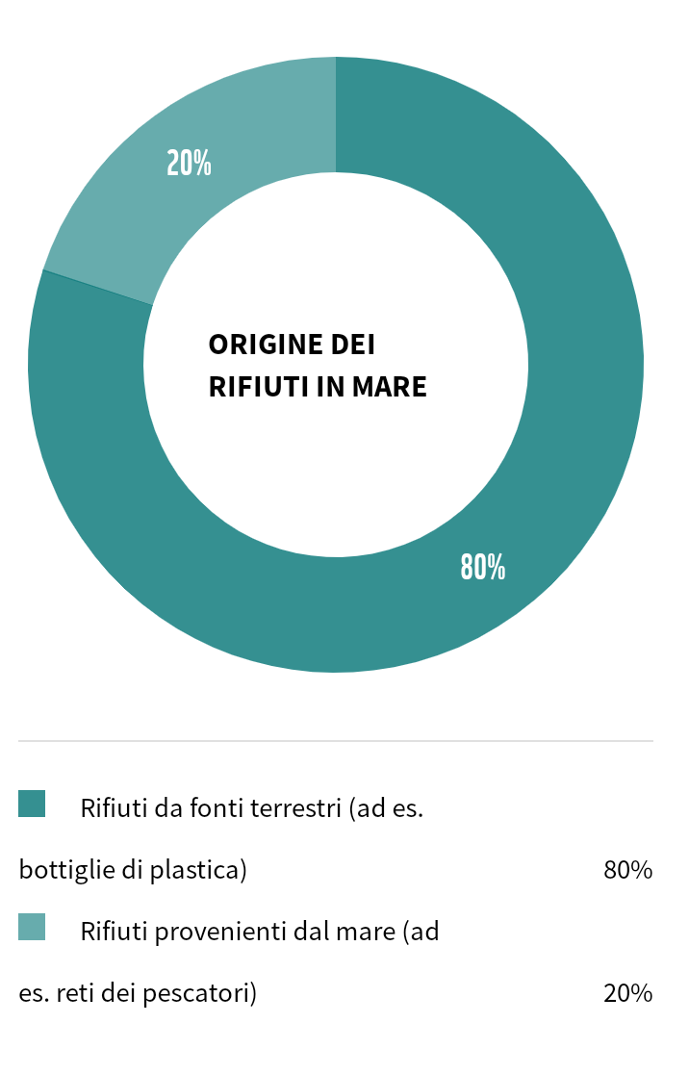
= 80% waste coming from
Earth (i.e. plastic bottles)
= 20% waste coming from
the sea ( i.e. fishing nets )

Slide 13
My advice for health
Diet greatly determines our health. In general, it is recommended to reduce salt consumption, refined sugar, saturated fatty acids (meat, dairy products), trans fatty acids (certain margarines), to favor unsaturated fatty acids, fruits, vegetables and cereals complete. For the same reasons, it is better to avoid industrial dishes and meals taken outdoors.

Slide 14
What kind of diet
In my opinion, to eat fresh local food as much as possible is VERY important if I want to respect my body and my planet !!!!

