Slide 1
HELLO!
I INVITE YOU ON PRESENTIATION
Nice watch ☺

Slide 2
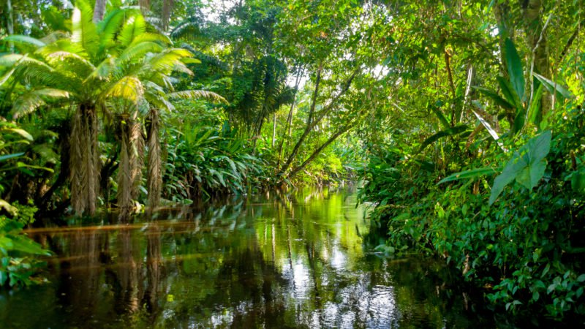
Rainforest
As many as 30 million species of plants and animals live in tropical rainforests.
Rainforests are the Earth's oldest living ecosystems. They are so amazing and beautiful. These incredible places cover only 6 %of the Earth's surface but yet they contain MORE THAN 1/2 of the world's plant and animal species! A Rainforest can be described as a tall, dense jungle. The reason it is called a "rain" forest is because of the high amount of rainfall it gets per year. The climate of a rain forest is very hot and humid so the animals and plants that exist there must learn to adapt to this climate.

Slide 3
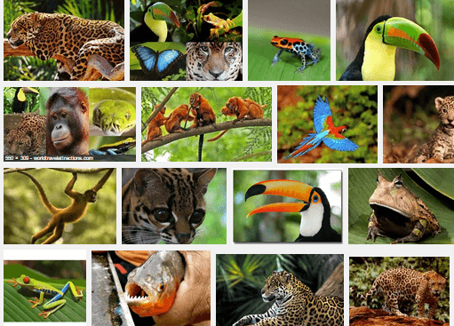
ANIMALS
Mammals
Bengal Tiger
Capybara
Common Chimpanzee
Western Gorilla
Jaguar
Lar Gibbon
Lemur
Okapi
Sumatran Orangutan
Siamang
Black-Handed Spider Monkey
BIRDS
Great Hornbill
Harpy Eagle
Hoatzin
Resplendent Quetzal
Scarlet Macaw
Southern Cassowary
Toco Toucan
REPTILE
Anaconda
Black Caiman
Boa Co
nstrictor
Gaboon Viper
Reticulated Python
Rainforests have an abundance of plants and animals for the following reasons: Climate: because rainforests are located in tropical regions, they receive a lot of sunlight. ... Since there is a lot of sunlight, there is a lot of energy in the rainforest. This energy is stored in plant vegetation, which is eaten by animals.
AMPHIBIANS
Golden Poison Dart Frog
Red-Eyed Tree Frog

Slide 4
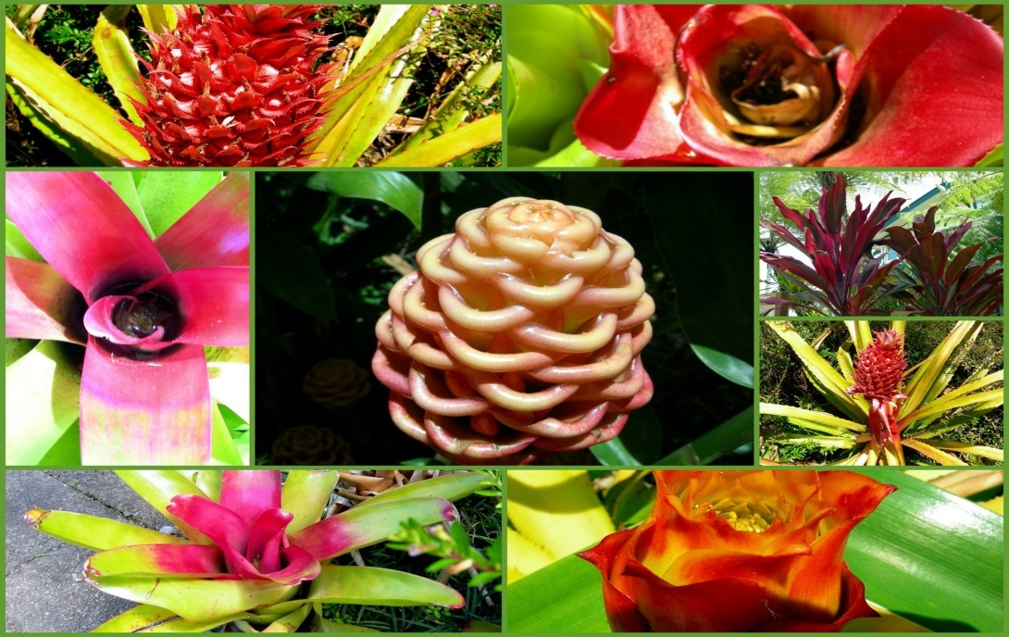
PLANTS
The Coolest Plants in Rainforest
Heliconia Flower (Lobster-Claw)
Rubber Tree (Hevea brasiliensis)
Orchids
Cacao (Theobroma cacao)
Giant Water Lilies (Victoria amazonica)
Passion Fruit Flower (Passiflora)
Bromeliads (Bromeliaceae)
Monkey Brush Vine (Combretum rotundifolium)
Banana Tree
Coffee Plant (Coffea)
More than two thirds of the world's plant species are found in the tropical rainforests: plants that provide shelter and food for rainforest animals as well as taking part in the gas exchanges which provide much of the world's oxygen supply.Rainforest plants live in a warm humid environment that allows an enormous variation rare in more temperate climates: some like the orchids have beautiful flowers adapted to attract the profusion of forest insects.Competition at ground level for light and food has lead to evolution of plants which live on the branches of other plants, or even strangle large trees to fight for survival.The aerial plants often gather nourishment from the air itself using so-called 'air roots';. The humidity of the rainforest encourages such adaptations which would be impossible in most temperate forests with their much drier conditions.

Slide 5
MEDICINE
In Western modern medicine, around 25% of all drugs are derived from rainforest plants. That’s an impressive statistic, especially considering that less than 5% of Amazon plant species have been studied for their potential medicinal benefits. Below are some of the most famous examples of modern medicine derived from Amazonian plants, as well as some whose huge potential has been noted but remains — for now — clinically unproven, like so many indigenous Amazonian treatments.

Slide 6
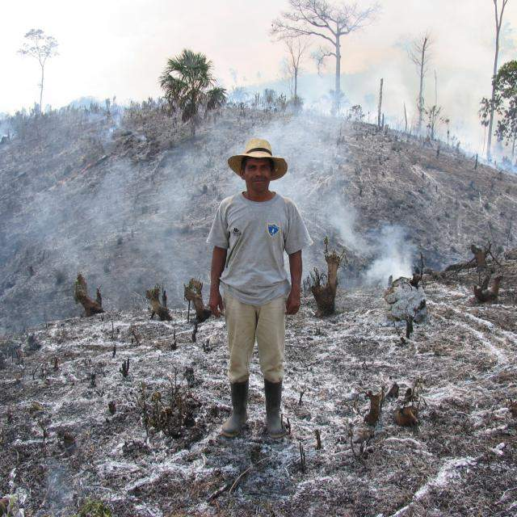
FARMINGS
The Rainforest Alliance trains farmers around the world to conserve forests, boost the productivity of the land, and support the well-being of their communities. Thanks to these farmers, 8.6 million acres (3.5 million hectares) of agricultural land are being managed sustainably—bringing us closer to an Earth rebalanced.
Thriving farmers and healthy forests go hand-in-hand. Subsistence farming and commercial farming combined are responsible for more than 80 percent of tropical deforestation. As the world's population increases, so does the demand for food—and with it, the pressure to raze forests for more farmland. Making current cropland more productive is one of the most direct ways to improve farmer livelihoods and halt deforestation.

Slide 7
THE END
I HOPE YOU LIKED IT
THANK YOU FOR YOUR VIEW

