Slide 1
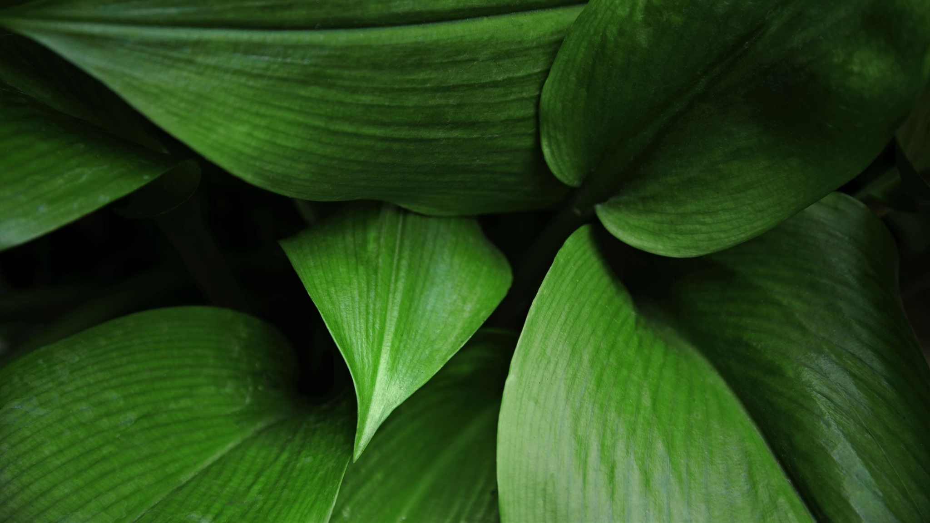
Tropical forests
Jagoda Banasiak-Kostecka

Slide 2
CO2 in tropical forests
Poznaj wymowę
co2 in tropical forests
Poznaj wymowę
co2 in tropical forests
According to the latest reports from the world of science, tropical forests are already at such a level of degradation that instead of absorbing harmful amounts of carbon dioxide, they emit them themselves and on a large scale. Research conducted by scientists has shown that these forests with their emission of 425 teragrams annually already exceed the amount of greenhouse gases generated throughout the year by traffic in the United States

Slide 3
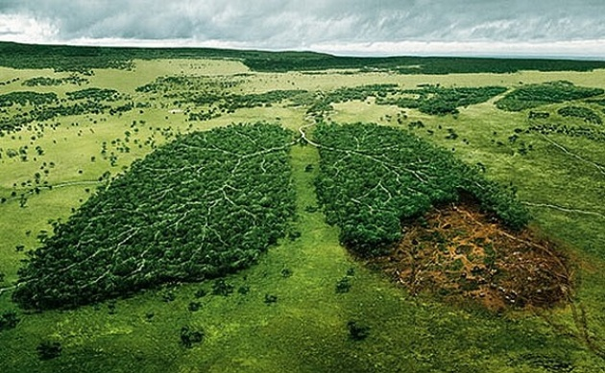
Oxygen in tropical forests
oxygen in tropical forests is generated by the trees and plants found in it. Amazonia accounts for 20% of all oxygen on earth. As a result, when it comes to oxygen balance in the atmosphere , the role of the Amazon jungle is practically zero-emphasizes mills. He adds the oxygen content in the air is about 20.95 percent. And it doesn’t change significantyly. Even if the entire Amazon jungle burns, the amount of oxygen in the atmosphere would not change.

Slide 4
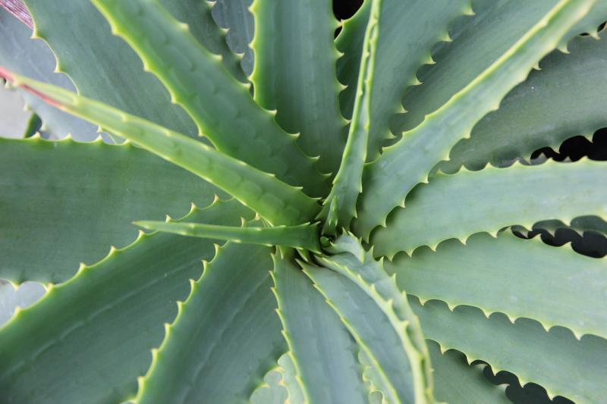
Medicine in tropical forests
So far, only a fraction of the extremely effective active substances that nature has at its disposal have been discovered. The existence of the largest resources of these substances, waiting to be discovered in tropical forests and oceans, is not the result of the sheer diversity of species found there, but also of the unbelievable environmental conditions in which individuals of a given species had to fight for survival. Only sophisticated techniques - using venoms and antidotes in the highest concentration - gave a chance to wait the next morning. Pioneers venturing deep into the equatorial forests in search of these substances must be professionals in more than one field. They are so-called ethnomedists who can learn even from animals. Anthropologist, prof. Richard Wrangham from Harvard noticed that the sick chimpanzees were recovering after eating the leaves of a certain Aspilia plant similar to our sunflower. He learned from representatives of the Tongew tribe that the same leaves are also consumed by people suffering from stomachaches caused by gastrointestinal parasites. Chemical analysis of the plant showed that its leaves contain antiparasitic substances. What's more, as it turns out, the monkey medicine can be used to treat some cancers.

Slide 5
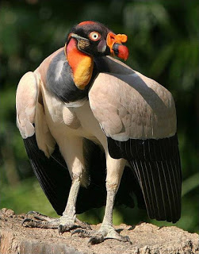
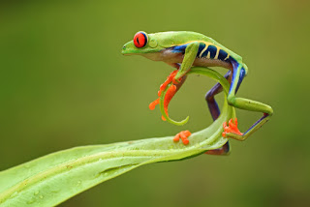
Animals in tropical forests
The royal condor lives in the forests of South America together with numerous urubu, also scavengers. Against their background, it stands out with its beautiful and majestic appearance. Bald head, with skin growths reminiscent of stones in the crown, hence the name. It feeds on carrion, especially eats dead fish. Due to the dense forestation of the area, the sight itself does not take the exam for carrion, so it is also helped by the excellent sense of smell.
If in the rain forests even frogs lead the arboreal life, it can be expected that there will also be tree frogs. In South America, we find a colorful tiller. It is light green, has yellow and blue stripes on the sides, dark red eyes with a black, vertical pupil. It is threatened by the destruction of its habitat

Slide 6
extinct species in tropical forests
TEMPLATE ANTILLOPA (Hippotragus niger) - A species of antelope found in the areas of Equatorial and Southern Africa.
ARA BLUE (Cyanospitta Spixii) - The least common of parrots, the condition in which the population of this parrot is, is so drastic that scientists use the word "bezsękowy".
BABIRUSSA (Babyroussa babirussa) - A species from the pig family of the swamp forests of Celebes and Moluccas.
BANTENG (Bos javanicus) - A species of wild cattle inhabiting the mountainous forests of the Indochina Peninsula and Indonesia.
BARASINGA (Cervus, Rucervus duvauceli) - A species of deer from the wetlands of India.
MIKADO BAŻANT (Syrmaticus micado) - A bird living in Taiwan.
BELARUS (Stenodus leucichthys) - Fish living in the Caspian Sea.
AMERICAN BIZON (Bison Bison) - This bison once performed from Alaska and Canada to Mexico. In 1890 there were about 1,000 of them. However, the involvement of the government and private individuals has caused that today there are about 50,000 of them.

Slide 7
Farming in tropical forests
Half of the tropical forests that disappeared in 2000-2012 were cut down for the needs of intensive agriculture on an industrial scale - according to an analysis of American scientists published in the pages of Environmental Research Letters.
Increasingly larger tropical rainforest areas around the world are being destroyed as governments and corporations need new land for high-volume agricultural production on an industrial scale, scientists from the University of Duke (US) are alerting.
They used high resolution satellite maps showing the forest cover to create a new computer model. It made it possible to analyze the phenomenon of changing forests into fields, plantations and pastures around the world.
Their research shows that deforestation for large-scale agricultural production is responsible for an increasing proportion - in some places more than half - of the entire deforestation in the tropical zone between 2000 and 2012. This procedure is the most common in Southeast Asia and South America.
"In South America, more and more frequent cuts of medium and large forest areas account for over 60 percent of deforestation growth. They are typical of activities for the needs of large-scale market agriculture "- explains the author of the study, prof. Jennifer J. Swenson of the Duke University Nicholas School of the Environment.
As he says, the only country with the opposite trend - there were dominated by small forest fragments - was Brazil, where until 2012 the expansion of agriculture was legally restricted. "But this exception may no longer be valid, because Brazil has loosened regulations on forest resources in recent years," says the researcher.
According to Duke scientists, their analysis confirms the growing need for intervention by states that would target large producers of agricultural products in the tropics.
As one of the co-authors of the study Kemen G. Austin explains, a small family farm that he produces for his own use or for the local market, "takes" on average less than 10 hectares of forest area per year. Deforestation on such a small scale does not have a significant impact on biodiversity, habitat connectivity, water quality, soil erosion and other ecosystem-critical functions provided by forests.

Slide 8
Thank you for watching this presentation

