Slide 1
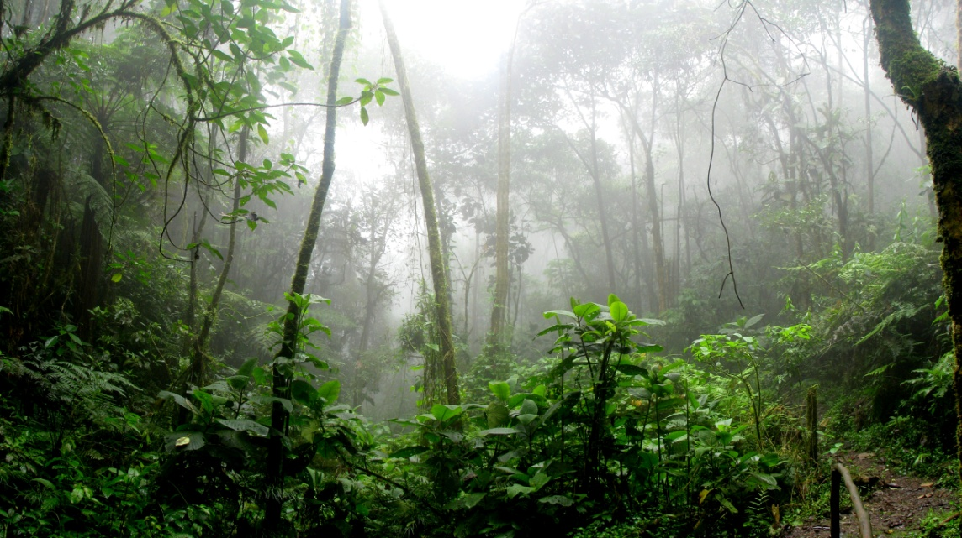
Rainforests
Rainforests are forests characterized by high and continuous rainfall, with annual rainfall in the case of tropical rainforests between 2.5 and 4.5 metres (98 and 177 in), and definitions varying by region for temperate rainforests. They occurt in Asia, Australia and Center America.

Slide 2
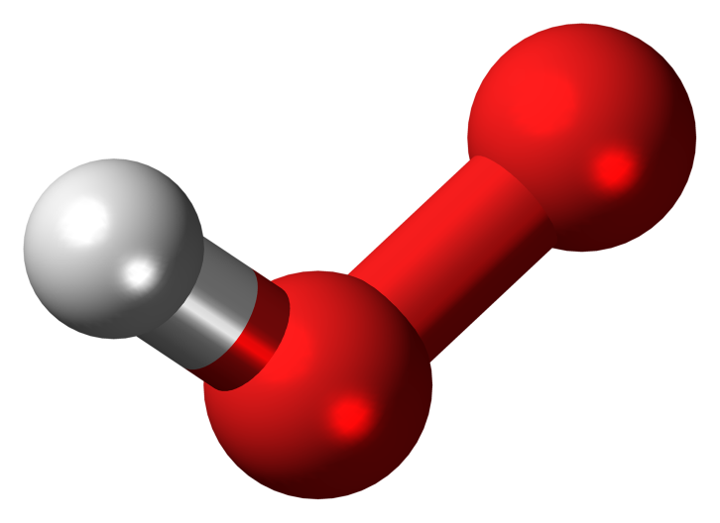
CO2
CO2 (carbon dioxide) is a colorless gas with a density about 60% higher than that of dry air. Carbon dioxide consists of a carbon atom covalently double bonded to two oxygen atoms.

Slide 3
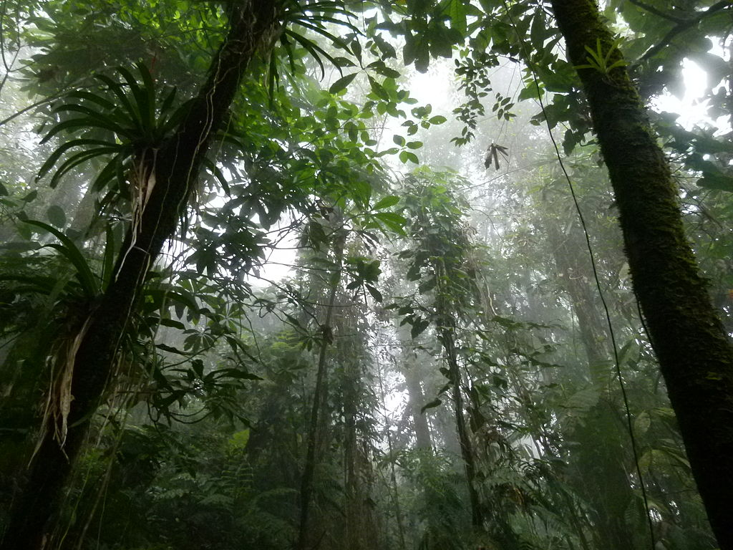
CO2 occurs naturally in Earth’s atmosphere as a trace gas. So much of the Earth’s forest has been destroyed that the tropics now emit more carbon than they capture, scientists have found.
Tropical forests previously acted as a vital carbon “sink”, taking carbon from the atmosphere and turning it into oxygen, but the trend has reversed: they now emit almost twice as much carbon as they consume

Slide 4
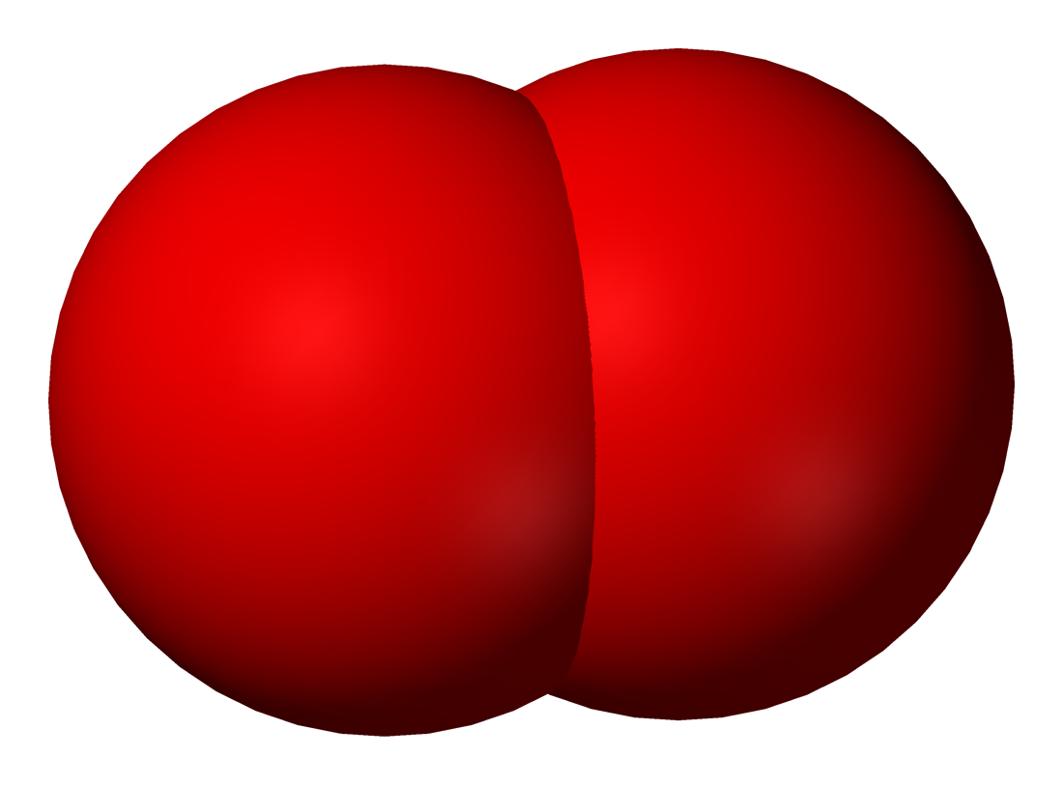
Oxygen
Rainforests are also responsible for 28% of the world's oxygen turnover, sometimes misnamed oxygen production, processing it through photosynthesis from carbon dioxide and consuming it through respiration. The undergrowth in some areas of a rainforest can be restricted by poor penetration of sunlight to ground level.

Slide 5
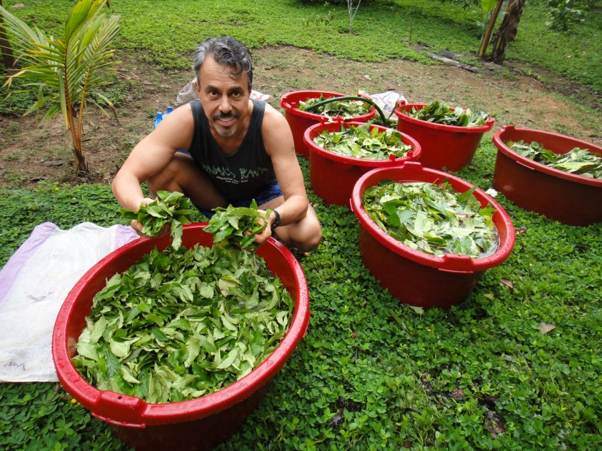
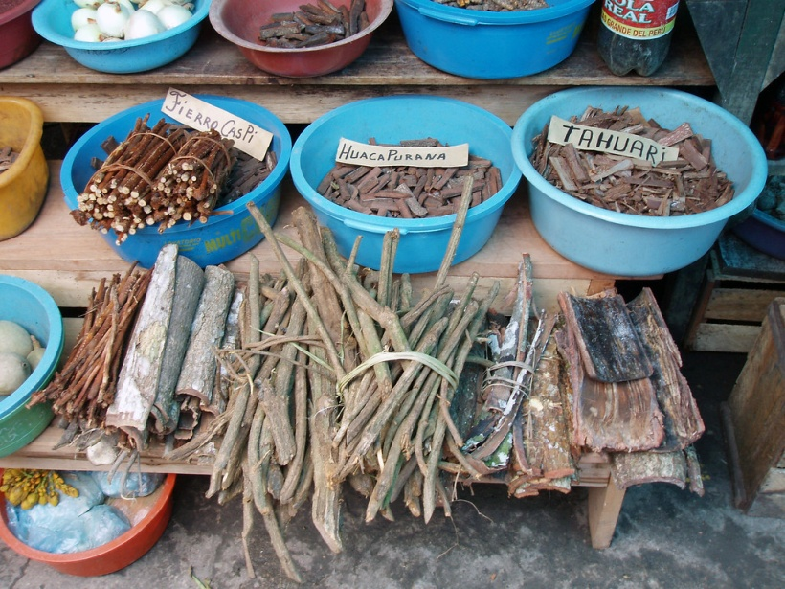
Medicine
For maladies ranging from nagging headaches to lethal contagions such as malaria, rainforest medicines have provided modern society with a variety of cures and pain relievers. Quinine, an aid in the cure of malaria, is an alkaloid extracted from the bark of the cinchona tree found in Latin America and Africa.

Slide 6
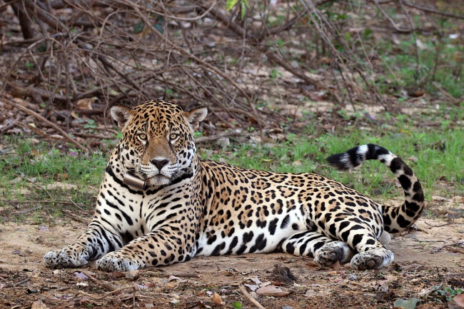
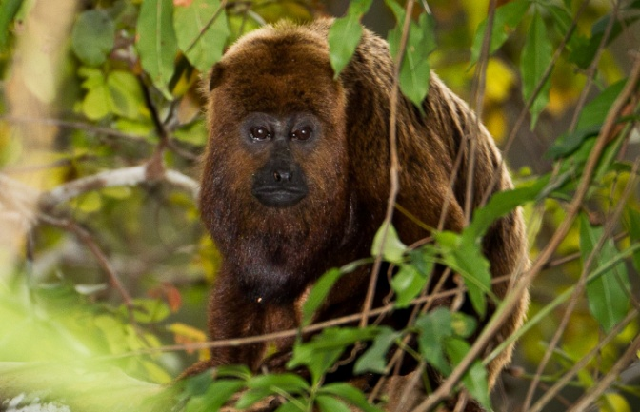
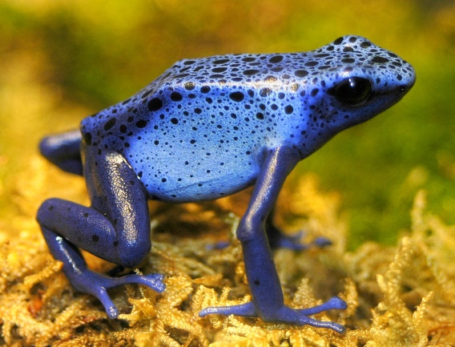
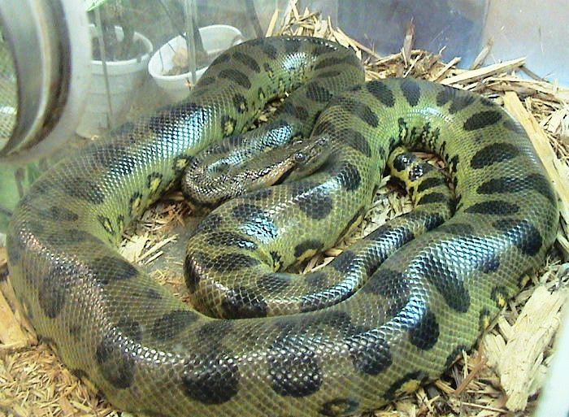
Animals
Well-known rainforest animals are: jaguars, tigers, howler monkeys, red – eyed tree frogs, poison dart frogs and green anacondas.

Slide 7
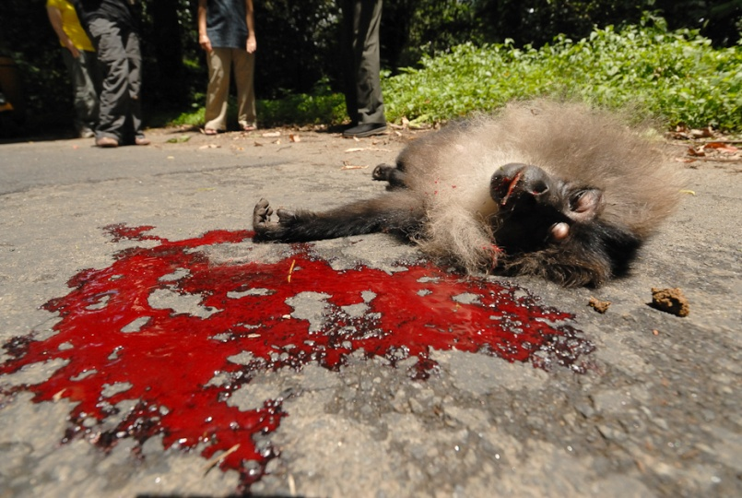
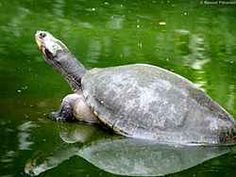
Extinction
An average of 137 species of life forms are driven into extinction every day in the world's rainforests. The forces of destruction such as logging, cattle ranching have all contributed to the loss of millions of acres of tropical rainforest. Animals and people alike lose their homes when trees are cut down.

Slide 8
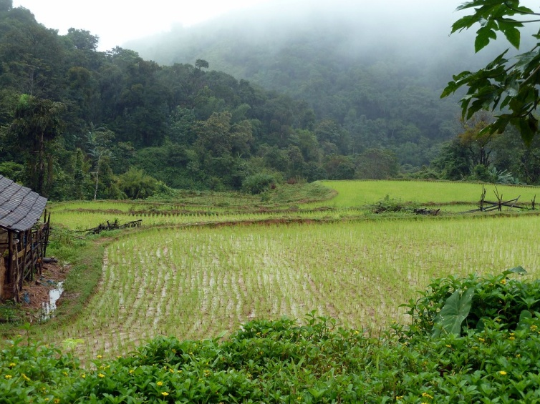
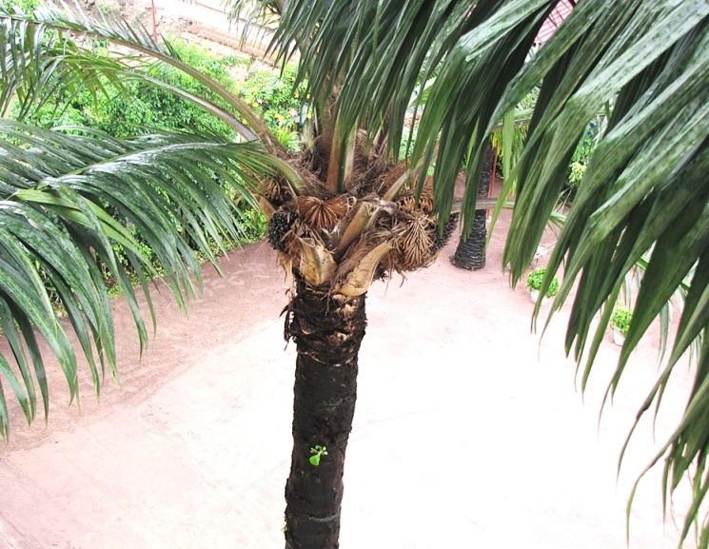
Farming
When the land is suitable for agriculture, generally large single cash crops like rice, citrus fruits, oil palms, coffee, coca, opium, tea, soybeans, cacao, rubber, and bananas are cultivated. Some of these crops are better adapted to such conditions and last longer on cleared forest lands.

