Slide 1
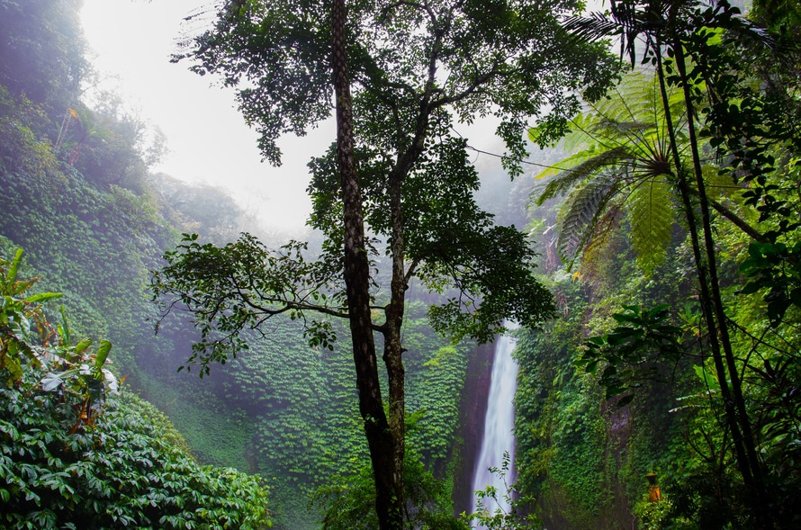
Rainforests and photosynthesis

Slide 2
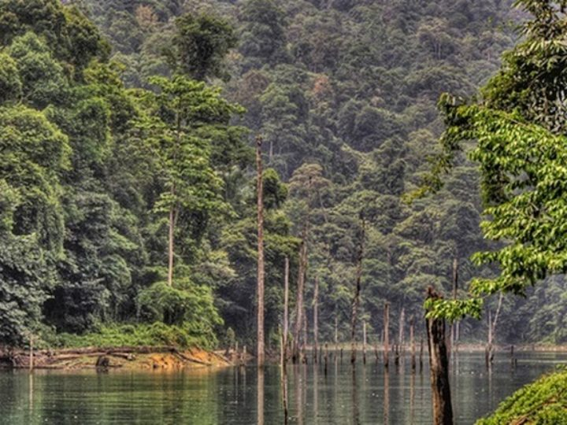
Rainforests produce oxygen
which is very necessary for life.
One of them is Amazonia,
called the lungs of the world.
They are shelter for at least half
of all species of plants,
insects and animals found on Earth.
The most beautiful plants grow here,
the most beautiful animals live and unfortunately
they are also the most endangered.

Slide 3
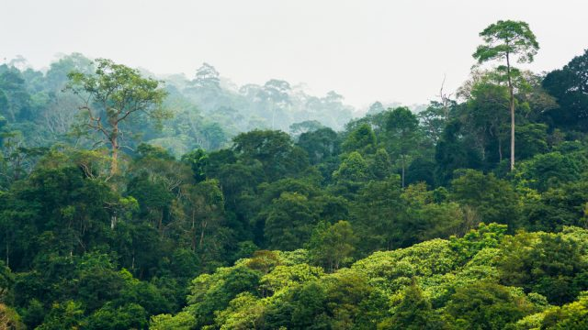
Plants absorb a lot of carbon dioxide, which they need for photosynthesis. thanks to photosynthesis, they "take" carbon dioxide from the world, which in large quantities is dangerous to humans.

Slide 4
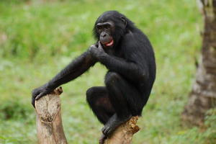
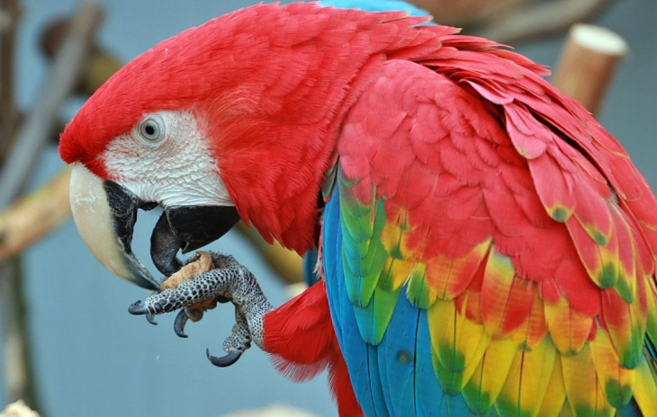
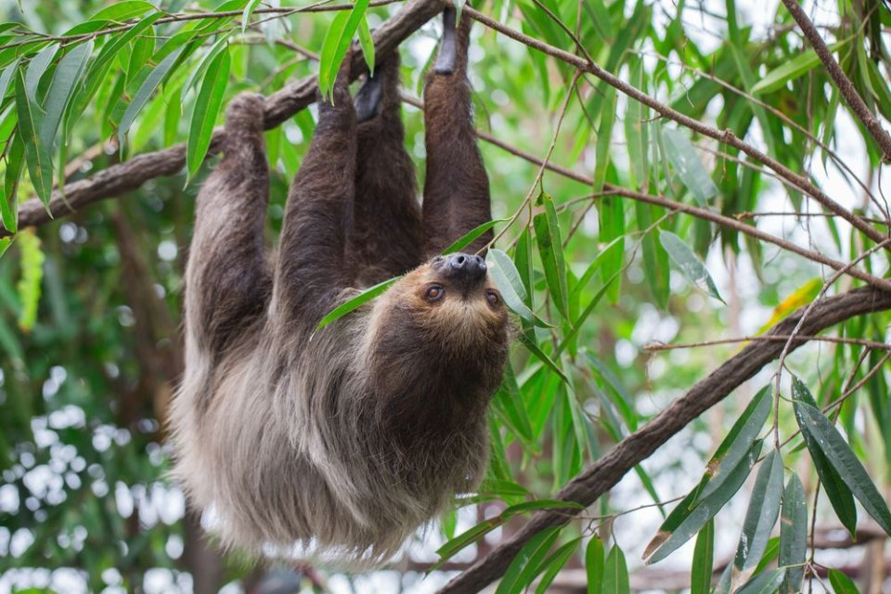
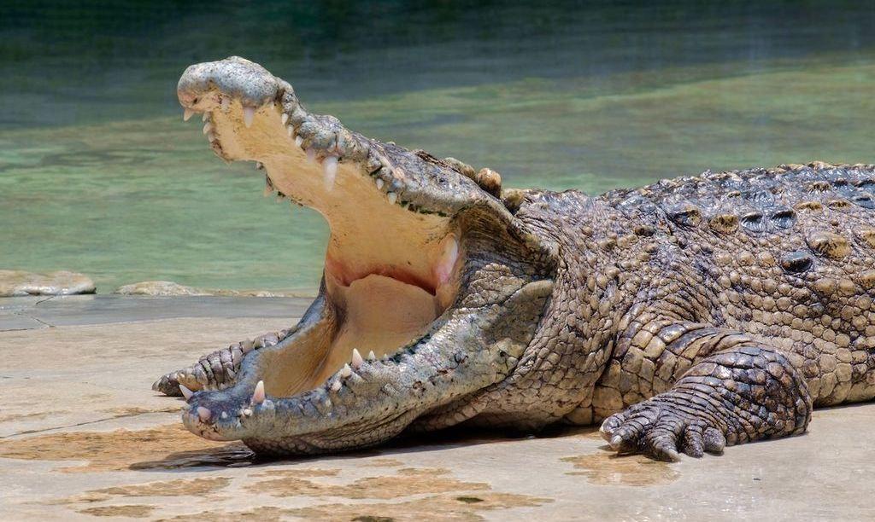
In the rainforests lives:
- monkeys
- sloths
- spiders
- leopards
- parrots
- snakes
- crocodiles

Slide 5
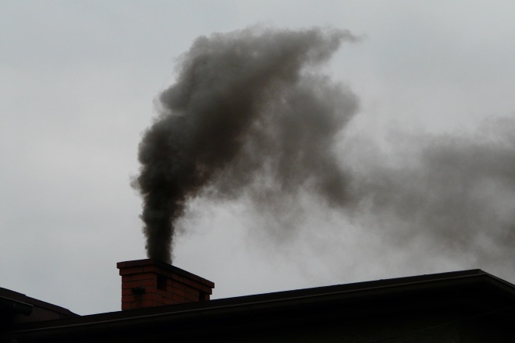
Medicine for the world:
Rainforests that produce oxygen are medicine for the silly people who destroy the environment by burning rubbish.

Slide 6
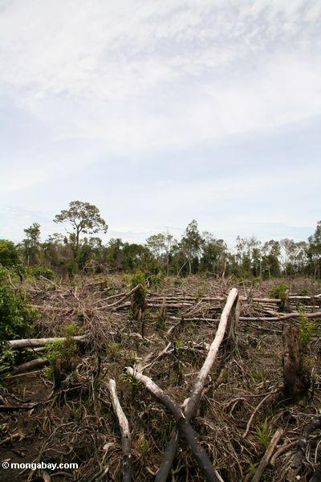
Rainforests, mainly Amazonia,
are cut down and burned
to get space for fields.
They have too little space
for growing crops
so they destroy trees and plants
growing there
without knowing
they are doing wrong.

Slide 7
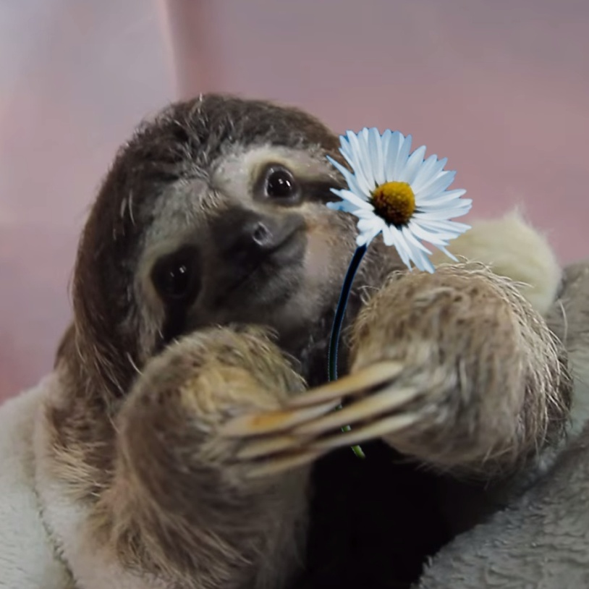
Let’s to this!
Rainforests occupy smaller areas
than they were a few years ago.
Let's do something for Earth
and don't let rainforests become history.
Please save me!!

