Slide 3
Regional and traditional dishes
Patatnik
A patatnik is a typical Rhodopean dish cooked very easy.
It is named long years ago and origins from potatoes.

Slide 4
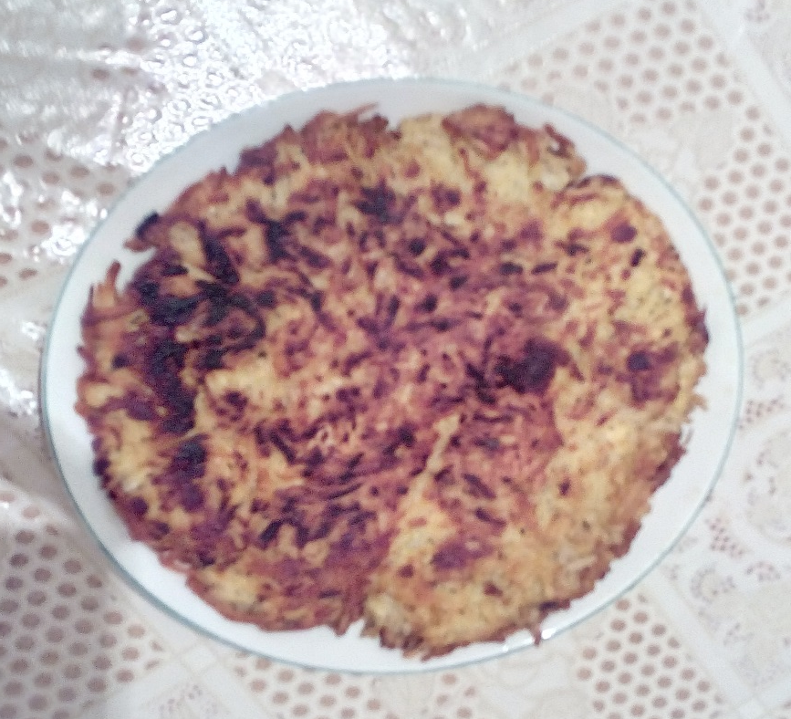
Ingredients and making
Raw potatoes are peeled and grated. Then grate and onion. Add salt and mint to taste. Stir and allow to stand 15 minutes. In a wide pan pour oil, streach a dough sheet onto, put the mixture and cover with another dough sheet. Put the pan on the stove. When the bottom is golden turn it on a lid, return it to the pan and fry the other side.
Potatoes
Dough sheets
Onion
Salt
Mint
Cheese
Sunflower oil

Slide 5
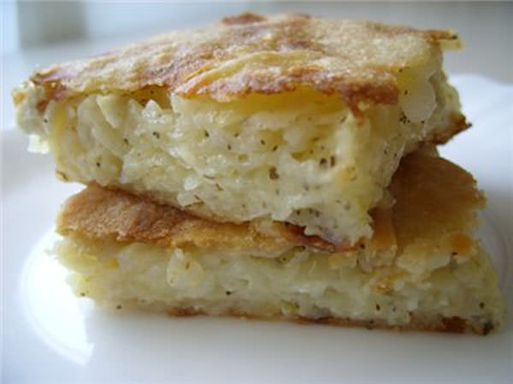
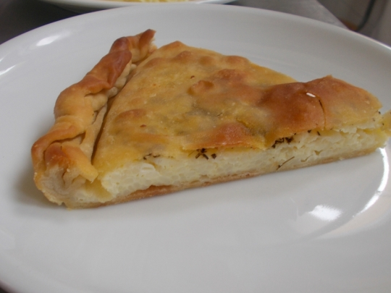
Rhodopean wedge
The wedge can be of different components and combinations such as rice, milk, spinach, stinging nettle or as you like, but it is most common with rice and cheese.

Slide 6
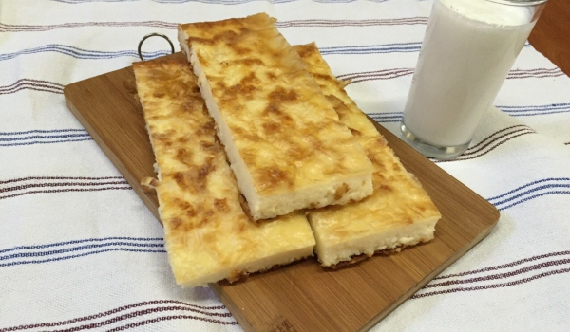
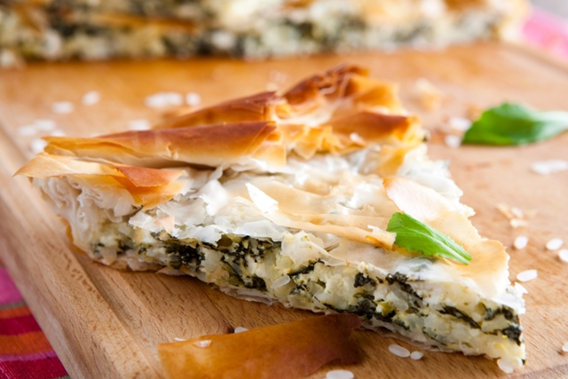
Ingredients and making
Filo pastry(or homemade dough sheets)
Eggs 5
Butter
Rise 200-300 gr.
Cheese 150 gr.
Salt
Milk 200 gr.
Boil the rice, add cheese, eggs, milk and stir together.
Make two homemade dough sheets prepared with a coffeespoon salt, water and a soupspoon sunflower oil.
In another pan pour four soupspoons sunflower oil. Preheat it on the stove. Cool it for a while and spread one of sheets onto. Sprinkle the mixture on the top and add melted butter.
The wedge bake until browned on both sides.

Slide 7
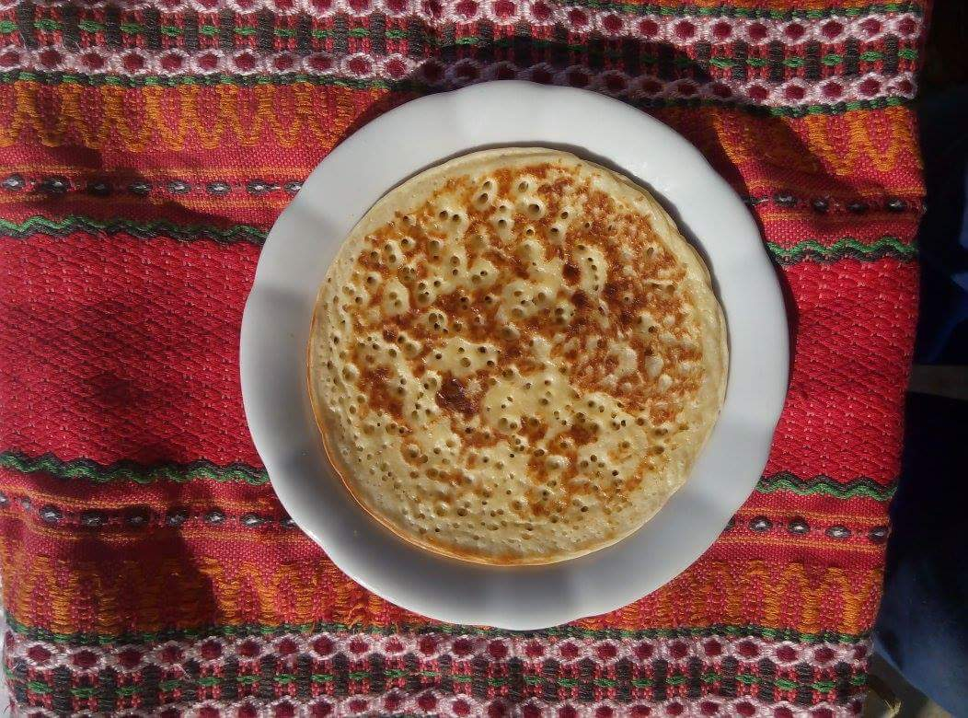
Rhodopean katmi
They are ticked and very delicious bakes called katmi.This dish is baked onto traditional earthen sach instead of pan.

Slide 8
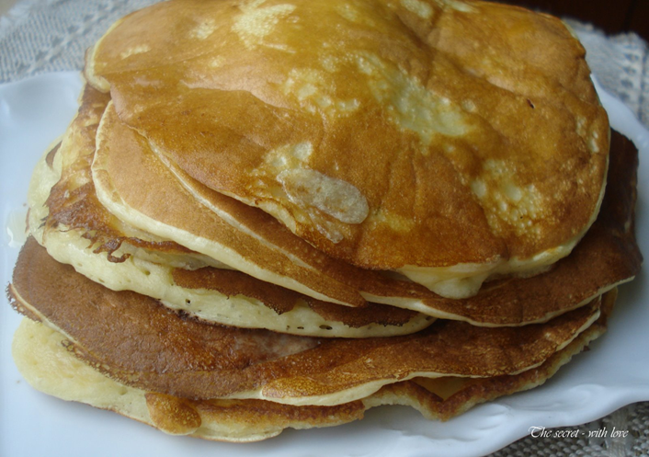
Ingredients and making
Yoghurt 0,400 L
4 Eggs
Sugar
Salt
Flour
Soda(powder)
Butter
Cool water
Honey or jam
In a bowl beat together the eggs, yoghurt, a pinch of salt, a soupspoon of sugar and soda. Put the flour and stir it well . Put the pan on the stove , coated with oil, and heated well.
Take a medium-sized ladle and it dosed mixture.
Bake the mixture both sides and spread it with butter.
After baking the whole mixture you can serve them with jam or honey.

Slide 9
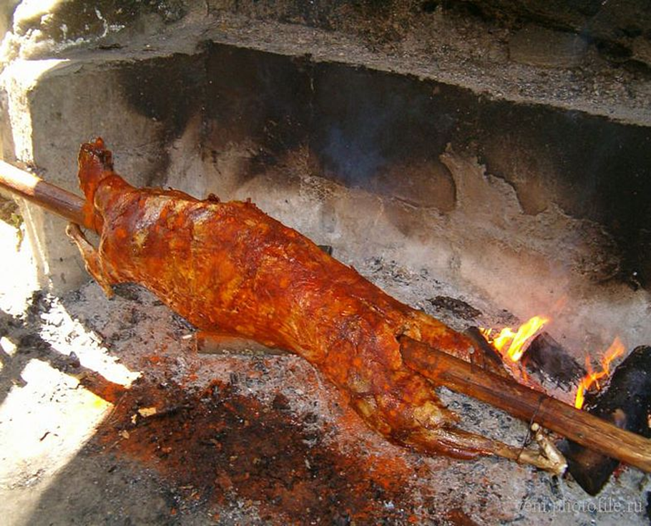
Lamb barbecue
Lamb barbecue is an integral part of any feast in the Rhodopes. Delicious lamb meat is a typical dish for the mountain region.

Slide 10
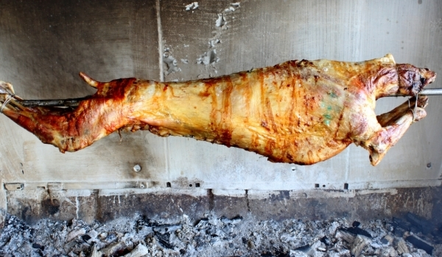
Ingredients and making
Lamb is baked over glow with continuous rotation for 6 hours. Remove permanently maintain fire and occasionally added extra glow.
1 lamb
Salt
Butter

Slide 11
Kachamak
Ingredients and making
Put salt and pour the flour all at once in boiling water. Use a rolling wood stick to make a hole in the middle and through among which to go out steam. Once it boil 1 1/2 hours you may remove it from heat and stir with the rolling wood stick until it begins to lift off the court. Pour it into a wide vessel and spread it in an even layer and sprinkle with crumbled cheese and melted butter. On top of it add golden color crackling of bacon.
5 cup (1 kg), corn flour
3 liters water
Salt
Cheese 600 gr.
Butter 200 gr.
Meat 500 gr.

Slide 12
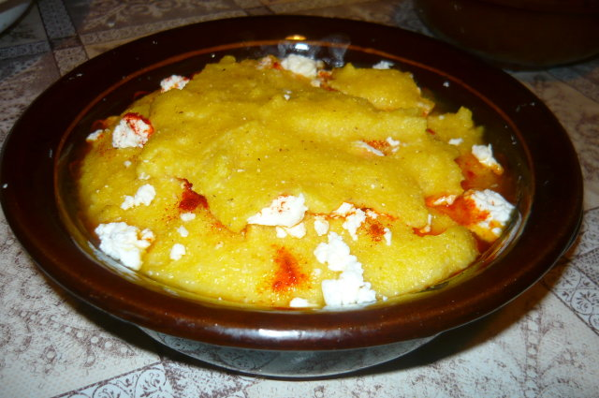
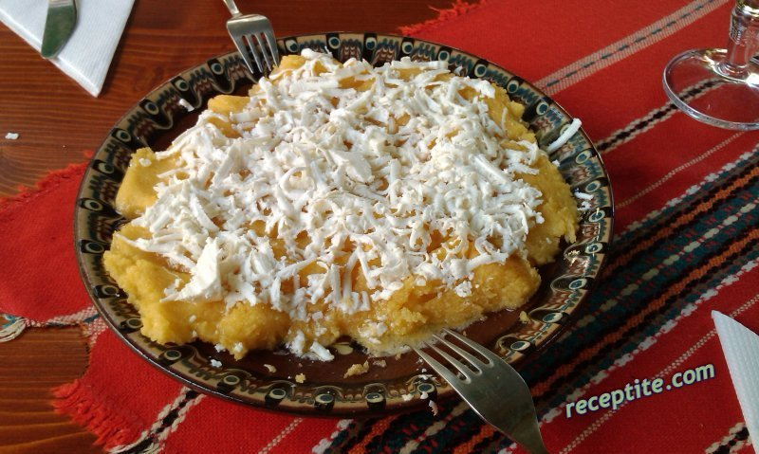

Slide 13
Created by:
George Mandov
and
Vasil Chervenakov

