Slide 1
My favourite book
By Filip Tokarski

Slide 2
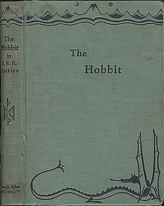
The Hobbit or There and Back Again
The Hobbit or There and Back Again is a children's fantasy novel by English author J. R. R. Tolkien. It was published on 21st September 1937 and awarded a prize from the New York Herald Tribune for the best juvenile fiction. The book remains popular and is recognized as a classic in children's literature.
Original cover of the book

Slide 3
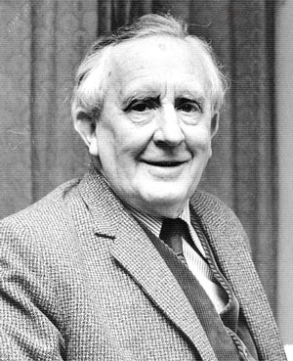
The Author of the Book
John Ronald Reuel Tolkien
3rd January 1892 – 2nd September 1973

Slide 4
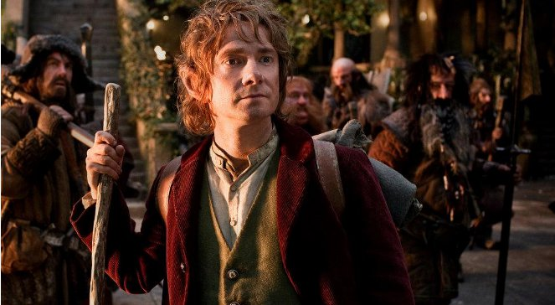
Short story
The book is about an expedition during which Thorin’s team of dwarves and a hobbit are going to Lonely Mountain. They must kill dragon and get back precious jewel. The Hobbit called Bilbo Baggins becomes the owner of magic ring which can make him invisible.

Slide 5
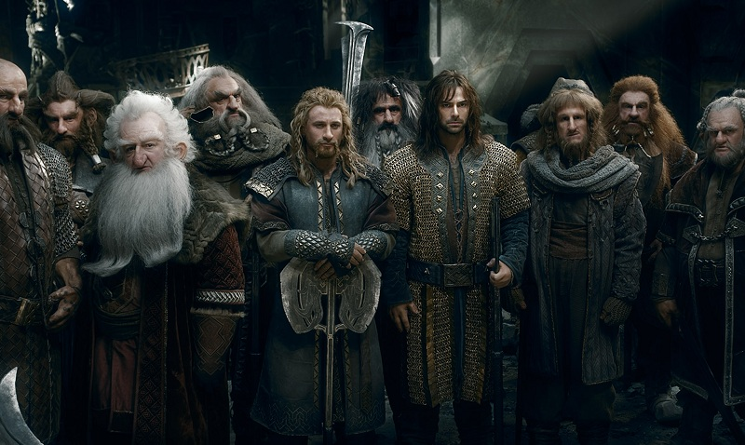
PROTAGONISTS

Slide 6
Gollum
Gollum was very keen eyed and quick of hand, this made him an excellent fisherman. He could spot and catch fish in almost any level of light and water. He fished the waters of the Misty Mountain's underground lake for centuries in almost complete darkness. He had to leave his cave in search of the Ring and the thief Baggins. He was known to eat almost anything that was living or edible and could digest anything raw and uncooked. He was also very good at not being seen and was an excellent waterman making use of anything that could float. This ability made it possible for him to follow the Fellowship for so long.

Slide 7
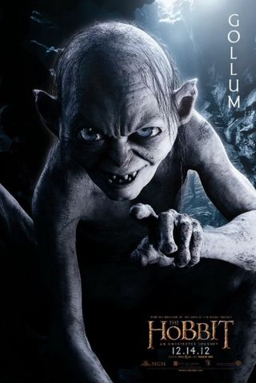
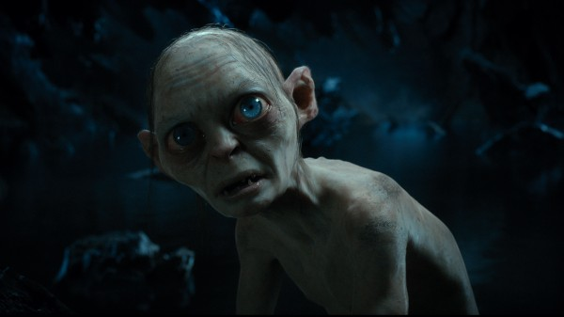

Slide 8
Bilbo Baggins
Bilbo was a very friendly and well-mannered hobbit fond of food, drink, a full pipe, his friends and good cheer, and was known for greeting strangers and friends with hospitality saying; "At your service and your families". Being related to both the Tooks and the Baggins two family groups that were fundamentally opposite in their mentalities, with the Tooks being more fond of adventures and wandering, and the Baggins who were more fond of the settled life, Bilbo had two different sides of him, something he referred to as the "Took side" and the "Baggins side". This meant that he secretly relished having adventures but still wanted to remain settled.

Slide 9
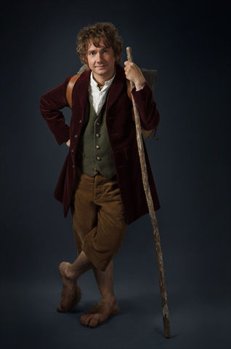
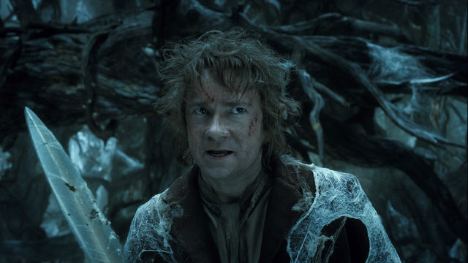

Slide 10
Gandalf
Gandalf was a wizard, sent by the West in the Third Age to combat the threat of Sauron. He joined Thorin and his company to reclaim Lonely Mountain from Smaug, convoked the Fellowship of the Ring to destroy the One Ring, and led the Free Peoples in the final campaign of the War of the Ring.

Slide 11
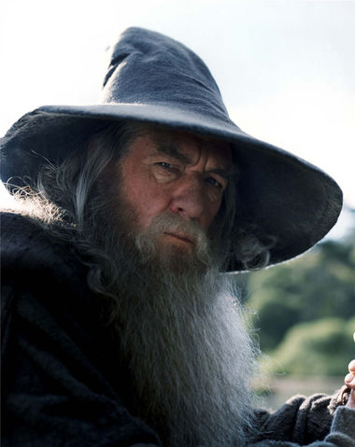
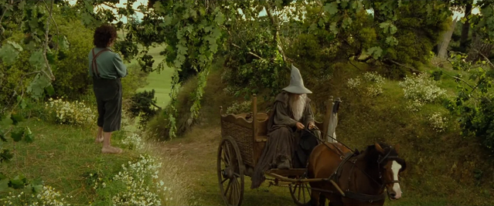

Slide 12
Smaug
Smaug was a fire drake of the Third Age, considered to be the last "great" dragon to exist in Middle-Earth. Smaug was drawn towards the enormous wealth amassed by the Dwarves of Lonely Mountain during the reign of King Thror, and laid waste to the neighbouring city of Dale. The creature captured Lonely Mountain, driving the surviving Dwarves into exile.

Slide 13
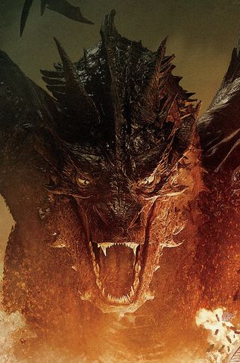
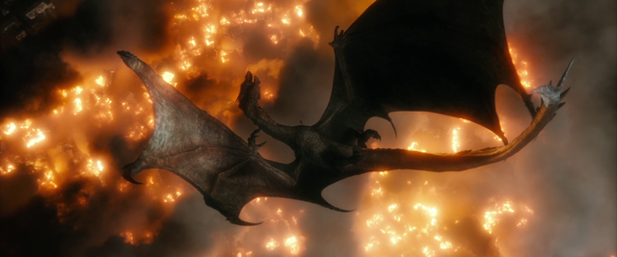

Slide 14
Thorin II Oakenshield
Thorin II, also called the Oakenshield, the King under the Mountain or the Mountain King was the son of Thráin II, the older brother of Frerin and Dís, the grandson of King Thrór and the uncle of Fíli and Kíli. Thorin was best known for his deeds as the leader of the fellowship that infiltrated the lost Kingdom under the Mountain to take it back from Smaug and for leading an alliance of Men, Dwarves, and Elves in the Battle of the Five Armies.

Slide 15
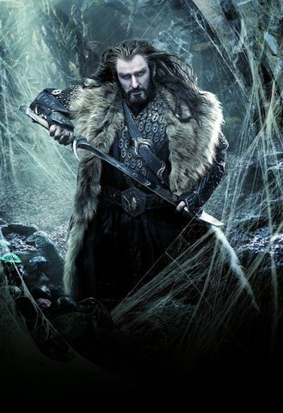
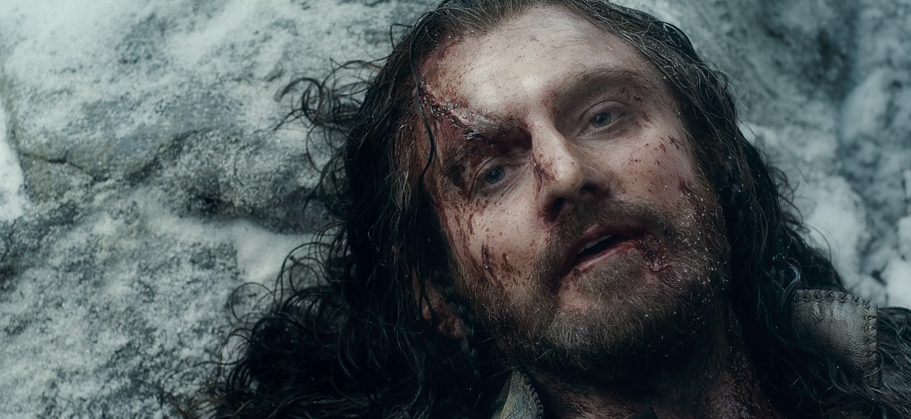

Slide 16
Thanks for watching

