Slide 1
The EuroStud Project
Our town

Slide 2
Attractions
In Celle there is a big garden. It is called ‘‘Französischer Garten“. There are many monuments and lot‘s of plants. Inside the garden there is the ‘‘Celler Schloss‘‘. The castle is sure the most important building of the town and was built in 1315. Opposite the castle there is the ‘‘Bomann Museum‘‘. The museum is one of the biggest and the most important of Lower Saxony. (Germany has got 16 states and Lower Saxony is one of them). Behind the museum there is the city church ‘‘Sankt Marien‘‘. Our class often has choir performances there. In the town there are five speaking lanterns. They tell the visitors funny and exciting stories about Celle.

Slide 3
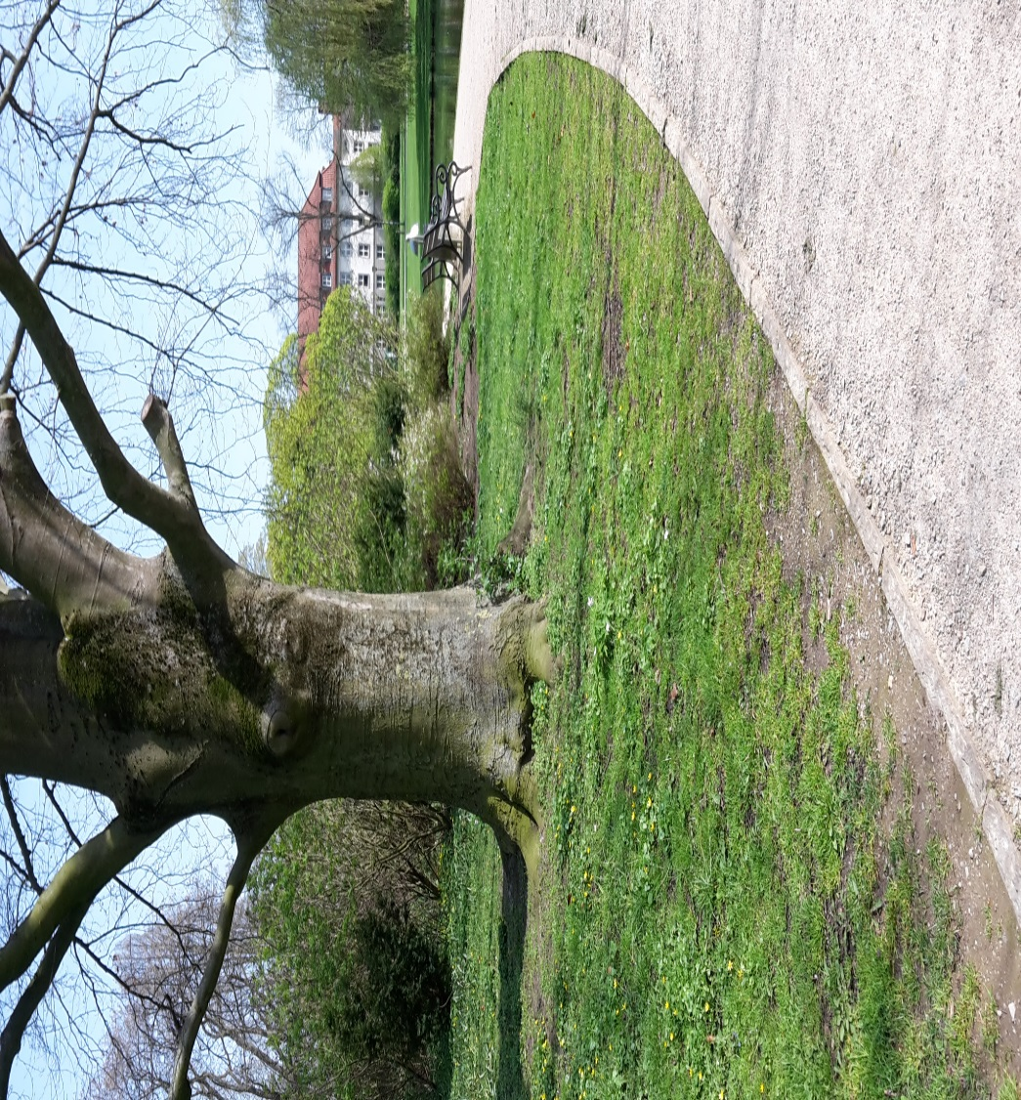
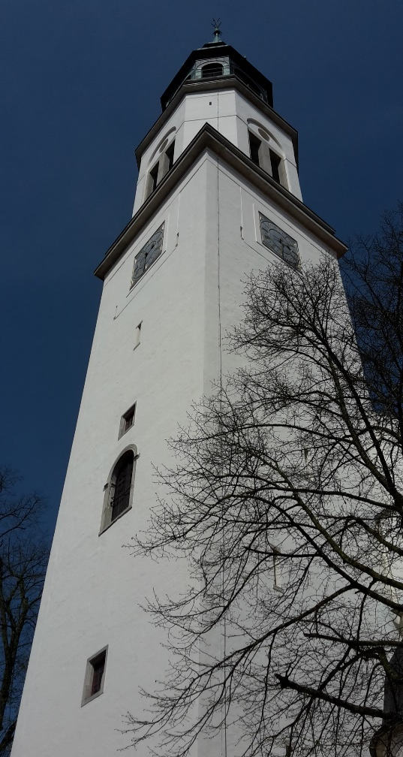
Photos
city church ,,Sankt Marien“
,,Französischer Garten“ (French Garden)

Slide 4
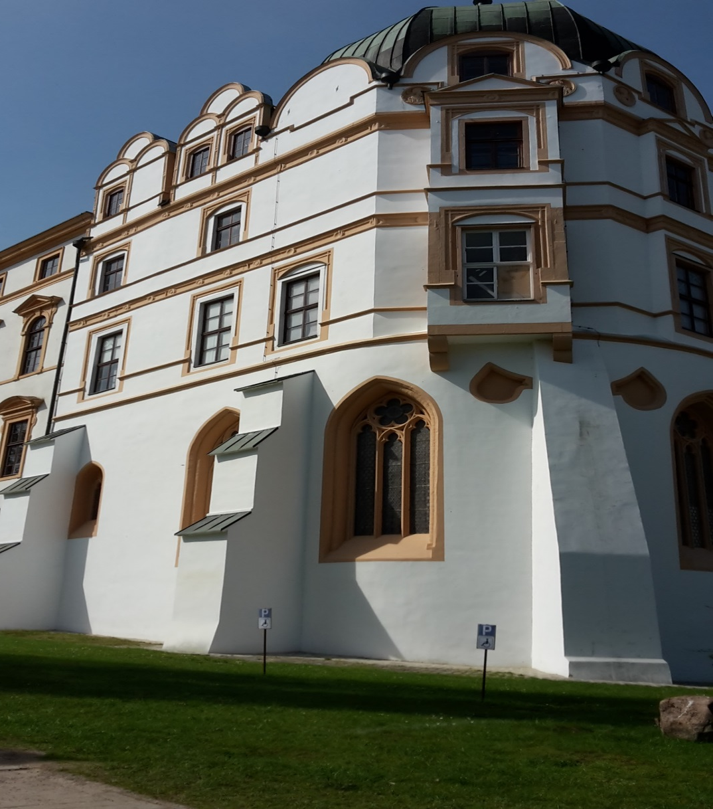
,,Celler Schloss“

Slide 5
Questions
When was the ‘‘Celler Schloss“ build???
How many speaking lanterns do you find in the city???

