Slide 1
Celle-our town
The half-timbered houses

Slide 2
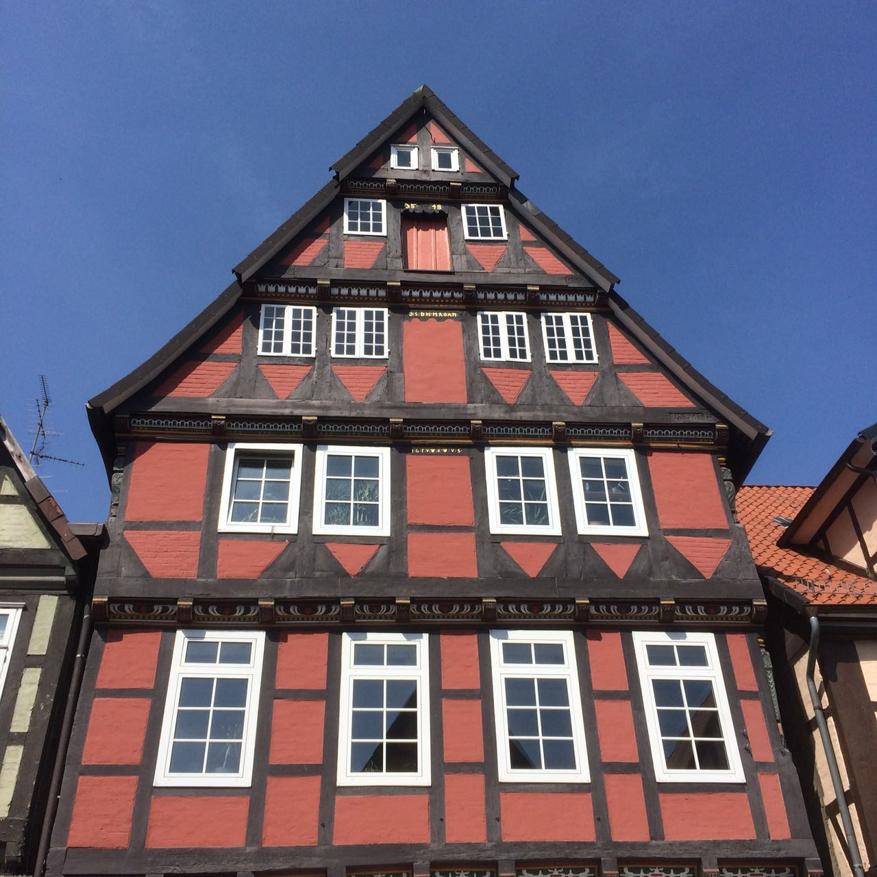
The half-timbered houses
The half-timbered houses are out of wood,sand and stones. Timberes beams make a part of the houses. Very often there is a writing in Latin on these houses. Many houses were built in the Middle Ages. The half-timbered houses are very important for the visitors and the inhabitants, because the biggest part of the old city is made out of half-timbered houses. Celle is very famous for the half-timbered houses.

Slide 3
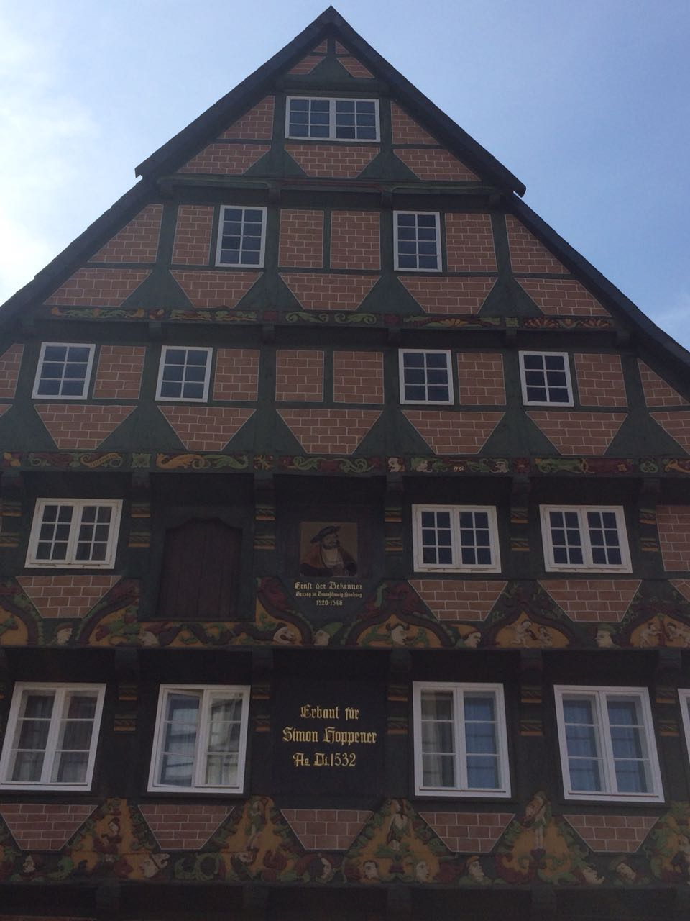
The ´´Hoppener Haus´´
The most famous house is the ´´Hoppener Haus´´ in Poststraße 8.

Slide 4
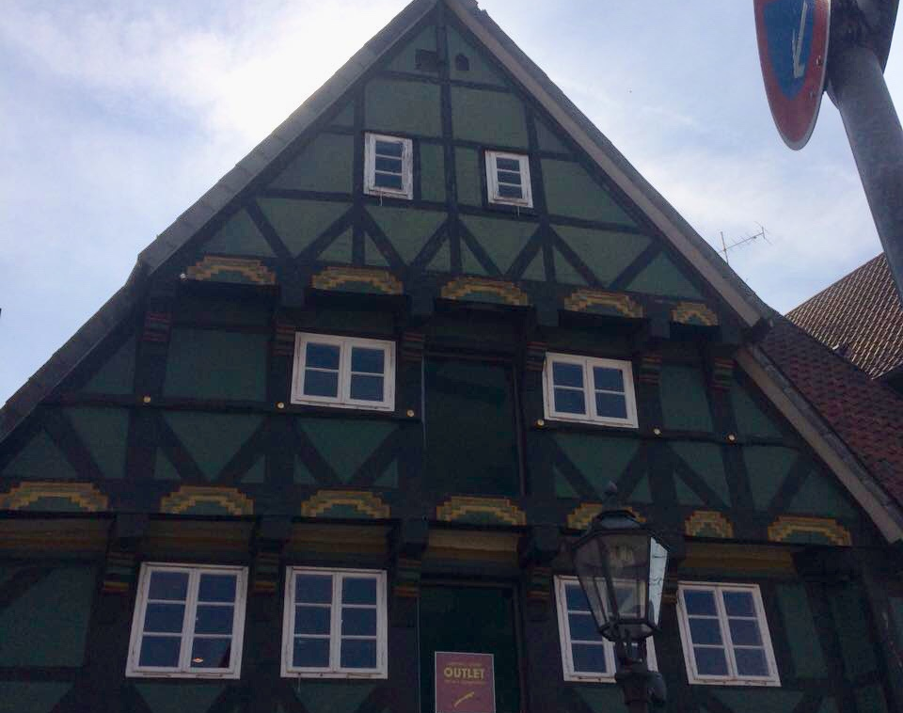
The oldest house
The oldest house is ´´Am heiligen Kreuz´´, that´s a road in Celle and means ´´Holy Cross´´

Slide 5
Questions:
1.In which road is the ´´Hoppener Haus´´?
-
2.What are the half-timbered houses made out of?
-

