Slide 1
Holidays
Easter

Slide 2
Easter
We always celebrate Easter on a Sunday, the day is called Easter Sunday.
The next day`s name is Easter Monday.
The kids search chocolate eggs in the garden, most parents tell their kids that the chocolate comes from the Easter bunny.
Families dye the eggs with colours. We put the eggs on a tree.
We celebrate Easter with our families (grandparents, parents , sister, uncle, aunt ).
We have breakfast together, we usually eat colorful eggs. In the afternoon we eat cakes.
Every Saturday before Easter there are barnfires. They are in the evening or at night. There are many people who talk and they are happy.
We celebrate Easter because Jesus rose up from the dead.
During Easter we have two weeks of holidays and on Easter Sunday and on Easter Monday the shops are closed.

Slide 3
QUESTIONS
Why do we celebrate Easter?
What do parents tell their kids?
What do we do in the evening before Easter Sunday ?

Slide 4
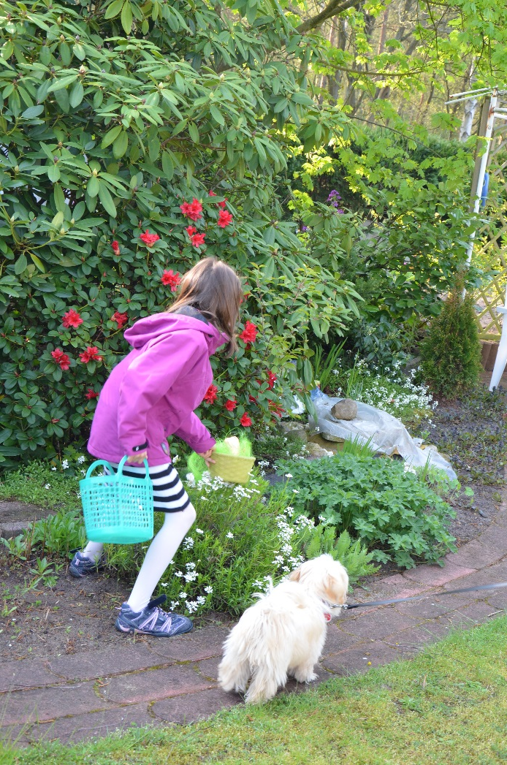
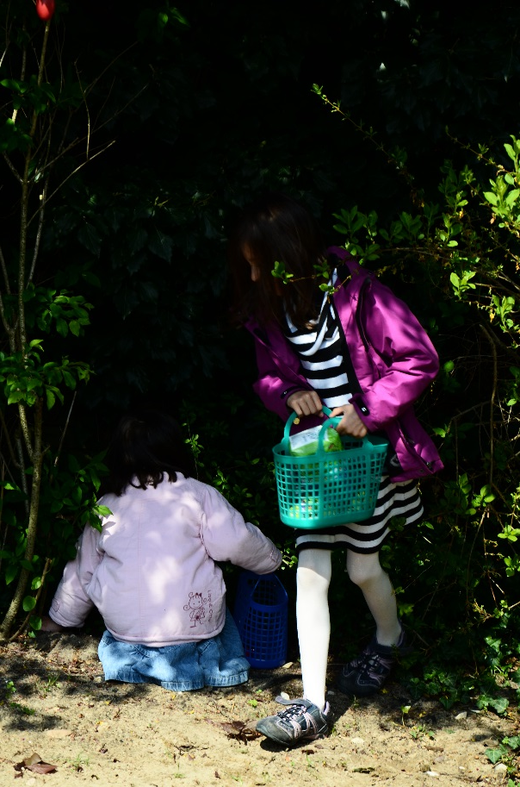
We search chocolate in the garden.

