Slide 1
The Eurostud Project
Freetime Activities

Slide 2
freetime activities in Celle
We have a lot of activities in Celle. In this text there is some information for you:
minigolf
swimming
cinema
voluntary fire brigade
bowling
scouts
museum
castle park
choir
go by boat/ kanu on the rivers Aller or Fuhse
rowing

Slide 3
The show
When you make a show you sing a song with your group etc.
When you are in an orchestra you play with some people songs with different instruments
With a choir you can give a concert with over 100 spectators, who are for example in the church

Slide 4
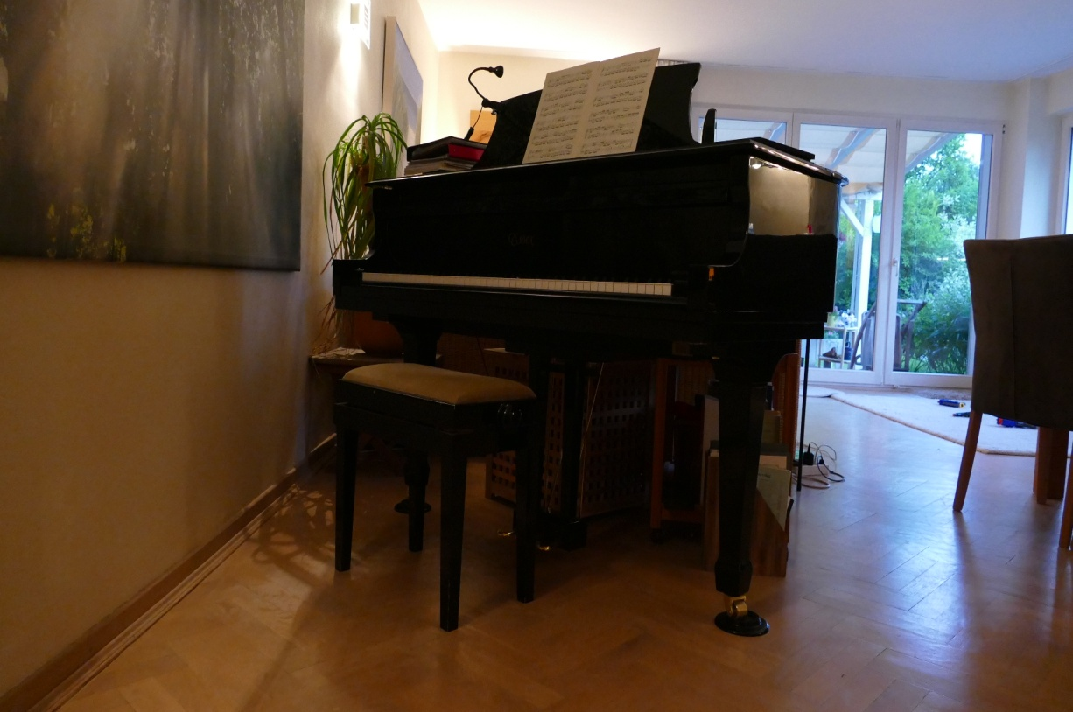
Our activities are :
Playing the piano -Playing the guitar

Slide 5
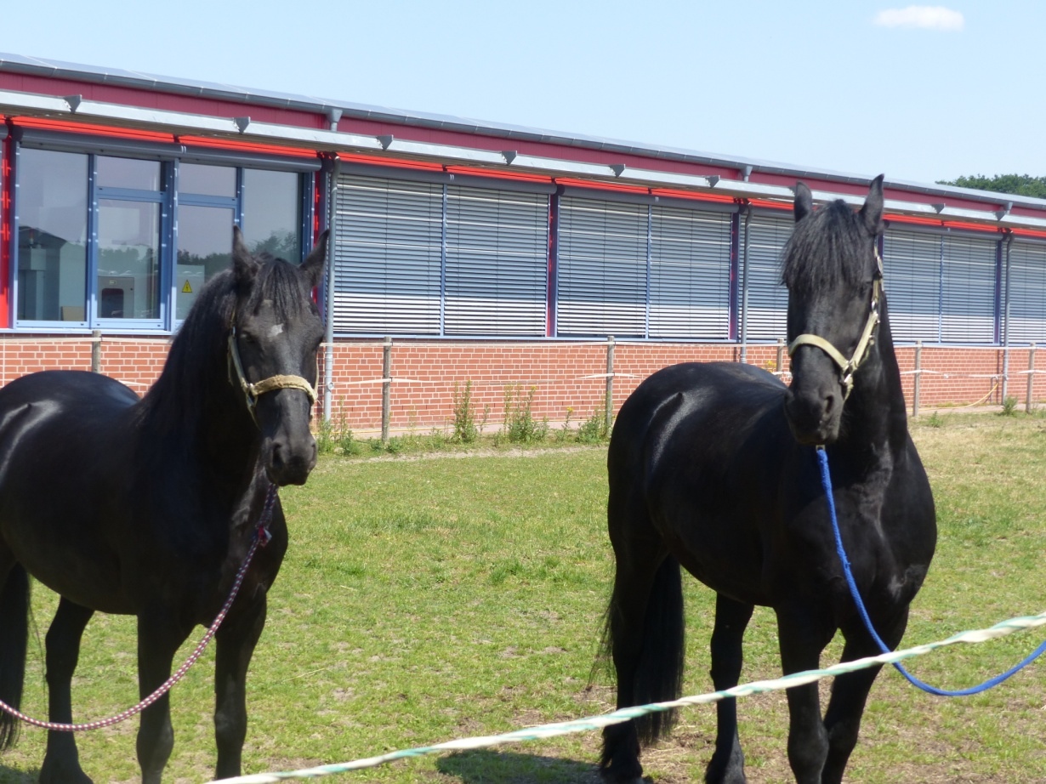
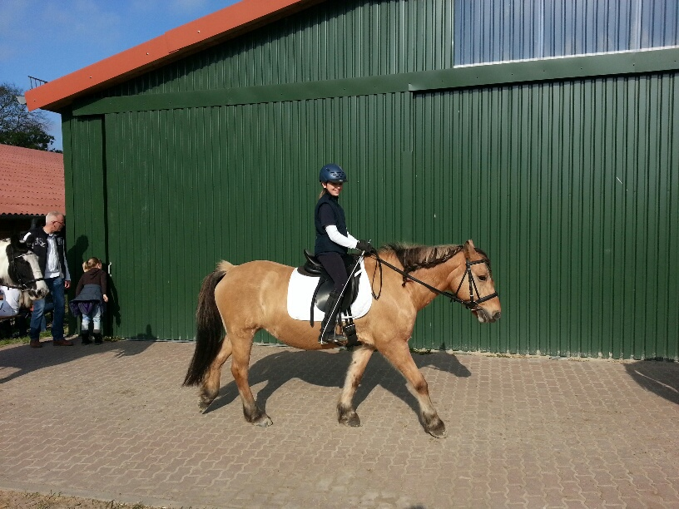
Riding
Teake and Barny Fenja

Slide 6
judo

Slide 7
survey
riding 6
playing the guitar 2
playing the piano 2
playing the fluit 1
dancing 6
swimming 3
football 1
judo 1
playing the violin 1
ice scating 1
climbing 2
scout 1
singing 1
skating 1
Voluntary fire brigade 1
Tennis 2
Athletics 1
Handball 2

Slide 8
Questions
Which hobbies can you try when you want to do sport?
Which hobby does our class like most?

