Slide 1


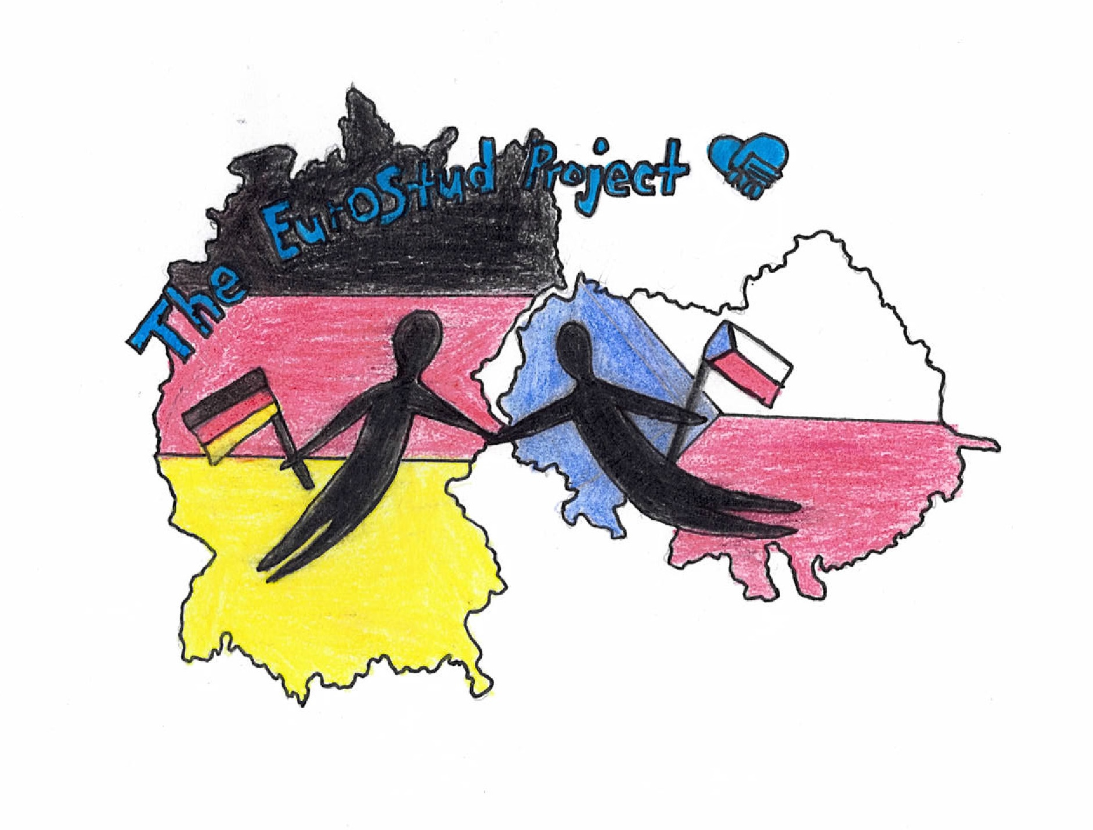

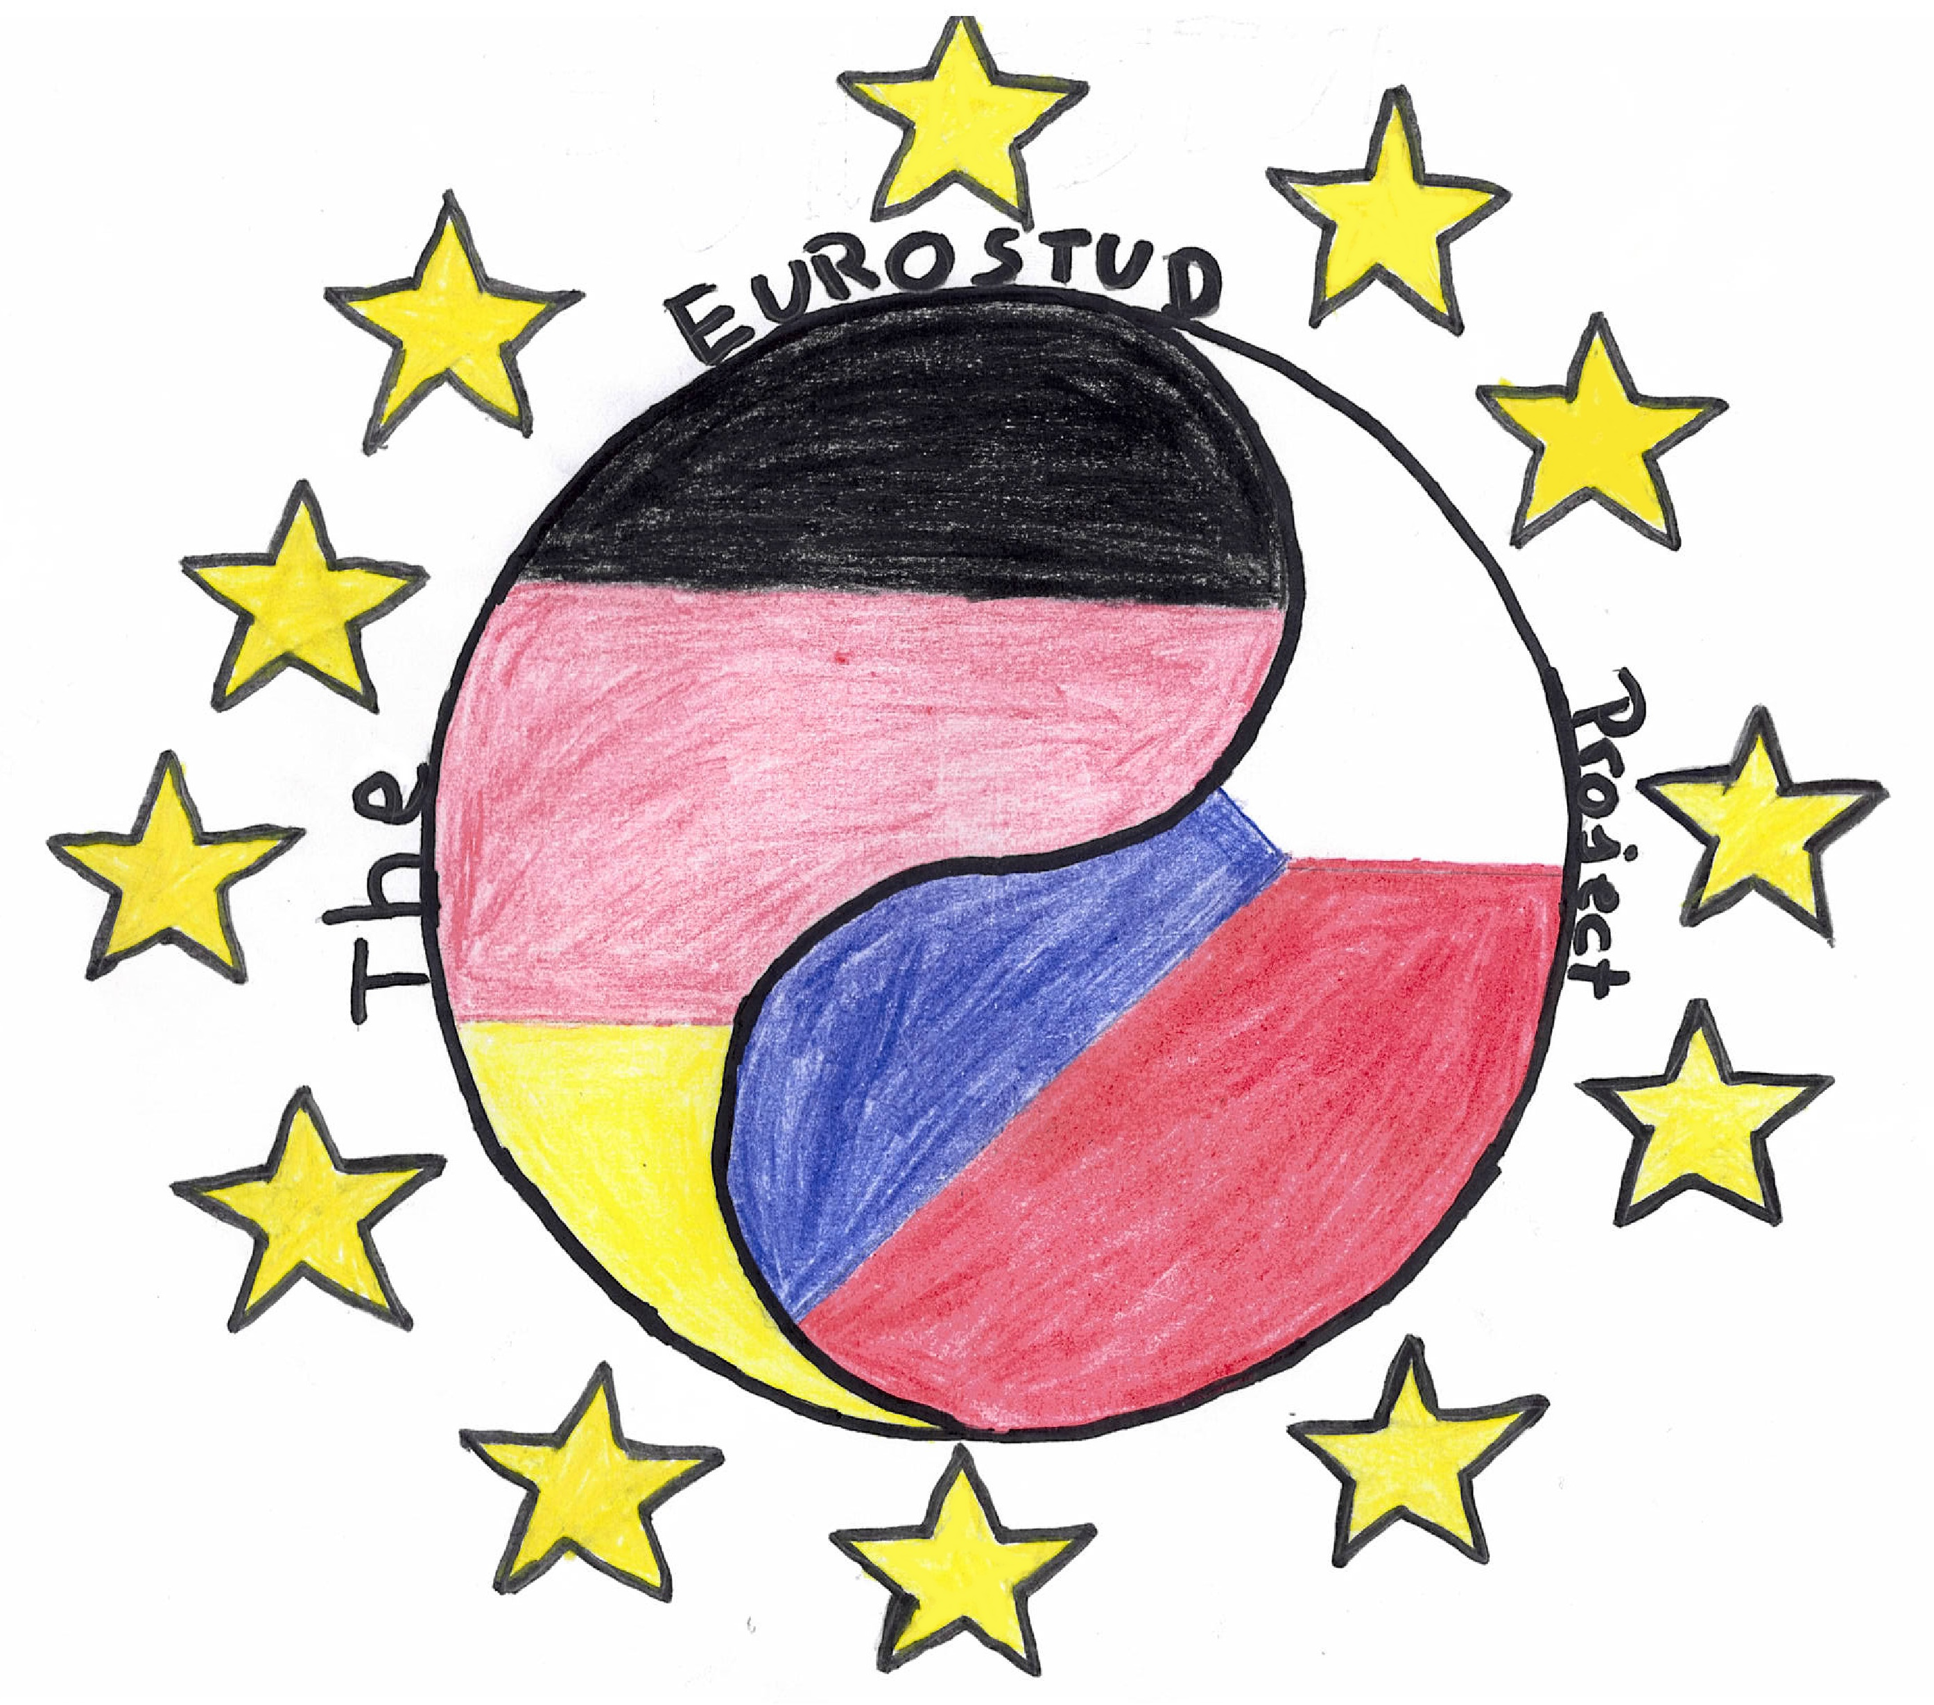

1.
2.
3.
4.
5.
Which logo do you like best?
6.

