Slide 1
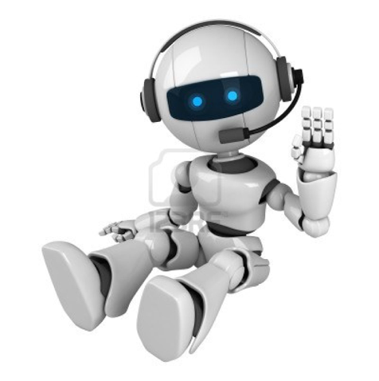
BE DIGITAL TEAM 3 ROBOT STORY

Slide 2
Once upon a time there lived a little robot. His name was Roby. He was not very happy because he was separated from his family and missed them so much. He dreamed that one day he would meet again his “parents” -students from the school , where he was created, in Ukraine.
One day he went for a walk with his friend Markus, and saw a beautiful girl-robot Gloria, and fell in love with her.The next day,the robot was walking through the park and when he saw Gloria again he offered to go out.
She agreed and they spent much time talking about his time in the school with his “parents”, ukrainian students. After two weeks they became the best friends.
Gloria was a volunteer in some European Projects..Every year she travels and not only see and meet new people but also do some studies about European Problems,different robots from different countries come together and find solutions to common problems for a better and peacefull Europe and World.
Gloria offered Roby to participate her and travel together.Roby accepted with a big excitement.
The project is about culture and let other people be aware of different countries they are going to be the ‘Cultural ambassadors’.They will visit lots of places meet lots of people and have an idea about different cultures.That really sounds good.They were excited to start their journey.
The first place is İSTANBUL.They started to preparations,took their tickets and YEEEYY its time to travel in EUROPE!

Slide 3
THEIR FIRST DAY IN ISTANBUL (KADRİYE GÜVEN’S PART)
It’s 4 in the morning when they land in Ataturk airport just outside Istanbul. They haven’t had much sleep but there is certainly no time for this.it’s the best time to visit some warmer place. Istanbul will do. They ve always been curious about this city. Is it in Asia or Europe? Well, it’s on both actually. But not only geographically Istanbul shows two distinct faces, historically too. Gloria was also so excited to explore this famous city.
By the time they drop their bags in the hostel in the borough of Sultanahmet, the sun is rising and it’s the best time to start exploring the historic centre. A few minutes walk later, Gloria and Roby get the first glimpse at the imposing Blue Mosque.

Slide 4
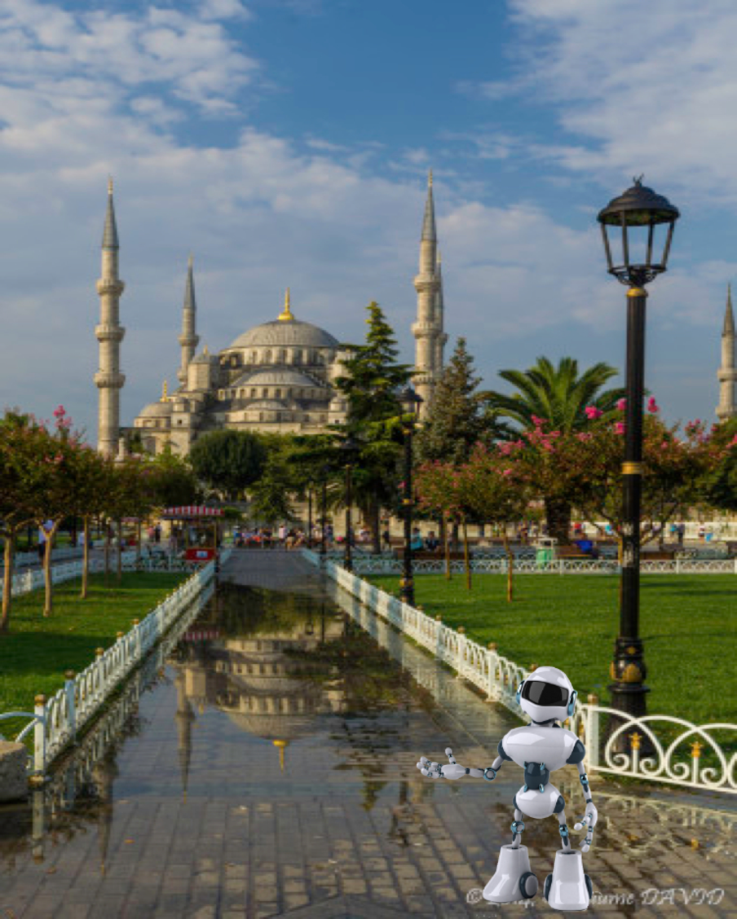
It was commissioned by sultan Ahmed I in 1609 and completed in 1616 with 6 minarets.The mosque was really amazing and Roby took a photo of himself with this beautiful view.

Slide 5
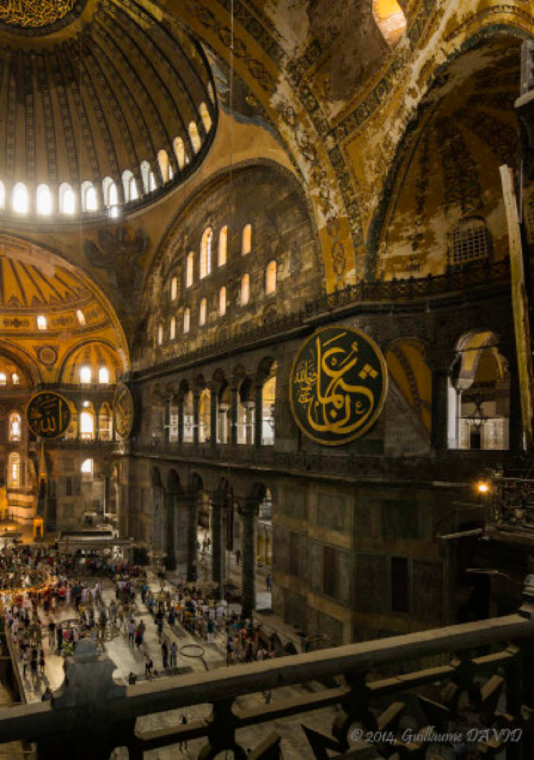
AYA SOFYA (HAGIA SOPHIA)
On the other side of Sultanahmet park is the famous Aya Sofya, greatest evidence of the city’s history. It was built as a cathedral in 537 by the emporor Justinian, got turned into a mosque in 1453 when the muslim conquered the capital and is now a museum since 1935 thanks to Mustafa Kemal Ataturk, first president of Turkey. The monument they see today is in fact the third attempt after the first two disappeard into flames in 404 and 532. It was in the 6th century, and still is today, a marvel of architecture, a majestuous an unrivaled interior.

Slide 6
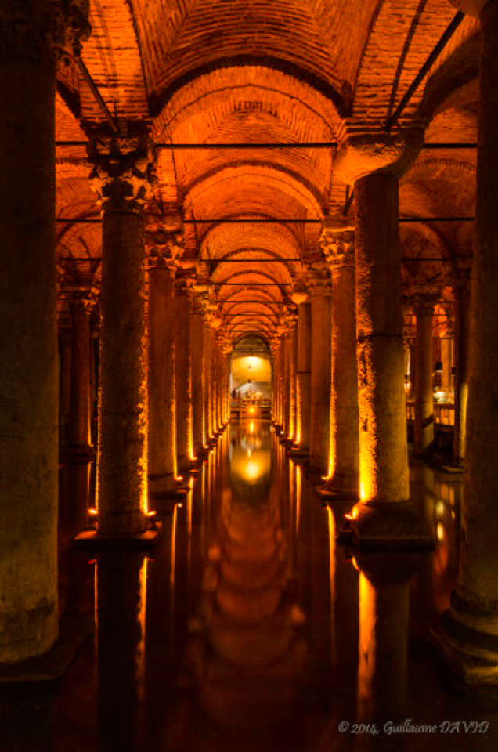
BISILICA CISTERN
Just a few hundred meters away is the Bisilica Cistern. Also built under Emperor Justinian command in 532, the gigantic chamber, supported by 336 columns, could keep 80,000 cubic meters of water brought via an aquaduc from the Black Sea. Forgotten by the city authorities, it was rediscovered by the Ottoman only in 1545 but used as a trash dump, even to throw dead bodies. It was cleaned in 1985 so visitors could admire this underground water reservoir.

Slide 7
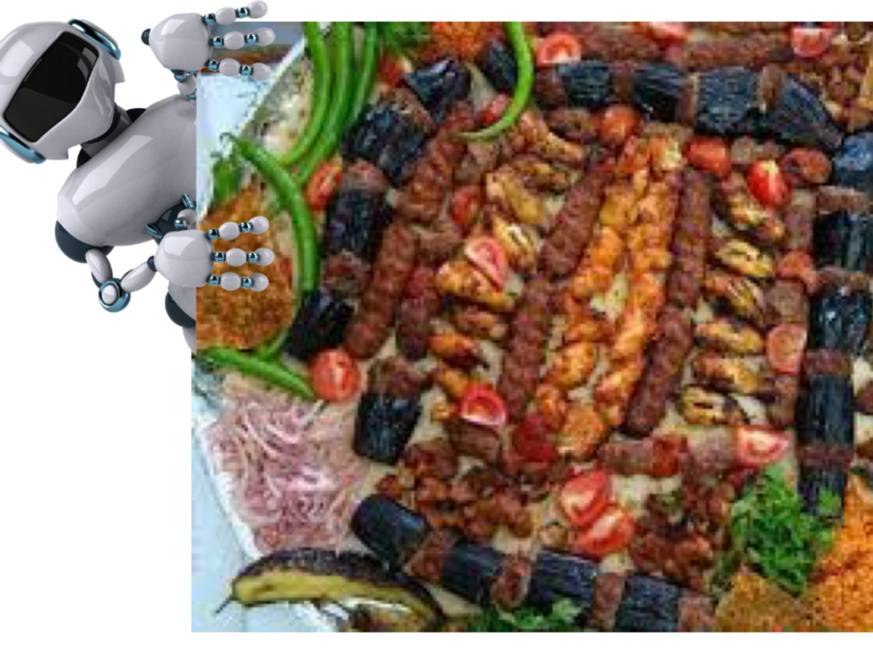
When they come out, the sky hasn’t changed at all it’s cloudy and rainy. They have a bit of a walk now, since they are going to the Bazaar District to see… the Grand Bazaar, where hopefully they can get some lunch. Since they are
in Turkey,they are definitely going to have a kebab.

Slide 8
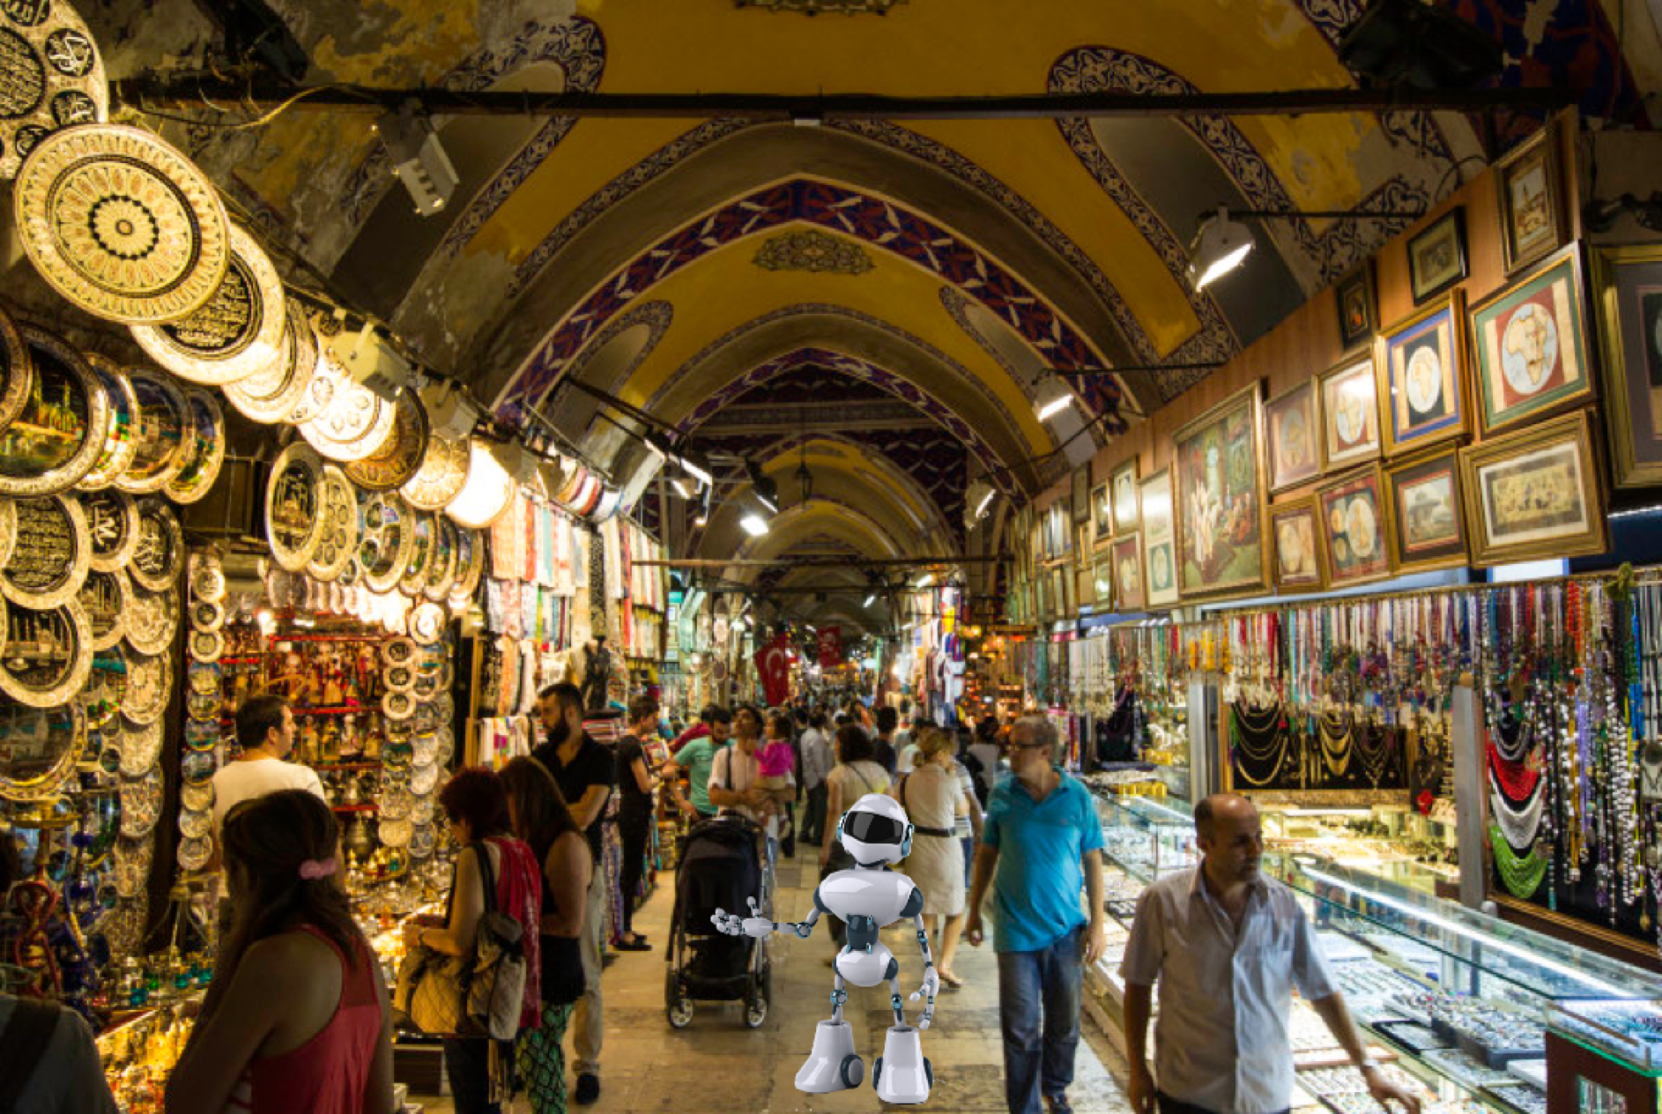
They ate a wonderful kebap and Gloria drank 2 glassess of AYRAN ,she really liked it.
The meal was also delicious.They took lots of pictures to show their friends and parents when they go back.Everyone should see this amazing cultural foods.
As they are not hungry anymore,Now the plan is to explore as much as possible of this labyrinth,and find something as a souvenier.

Slide 9
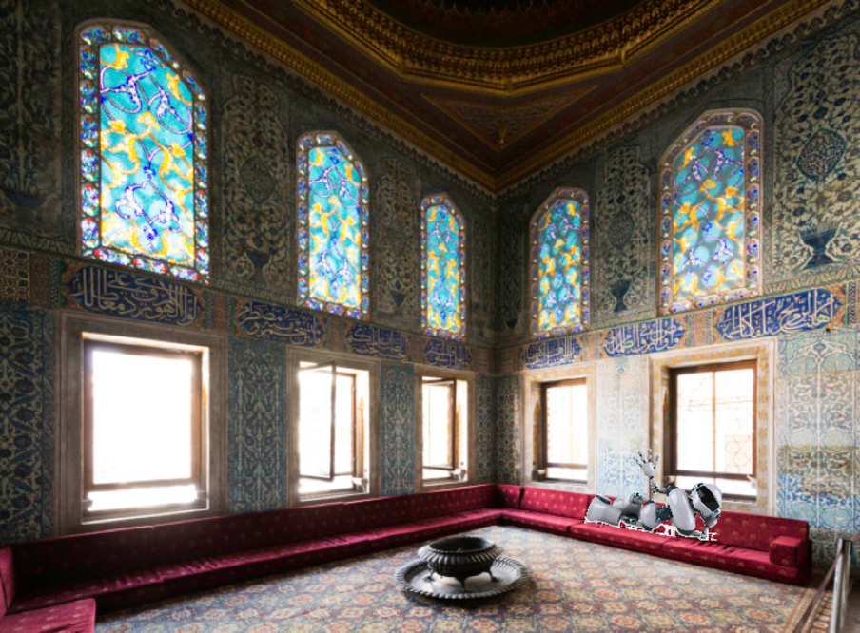
TOPKAPI PALACE
In the following morning, the plan is to start by visiting the luxurious Topkapi palace. It is built to accomodate the Sultan, his wives and children and their thousands of servants. Every room is beautfilly decorated, from top to bottom.
The private quarters of the imperial family are extremely luxurious, every single wall surface covered in colourful tiles.
Roby lied and Gloria took his entertaining photos:)

Slide 10
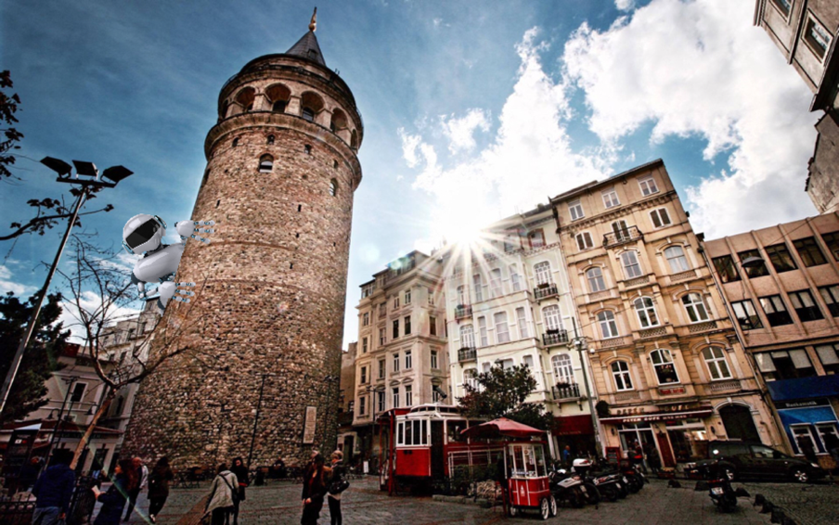
GALATA TOWER AND VİEW
Later in the day, they crossed the Golden Horn and stepped into Beyoglu, which seems to be the lively area of Istanbul. They are finally at the top of Galata Tower watching the sun set over the Bosphorus and Istanbul

Slide 11
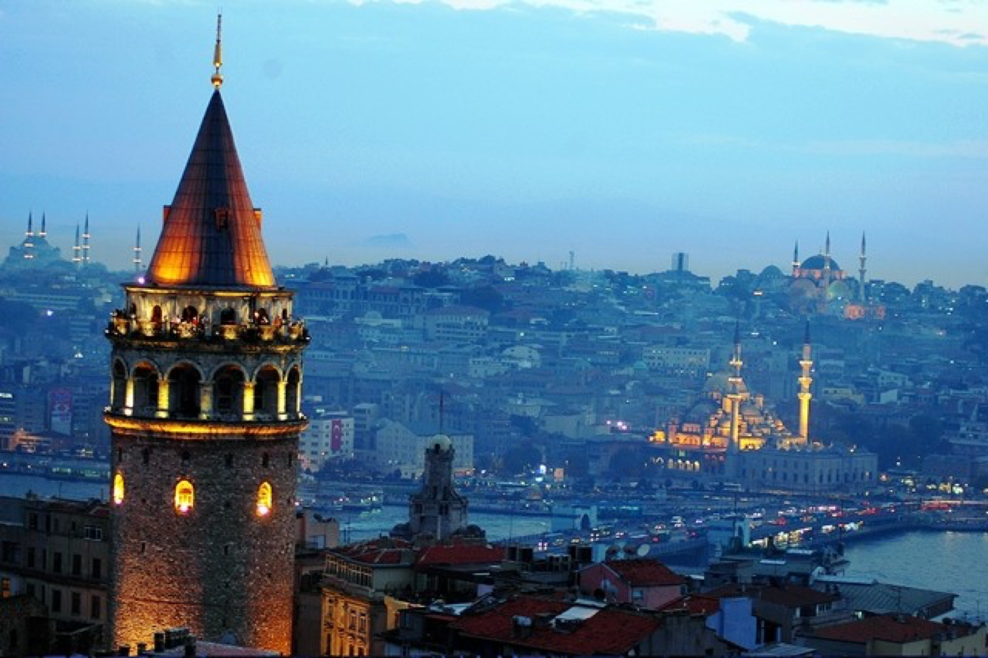

Slide 12
Roby was pleasantly surprised by Istanbul. It’s not the overcrowded, noisy and polluted city as He had imagined. It was rich in monuments, remnants of a long history, which has definitely shaped the Istanbul we can see today.
Their last place is one of the school in İstanbul Maltepe, İts name is ATAKÖSEOĞLU PRIMARYSCHOOL
Gloria met one of robot friend last year in one of project and her friend called them to host and meet with the students.
The robots and students were so hospitable to them.They talked a lot about İSTANBUL.Three days is not enough to explore this amazing city ofcourse but Gloria and Roby really loved here.

Slide 13
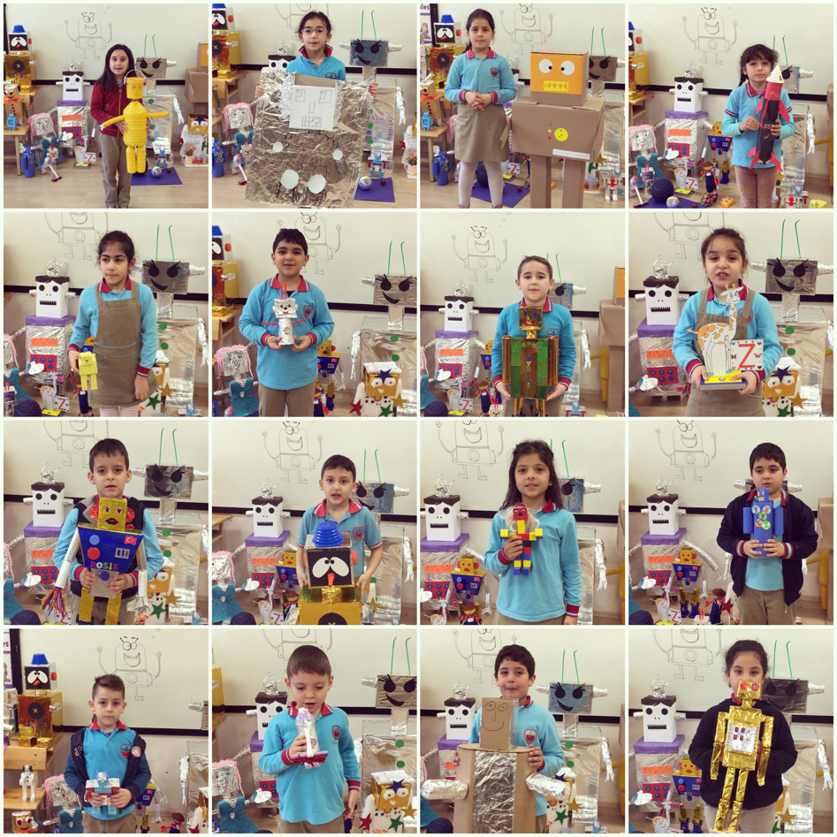

Slide 14
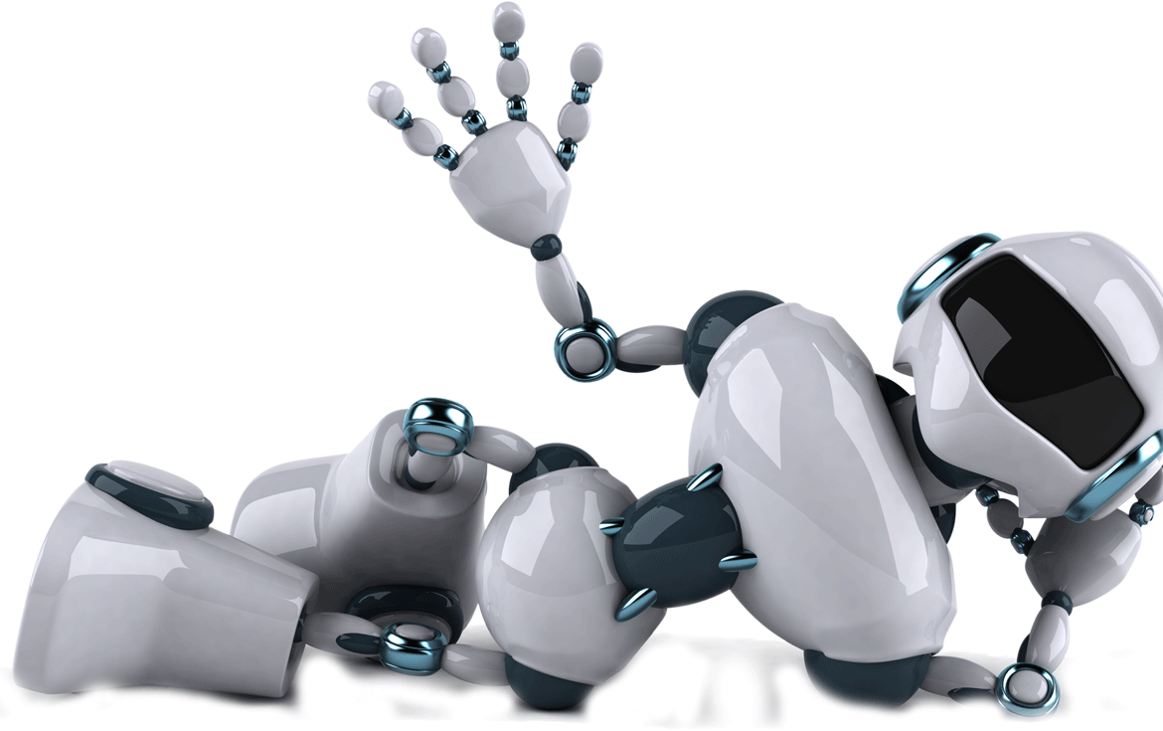
They are certainly more curious about Turkey and they ll soon be coming back to explore further into the country.
But Now their next city is OSMANİYE again in TURKEY.
They have to hurry up because their friends are waiting them at the airport now!
KADRİYE GÜVEN

