Slide 1
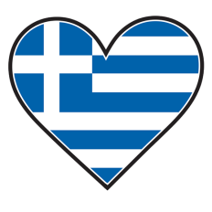
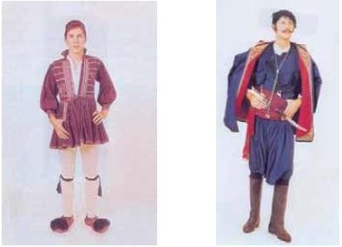
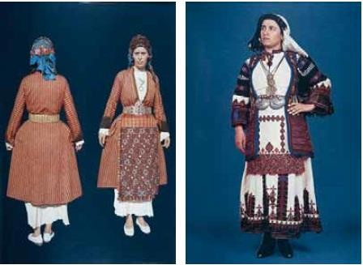
Traditional Costumes

Slide 2
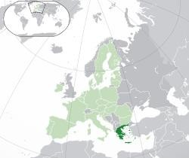
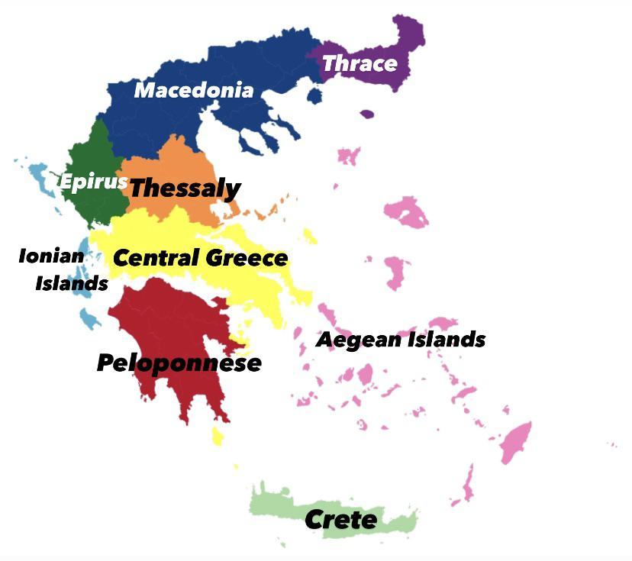
Greece

Slide 3
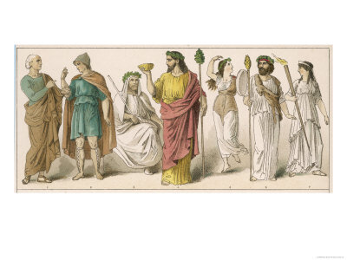
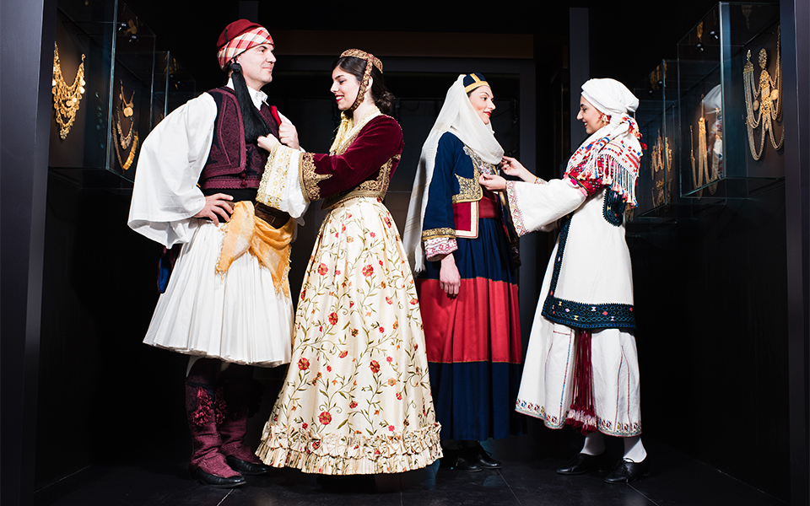
History
a continuation of Byzantine clothing, not ancient times
influenced by both the East and the West,
similar to neighboring peoples,
main elements : the shirt and a dress with either long or short sleeves, worn casually.

Slide 4
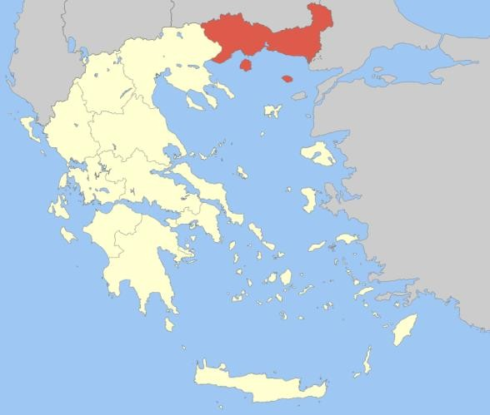
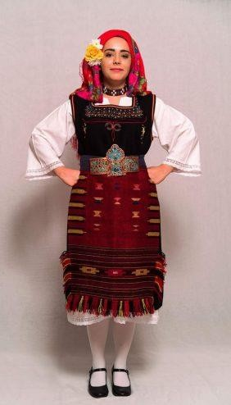
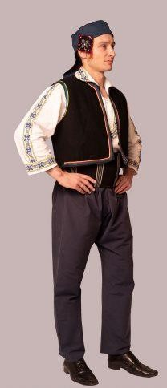
Thrace
Women's : made to impress, great differences within the area, communicated a woman's social status or social class.
Men's: presented as a single, common clothing, standard shoes.

Slide 5
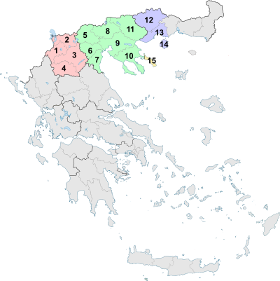
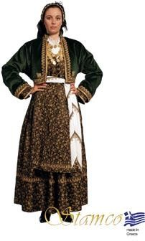
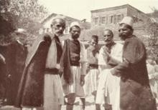
Macedonia
Women's:
strict / dark colors
peculiar cufflink,
the head band, called ‘katsouli’,
distinctive elements: the katastari (thick woolen shirt), the thick or thin cotton shirt, the belt, the apron or the skirt.
Men's: simple, without decoration,
(in the summer): linen breeches, a shirt, a belt and a vest or a doulama (kind of coat).

Slide 6
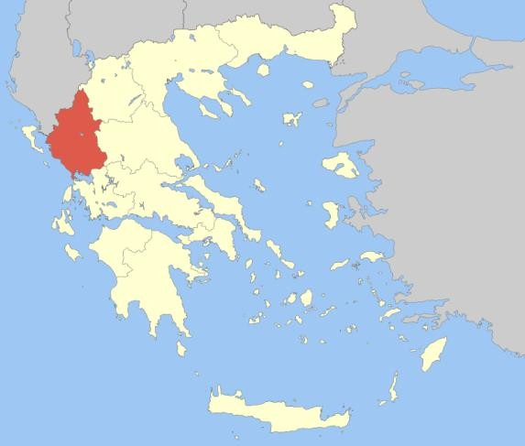
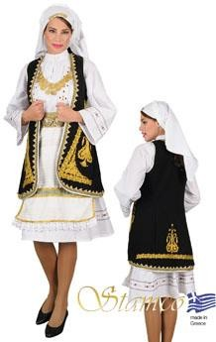
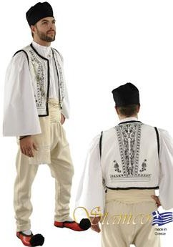
Epirus
Men's: beige and white pants, the traditional shirts etc.
notice the fur cap and the special shoes called ‘tsarouhia’ with tassels
Women’s:
consist of the shirt, the sigouni, the skirt, the traditional aprons and handkerchiefs

Slide 7
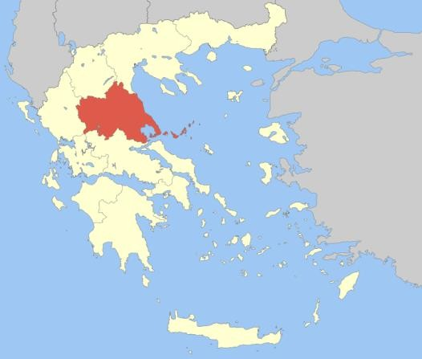
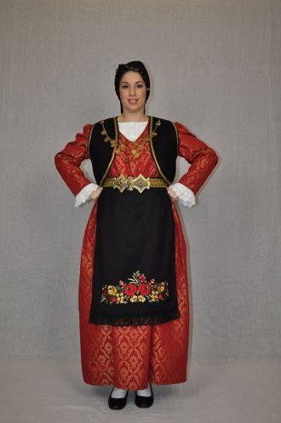
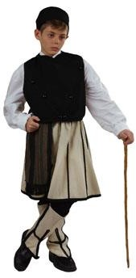
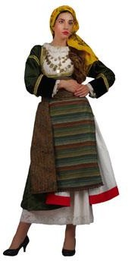
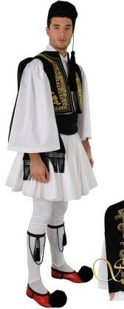
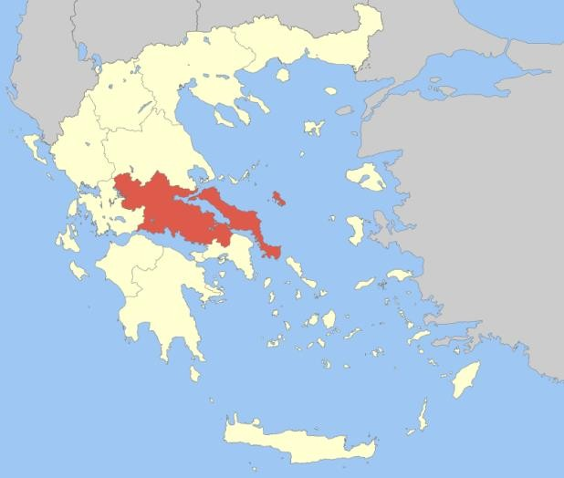
Thessaly
Central Greece

Slide 8
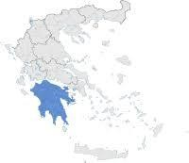
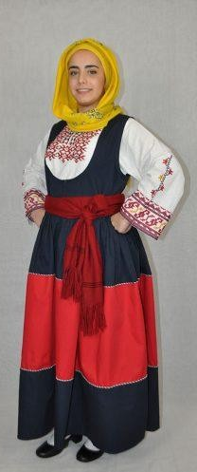
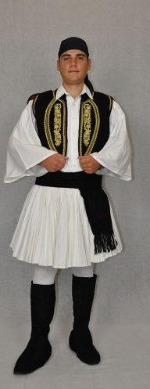
Peloponnese
Women’s : a long shirt, a sleeveless dress of dark-colored woolen cloth and a skirt that falls in folds, a striped belt round the waist, and a silk headscarf that is called bolia.
Men’s: look like pirates
wear a black strapped headscarf,
a shirt and a short red or black vest over it
breeches with white skirt (foustanela) and a different form of tsarouhia : like boots without tassels.

Slide 9
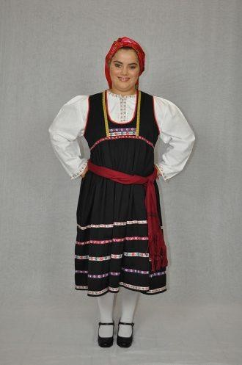
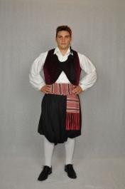
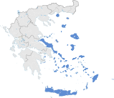
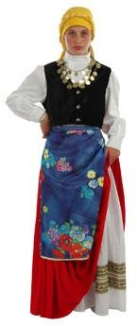
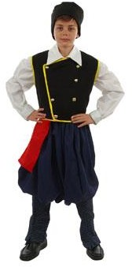
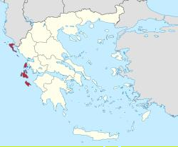
Aegean Islands
Eptanisa

Slide 10
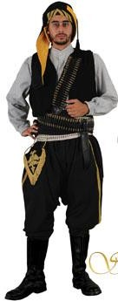
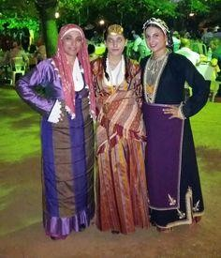
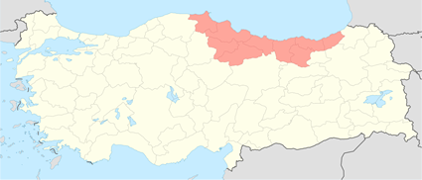
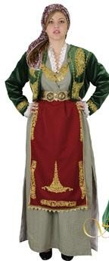
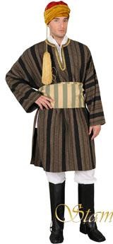
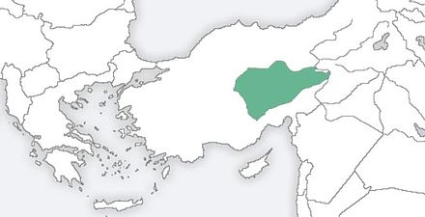
Pontos
Cappadocia

Slide 11
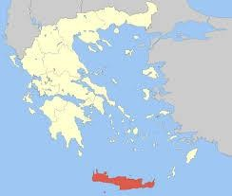
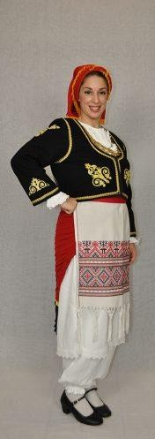
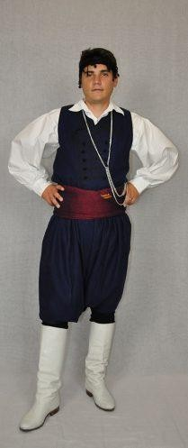
Crete
Women’s: a skirt with a bag, a katinaki (dress with a bodice sewn into a wide skirt), a headscarf, a salwar (long pants), a shirt and black shoes, as well as many, gold coins
Men’s: distinctive elements:
breeches with salwar kameez,
the belt with a silver knife in the middle,
white boots and
a katsouna, resembles a cane

