Slide 1



The Basque Language in Education: from mono to multilingualism
Luisa García Gurrutxaga
Education Advisor
Donostiako Berritzegunea
Basque Autonomous Government

Slide 2
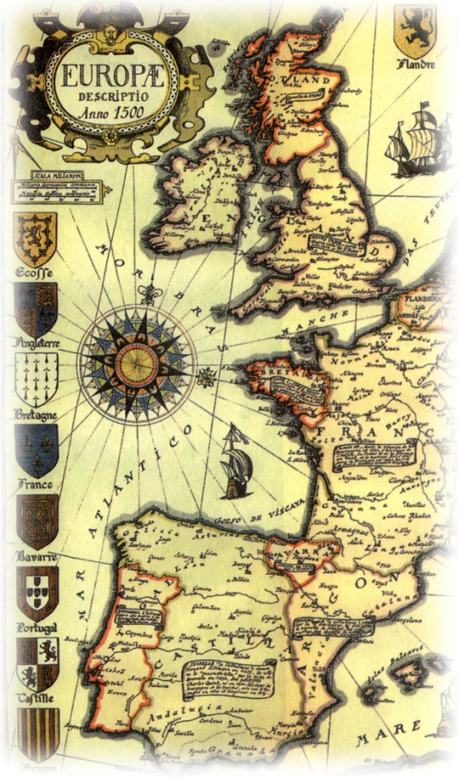
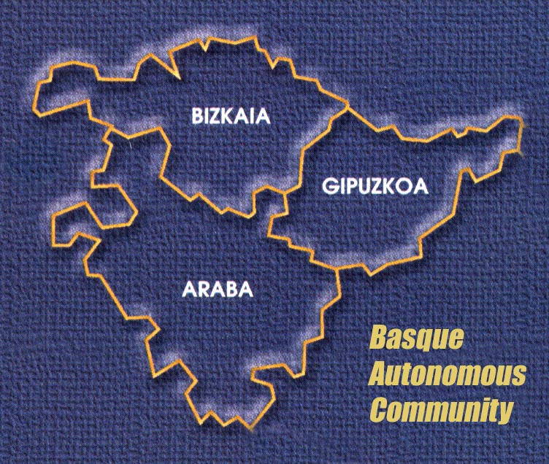

Basque Autonomous Community
 | BAC
Fully bilingual | 29,4%
Passive bilingual | 11,4%
Monolingual | 59,2%

Slide 3
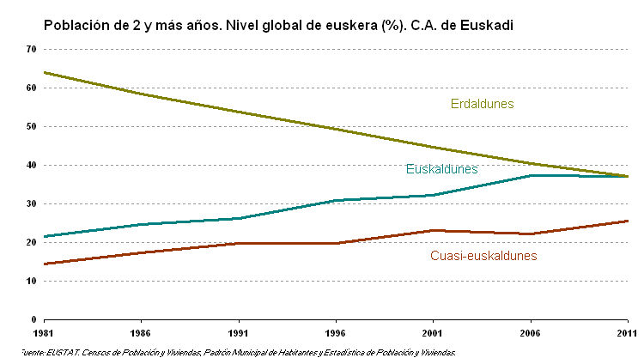
Basque & Spanish Speakers
Monolingual Spanish Speakers
Bilingual Basque-Spanish Speakers
Spanish speakers with medium to high competence in Basque

Slide 4
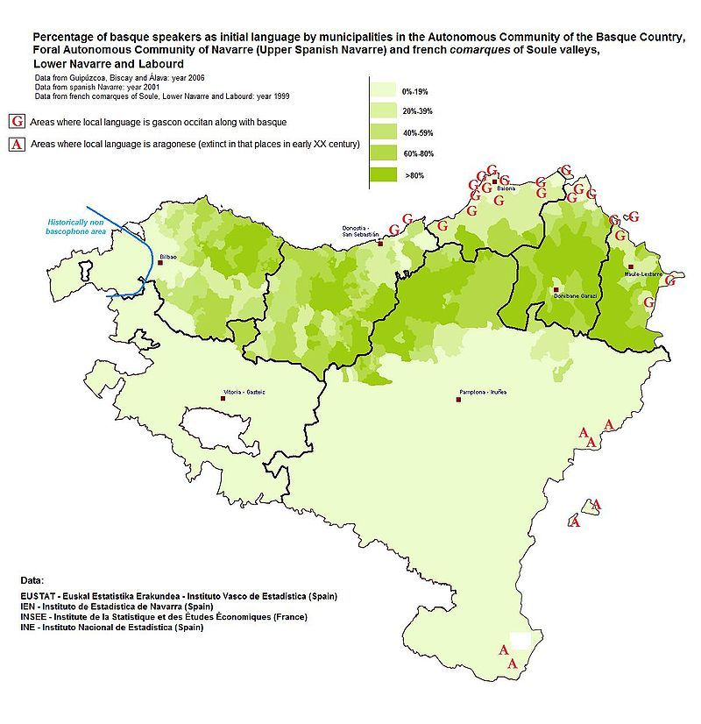

Slide 5
The Basque Case
General Franco’s dictatorship ends in 1975
Spanish Constitution is approved by referendum in December 1978
Basque Autonomy approved by referendum in

Slide 6
The Basque Case
Spanish Constitution is approved by referendum in 1978:
Castilian Spanish is the official language of the State. All Spaniards have the duty to know it and the right to use it.
The other Spanish languages shall also be official in their respective Autonomous Communities in accordance with their Statutes.
The wealth of the different language variations in Spain is a cultural heritage which shall be the object of special respect and protection.
Basque Autonomy approved by referendum in 1979:
According to the Statute of Autonomy of the Basque Country, Basque, or Euskara, is granted co-official language status alongside Spanish.
Law governing the Normalisation of the Use of Basque 1982:
“All citizens of the BAC have the right to know and use both official languages, Basque and Spanish”.

Slide 7
The Three Linguistic Models
Basque
50%
SPANISH
B
SPANISH
A
15%
Basque
BASQUE
BASQUE
FOREIGN LANGUAGE
FOREIGN LANGUAGE
BASQUE
D
75%
Basque
SPANISH
FOREIGN LANGUAGE

Slide 8
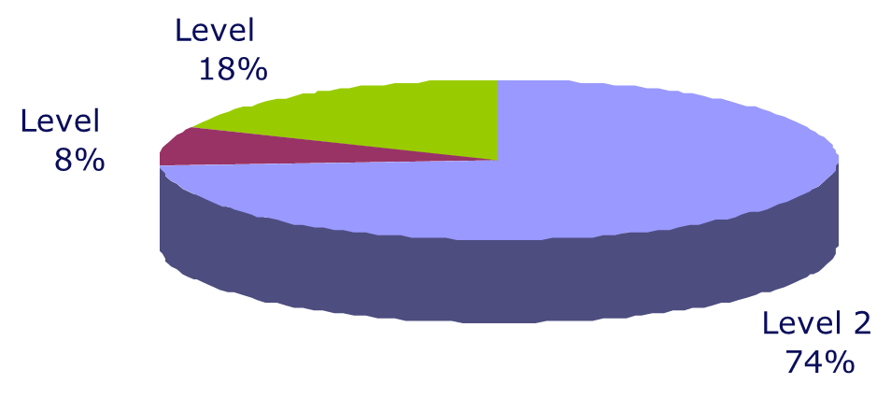
The IRALE Program

Slide 9

The IRALE Program
Level 1 (PL1)
This linguistic level guarantees the use of Basque as a tool for communication and interrelation within the school community.
Teachers with PL1 don’t teach in Basque.
It corresponds roughly to B1/B2 in the European Common Framework for Languages
Level 2 (PL2)
It guarantees the use of Basque as a means of instruction.
Teachers have to prove they have this level in order to be able to teach different subjects in Basque .
It corresponds to the C1 in the European Common Framework for Languages.

Slide 10
The IRALE Program
The Program provides:
Courses according to linguistic level: PL 1, PL2, update courses.
Courses are held in school working hours, so while teachers are learning Basque, schools are provided with substitute teachers.
Teachers are fully paid while in the IRALE program.
Teachers in the IRALE program training in the BAC, 1981-2007
SCHOOL YEAR | TEACHERS IN IRALE
1981/82-1990/91 | 5,093
1990/91-2000/01 | 13,575
2001/02-2006/07 | 4,071
TOTAL | 22,739

Slide 11
Where are we heading now? An only trilingual linguistic model?
The Educational Trilingual Framework experimentation 2010-2013
115 schools took part in this experimentation that was evaluated by the ISEI_IVEI , Cambridge English Language Assessment and ACER (Australian Council for Educational Research) .
http://www.isei-ivei.net/cast/indexcas.htm

