Slide 1
Learning environments
23 ottobre 2018
Secundary school
San Martino di Lupari
Enrica Zanon

Slide 2
Competences: the European context
2000 Lisbon strategy
2002 CoE Barcellona «by 2010…»
2006 8 Basic competences defined by CoE
2018 New definition of basic competences by CoE

Slide 4
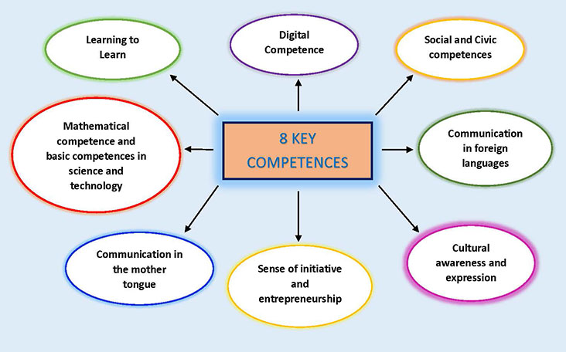

Slide 5
In Italy compulsory education lasts ten years:
Compulsory education
First cycle
6-10 Primary School
11-14 Secondary School (1^ level)*
15-16 Secondary School (2^ level)
*State Exam at the end

Slide 6
Several passages of the Italian educational system law represent essential indications for methodology and didactic actions as well as for evaluation researches:
National Indicators for the curriculum
(Indicazioni nazionali)
✓ Dlgs 59/2004;
✓ D.M. 139 2007
✓ D.M. 594 2012
✓ D.M. 742/2017 (certification model)

Slide 7
At the centre of didactic, formative and pedagogical actions there is a new definition of Competence: the European Parliament’s Recommendation of 18th December 2006 (revised by a new Recommendation on 22nd May 2018), with its eight key competences regarding lifelong learning, has redefined structures and indicators for
educational planning,
methodological and evaluative research
didactic mediation of competences and their certification.

Slide 8
COMPETENCE
Not only theory
Not only know how
Applying knowledge and skills to solve a real problem

Slide 9

We have to change our teaching aiming at a Certification of Competences and constructive evaluation.
We cannot teach if our students are demotivated.

Slide 10
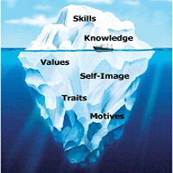
The building of a competence regards
not only knowledge and skills, because
a competence is like an iceberg where knowledge and skills are visible, but many other things are hidden under the surface, such as motivation, processes and so on.
If we manage to teach by competences, we can make learning more significant for our student!

Slide 11

Teaching by competences means to set a problem and use all possible strategies to reach a positive resolution.
Competences must be understood as stable personal attitudes used to decode the components of reality.

Slide 12

In the process of learning students play a central role while the designer/teacher takes on a marginal role, facilitating the completion of the process. The teacher has to produce a teaching programme based on the learner.
It is essential to introduce many practical activities, simulations that stimulate creativity

Slide 13
The learning environment takes on a new meaning.
It becomes a laboratory where students learn how to integrate and interact with others and to promote cognitive processes for problem solving by creativity, discussion and exchange of points of view.

Slide 14

For Vigotskij (Russian School), learning achievements imply a continuous and collaborative interaction with teachers and more experienced classmates.
The class becomes a harmonic context based on mutual confidence and this happens when all the students are involved in an interesting activity that results in outcomes of and for the class.

Slide 15
In the learning environment students live and mature experiences that can progressively develop their skills.
In our school we try to plan our teaching by competences, with problem solving and special learning environments.
Teachers rise to the challenge and students have to find a solution

Slide 16
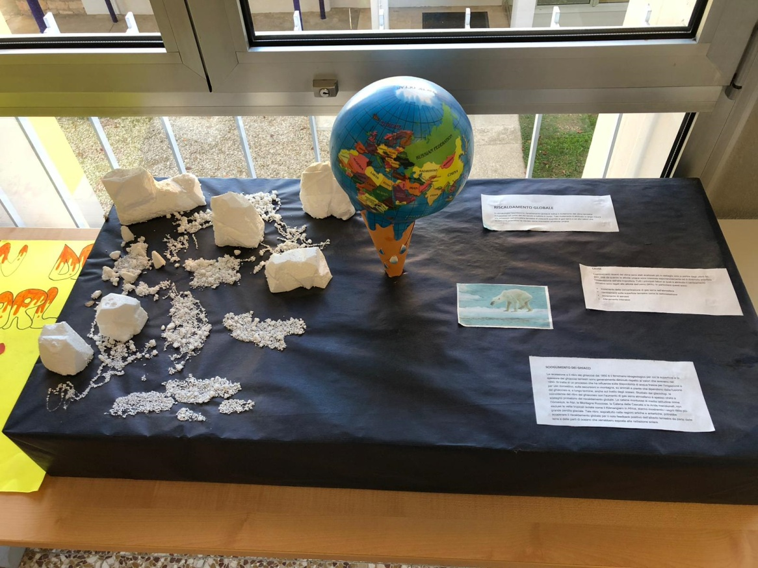
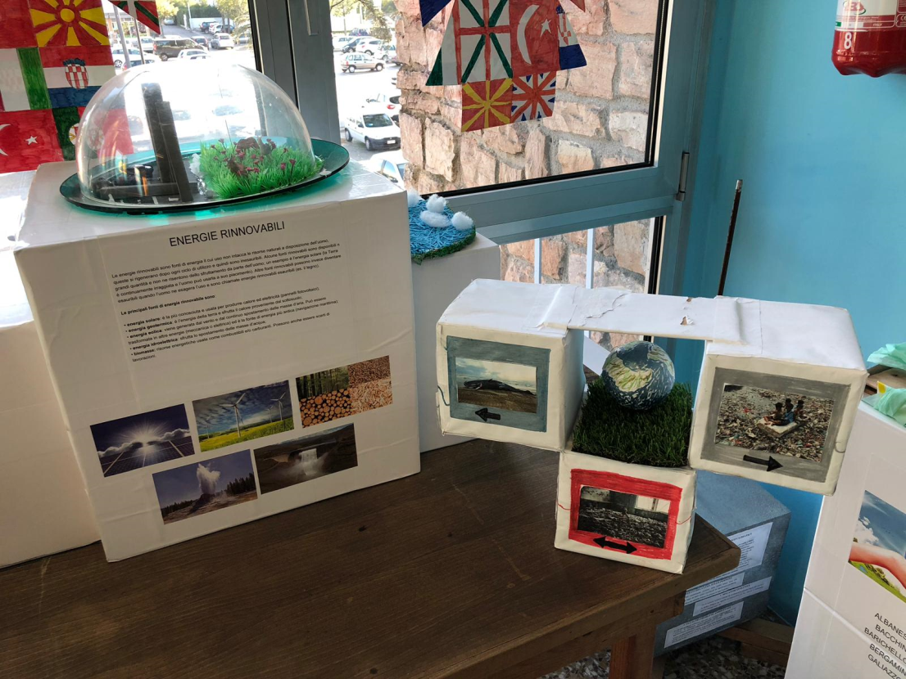
Explain global warming for thematic exhibition

Slide 17

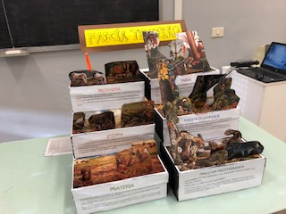
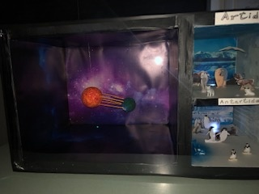
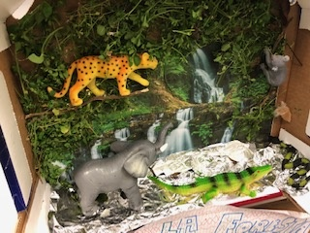
Building natural environments

Slide 18
Assessment of competences by
Competence | advanced | intermediate | basic | initial
Learning to learn | (description) | (description) | (description) | (description)
Sense of initiative entrepreneurship | (description) | (description) | (description) | (description)
Sense of initiative and entrepreneurship refers to an individual's ability to turn ideas into action. It involves creativity, innovation and risk-taking, as well as the ability to plan and manage projects in order to achieve objectives.
Learning to learn engages learners to build on prior learning and life experiences in order to use and apply knowledge and skills in a variety of contexts: at home, at work, in education and training. Motivation and confidence are crucial to an individual's competence.

Slide 19
Speaking corner
A place where students can freely talk, have tea or read English magazines.
When Educhange volunteers arrive in our school, they sit here with students speaking English and having a tea: they can learn about foreign cultures and languages of hosted students.
One of the main task of Educhange students is to showcase his/her country's tradition/culture, national traditions, food, geography, nature, games history, etc.

Slide 20



ROLE PLAYING FOR STUDENTS
Simulating roles that teachers gives them
Behaving as in real life
Taking on a role
Fully understanding what a specific role requires

Slide 21
“Insanity is doing the same thing over and over again and expecting different results.”
(Einstein)

