Slide 1
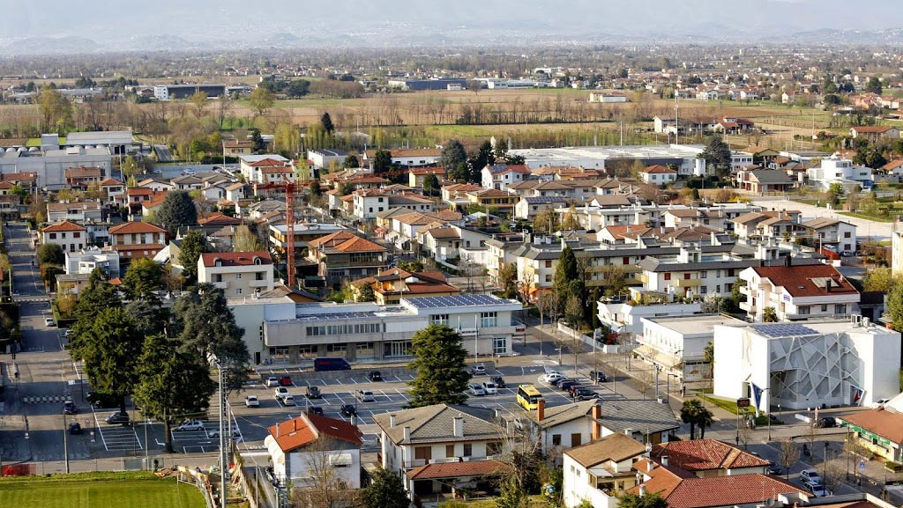
San Martino di Lupari

Slide 2
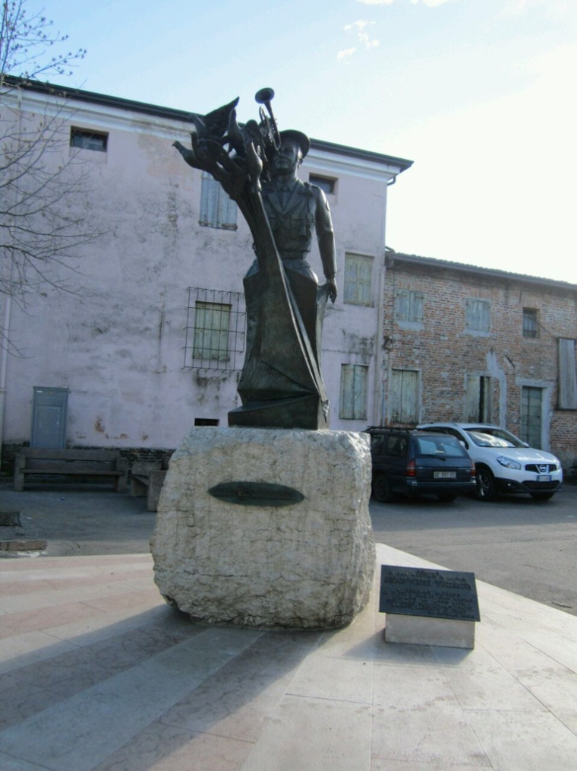
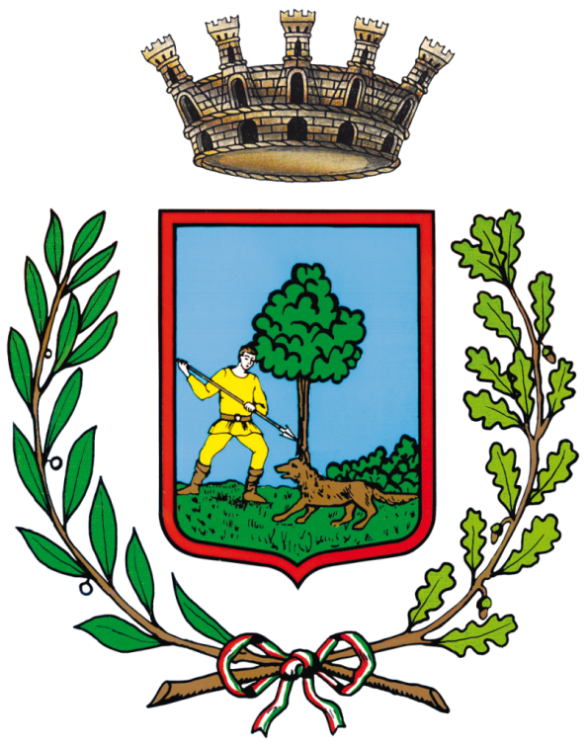
The name of San Martino di Lupari come from San Martino a Luparo referring to the wolves who lived in these areas.
The villages of the town are:
-Borghetto;
-Campagnalta;
-Lovari;
-Monastiero;
-Campretto.
There are 13000 inhabitants.
Its surface is 24.3 km2.
There are many industries in San Martino: Pettenon cosmetics, Liking sweets,Fila,Sidea (a world leader in spices) and there are many fields where corn and soy are grown

Slide 3
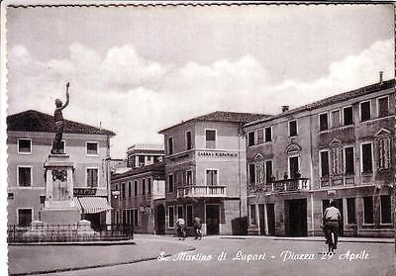
The history of the city
In Borghetto there is a Roman church; in the Middle Ages churches rose on all the villages. The municipality was founded in the Napoleonic times and in the nineteenth century there were industrialized producing fur, furniture, shoes, timber and more .
In 1914 the italian people on exhibition along streets and squares because austrian military troops invaded the town.
In 1915 the italian troops encamped on the streets of the city.

Slide 4
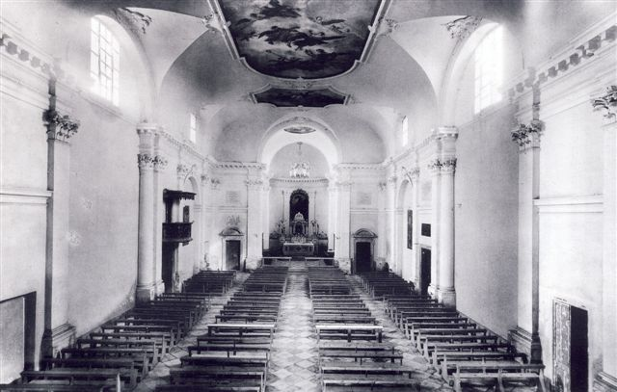
Places of interest
-the Civic Museum of Contemporary Art, - Permanent civic museum of contemporary art “Umbro Apollonio ” exhibition of paintings, unique in Italy - the Vae of Campretto and, - the Motte

Slide 5
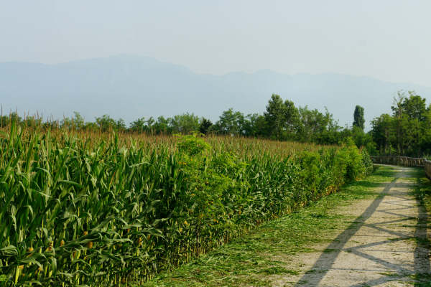
The Motte
An embankment that rises for three to four meters in height from a flat campaign colonized by a small wood, the inside a basin of cultivated fields and an old house. This is what we can observe at the 'Motte'. It is a human settlement with at least thirty centuries of history. The earliest finds date back to the Bronze Age, the final form, of which we now see the trace, is due to a Roman encampment.

Slide 6
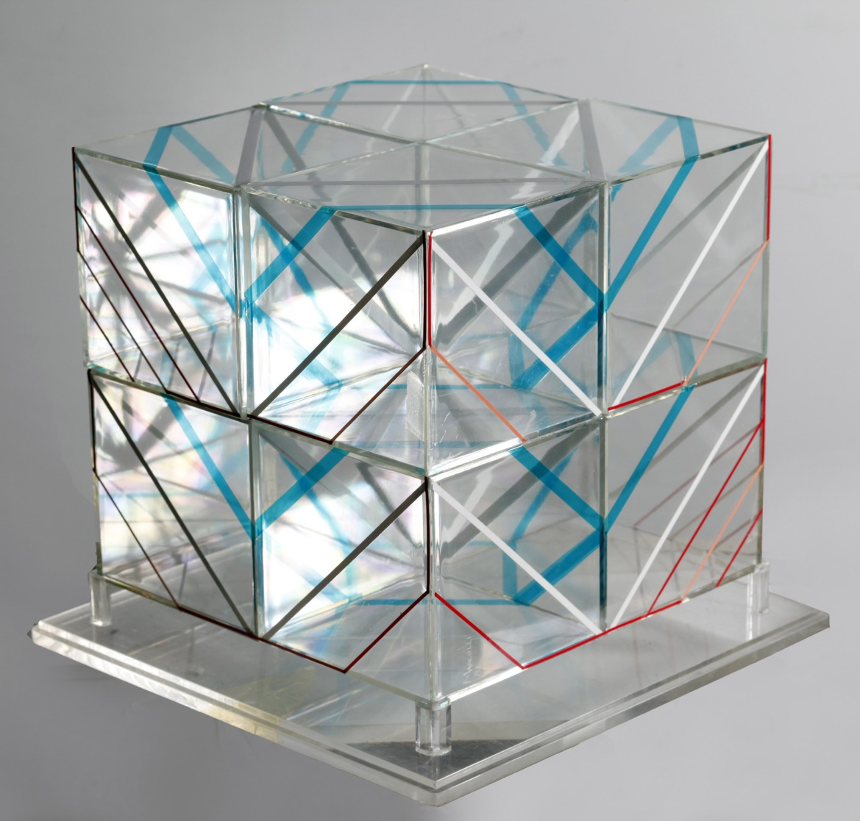
Museum
Opened in 1981 by the will of the municipal administrator who bought the works (paintings and sculptures) of Italian and foreign artists who had established themselves at the Biennial of Contemporary Art organized in San Martino. The collection has 77 Italian, Argentinian, French, Swiss and Spanish artists and is located in the Council Chamber of the Town Hall.

Slide 7
ENJOY YOUR WEEK

