Slide 1
Wine in mythology

Slide 2
Since ancient times, wine has always been a significant part of the diet of many people, especially in the Mediterranean area.
It’s often used in special occasions, since it creates a joyful atmosphere and it’s a good way to relax when you are with friends.
Except from the social function, it also has a very important religious one. Infact, for example, it is one of the most common symbols in the Christian religion, referring to the Last Supper.

Slide 3
GREEK MYTHOLOGY
The most famous character of the Greek mythology when thinking about wine is the demigod Bacco. He was the son of Zeus and of a mortal woman. It is told that Hera, Zeus’ wife, was so jealous that she gave him madness. The legend says that one day, to scare some enemies, he turned the mainmast of a ship into a vine and made himself become a lion.
His symbols are, infact, the lion and the vine.
Bacco is an emblem of energy, power of nature, drunkenness and frenzy.

Slide 4
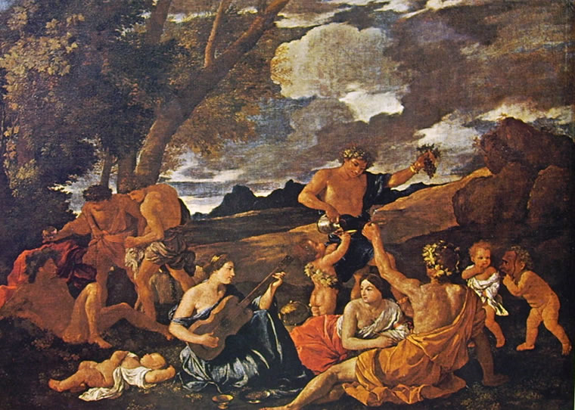
The bacchanals
The Bacchanals are some festivities and rituals made to honour Bacco: during them there are music, dances, delicious food and plenty of wine. Usually, with the God, there are also many young women, called «menadi», and satyrs (creatures half man, half goat). Since they are all drunk, the main characteristics of the bacchanals are chaos and euphoria.
As we can see Bacchus is often represented in relaxed positions, with a glass of wine in one hand and some fruits in the other (mostly grapes) and a crown of leaves on his head.

Slide 5
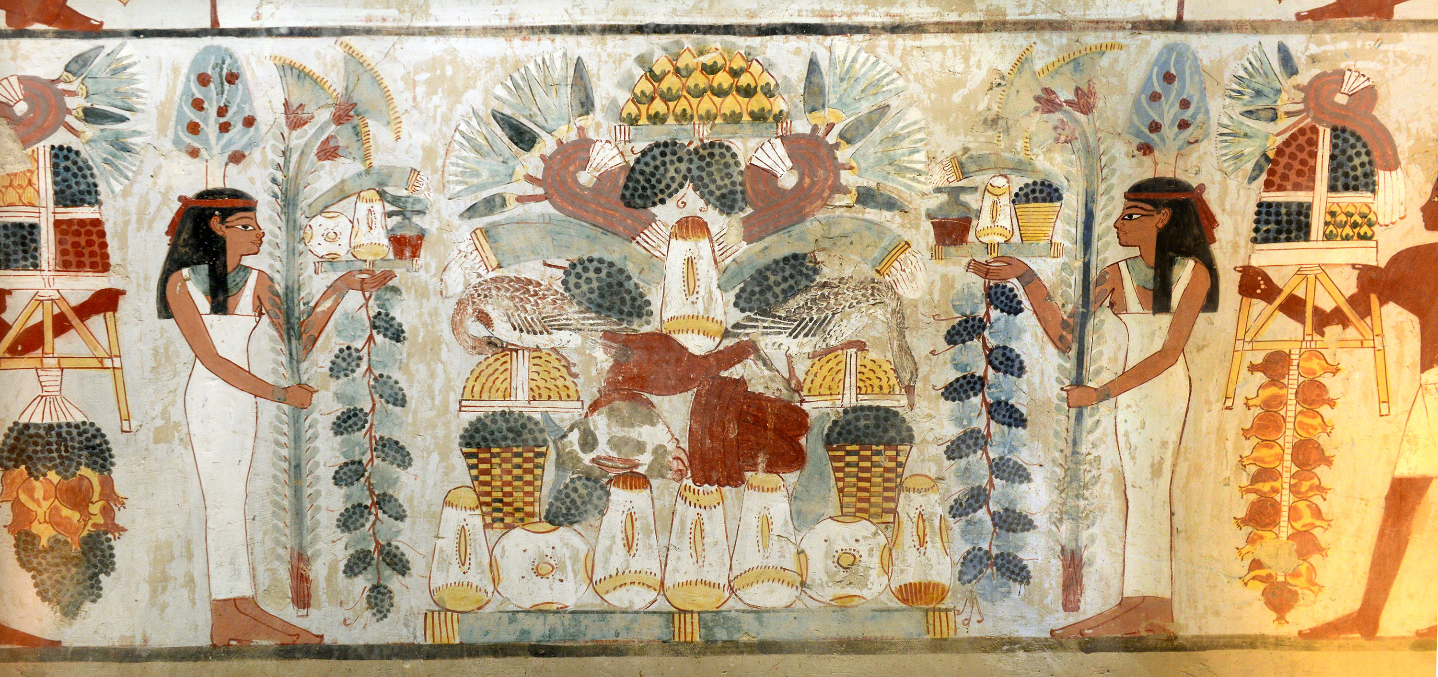
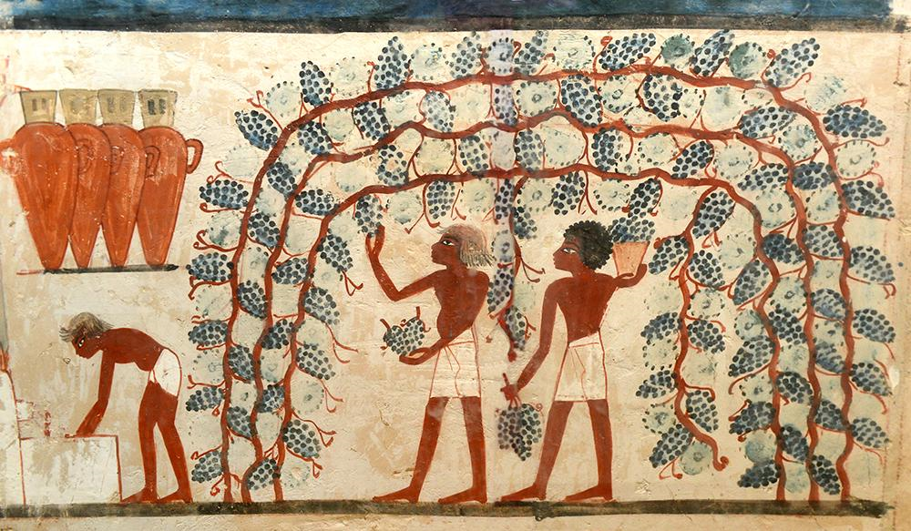
Egyptian mythology
As we said before, wine has an important social and religious meaning and it was like that even in Ancient Egypt.
One of the oldest myths of the Egyptian culture is, in fact, the one that tells about Osiride, a God, who, for the first time, discovered a vine and used it to make wine and then taught everything he knew to humans.
Plutarco, a philosopher from ancient Greece, wrote that the Egyptian used to believe that the first vine was born by the blood of those men who dared to challenge the Gods. So, people who drink wine, are actually drinking the blood of rebellious ancestors and this is why they risk to become mad.

