Slide 1
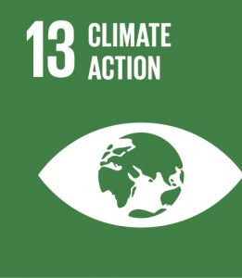
EXPLANATION: Taking urgent action to tackle change and its impact

Slide 2
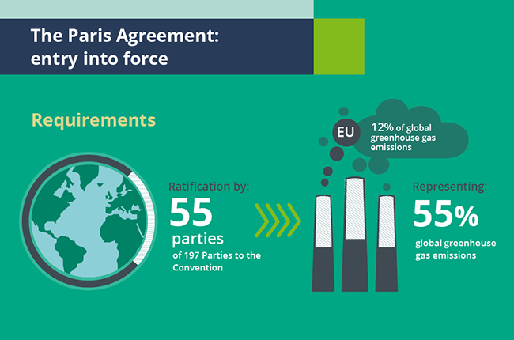
WHAT SHOULD BE DONE INTERNATIONALLY?
Much is happening around the world – investments in renewable energy have soared. But so much more needs to be done.
The world must transform its energy, industry, transport, food, agriculture and forestry systems to ensure that we can limit global temperature rise to well below 2°C, maybe even 1.5°C.
In December 2015, the world took a significant first step by adopting the Paris Agreement, in which all countries committed to take action to address climate change.
Many businesses and investors are also committing themselves to lower their emissions towards Green Econmy.

Slide 3
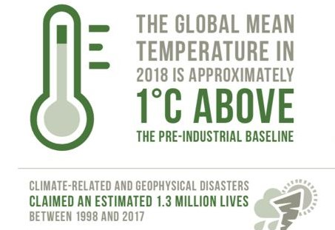
WHY IS IT IMPORTANT?
As greenhouse gas levels continue to increase, climate change is occuring at much higher rates than anticipated and its effects are evident worldwide. Weather patterns are changing, sea levels are increasing and weather events are becoming more extreme.
It is disrupting national economies and affecting lives, costing people, communities and countries today and even more tomorrow. Without action the world's average surface is likely to surpass 3 degrees centigrade this century, which will adversely affect every ecosystem.
In 2018 global temperatures already set at new record of around 1.1°C above the pre-industrial period.
The extent of global sea ice fell to 4.14 million square kilometers in 2016 and CO2 levels reached 400 parts per million.

Slide 4
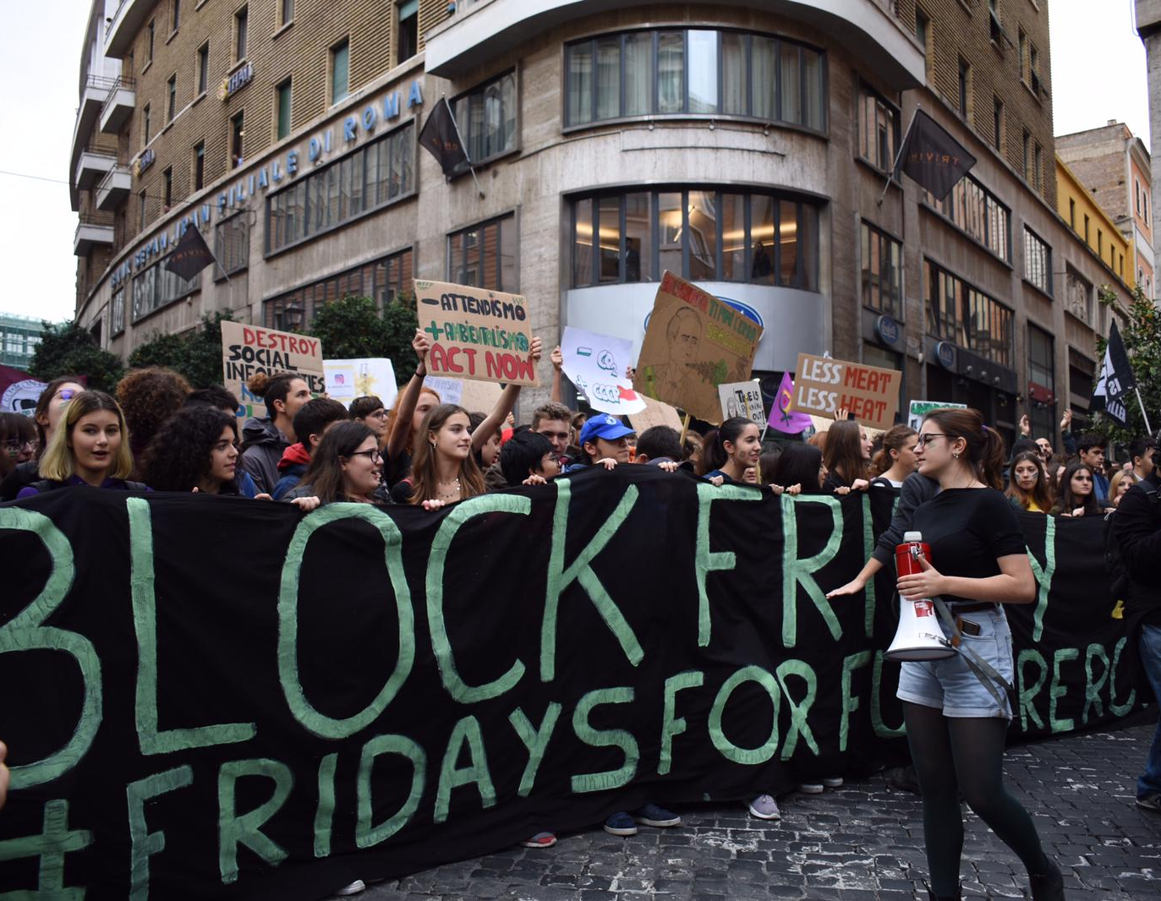
WHAT CAN WE DO IN OUR EVERYDAY LIFE?
Change must start within us so here there are some daily actions we must adopt in order to live a more sustainable lifestyle: -Drive less. Walk, cycle, take public transport or car pool; -Take re-useable bags to the store; -Air dry. Let your hair and clothes dry naturally; -Maintain your car. A well-maintained car emits fewer toxic fumes; -Avoid driving in peak-hour traffic; -Organize to plant new trees every year. Trees give oxygen and take in carbon dioxide; -Unplug TVs, computers and other electronics when not in use; -Spread awareness about ways to stop global warming; -Compost food scraps; -Only buy what you need. 20-50% of the food we buy ends up in landfill.

