Slide 1
VANDALISM
any activity that is considered to be damaging or destroying something that was in good conditions and useful

Slide 2
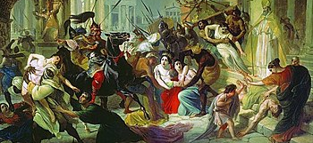
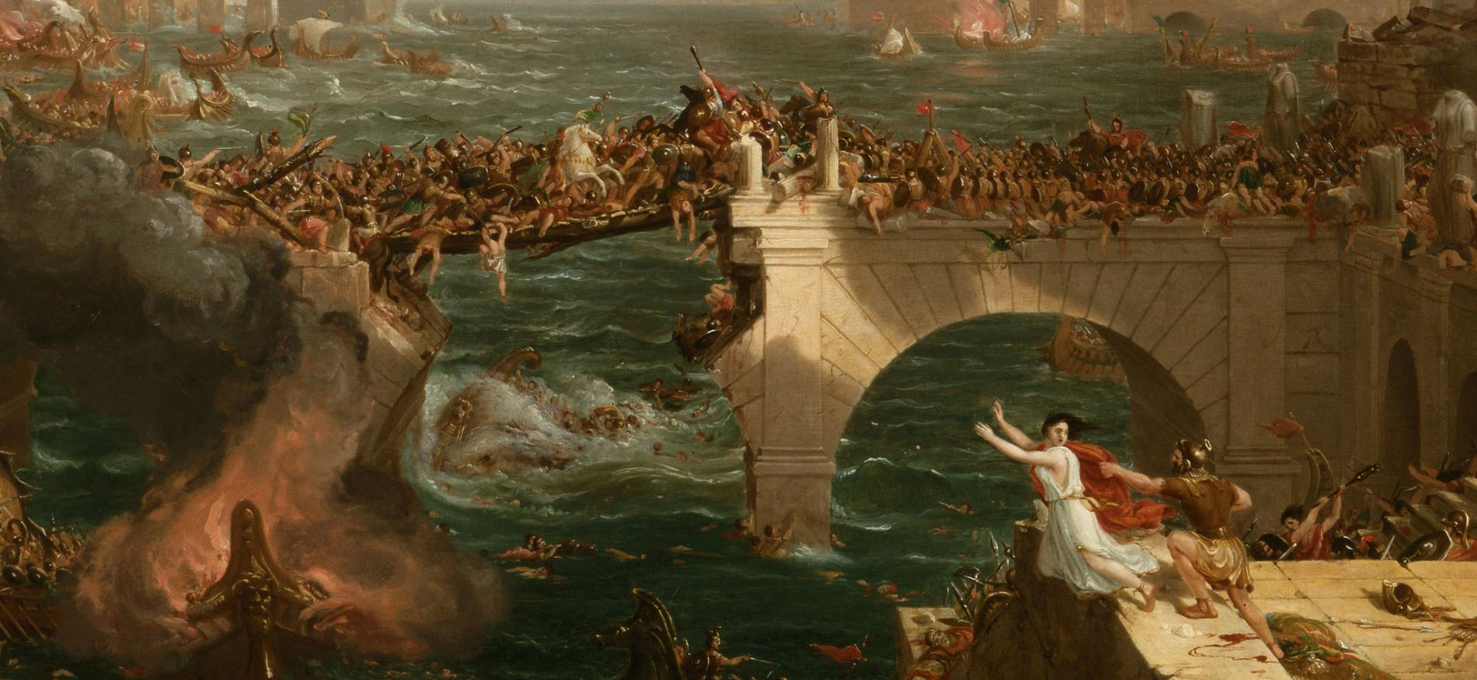
History of vandalism
Vandals, the members of a Germanic people who maintained a kingdom in North Africa from 429 to 534 CE and who sacked Rome in 455. Their name has remained a synonym for willful desecration or destruction.

Slide 3
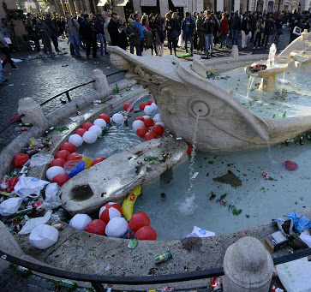
Some famous episodes of Vandalism in Rome: the Barcaccia Fountain
Hundreds of Dutch soccer fans that were in Rome for a Europa League match wreaked havoc on Rome, damaging a 17th-century fountain designed by Pietro and Gian Lorenzo Bernini and leaving the city’s historic center strewn with beer bottles and trash.
There, hundreds of Dutch fans threw bottles and smoke bombs at the police, who retaliated with tear gas and truncheons.
The Dutch government offered to pay for the damages and restauration

Slide 4
A horrible attack to one of the most famous statues in the world: La Pietà
In 1972 a deranged Hungarian named Laszlo Toth jumped an altar railing in St. Peter’s Basilica and inflicted 12 hammer blows to Michelangelo’s Pietà, severely damaging the Renaissance masterpiece.
Toth, who alternately said he was Jesus Christ or Michelangelo, broke her nose in three parts and left about 100 other fragments, including chips from the back of her head, lying on the floor of the chapel where it was on display.

Slide 5
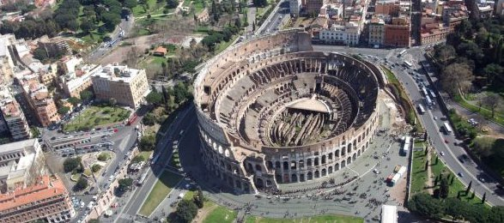
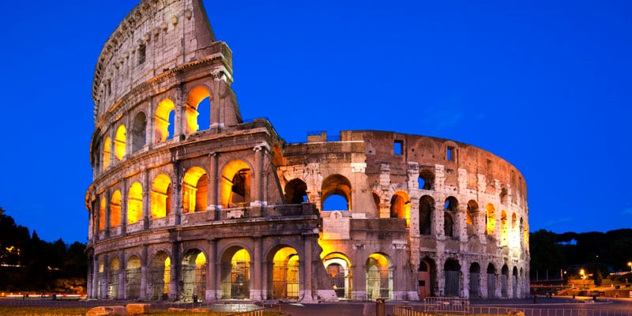
Graffiti and vandalism thoughout centuries of history: The Colosseum
The Anfiteatro Flavio, or Colosseum, is a magnificent architectural work built in Roman times to reproduce famous battles and to host gladiator duels.
As an emblem of the city of Rome it's subject to more and more acts of vandalism, due both to the 7.5 million tourists who visit the monument each year, and to the city's residents.
Cameras have been installed and guards carefully control the precinct

Slide 6
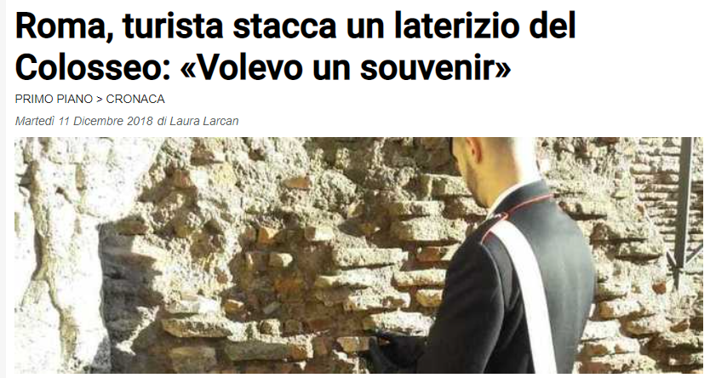
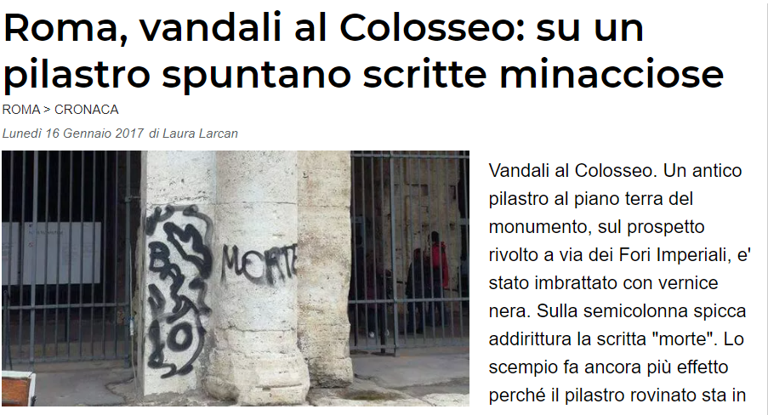
Othe vandalism episodes in Rome:
In 2017 a 17 year old tourist was surprised by the police while he was removing a piece of brick from the external colonnade of the monument, and then putting it in his backpack as a souvenir.
On the same year two writings with black paint were found on a column of the amphitheater. The two main suspects of the incident were two drunk boys, filmed the night before while climbing over the Coliseum security fence.

Slide 7
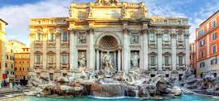
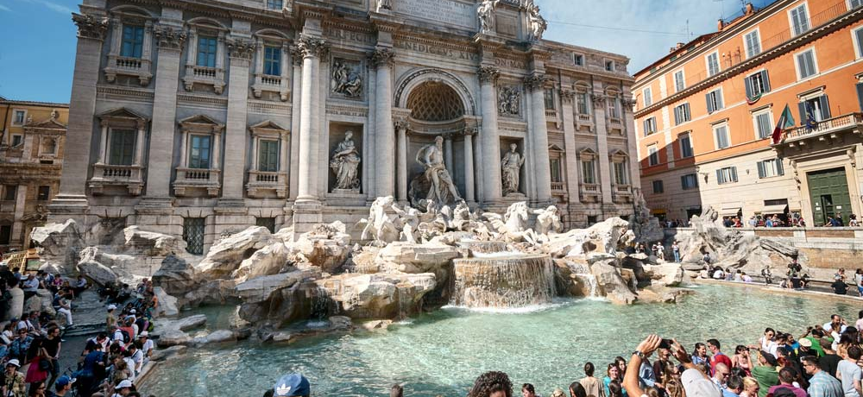
The Trevi Fountain
The Trevi Fountain, is the largest and one of the most famous fountains in Rome. It was built by Nicola Salvi on the facade of Palazzo Poli.
The large amount of tourists visiting the site every day causes great danger to this magnificent, yet fragile structure.

Slide 8
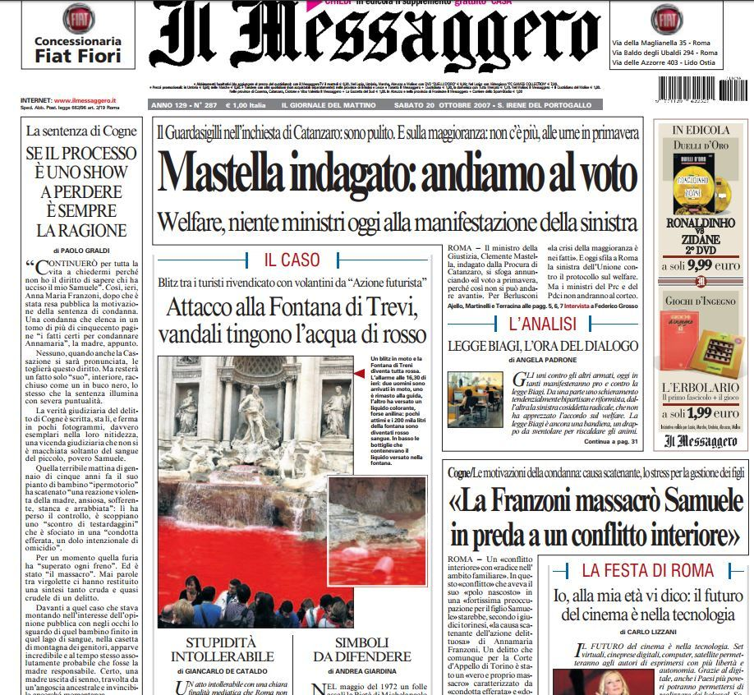
Other vandalism episodes in Rome
The Trevi Fountain has been hit several times by vandalism. The author of these acts is only one man, Graziano Cecchini. In 2007 and then 10 years later in 2017,
Cecchini sneaked into the perimeter of the fountain and then poured a jar of coloring liquid. The result was a fountain that appeared to be filled with blood. The reason for this act was to protest against the conditions of Rome, a city he defined "in decline".

Slide 9
The UNESCO convention
Adopted in 1970, the convention is a prominent legal instrument in the fight against looting and illicit trafficking. By laying down the principles of shared responsibility and cultural equity, it has also opened the way to the right of peoples to enjoy their own cultural heritage.
UNESCO fights to preserve cultural Heritage, monuments and areas of interest in areas of conflicts: these places are often attacked for religious of political vandalism, springing from a disrespect of diversity of culture and ideas and lack of sense of historical background.

Slide 10
Do you want to know more?
Video on vandalism and graffiti: what’s the difference?
https://www.youtube.com/watch?v=4GNoUYZhrT0
ISIS destroying cultural heritage from the past
https://www.youtube.com/watch?v=9qtICrgZM7o
Palmira, Mosud, Hatra

Slide 11
Thank you for watching!
Before leaving, please, complete these Google Form, your opinions will be highly appreciated!
https://forms.gle/888YRGm4JfcTRqaS8

