Slide 1
History of Poland the Middle Ages
Copernicus Upper-Secondary School
in Tarnobrzeg, Poland

Slide 2
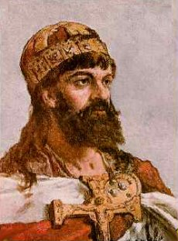
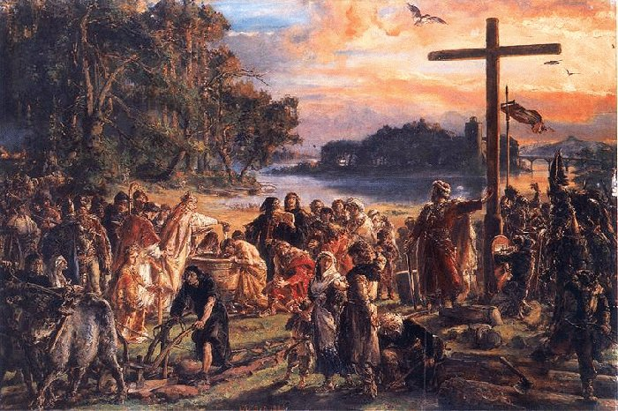
The written history of Poland began in the 10th century. At that time Poland was ruled by a dynasty called the Piasts. A Piast named Mieszko I reigned from about 960 to 999. In 966 he became a Christian and his people followed.

Slide 3
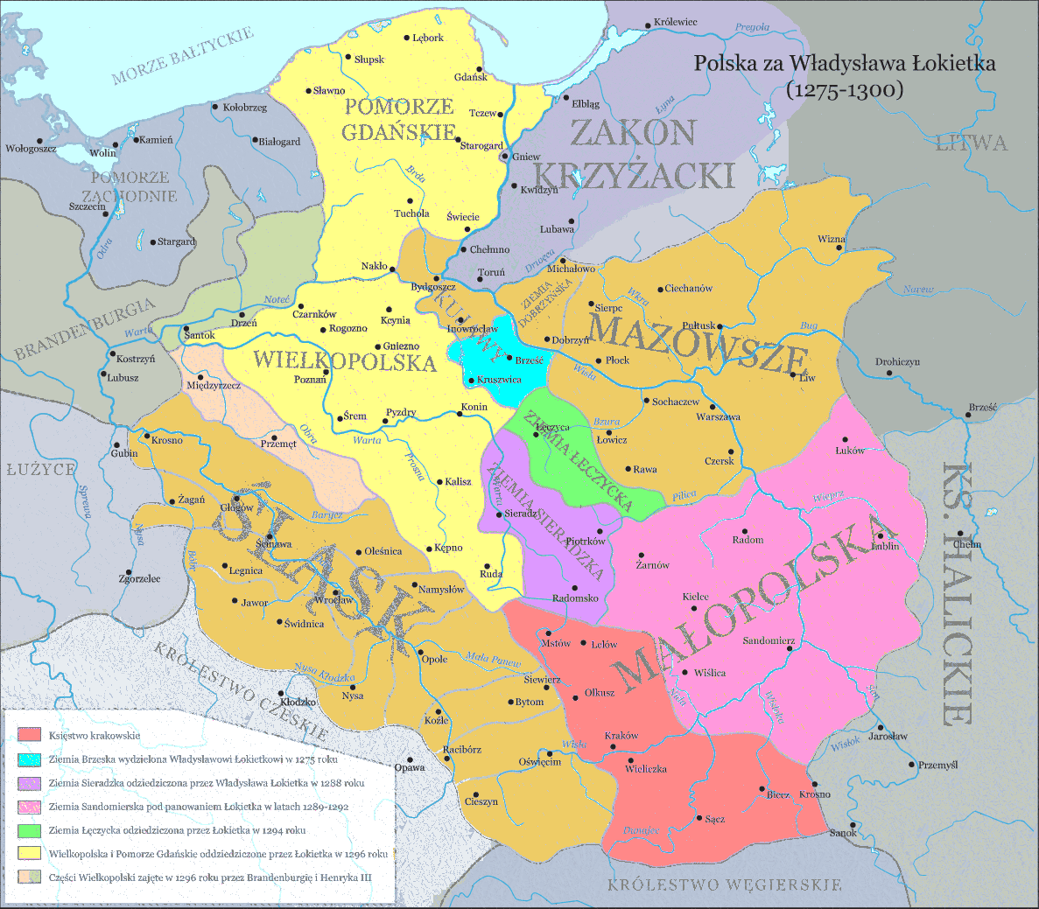
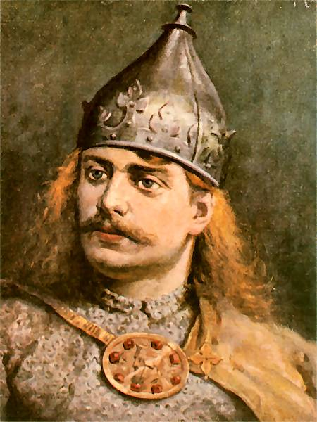
However a king named Boleslaw the Wrymouth (1102-1138) decided that after his death the kingdom should be divided between his sons. (Although the eldest son was to have overall control). This decision weakened Poland.

Slide 4
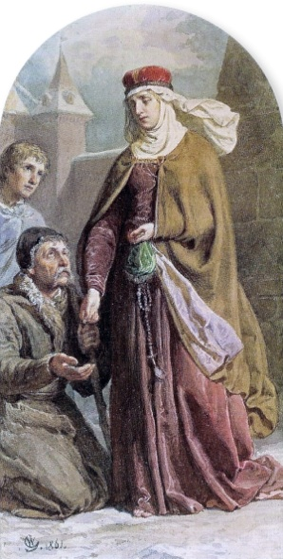
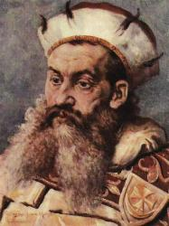
Nevertheless in the 12th and 13th centuries Poland prospered and town life flourished. A king named Henry the Bearded reigned from 1201 to 1238. His wife Jadwiga encouraged German merchants and craftsmen to come and live in Poland. They founded towns with German laws. Some Germans also came to farm uncultivated land in Poland.

Slide 5
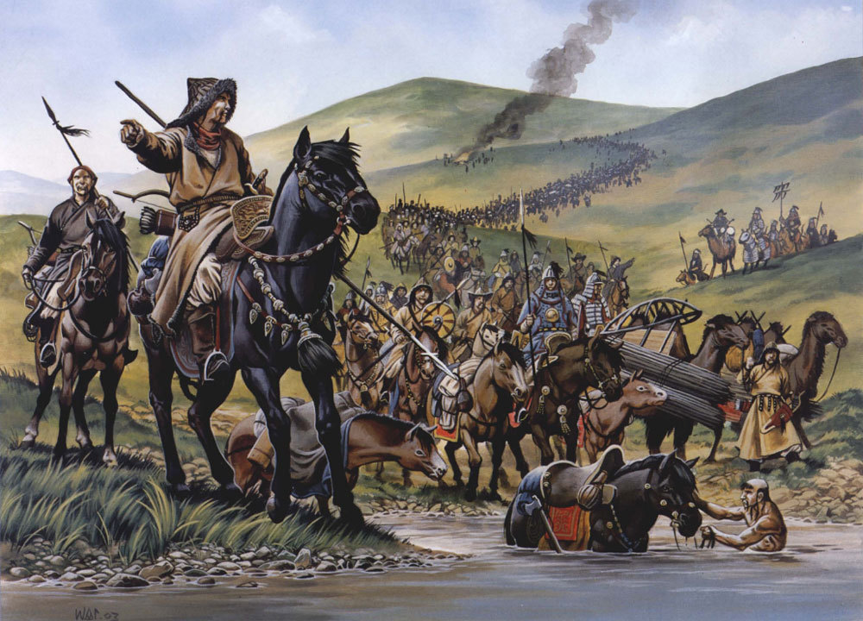
However in 1241-42 the Mongols invaded Poland. The Poles were defeated at the battle of Legnica in April 1241 but the Mongols soon withdrew.

Slide 6
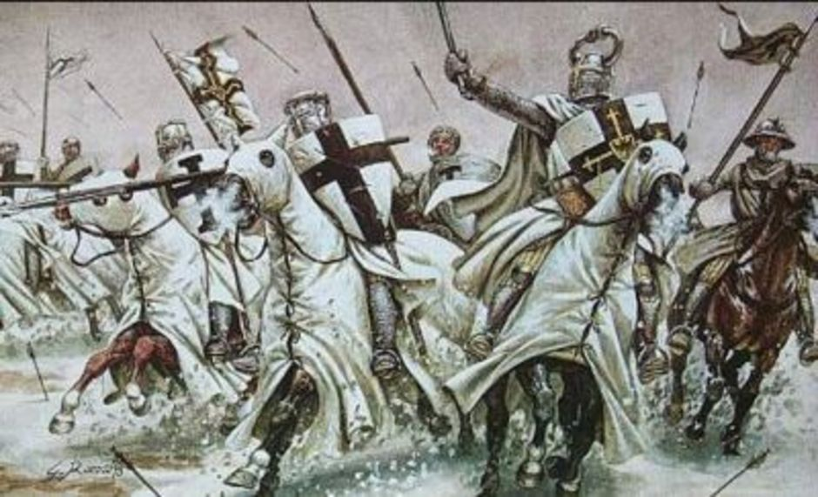
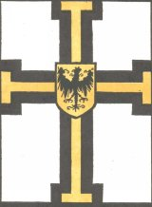
Another threat to Poland came from the Teutonic Knights. They were an order of fighting monks. They set out to conquer the Pagan peoples of eastern Europe and convert them by force. In 1235 they began conquering the pagan Prussians (who lived northeast of Poland). By 1283 Teutonic the Knights had conquered the Prussians. However in 1308 they turned on Poland.

Slide 7
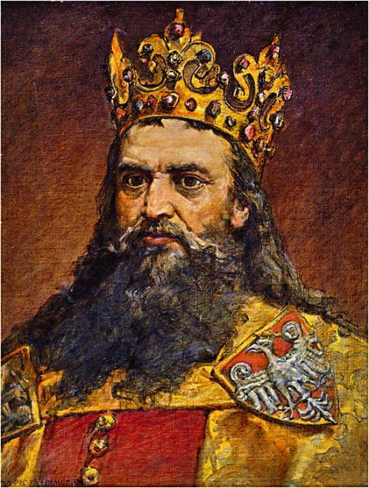
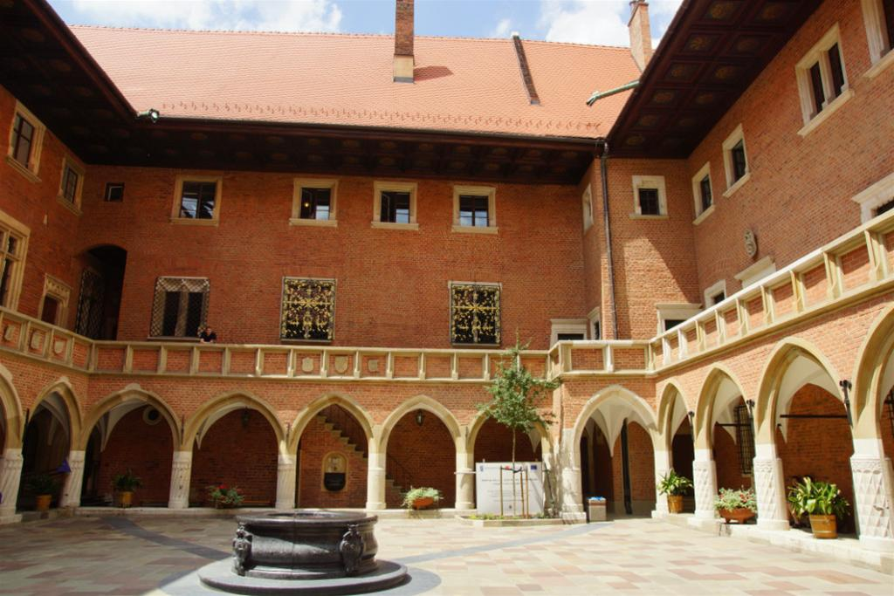
Yet in the early 14th century Poland became a strong and unified state. Kazimierz III, known as Kazimierz the Great (1333-1370) expanded east into Russia. He also reformed the law and administration. Furthermore during his reign the first university in Poland, Krakow, was founded.

Slide 8
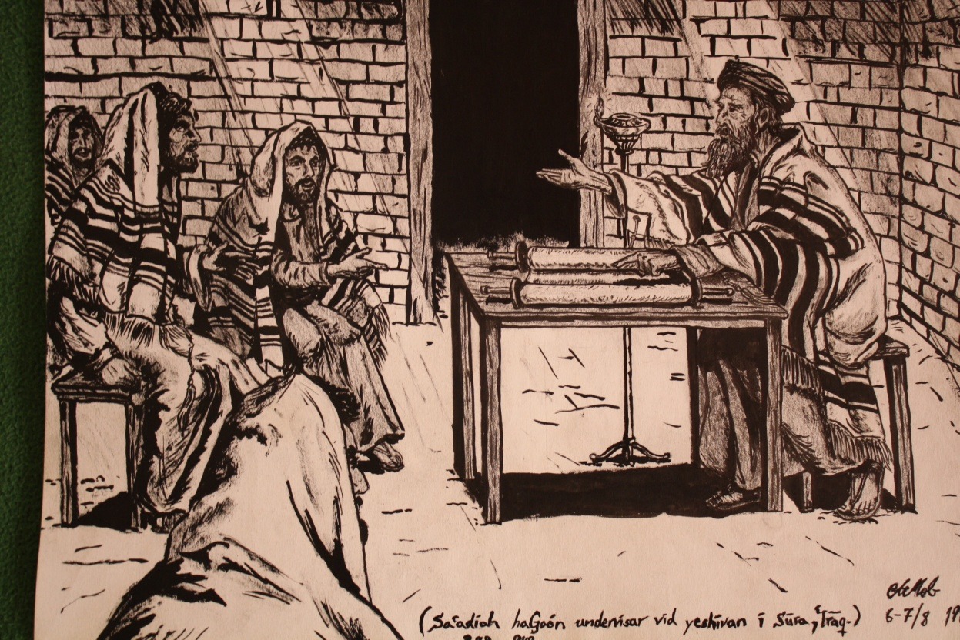
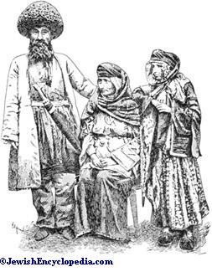
Kazimierz also protected and supported the Jews. It was partly due to him that Poland came to have a large Jewish community.

Slide 9
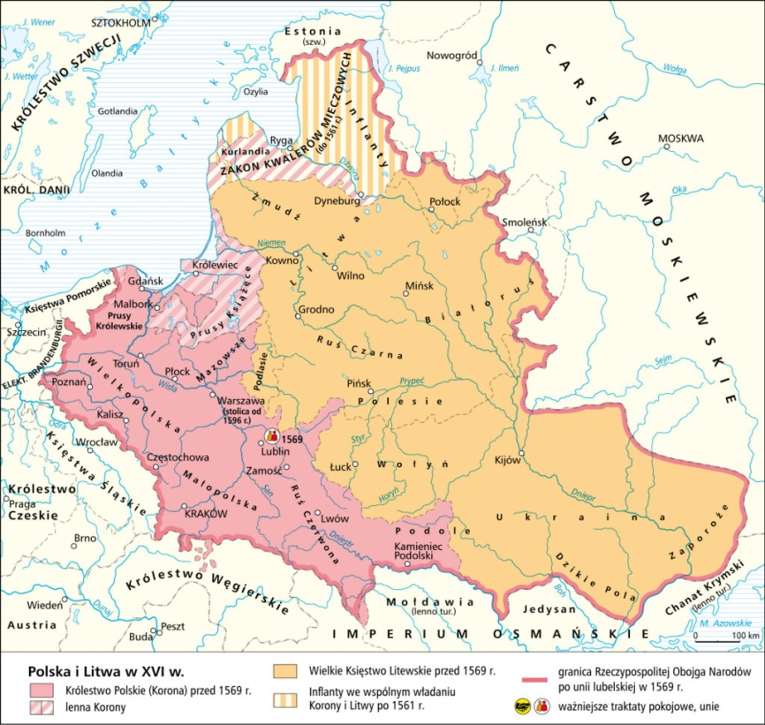
The era from the 14th century to the 16th century was one of greatness for Poland. Nevertheless the power of the king gradually weakened. The Polish nobility became more and more powerful.

Slide 10
Kazimierz was succeeded by his nephew Louis, the king of Hungary. Louis wanted his daughter to succeed as ruler of Poland him but in order to obtain the agreement of the Polish nobles he was forced to grant them concessions. The Privilege of Koszyce (1374) made the nobles exempt from most kinds of tax. It also gave them an important role in government. In future no important decision could be made without their consent.

Slide 11
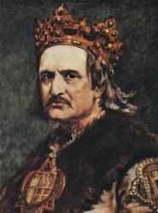
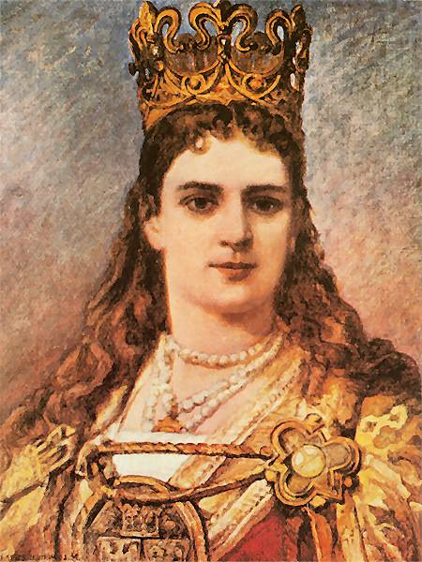
In 1384 the Polish nobles finally accepted Louis' daughter Jadwiga as Queen of Poland. They also arranged for her to marry Jagiello, Grand Duke of Lithuania and the two countries became allies. Jagiello became Wladyslaw II of Poland (1386-1434). Wladyslaw joined the Catholic church and his people followed.

Slide 12
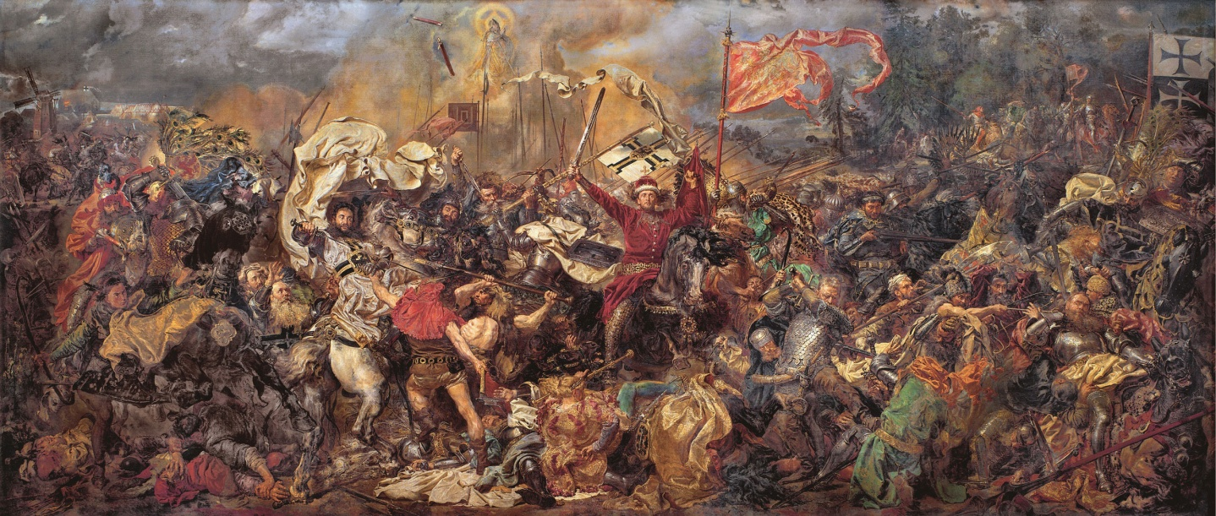
In 1410 Poland and Lithuania defeated the Teutonic Knights at the battle of Grundwald.
Then, in 1453 the people of Pomerania rebelled against the Teutonic Knights and appealed to the Poles for help. After 13 years of fighting the Poles took Pomerania and Gdansk.

Slide 13
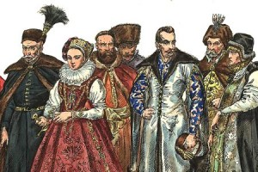
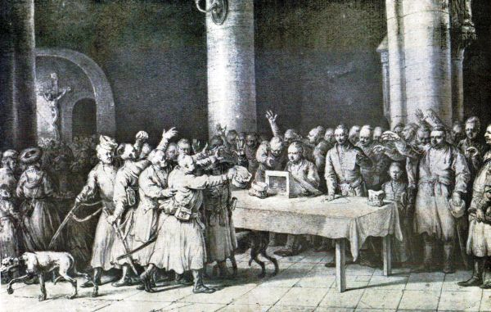
However in the late 15th century the Polish nobles became increasingly powerful and the monarchy grew weaker. In 1505 the king agreed that no political changes would be made without the consent of the nobles.

Slide 14
To be continued …

