Slide 1
Stolpersteine
stumbling blocks - kamień paięci

Slide 2
General
A project for…
…all jews,
…roma and sinti,
…homosexuals,
…dissidents,
…victims of euthanasia
to keep the memory of their deportation and extermination alive.

Slide 3
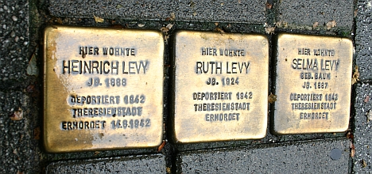
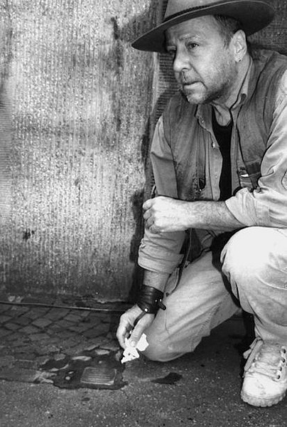
What are “Stolpersteine“?
- Brass plaques that are installed in the pavement in front of National Socialism vistims‘ last residence
- in over 610 places in Germany as well as in Austria, Hungary, the Netherlands, Belgium, the Czech Republic, Norway and Ukraine
- invented and made by Gunter Demnig
- The Talmud says that "a person is only forgotten when his or her name is forgotten“
- Each “stone” begins with HERE LIVED… One “stone”. One name. One person.

Slide 5
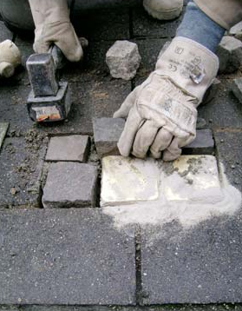
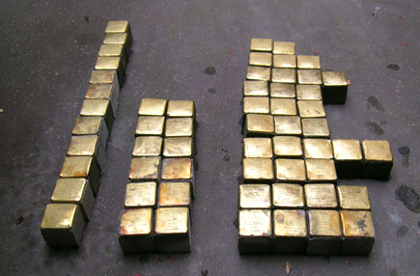
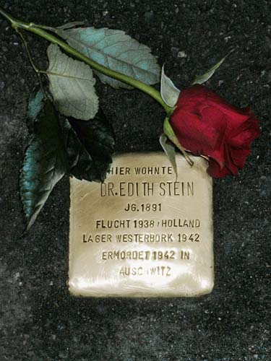
How are „Stolpersteine“ installed?

Slide 6
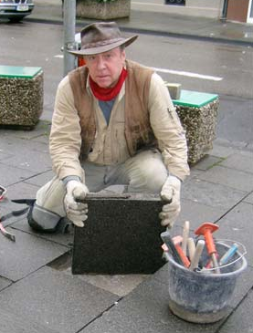
Who installs „Stolpersteine“?
Gunter Demnig

Slide 7
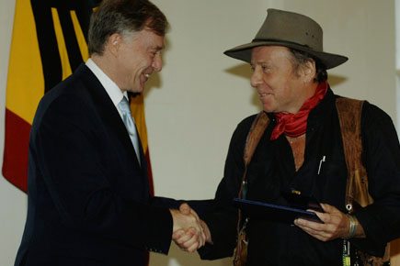
For the „Stolpersteine“- Project Gunter Demnig was honoured with the Order of Merit of the Federal Republic of Germany

Slide 8
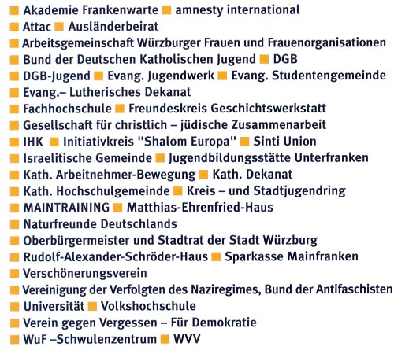
Who supports the „Stolpersteine“-project?

Slide 9
„Stolpersteine“ in Würzburg
Since july 2006 until january 2015 440 „Stolpersteine“ have been installed in Würzburg.
Each stone has his own history.
This project is supported by the local press.
The next „Stolperstein“ will be installed on 20th september 2015
There are many events organized by „Würzburger Stolpersteine“ about different groups of holocaust victims

Slide 10
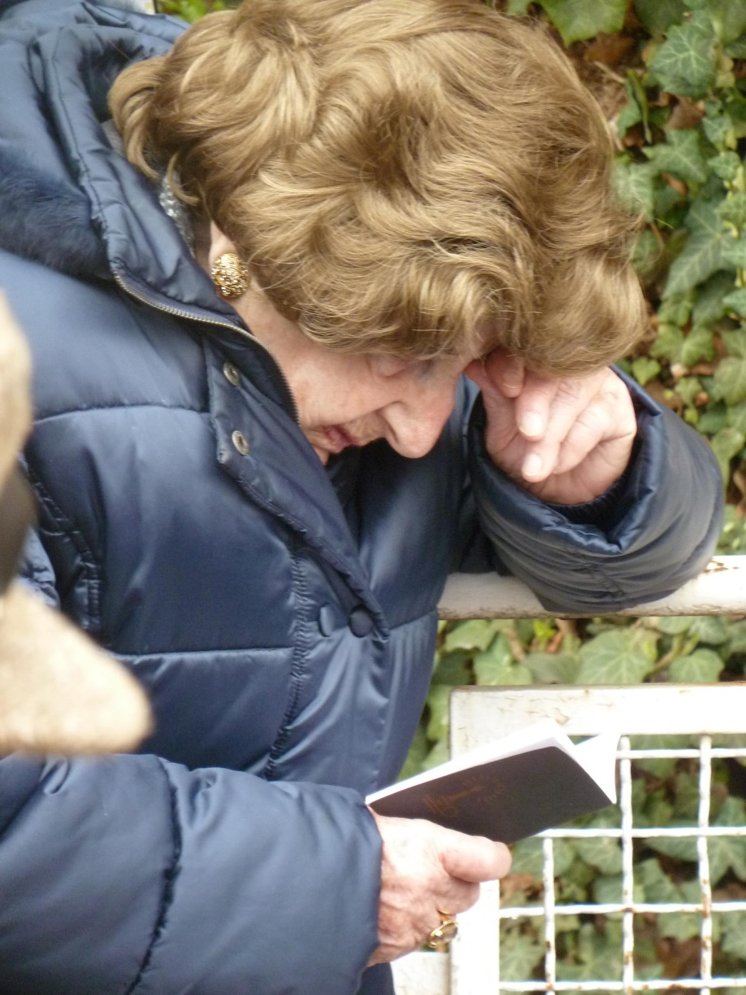
Amalie Waltner mourns her father Moses Stryker at the installing of his own „Stolperstein“

Slide 11
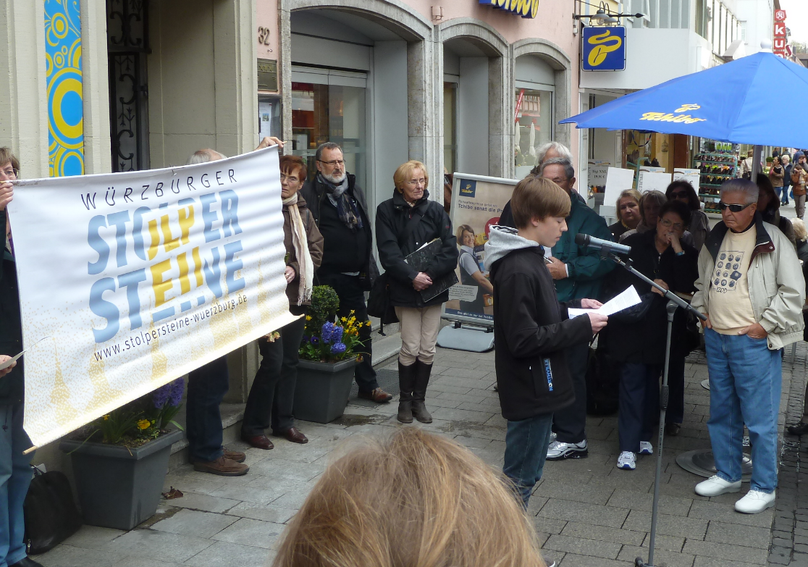
Sponsorships for „Stolpersteine“

Slide 12
Sources
http://www.montabaur.de/montabaur/en/Stolpersteine/stolpersteine-02.jpg
http://www.stolpersteine.eu/en/home/
http://www.stolpersteine-wuerzburg.de/warum_pate_werden.php

