Slide 1
Erasmus+ Villaputzu Cerdeña. Italia.
Diana Cabellos Marigil
IES D. Juan Manuel
Cifuentes (Guadalajara)

Slide 2
EDUCATIONAL SYSTEM in italy
SCUOLA INFANTIL
SCUOLA PRIMARIA (UNTIL 11 YEARS)
SCOULA MEDIA (3 YEARS)
LICEO
SCUOLA SUPERIOR.

Slide 5
ISTITUTO COMPRENSIVO VILLAPUTZU
THE ISTITUTO COMPRENSIVO HAS 6 CENTERS WHERE THERE ARE PUPILS FROM 3 AND 16 YEARS
A HEAD TEACHER OF SCHOOL FOR ALL CENTERS. HE IS NOT A TEACHER.
STAFF USUALLY MEET ONCE A WEEK

Slide 6
pre –primary children ( 3-6) go to school
between 40- 44 hours a week
Primary pupils ( 6- 10) go to school from Monday to Saturday for 28 hours a week
Secondary students ( 10-14) go to school from Monday to Saturday for 30 hours a week

Slide 7
EMPLOYMENT SITUATION
TEACHERS EARN 1200E AND SECONDARY TEACHERS,1300E.
THEY WORKS FIVE DAYS A WEEK, EVEN SATURDAY.
THEY HAVE 24 HOURS A WEEK WITH PUPILS AND 80 HOURS IN ALL YEAR OF PERMANENCE FOR MEETINGS
THERE ARE CAREER OFFICER AND ACTING OFFICIALS

Slide 8
TRADE UNION/STRIKE
WHEN THERE IS A TEACHER STRIKE, THE STUDENTS GO HOME
TEACHERS ALSO HAVE THE RIGHT TO ATTEND TRADE UNION ASSEMBLIES FOR 10 HOURS MAXIMUM EVERY SCHOOL YEAR. WHEN SO, THE STUDENTS GO HOME

Slide 9
METHODS
THE EMPHASIS IS ON THE ORAL LANGUAGE.
IN SOME SCIENCE AND TECHNOLOGY LESSONS, SOME TEACHERS USE INDUCTIVE METHODS AND EXPERIMENTS.
IN ART, STUDENTS ARE REQUIRED TO SEE, FEEL, TOUCH THE OBJECT BEFORE PAINTING IT.
ALL OPINIONS ARE ADMITTED AND DISCUSSED. THE MOST OF STUDENTS PARTICIPATE.
IN MATHS LESSONS, TEACHERS USE INDUCTIVE METHODS TO MAKE THE STUDENTS CALCULATE NUMBERS WITHOUT WRITING ANYTHING.

Slide 10
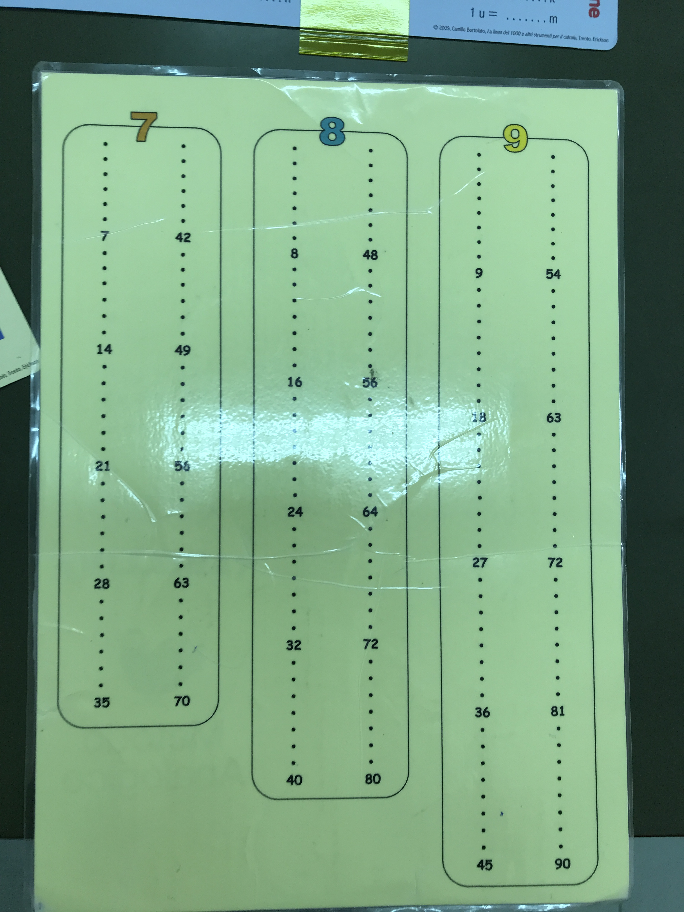
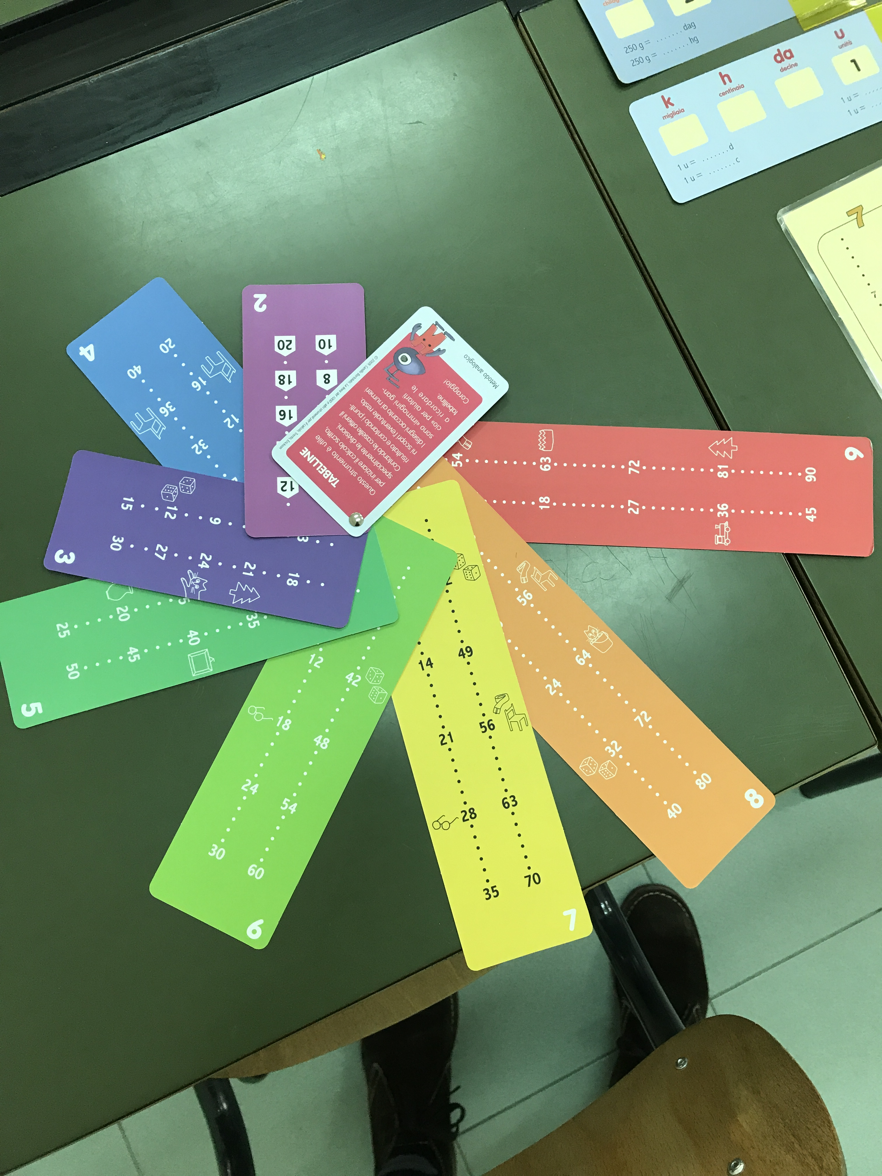
MÉTODO ANALÓGICO. MULTIPLICACIÓN

Slide 11
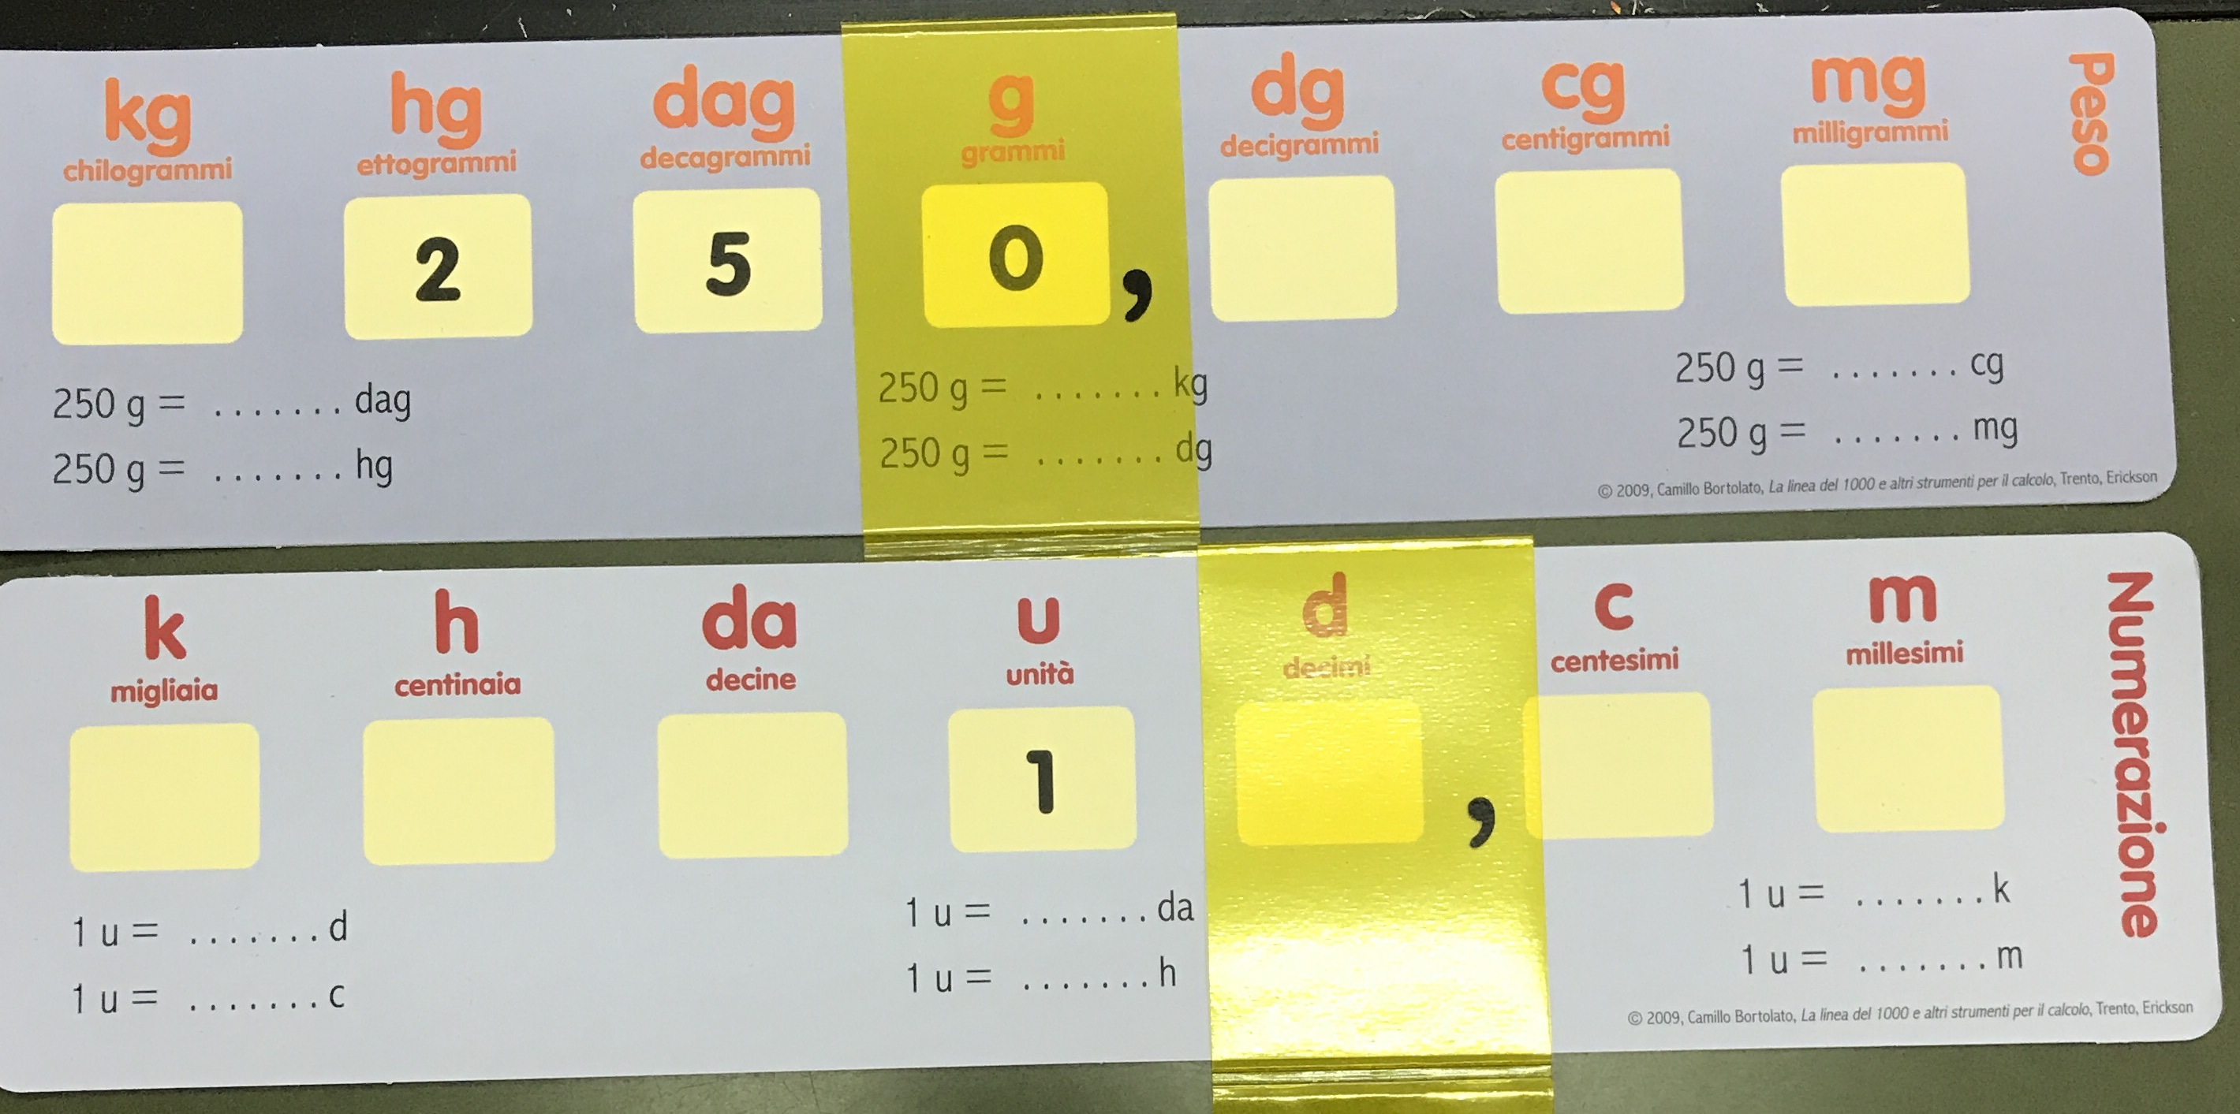
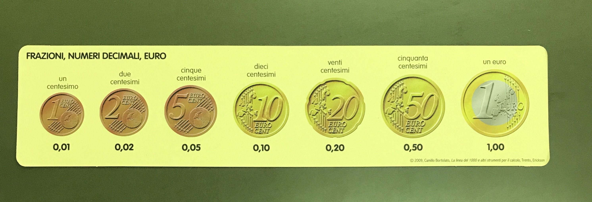
DECIMALES

Slide 12
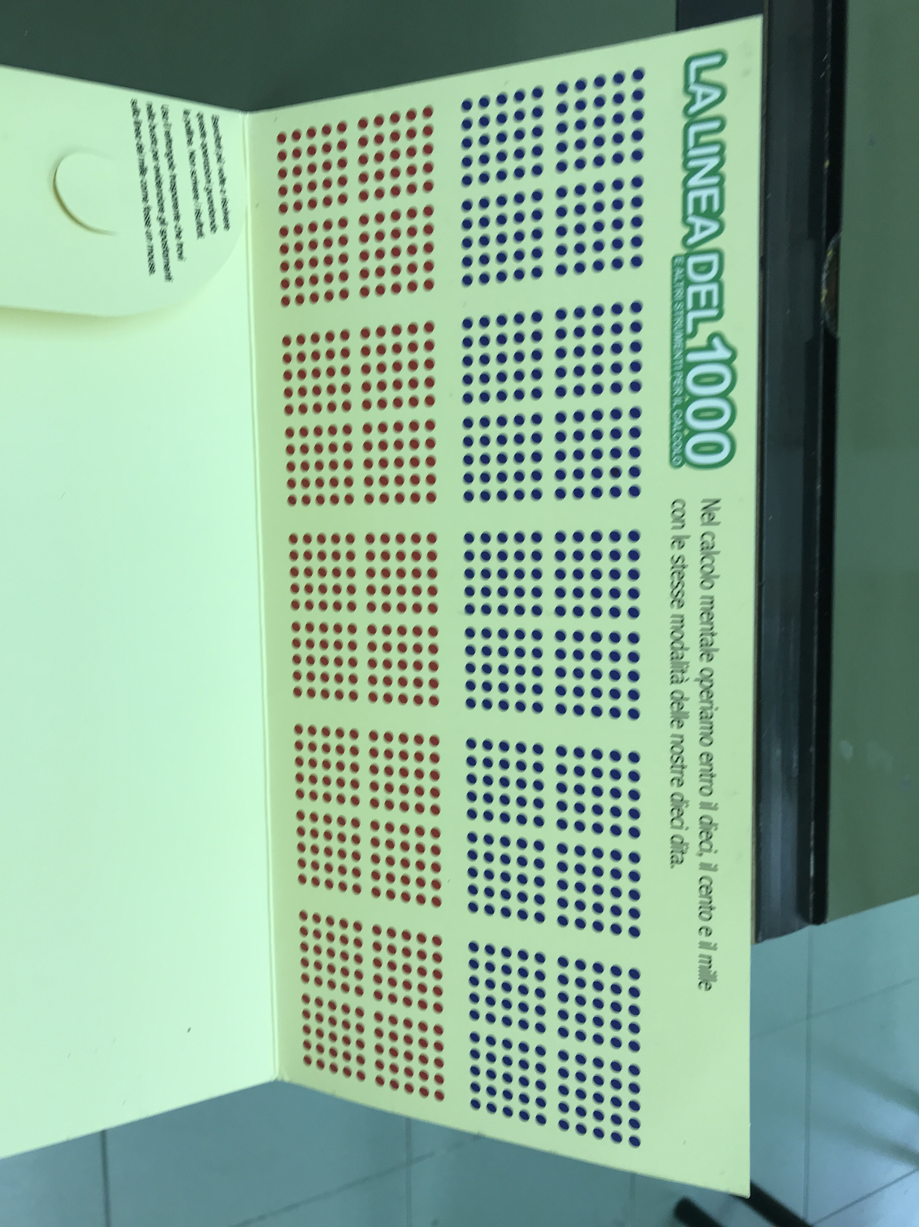
LA CASA DEL 1000

Slide 13
TUTORÍAS
THERE IS NO CLASS OF “TUTORÍA” IN ANY GROUP OF PRIMARIA OR SCUOLA MEDIA.
A TEACHER IS ASSIGNED TO EACH GROUP BUT THERE IS NOT A SPECIFIC PLAN OF TUTORIAL ACTION TO BE CARRIED OUT.

Slide 14
ATTENtION TO DIVERSITY
SINCE 1977 THERE AREN´T ANY SPECIAL NEEDS CENTERS. ALL PUPILS GO TO PRIMARY AND SECONDARY SCHOOL
LOCAL HEALTH UNITS MAKE A DIAGNOSIS AND THEY ELABORATE “Perfil dinámico funcional” THAT IN SCHOOL IS “Programa educativo individualizado”.
PUPILS HAVE INDIVIDUAL ATTENTION WITH SPECIALIZED TEACHERS INSIDE ORDINARY CLASSROOMS
THEY STAY IN SCHOOL UNTIL 18 YEARS.

Slide 15
EVALUAtioN
✔Evaluation session are held every two months
✔Families are informed twice a year
✔There is not extraordinary evaluation
✔students are not promoted with 4 suspended subjects.
✔The Necessary Mark To Pass A Test Is 6.
✔There is external evaluation at the end of Primary and 3 Scuola Media.

