Slide 1
OUR CITY, ORADEA, ROMANIA, ITS HISTORY AND ITS MAIN MONUMENTS
This is Oradea’s Coat of Arms.

Slide 2
Welcome to Romania, my country
City of Oradea
County of Bihor
Oradea is in the North-West of Romania, very close to the Hungarian border

Slide 3
The position of Romania in Europe

Slide 4
Located on the banks of Crisul Repede River, that divides the city into almost equal halves, it is the gateway to Central and Western Europe.
The County of Bihor
Crisul Repede River

Slide 5
Oradea crossed by Crisul Repede River

Slide 6
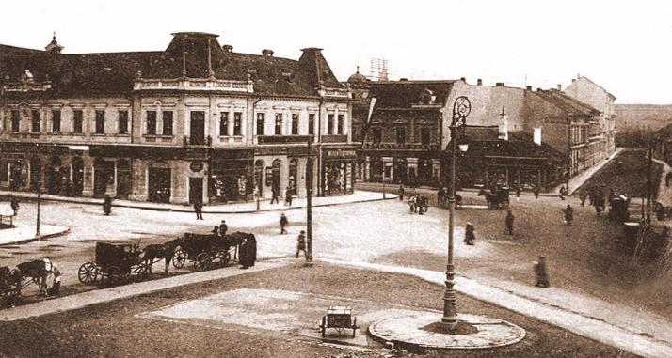
Oradea – multicultural and multiconfessional city
Ever since the Middle Ages, Oradea has been a cosmopolitan city inhabited by Romanians, Hungarians, Italians, Germans, Jews, Gypsies, Slovaks, Greeks, etc., who brought with them some of the cultural baggage of their places of origin.

Slide 7
Oradea dates back to a small 10th-century castle. Now the old fortress, which is absolutely gorgeous, is being restored and has become one of the most important attractions of our city.

Slide 8
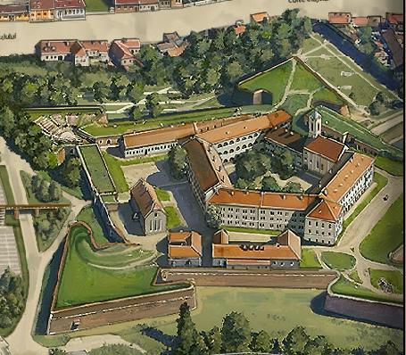
THE CITADEL / THE FORTRESS OF ORADEA
► Oradea’s most imposing sight is the spectacular Oradea Fortress (Cetatea Oradea). The present shape of the five-point-star fortress was given in 1569, when Italian military architect Domenico da Bologna rebuilt it after repeated invader attacks.

Slide 9
► EARLY HISTORY:
In the XIth century, Ladislau I built a fortified monastery.
Between the XIth and XIIIth centuries, the fortress was a castrum.
In the XIVth century, a new medieval fortress was built.
► IT HAD MANY OTHER FUNCTIONS:
a great library, with books from the whole of Italy
a meeting place for the great humanist scholars of the age
an astronomic observatory
a Catholic school, where the great people studied.
residence of the Roman Catholic bishop of Oradea, period when the fortress became an important religious and cultural center.
a printing house
a strictly military fortress (1557-1857) governed by various administrations: Hungarian/Transylvanian (1092-1660), Ottoman (1660-1692), Habsburg (1692- 1918).

Slide 10
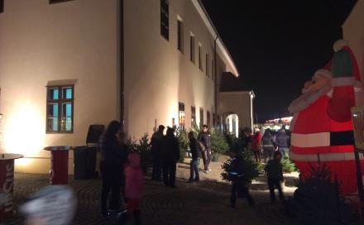
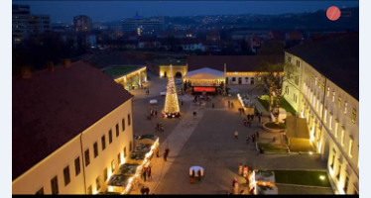
Pictures taken this Christmas
►Today we are witnesses of the restorations of the fortress.
► With a history of almost 1000 years, Oradea Fortress has become a wonderful tourist attraction, not only for the city on the banks of the Crișul Repede River, but also for the western region of Romania, and, in a wider sense, for the central-eastern-European area.
►Throughout the year the citadel is host to several art exhibitions and craft fairs, as well as festivals and concerts.

Slide 11
Oradea has a population of about 200 000 citizens. The people are very friendly. Various ethnic groups like the Hungarians, Germans, Slovaks, Jews, Gypsies, along with the native Romanians live in Oradea in peaceful co-existence.
Population and ethnic groups
Romanians: 73.1%
Hungarians: 24.9%
Roma: 1.2%
Other: 0.8%
There were ethnic conflicts in the past but the different ethnic groups now generally live together in harmony.

Slide 12
Under the Habsburgs, the city entered its golden age. A Viennese engineer was given the task of planning the city in the Baroque style and, starting with the year 1752, many of the city's most beautiful buildings were constructed, such as the Roman Catholic Cathedral, the Moon Church, the State Theatre and the Baroque Palace. You can see some of these monuments in the pictures below, and many of them have been recently restored thanks to a huge project.

Slide 13
Oradea is one of the most prosperous cities in Romania. It also has a university, called the University of Oradea
This is a photo of the beautiful university campus.

Slide 14
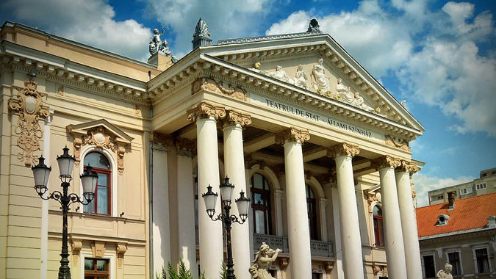
The State Theatre “Queen Mary” Placed in the heart of the city

Slide 15
The Theatre is gorgeous at night, too.

Slide 16
Wonderful interior, with red velvet and golden decorations

Slide 17
The Baroque Palace The city has many Baroque buildings. It was part of the Austro-Hungarian Empire many times in history. The Baroque Palace below is an example of the baroque architectural style.

Slide 18
The Roman Catholic Cathedral

Slide 19
Moon Church (Orthodox) – baroque style
Here you can see the phases of the moon. It’s real.
It is ‘Moon church’ because of the mechanism installed in the church tower in 1793. The mechanism that rotates the moon indicates the moon phases.

Slide 20
Interior of the Moon Church

Slide 21
Black Eagle Palace

Slide 22
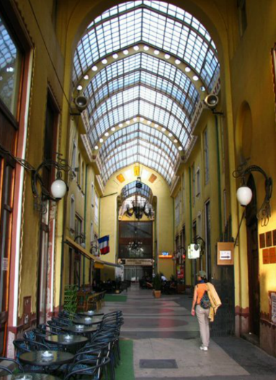
Entrance to Black Eagle Passage

Slide 23
Black Eagle Passage is famous for the beautiful coloured glass and the black eagle on one of the large windows.

Slide 24
This is where the Greek community lived in the past. This is called the Corridor of Canons

Slide 25
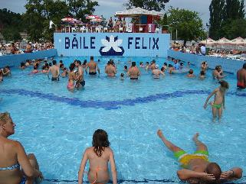
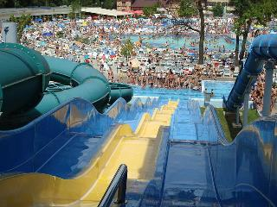
Oradea is very close to Baile Felix, a thermal spa, which is famous for its pools with thermal waters , a beautiful forest and old wooden churches.

Slide 26
The Olympic Swimming Pool of Oradea

Slide 27
A wonderful building in “Unirii” Square in the heart of the city

Slide 28
This is Oradea City Hall

Slide 29
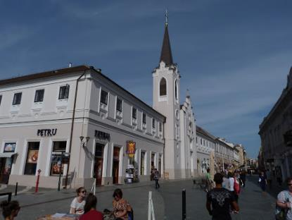
The car free zone with pubs perfect for walking and shopping

Slide 30
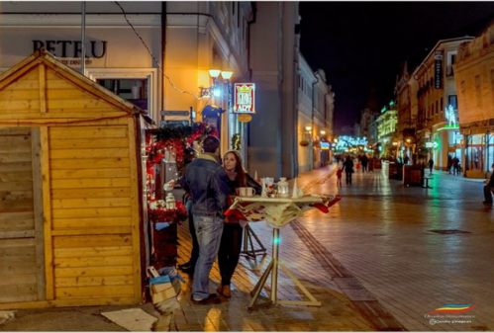
This is where you can walk at day and at night

Slide 31
This is how the City Hall reflects in the waters of Crisul Repede River at night

Slide 32
Postcard picture of Ferdinand Square
I hope you like our city. If you have the chance to visit it,
you will be impressed.

