Slide 1
This is who we are: “Onisifor Ghibu” High School Oradea, Romania
Our school is the largest school in our city. We are a big family
with over 1700 students and almost 100 teachers. We have pre-school, primary school, secondary school and high school, so our students are 6-19 years old.
This is only the main building.

Slide 2
The name of our school comes from our spiritual mentor, Onisifor Ghibu, who was one of the most important Romanian teachers of all time. He created almost 300 schools in Romania. He died in 1972.

Slide 3
The motto of our school is: THE SCHOOL OF A WHOLE GENERATION
The symbol of our school is the water lily/ lotus flower because 5 kilometers away from our school there is a famous resort with thermal water called “Felix Spa”, where this spectacular flower thrives.

Slide 4
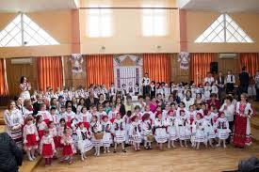
Snapshots from our school with our students

Slide 5
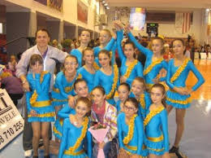
Classroom activity and our Cheerleaders team

Slide 6
Our sports hall Our volleyball team are national champions

Slide 7
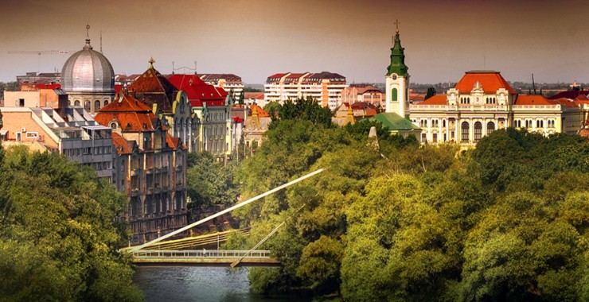
We can hardly wait to show you our beautiful city….

