Slide 1
LATSIA GYMNASIUM
E
R
A
S
M
U
S+
ACTIVE PARTICIPATION

Slide 2
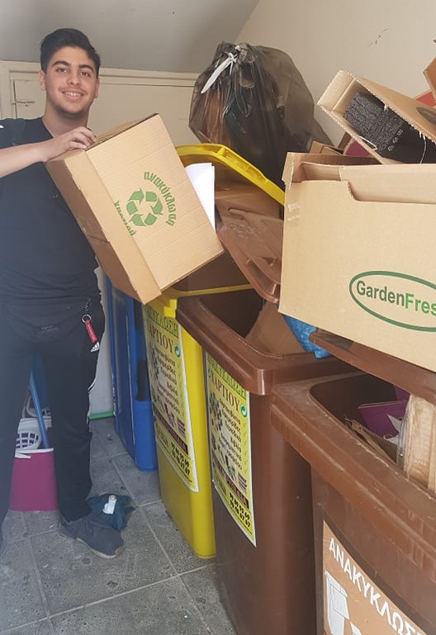
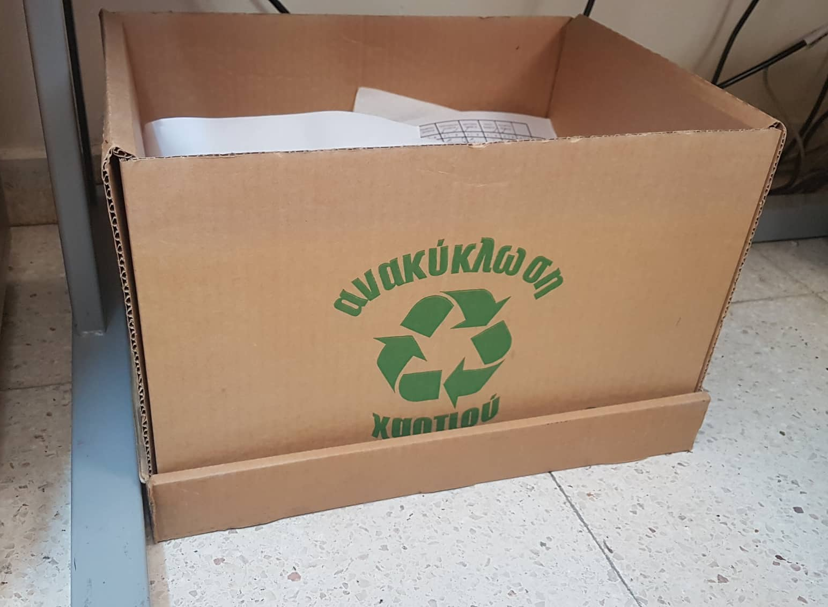
RECYCLE

Slide 3
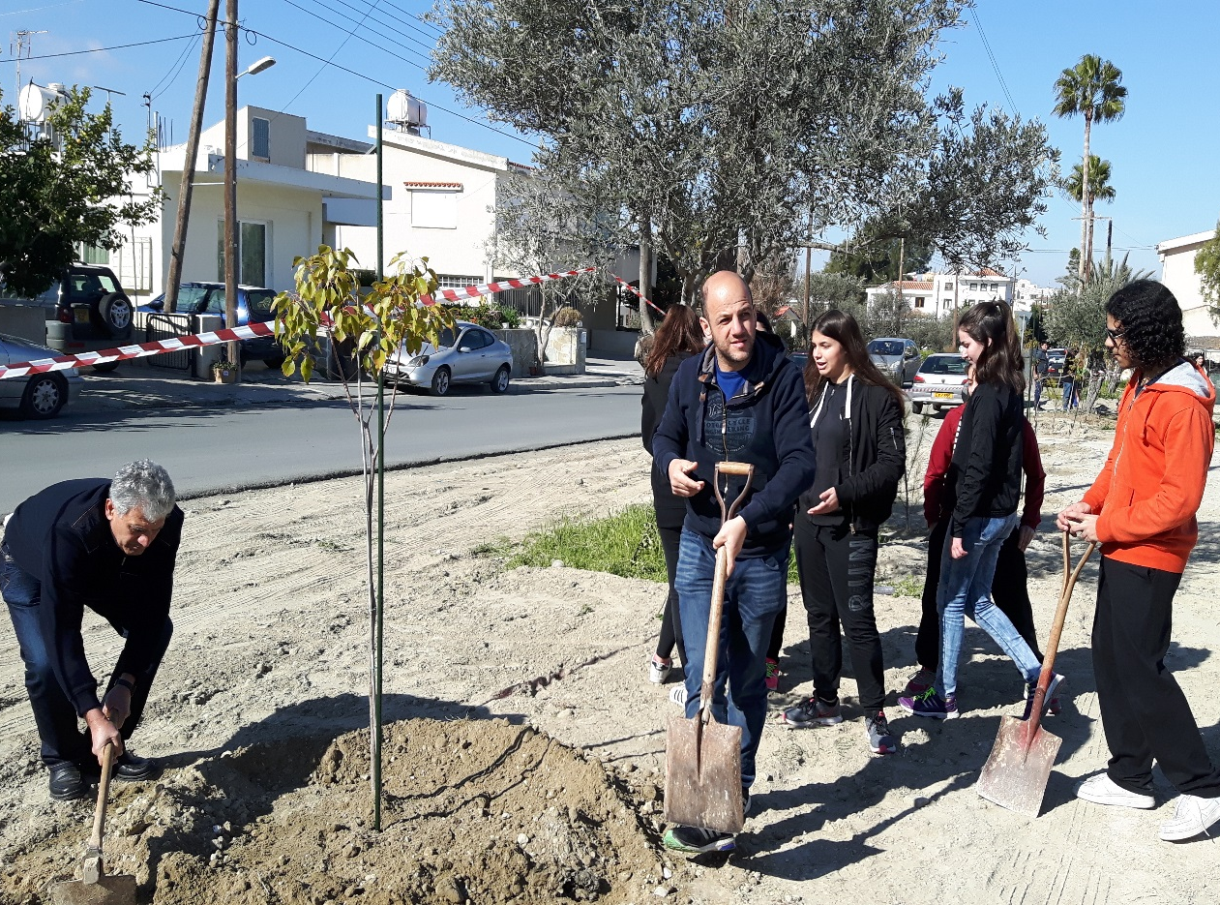
PARK PLANTING

Slide 4
fUNDRAISING

Slide 5
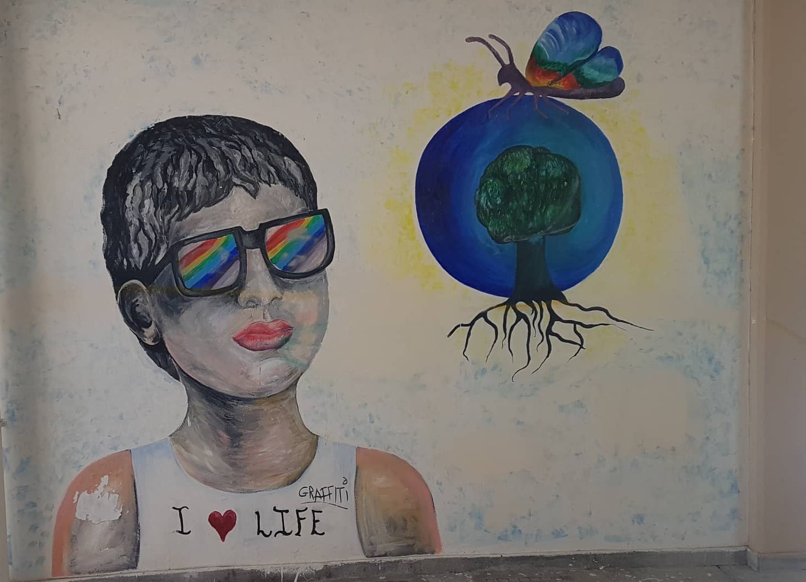
WALL PAINTING

Slide 6
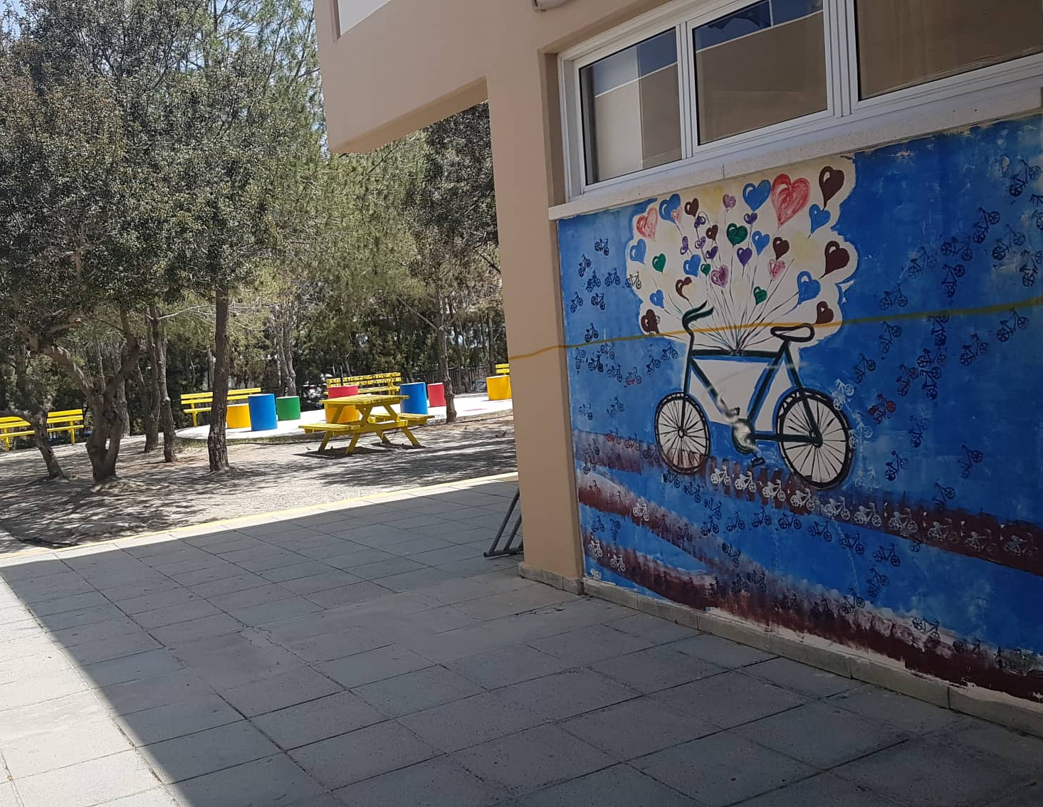
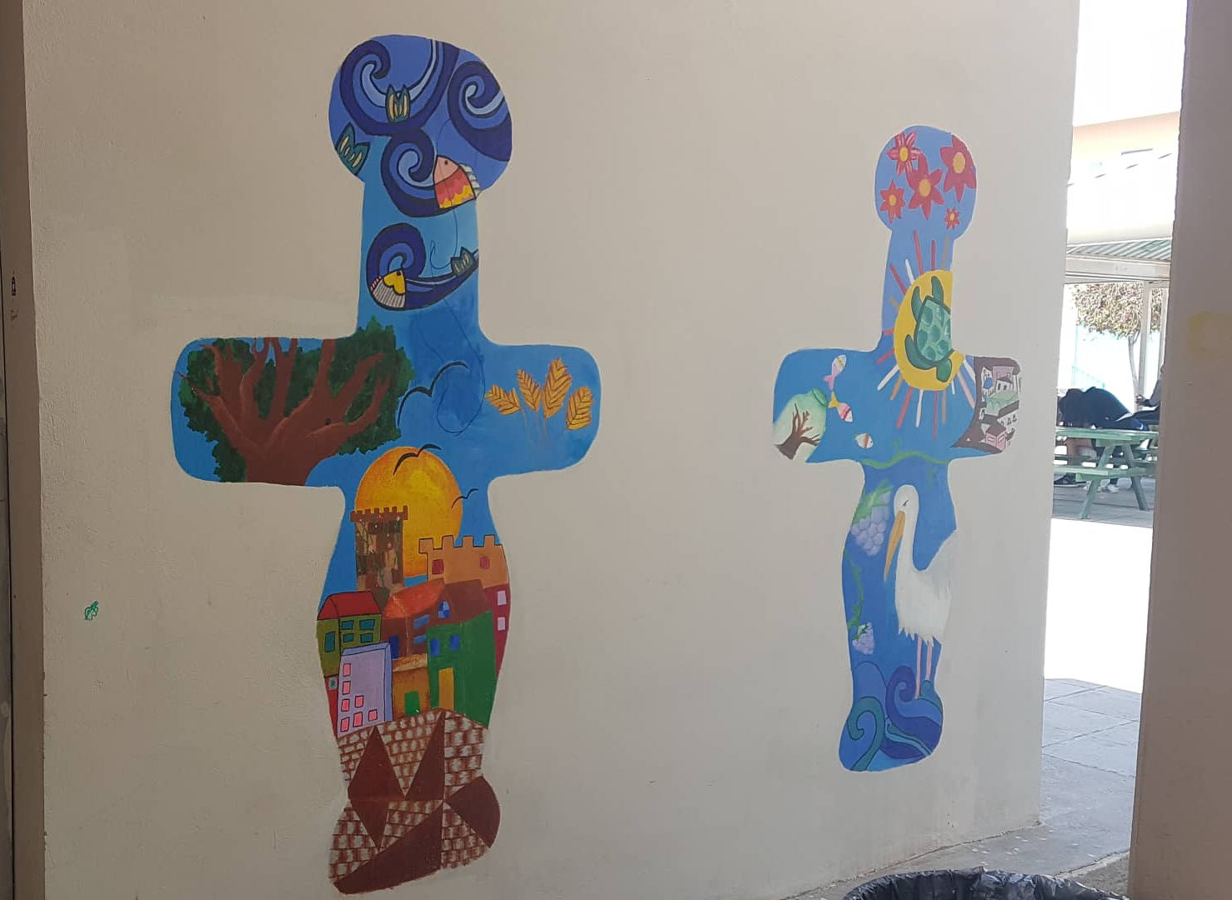
WALL PAINTING

Slide 7
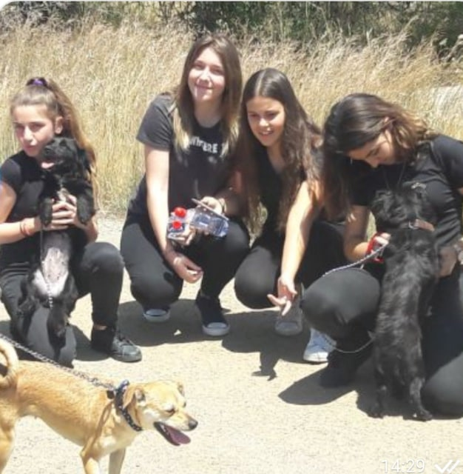
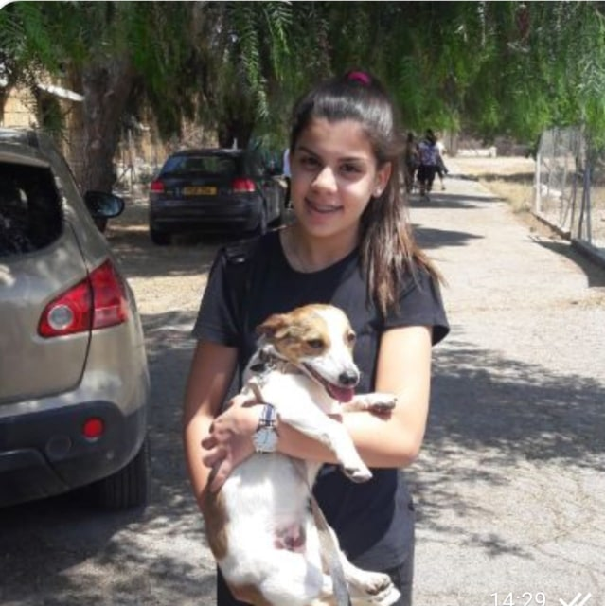
VISITING ANIMAL SHELTER

Slide 8
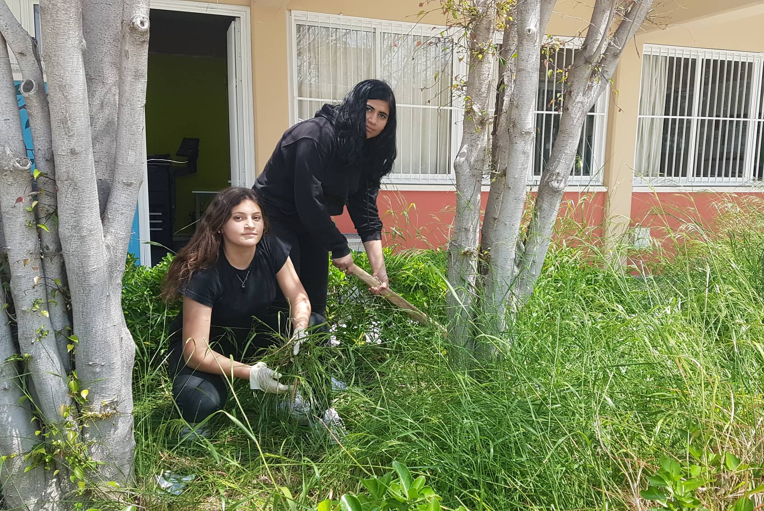
CLEANING ANG GARDENING SCHOOL YARD

