Slide 1
YOUR RIGHTS ARE MY RIGHTS, FIGHTING DISCRIMINATION AND PROMOTING EQUALITY
Learning / teaching, training activities in Oltenita, 18-22.03.2019
“NICOLAE BALCESCU”TEHNOLOGICAL HIGH SCHOOL
OLTENITA
ROMANIA

Slide 2
The Development Right

Slide 3
The Declaration adopted by the UN General Assembly states:
1 Development is an integral part of human rights;
2. All human rights and fundamental freedoms are indivisible and independent;
3. The right to development is strictly related to the concepts of equity, social justice and participation

Slide 4
The Philadelphia Statement adopted at the 26th International Labor Conference:
“All human beings, indifferent of their race, religion and sex, have the right to exercise both their material well-being and their spiritual development in conditions of freedom and dignity, economic security and equality”.

Slide 5
“Yes, yes, yes ... sure yes, Diogenes ... We all have the same rights ... Of course, some of us have a little more than others…”

Slide 6
The relationship between development and human rights:
1. All peoples have the right to economic, social and cultural development, taking into account their freedom, the identity and the equal use of the common identity heritage.
2. States have the obligation, individually or collectively, to ensure the exercise of the right
to development.

Slide 7
The UN General Assembly and the Declaration on the Right to Development
1. There is an inalienable right of every human being, which is the right to development;
2. There is a process of economic, cultural and political development where all human rights and fundamental freedoms are fully realized;
3. The right to development is a human right, so that every human being and all peoples have the right to participate, to contribute and to take advantage of this development process.

Slide 8
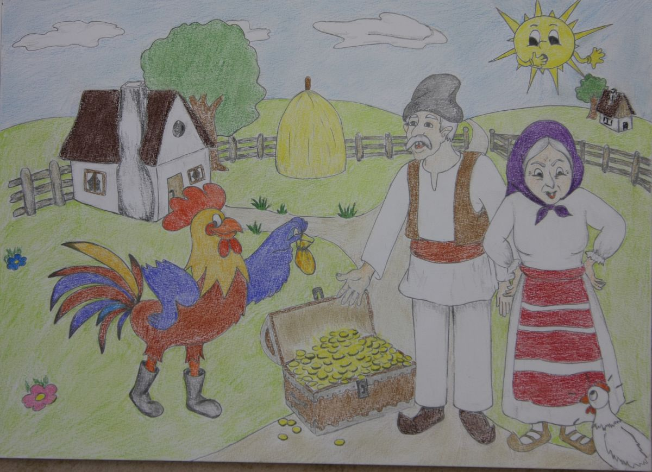
In connection with rights holders:
- The individual / community is the first holder but also the first responsible
- The state has the right and obligation to formulate national development policies
- The state must take firm steps to eliminate serious and flagrant human rights violations;
States should take at national level all measures to achieve the right to development, ensure equal opportunities for all, access to basic resources, education, health services, food, shelter, employment and fair distribution of revenue;
-States have a duty to cooperate to ensure development and remove obstacles to development.

Slide 9
Part of the development rights must be based on a rights-based approach, which means "a way that follows the procedures and norms of human rights law that are transparent, responsible, participatory and non-discriminatory, fair in decision-making and sharing benefits process.

