Slide 1
Creating a boardgame
Erasmus+ Your Rights Are My Rights. Fighting Discrimination and Promoting Equality
Budapest, 13th May 2018

Slide 2
Warmers
Zsófi
(10 min)

Slide 3
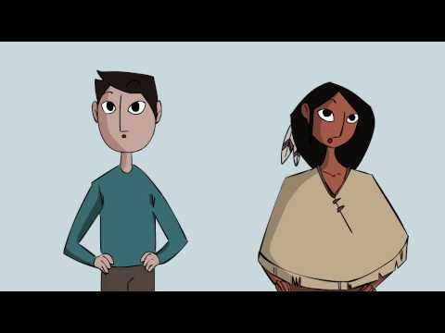
Inspirations
Human Rights in Two Minutes
https://www.youtube.com/watch?v=ew993Wdc0zo

Slide 4
Boardgame - rules
Maximum number of players: 5
The game is set on the map of Europe
You have to collect money and country flags during the game
There are three zones of countries (listed below and shown on the map)
Every player starts from Hungary
The starting amount of money is 500.-

Slide 5
Boardgame - rules
Every time you travel you have to pay an amount of money, just as in reality
200­.- Fabatka
If you would like to unlock the second zone you have to collect 10 different flags from zone 1 by visiting them
If you would like to unlock the third zone you have to collect 10 different flags from zone 2 by visiting them

Slide 6
Boardgame - rules
Every time it’s your round you get a question and if you answer it right, you will get money as an award, and that’s how you increase your budget
right answers in region 1: 300.-
right answers in region 2: 400.-
right answers in region 3: 600.-

Slide 7
Boardgame - rules
You are allowed to go back to a country where you have been, but you won’t get any more flags of it
You only get the flag if you answered the question right
If you lost all your money, or you can’t move or stay anymore, you have to go back to Hungary where you gain 300 restart money
The winner is the one with the biggest amount of money.

Slide 8
Questions
1. zone multiple choice exercises
2. zone Charades (draw, gesture, describe)
3. zone what would you do, if…

Slide 9
Work in international groups and create questions for the 3 zones.
Use the internet.
Write creative, interesting questions.
Goal of the board game: learning about human rights
You can either use your own ideas, or the given examples.

Slide 10
Good and bad examples – zone 1
Bad question:
„ What happened on the 10th December 1948?”
??????
Good question:
„What happened on the 10th December 1948?”
A. …
B. …
C. …

Slide 11
International Kahoot
https://play.kahoot.it/#/k/f3c70027-f9bc-4bd9-84be-e3d3572d0105

