Slide 1
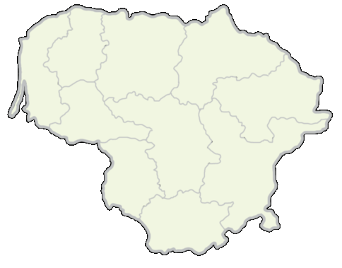
Lithuania
Games Achieve My Educational Success
2019-02-25
Turkey

Slide 2
Compare and contrast

Slide 3
Lithuania and Turkey in Europe

Slide 4
Near
the Baltic Sea
the Black Sea, the Aegean Sea and the Mediterranean Sea

Slide 5
Flag
of Lithuania
of Turkey

Slide 6
Money
euro in Lithuania
lira in Turkey

Slide 7
Ornaments
In Lithuania
In Turkey

Slide 8
Traditional clothes
in Lithuania
in Turkey

Slide 9
Traditional shoes
in Lithuania
in Turkey

Slide 10
Popular sport
in Lithuania is basketball
in Turkey is football

Slide 11
Bread
in Lithuania
in Turkey

Slide 12
Sweets
in Lithuania
in Turkey

Slide 13
How easy to learn the words?
Flag
Money
Bread
Map
Sea
Basketball
Football
Sweets

Slide 14
Quizlet
https://quizlet.com/359379677/quizlet-flash-cards/

Slide 15
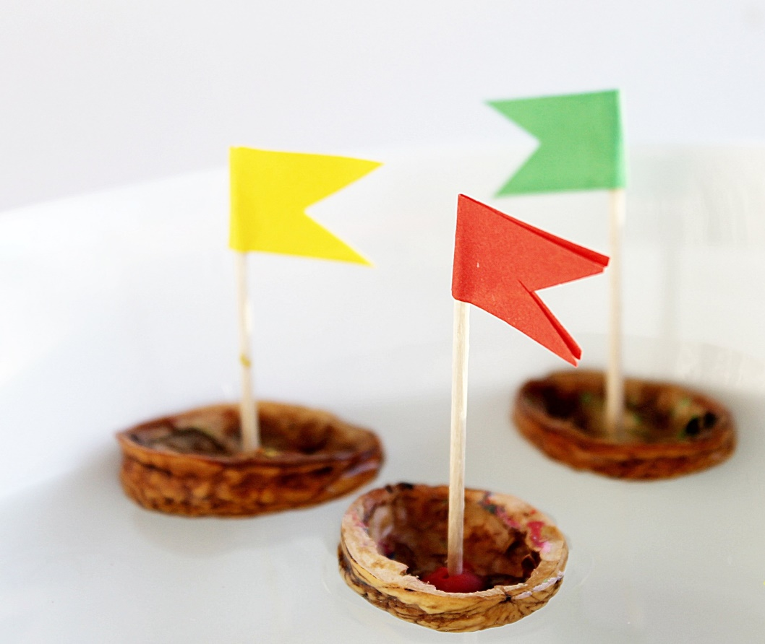
Have a nice day☺

