Slide 1
ACTIVITY C-4-USAK

Slide 2
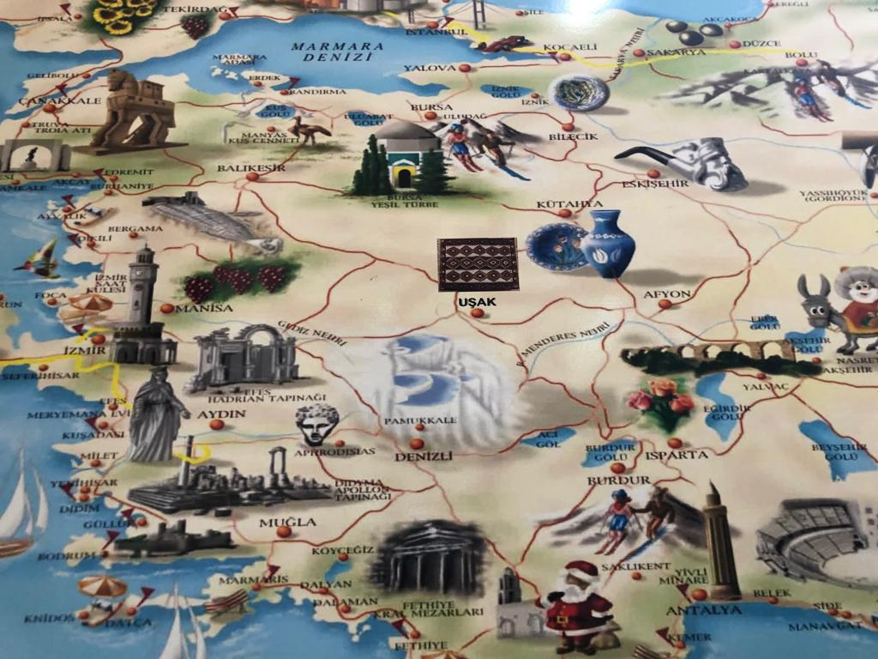
ACTIVITIES
CULTURAL ACTIVITIES
Open Lessons
WORKSHOPS-TEACHER TRAINING

Slide 4
WELCOMING AT – GALIP SCHOOL

Slide 5
AGREEMENT WITH TURKISH HEADMASTER

Slide 6
A WARM WELCOME

Slide 7
GALIP CETIN SCHOOL

Slide 8
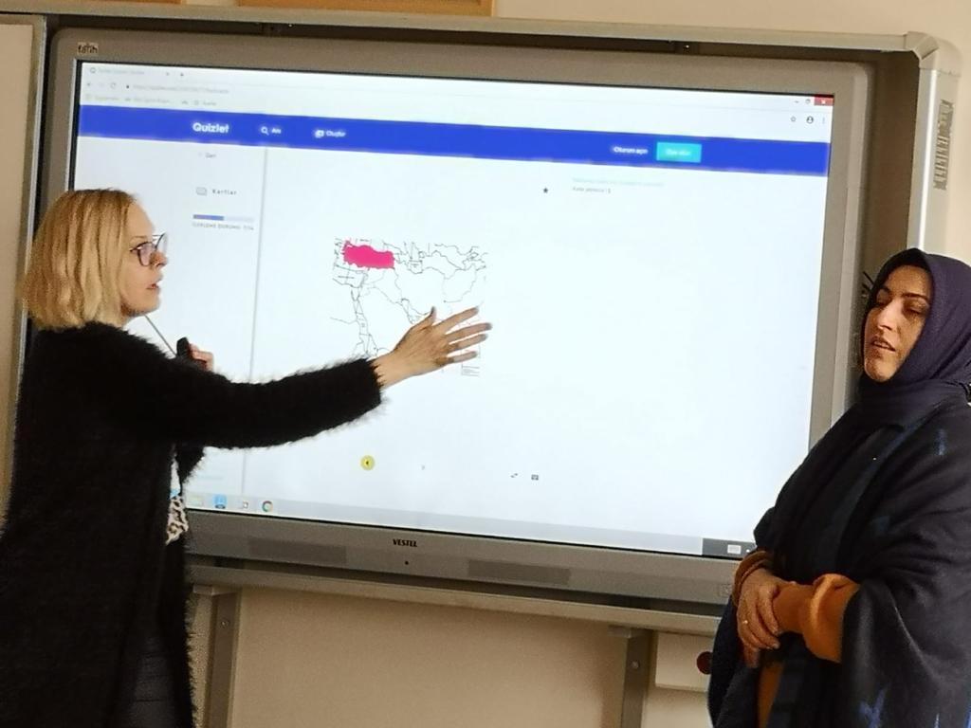
OPEN LESSONS

Slide 9
OPEN LESSONS

Slide 10
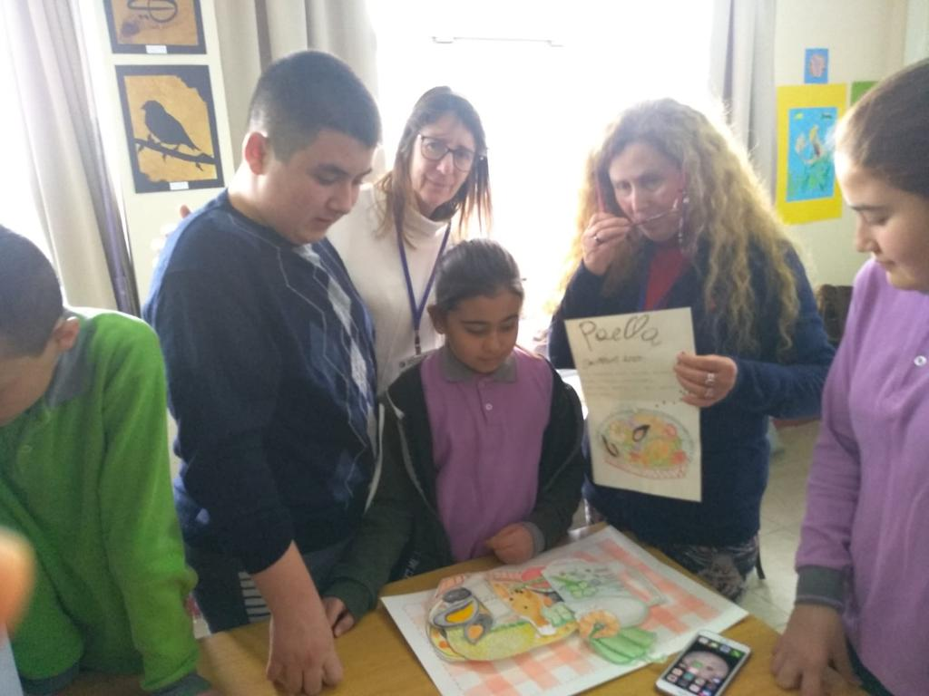
COLLABORATING WITH PARTNERS IN THEIR LESSONS

Slide 11
PORTUGUESE OPEN LESSON

Slide 12
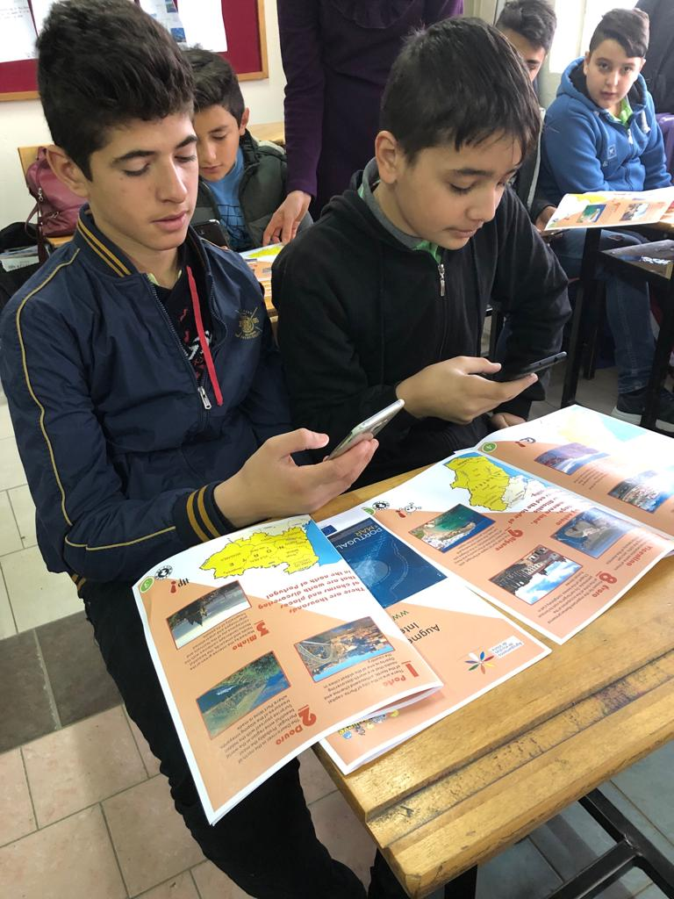
PORTUGUESE OPEN LESSON

Slide 13
ZAP ME TO KNOW MORE ABOUT THIS APPLICATION AND PORTUGAL

Slide 14
PORTUGUESE OPEN LESSON

Slide 15
LEARNING WITH ZAPPAR
PORTUGUESE OPEN LESSON

Slide 16
PORTUGUESE GROUP WORK

Slide 17
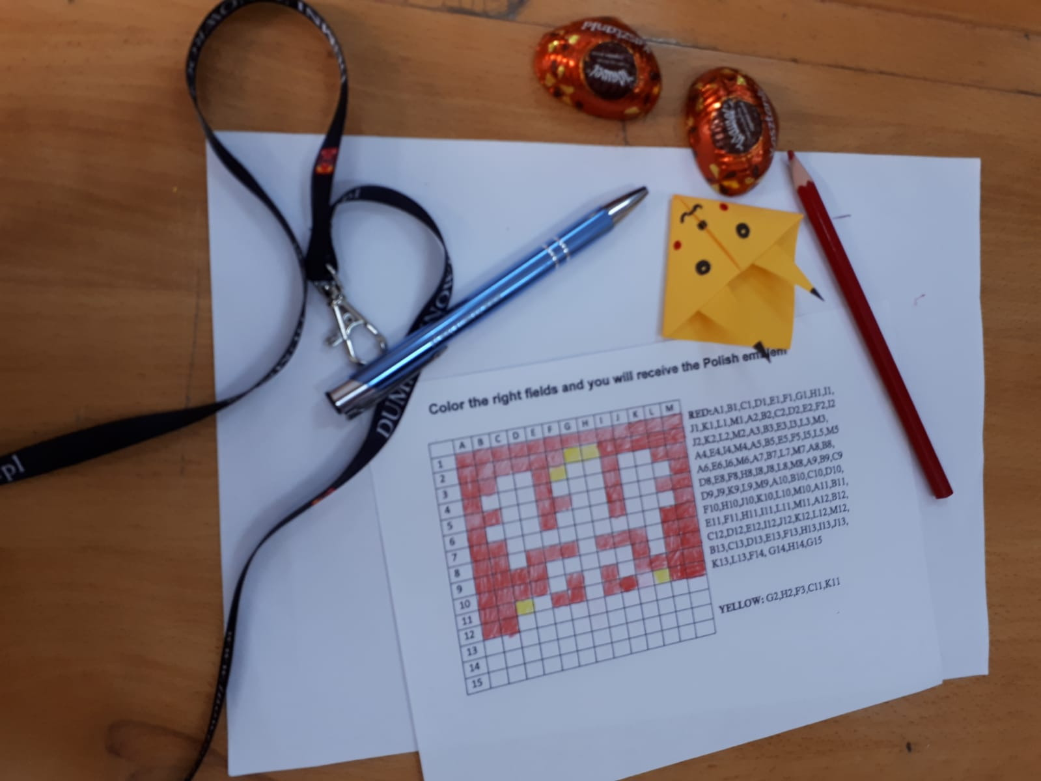
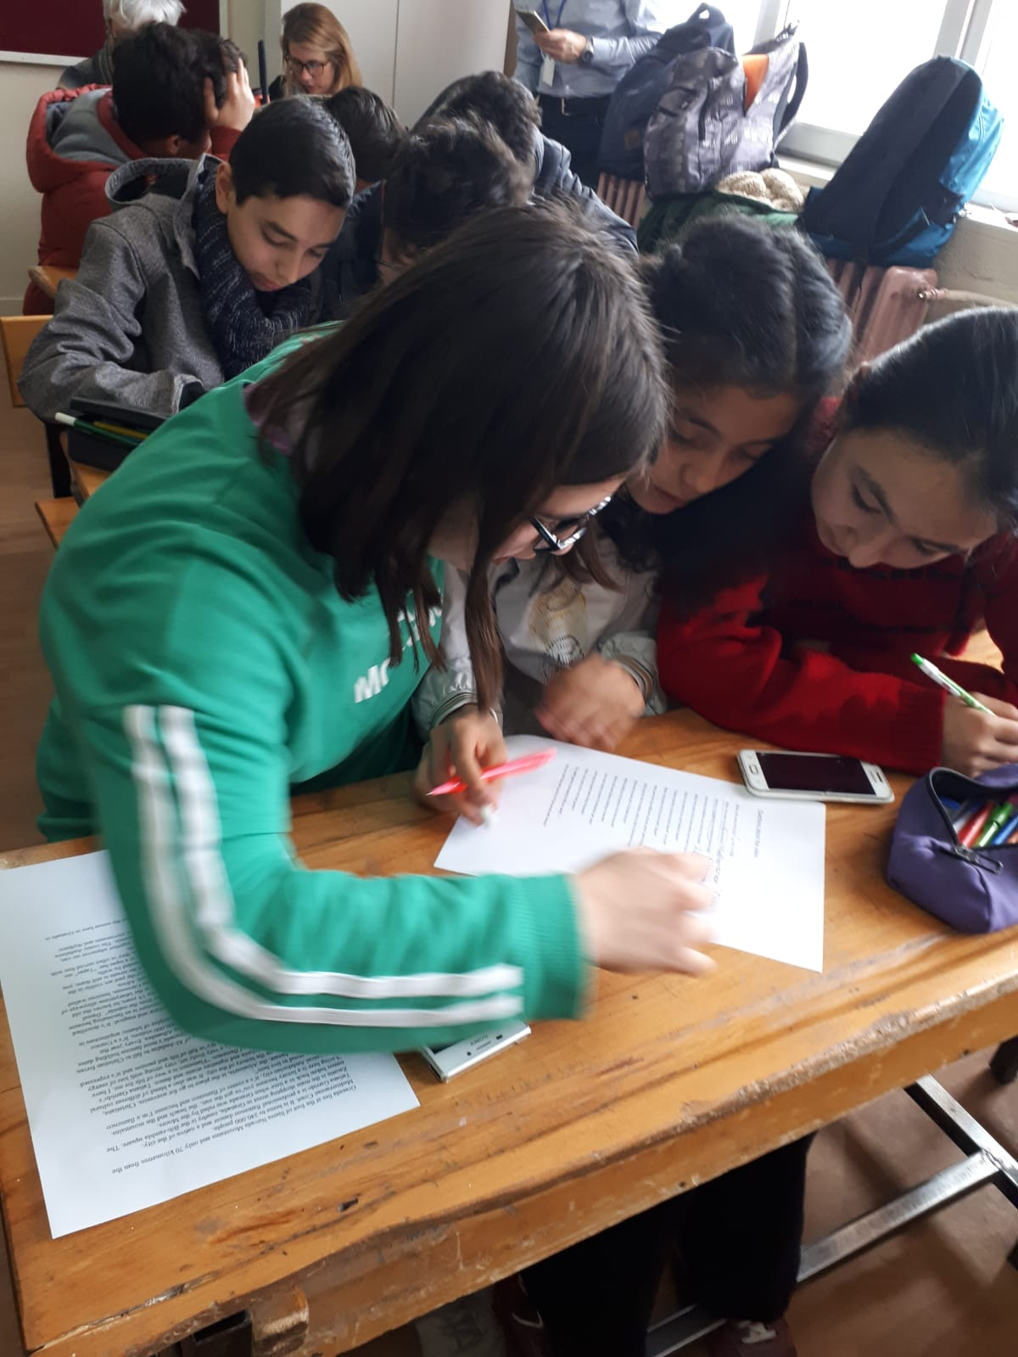
OPEN LESSONS FROM PARTNERS

Slide 18
OPEN LESSONS

Slide 19
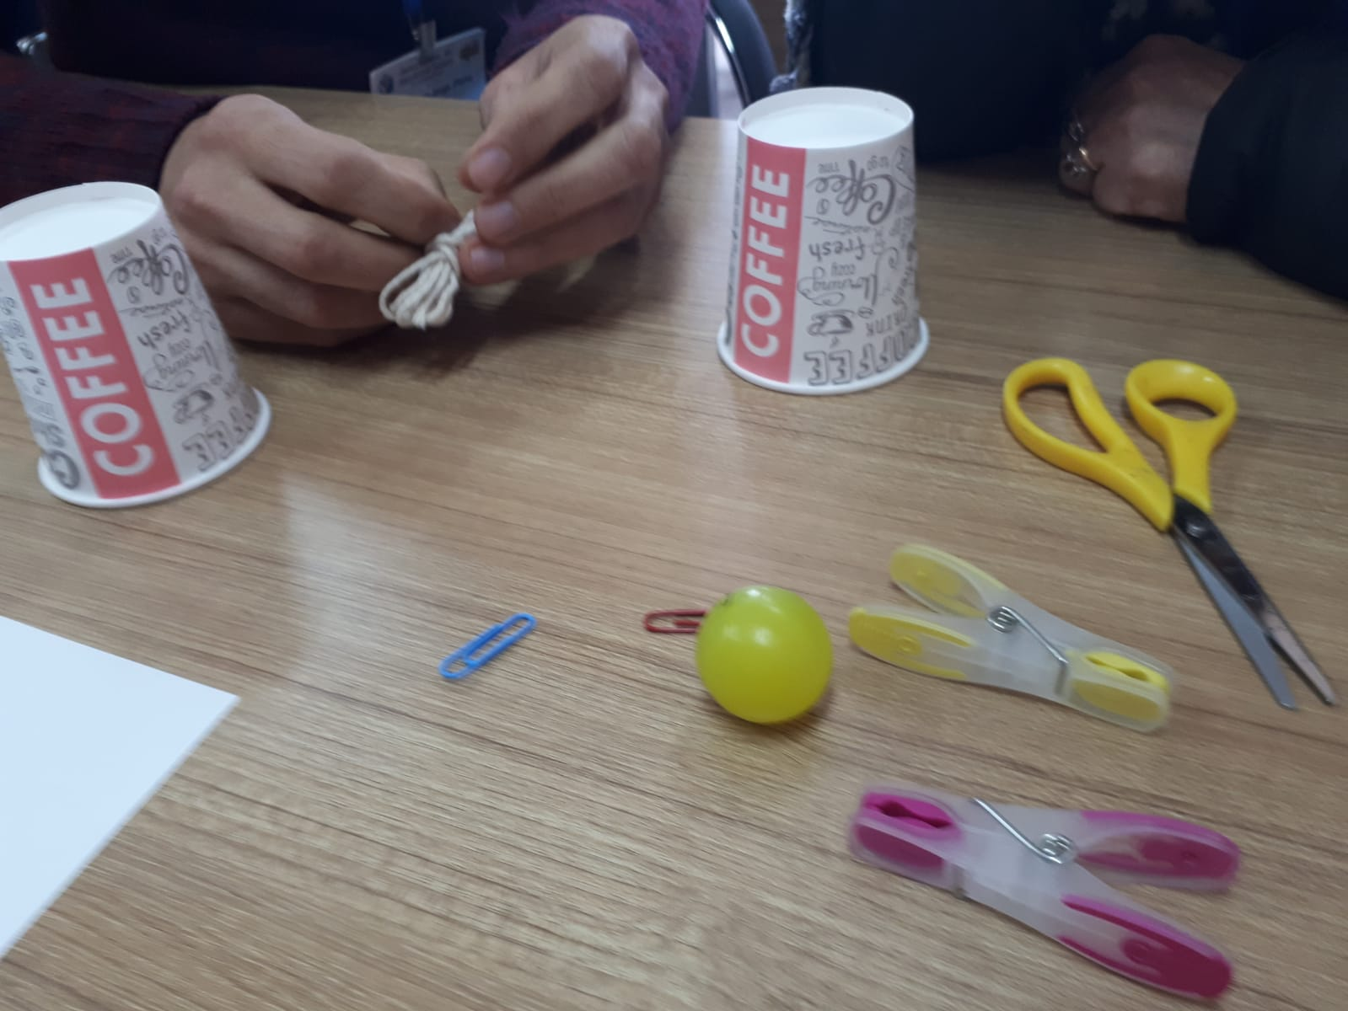
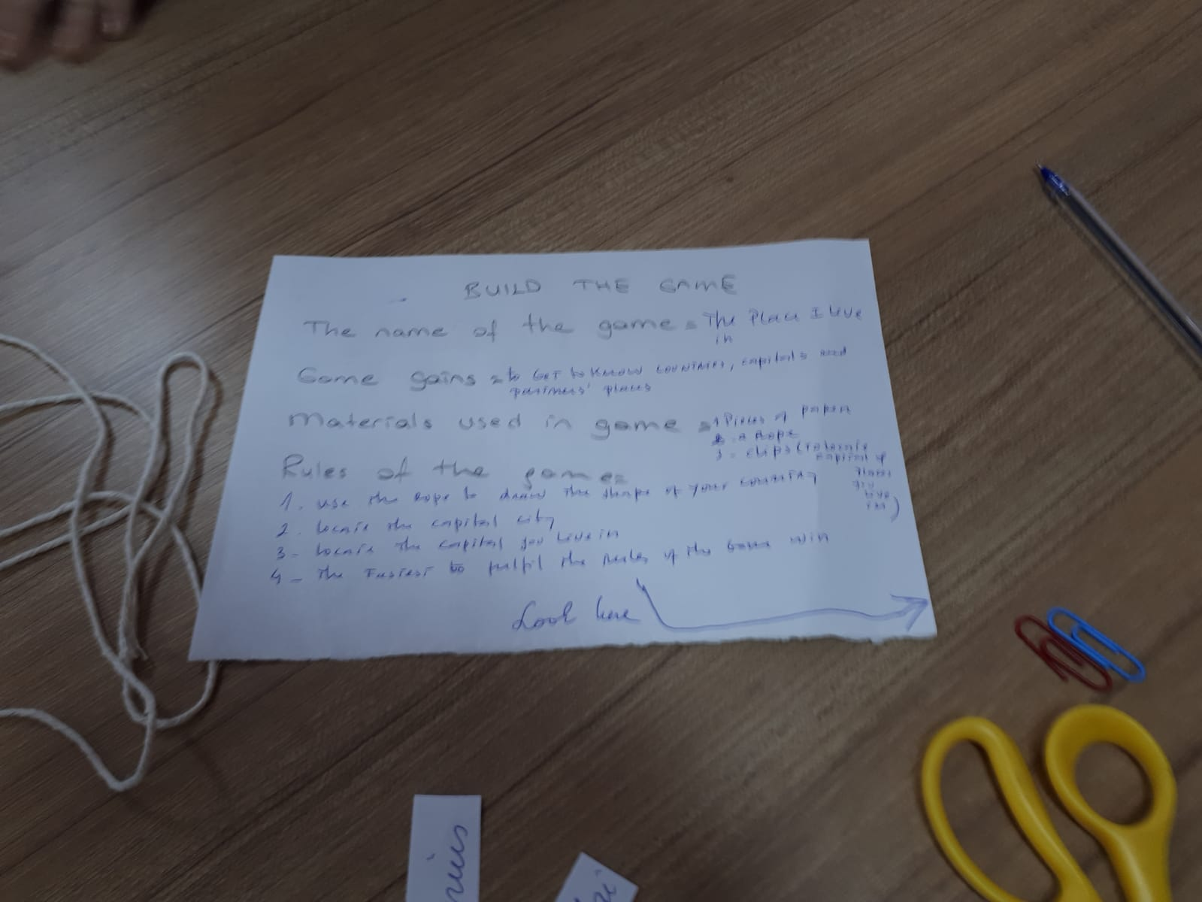
WORKSHOP BUILDING GAMES

Slide 20
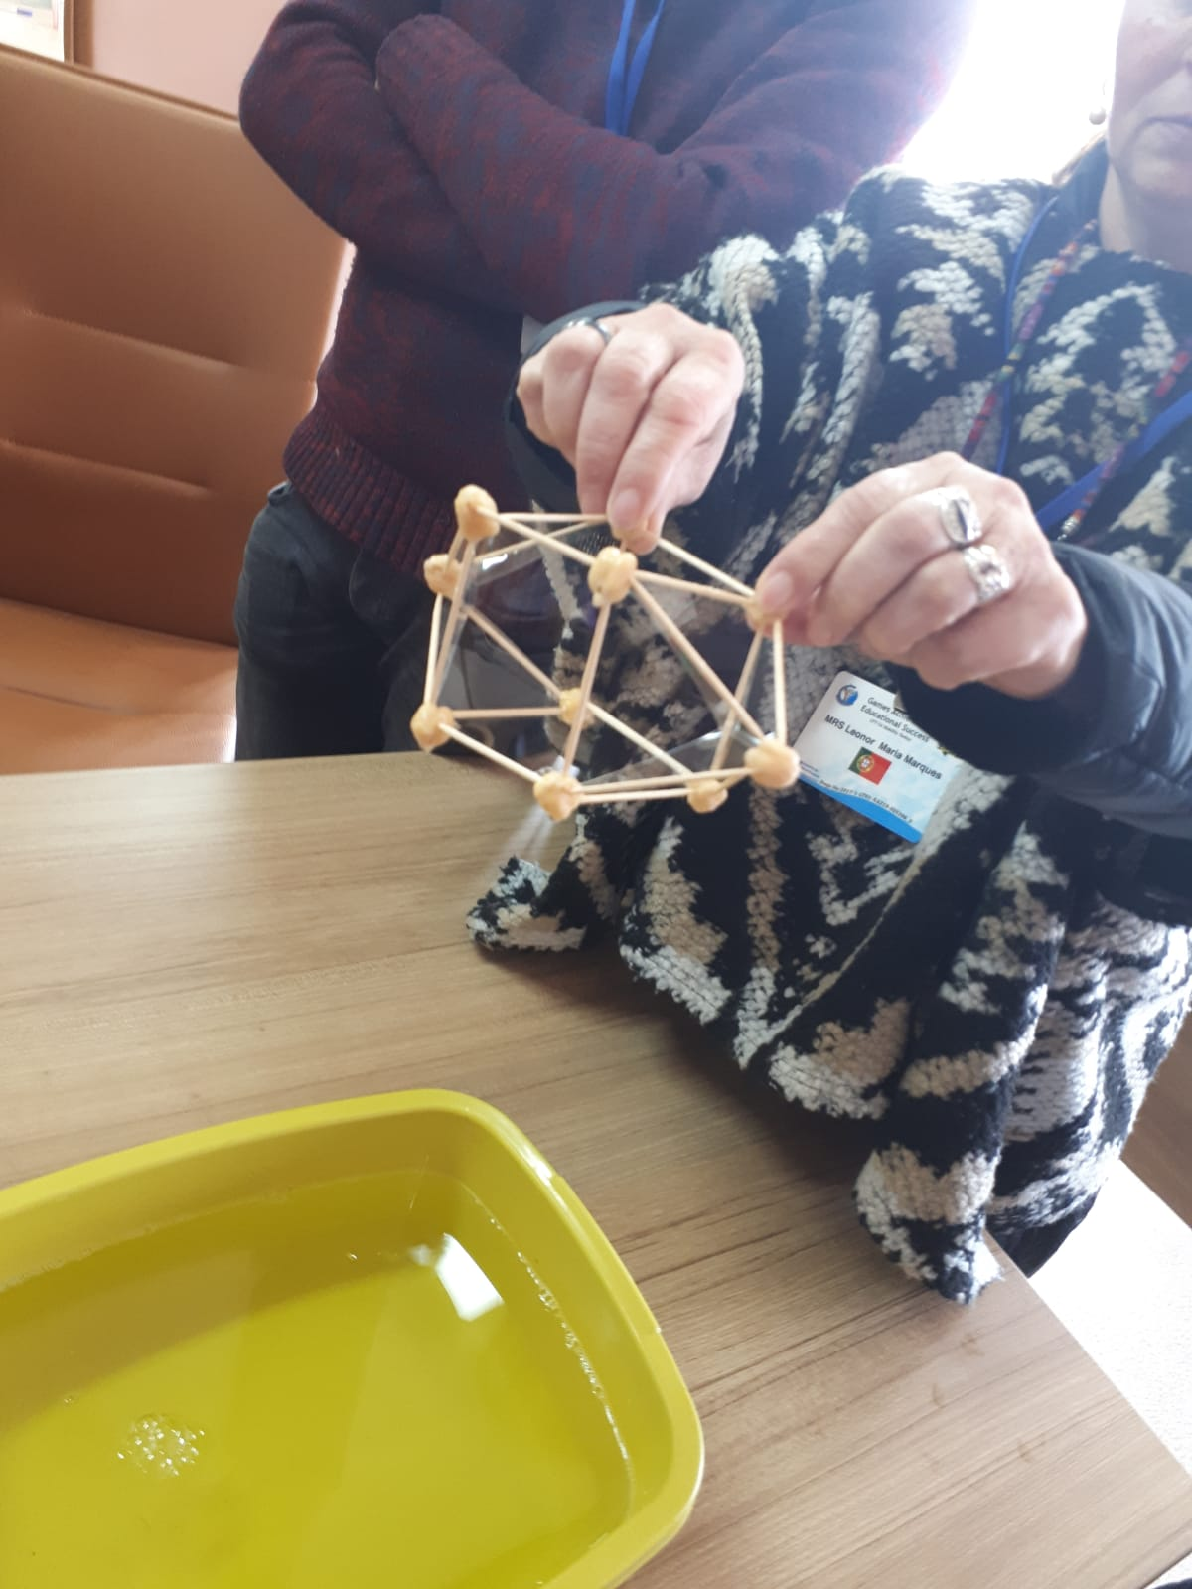
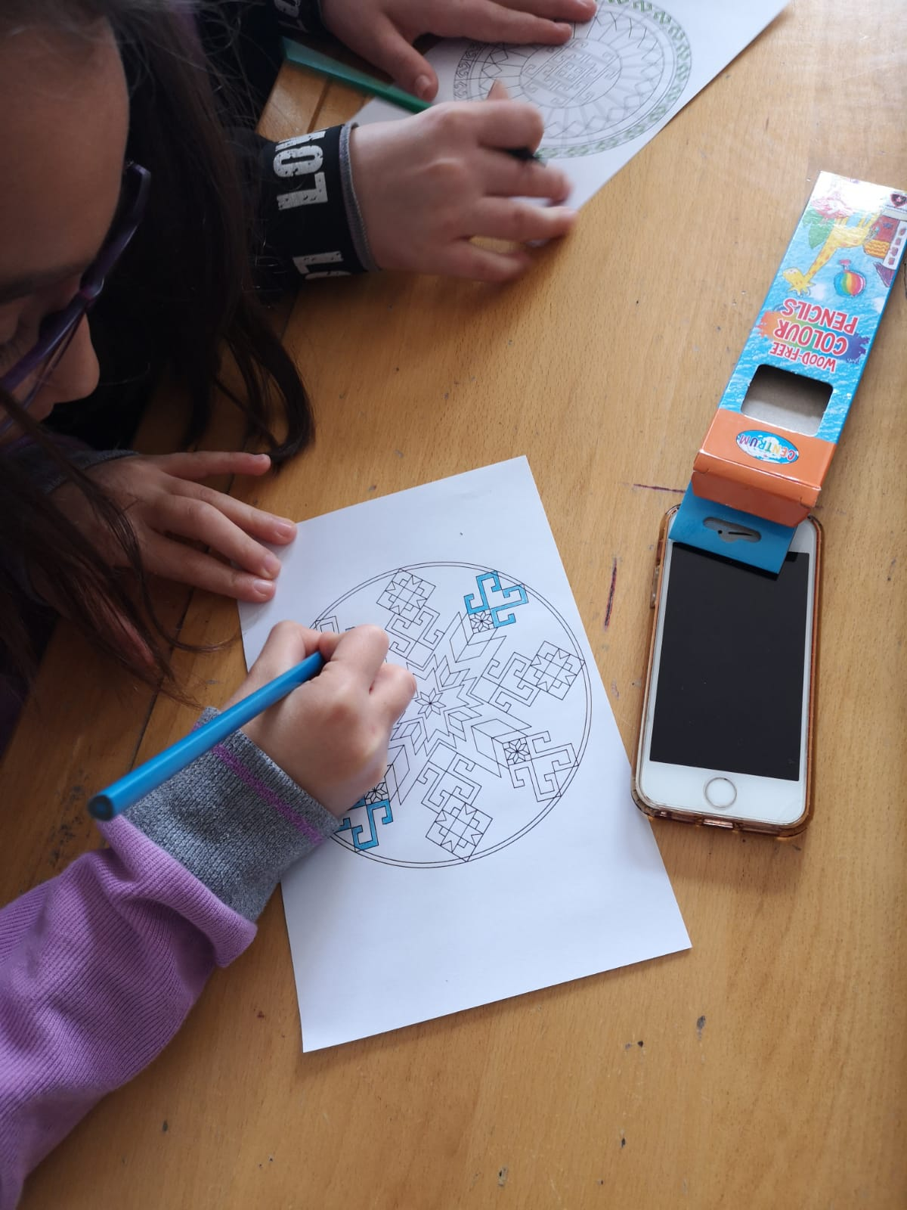
WORKSHOP BUILDING GAMES

Slide 21
ERASMUS –TEAM TURKEY

Slide 22
C4 – LTT
24-02-2019/02-03-2019
USAK

