Slide 1
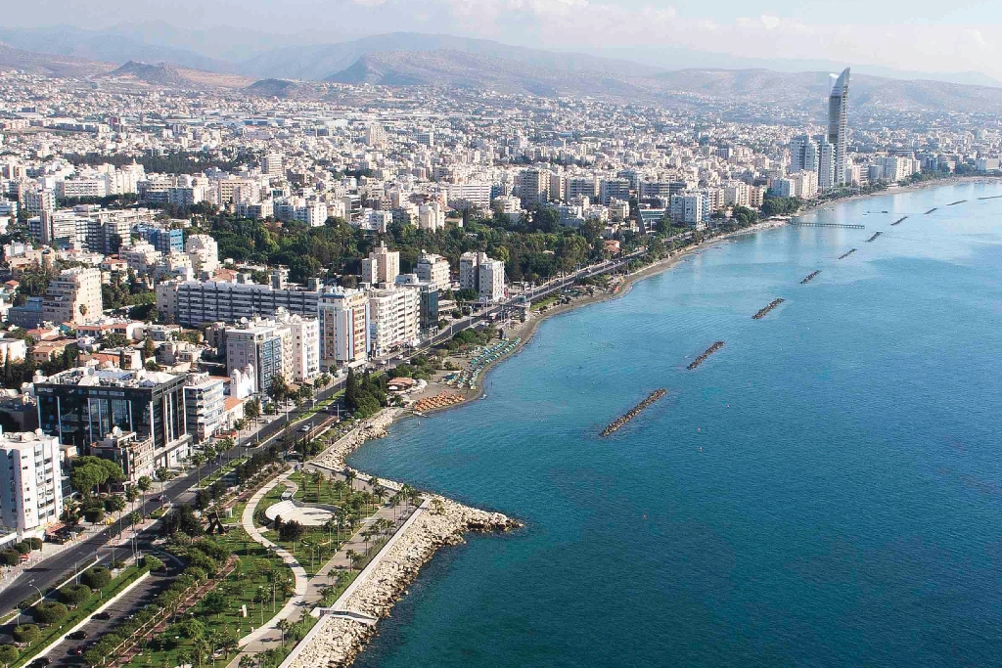
LIMASSOL
Limassol is a city on the southern coast of Cyprus and capital of the eponymous district. Limassol is the second largest urban area in Cyprus after Nicosia, with an urban population of 183,658

Slide 2
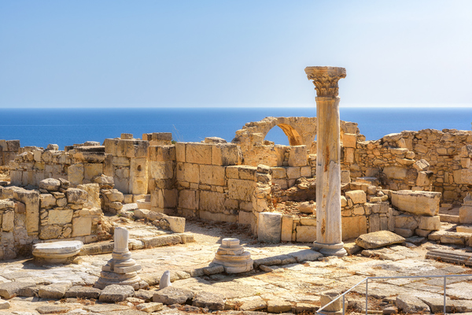
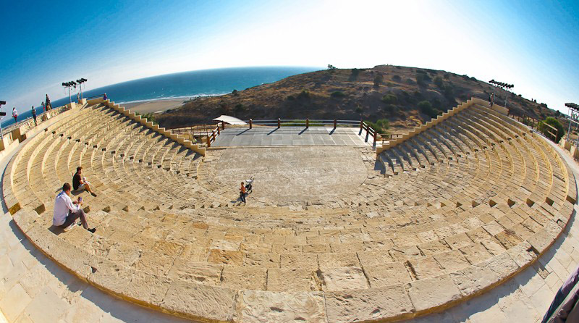
THE HISTORY OF LIMASSOL
Limassol was built between two ancient cities, Amathus and Kourion, and during Byzantine rule it was known as Neapolis (new town). Limassol's historical centre is located around its medieval Limassol Castle and the Old Port. Today the city spreads along the Mediterranean coast and has extended much farther than the castle and port, with its suburbs stretching along the coast to Amathus. To the west of the city is the Akrotiri Area of the British Overseas Territory of Akrotiri and Dhekelia.

Slide 3
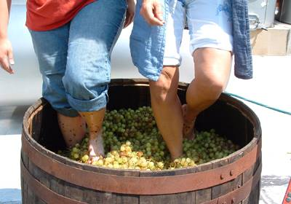
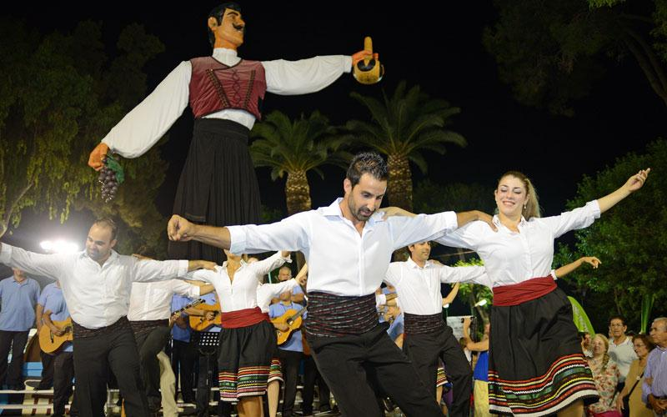
WINE FESTIVAL LIMASSOL
The Wine Festival of Limassol is an annual festival in Limassol that celebrates wine and winemaking. The festival was first organized in 1961 and since then it has become an established annual event of merrymaking and fun. The Wine Festival can be regarded as and a revival of ancient festive manifestations of worship in honor of Dionysus, the god of wine, and Aphrodite, the goddess of beauty and love. During these feasts people worshiped their gods, but primarily enjoyed themselves

Slide 4
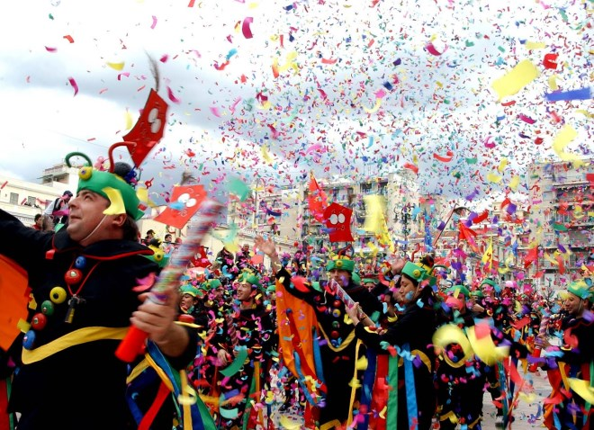
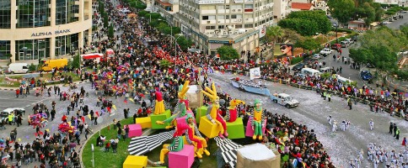
LIMASSOL CARNIVAL FESTIVAL
Limassol Carnival Festival, which is said to be an old custom traced to pagan rituals is now held as an entertaining event. The Carnival has been celebrated in Limassol the last one hundred years!! And you know what? It is one of the most famous and large carnival events worldwide!
It is every year celebrated before the green Monday that is floating. Then 10 days in a row are field with happiness, dance, fun, satire games, colorful carnival processions and many more!!

Slide 5
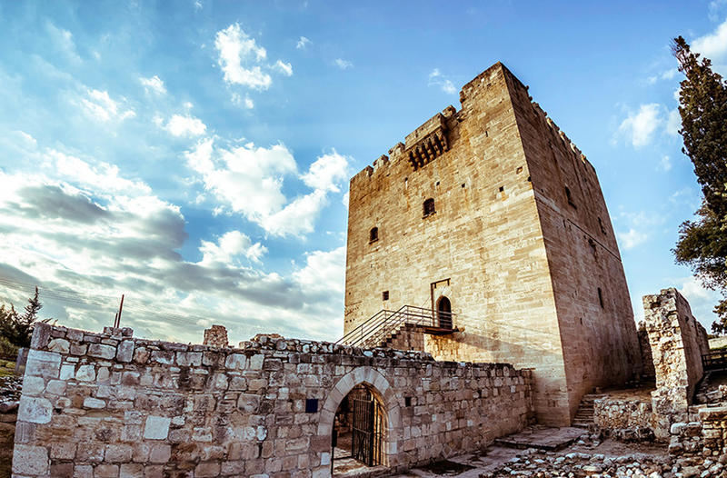
SIGHTS OF LIMASSOL Kolossi Castle
Kolossi Castle is a former Crusader stronghold on the south-west edge of Kolossi village 14 kilometres (9 mi) west of the city of Limassol on the island of Cyprus. It held great strategic importance in the Middle Ages, and contained large facilities for the production of sugar from the local sugarcane, one of Cyprus's main exports in the period. The original castle was possibly built in 1210 by the Frankish military, when the land of Kolossi was given by King Hugh I to the Knights of the Order of St John of Jerusalem (Hospitallers).

Slide 6
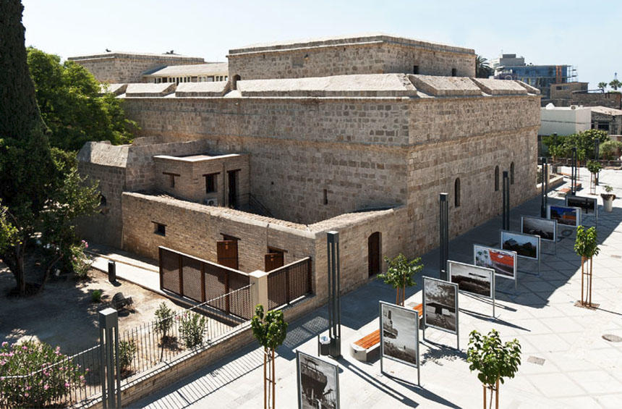
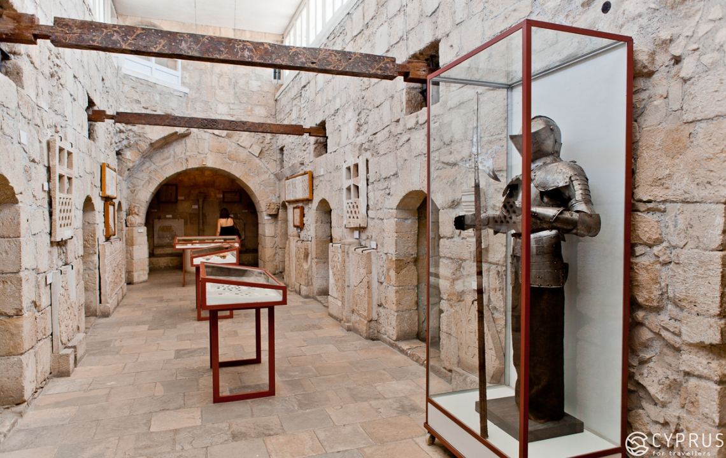
Medieval Limassol Castle
The medieval limassol Castle is situated near the old harbour in the heart of the historical centre of the city of Limassol. The castle as it appears today is a structure rebuilt circa 1590 under the period of Ottoman rule .
Archaeological investigation within the castle revealed that it was built over an Early Christian basilica (4–7th century CE) and a Middle Byzantine monument (10th–11th century CE). Other finds beneath the Castle witness the existence of an important church, possibly the city's first cathedral.

Slide 7
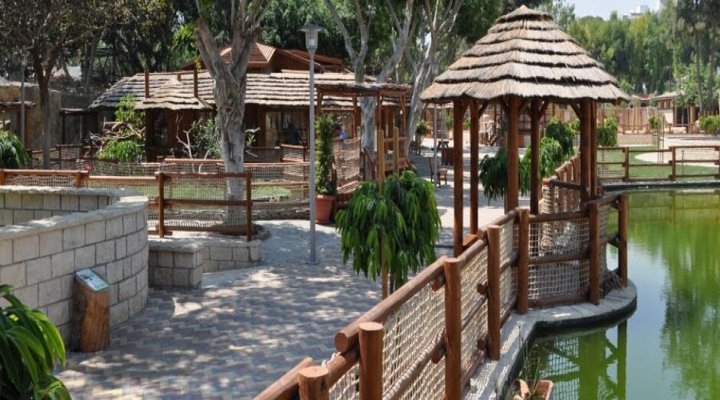
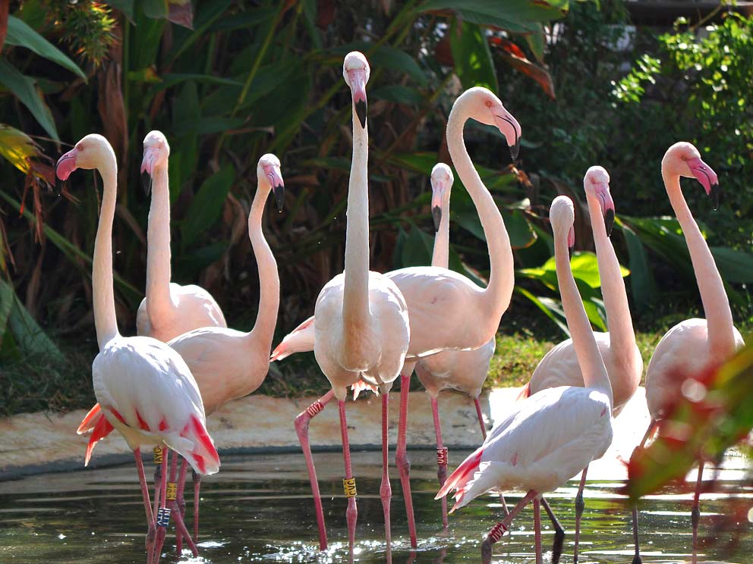
The Limassol Zoo
The Limassol Zoo, after designing and studying, made a completely modern reconstruction. Visitors to this small modern Zoo will see remarkable and very attractive animals, birds and reptiles from all continents.
For the pleasure and relaxation of the visitor, a unique and impressive café "Flamingo" has been built with a view to the sea. The modern playground and the children's zoo with mini goats and sheep will provide unforgettable moments for young visitors.

Slide 8
THANK YOU FOR YOUR ATTENTION
If you want to watch more about Limassol take a look to this video!!
https://www.youtube.com/watch?v=jiubu82XNtI
https://www.youtube.com/watch?v=2t7DmqYAF6c
https://www.youtube.com/watch?v=BIAWFs5zZ2I
ANASTASIA
STYLIANI
LAMPROS
ELINA
DESPOINA
KRISTIAN

