Slide 1
PAFOS
By the students:
Alex Nicolaou
Christos Metaxas
Dimitris Kostanidis
Maria Chrysostomou
Katerina Christoforou
Dimitris Christodoulou

Slide 2
Welcome to Pafos,
Welcome to the European Capital of Culture for 2017.
For the next three years our city becomes the official representative of Cypriot culture for the whole of Europe. At the same time, it becomes the city that expresses and reflects European culture all over the world.

Slide 3
For us it is a great honor and at the same time a great responsibility. However, we strongly believe that with forethought and hard work, a great sense of duty and determination, we will accomplish our goals and achieve impressive results.
Our vision and goal is to make Pafos a European Capital of Culture worthy of the history, the reputation and range of this great institution.

Slide 4
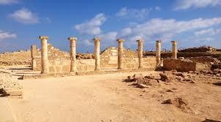
Pafo’s History
Nea Pafos was founded on the sea near a good natural harbor.
Pafos is a town full of history and was probably founded by Nicocles, the last king of Palaepafos. The inhabitants of Marion were probably also transferred to this new city after its destruction in 312 BC.

Slide 5
The city of Pafos
The city of Pafos is not only majestically beautiful, but historically very rich. Domestic villages full of environmental beauty and ancient castles fill the town of Pafos.
Pafos is also famous for its majestic beaches where you can relax with your family and friends under the the bright sun that never stops shining…
Pafos is one of the most popular destinations for tourists in Cyprus. It has a wonderful mix of beautiful beaches, lively towns and labyrinths of crumbling ancient ruins to explore. Here is a list of 5 essential things to do and see while you’re here.

Slide 6
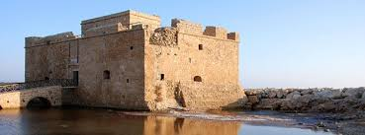
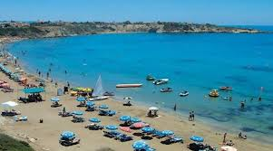
Sightseeing in Pafos
KATO PAFOS MEDIEVAL CASTLE: Pafos Castle was initially a Byzantine fort constructed to protect the harbor. It was also used as prison cells and a storage area for salt during the British colonial years. It is one of the most important landmarks in the Paphos region.
Coral Bay The popular tourist destination of Coral Bay lies north of the city of Paphos. This clean and picturesque stretch of coast became popular because of its white sandy beaches, lapped by the clear waters of the Mediterranean Sea. Additionally, for the more adventurous traveler, the bay is home to rocky headlands and sea caves, home to indigenous animals, flora and fauna.

Slide 7
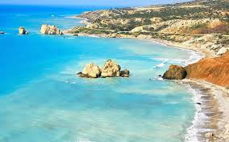
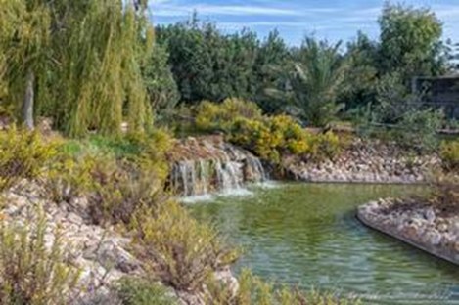
Pafos Zoo
Pafos Zoo is set in a natural setting with lakes, ponds and gardens. It is unique in Cyprus that it houses the third largest bird collection in Europe. The zoo is open to the public and has a tremendous variety of birds and animals from around the world. From ponies, giraffes, monkeys, tortoises and exotic parrots to emus, ostriches and swans, this park also have a children's farm where children can interact with cute bunny rabbits, guinea pigs, chicks and goats.
PETRA TOU ROMIOU - BIRTH PLACE OF APHRODITE:
«Πέτρα του Ρωμιού» is one of the most impressive natural spots in the island. According to myth this is the place where Aphrodite, the Greek goddess of love, rose from the sea and was carried on a large shell at the rocks known today in Greek as “Petra tou Romiou”. The terminology for this name (Rock of the Greek) is derived from a legendery warrior, Digenis Akritas, who drove away the invading Saracens with his formidable strength. A testament to his strength is the legend that he threw an enormous rock in to the sea, destroying the ships of the enemy.

Slide 8
Thank you for your attention…
We hope we see you soon in our town!

