Slide 1
QUALITY LABELS
ALAN COWIE AND LORNA PAYNE ETWINNING TEAM

Slide 2
Basic requirements
Does your eTwinning project have common goals and a shared plan?
Has it finished or is in its last stages?
Have you and your students contributed to all the project’s activities?
Have you and your partners organised collaborative activities?
Are your project results visible?

Slide 3
6 quality criteria
Pedagogical innovation
Curricular integration
Communication and exchange between partner schools
Collaboration between partner schools
Use of technology
Results, impact and documentation

Slide 4
Pedagogical innovation
the project has originality in terms of its theme
it uses a variety of pedagogical methods
pupils are the ones who take the lead
pupils interact with their partners and work collaboratively using different methods like information gathering, problem solving, research, comparative work
pupils take different roles as artists, journalists, technicians, scientists, actors etc.
Notes:
Is the project limited to exercises devised by the teachers or do the methods used encourage pupils and their partners to interact
Active learning is key: can include learning by teaching, think pair share, small group discussion…
Do pupils make decisions and express their opinions with regards to fundamental aspects of the project such as: project theme, work organization, activities, final products, etc.
Are the pedagogical methods and techniques particularly creative or well adapted to the on-the-ground conditions?

Slide 5
Pedagogical innovation
Sparks
“Engagement begins with ownership and so our project's starting point was to let the pupils guide the direction of the work, the management of the methods employed and the pedagogical methods to be employed.”
https://twinspace.etwinning.net/43401
Notes:
Ian Kell 141086

Slide 6
Curricular integration
the project is rooted in the school curriculum and syllabi
the majority of project work is done during the school hours
the curricular integration in the project is clear
project work allows pupils to develop their skills and competences
the project-based pedagogical framework has been explained and documented by the teacher
Notes:
How clear is the relationship between the key competences and skills and the contents, objectives, and activities?
Is the project is envisaged as a part of the official educative school or class planning?

Slide 7
Curricular integration
European cultures eConnection
“This project integrates seamlessly into the new Scottish Curriculum for Excellence. It meets many of the experiences and outcomes in the curriculum areas of technologies, modern languages, literacy and health and well-being. These are highlighted in the attached document”
https://twinspace.etwinning.net/44425
Notes:
Jacqui Crooks, 125528

Slide 8
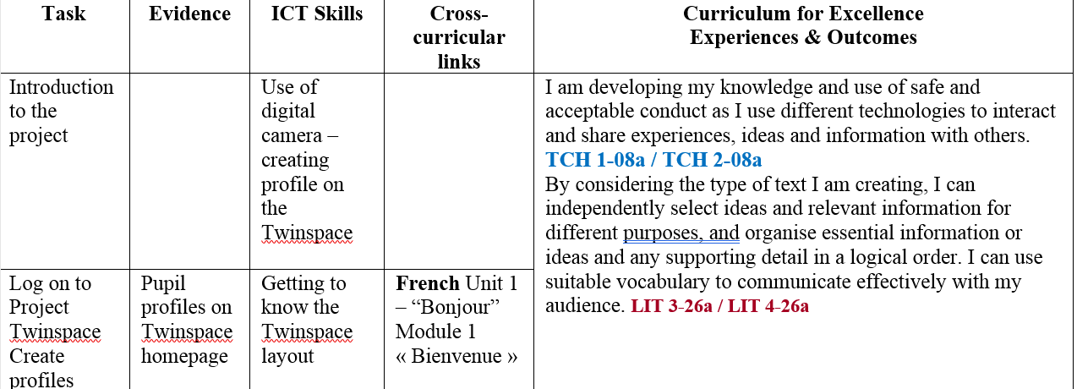
Curricular integration
Notes:
Make is easy for the evaluator to see explicit links to the curriculum

Slide 9
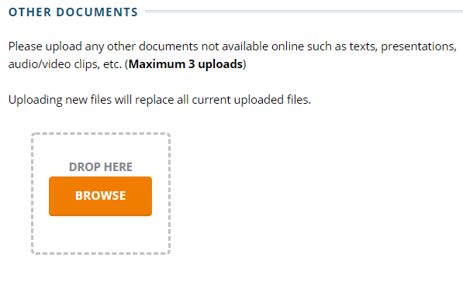
Curricular integration
Notes:
Upload files in the QL application form to draw attention to key documents

Slide 10
Curricular integration
The Earth and Natural Features - Learning from Italy and Northern Ireland
“The project work was completed within geography lessons in school, set as active learning tasks and as independent homework activities. Pupils were fully aware of the objectives of the project and how it would help them develop competencies and support their end of topic test.”
https://twinspace.etwinning.net/48835
Notes:
Rachel Sloan 139182
Pupils were 13-14 years of age
“Within my scheme, I focus on case study examples of volcanoes, therefore the project fitted into classwork as pupils were required to know about Mount Etna, so creating profile pages/presentations via Apps on the iPad and learning from students in Sicily was an excellent opportunity for my students to enhance their geographical knowledge and understanding. Having chat sessions with the students in Sicily allowed my students to find out facts and learn about the geography of a different country.”

Slide 11
Results, impact and documentation
Make sure that:
the project results are presented online
pupils are involved in the TwinSpace
all steps of the project are documented including planning - activities' description - evaluation - feedback
you evaluate and publish the impact that the project had on the pupils and teachers involved in the project.

Slide 12
Documentation – What do we mean?
We want to see your journey, we don’t just want to see your final product
Use pages and subpages, make your journey clear
We want to see how your aims in your Innovation and Curriculum sections were addressed.

Slide 13
Impact - What do we mean ?
We want to see if participants of the project or even observers of the project have been effected by the project
How have you captured this?
What are the results and what do they mean?
Have your aims and objectives been accomplished?
We want to see how you have disseminated your work and how you have done this?

Slide 14
Results – What do we mean?
What final products have you created?
How have you done this? Is it in the classroom or in the TwinSpace? Or Both
We need to see the full journey to the result, i.e planning, evaluation and feedback.

Slide 15
Task: Please work in Groups of 3 to answer these questions
Which are three main groups that you could ask to evaluate your project?
List as many ways that you can think of how to disseminate your work?
List three ways you could capture feedback? (Think about different age groups and abilities and participants)
Bonus Question: How should you approach your documentation?

Slide 16
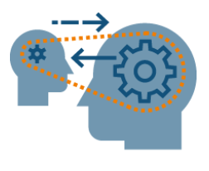
Communication and exchange between partner schools
the information sharing has identifiable goals
communication between pupils is a clear goal for the teachers
pupils can share the work, deal with the same topic, interact and come up with a final outcome
communication activities are designed to encourage pupils to read, listen and view the work of their partners.

Slide 17
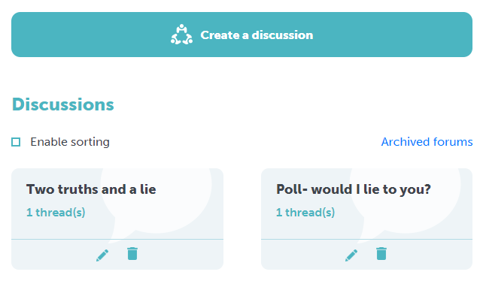
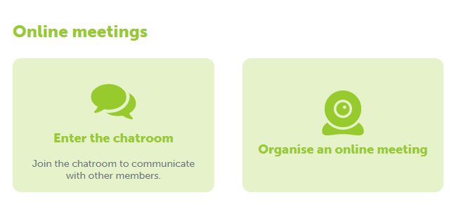
Getting beyond basic email exchange

Slide 19
Collaboration between partner schools
partner schools work together to accomplish joint activities
partners are not just recipients of information
collaborative activities result to a tangible outcome
Notes:
The Earth and Natural Features - Learning from Italy and Northern Ireland
https://madmagz.com/magazine/1197377

Slide 20
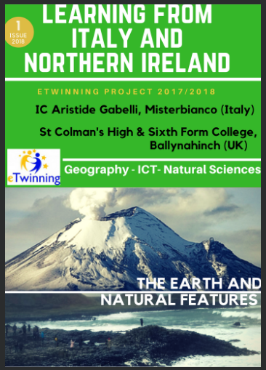
eBook
https://madmagz.com/magazine/1197377

Slide 21
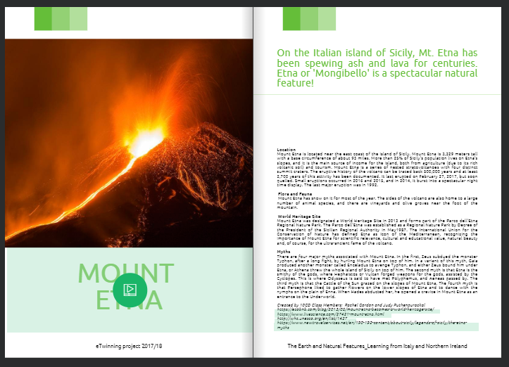
eBook
https://madmagz.com/magazine/1197377

Slide 22
Use of technology
the technology is used to help the partners achieve their pedagogical objectives
the tools help partners to collaborate better among themselves
Notes:
This criterion focuses the good adaptation of technology as a facilitator of both authentic interaction and collaboration between the project partners, as well as of the creation of content.

Slide 23
Use of technology
Other considerations:
Is there responsible use of technology?
How is eSafety managed?
Notes:
Other important considerations:
What digital skills are improved?
Is there good awareness of eSafety issues insofar as pupils are not identifiable. Are copyright issues on images, music, etc. observed?

Slide 24
Use of technology answers
ICT use was improved for both pupils and teachers, as they searched to find out more about the project topic. We used email, Skype and TwinSpace for communication with the partners & created PPT’s and short video clips.
The use of photos being exchanged via the website.
Both computers and ipads were used during this project. Many different applications and websites such as dotstorming for the voting, padlet to create common sharing places, canvas to create cards, vimeo to upload videos over Christmas, answergarden to encourage feedback on the advent calendar, leaning apps and quizlet to create vocabulary games, smore to create the school posters and google forms were extensively used.
Notes:
Typical answers

Slide 25
Main things to remember when applying
Document the process not just the result
Collaboration is king
Wait until the project is finished
Work on the application together
eSafety and responsible use of the internet is a given
Talk to us – we’re there to help!

