Slide 1
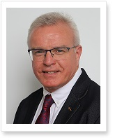
eTwinning Ambassadors ~ The Junior Version
‘A tale of two schools’
Markella Afenti-Sassis
Derek Harkness

Slide 2
eTwinning Ambassadors ~ The Junior Version
Objectives:
To outline the process of building a pupil-led eTwinning team
To clarify the roles of eTwinning Student Ambassadors
To give examples of eTwinning Ambassadors’ practice
To explore the potential for eTwinning Student Ambassadors ~ next steps
To allow time for questions/queries

Slide 3
eTwinning Ambassadors ~ The Junior Version
How to build eTwinning projects in a primary school setting through student participation and autonomy
Carr’s Glen Primary: eTwinning School Label 2019-2021
Little Hadham Primary: eTwinning School Label 2019-2021 & Accreditation of ISA 2019-2022

Slide 4
eTwinning Ambassadors ~ The Junior Version
Why?
Difficulties:
Teachers’ workload / resistance
Pupils’ inability & inexperience to use twinspace
Teachers’ and pupils’ ICT skills
School ethos and values
Requirement for full accreditation of ISA: the majority of students, across various age ranges to participate in activities.

Slide 5
eTwinning Ambassadors ~ The Junior Version
How?
Job description:
To support pupils and teachers to participate in projects.
Criteria:
Enthusiasm, motivation, desire to learn and support
No essential ICT skills
Be able to demonstrate basic ICT skills (Carr’s Glen)
Different ways for selection:
Democratic way of choosing: Whole school election
Interviews held by ICT Co0rdinator and Ambassadors
Ambassadors’ club

Slide 6
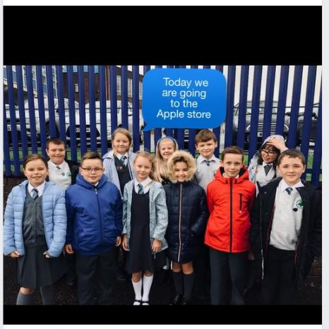
eTwinning Ambassadors ~ The Junior Version
First steps:
Training
twinspace
eSafety
Discussion on respect, understanding, tolerance
Use of Apps ~ Padlet, Apple Store Training Day

Slide 7
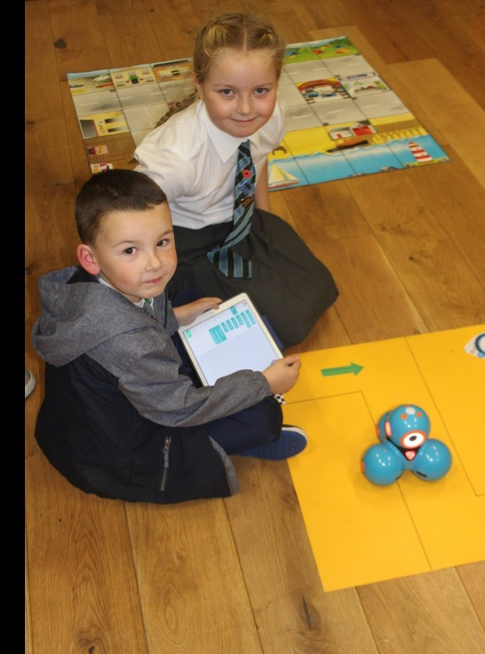
eTwinning Ambassadors ~ The Junior Version
Digital Ambassadors ~ The role of a Junior Ambassador – Examples of practice
Support pupils and empower them to use twinspace and to navigate through the journal and the project pages
Read questions to younger ones and record answers to online questionnaires and in forums
Take photos to upload in twinspace
Create materials e.g. PPT presentations
Responsible for project displays
Assisting with parent evenings/open days
Run ICT clubs to develop younger pupils’ ICT skills

Slide 8
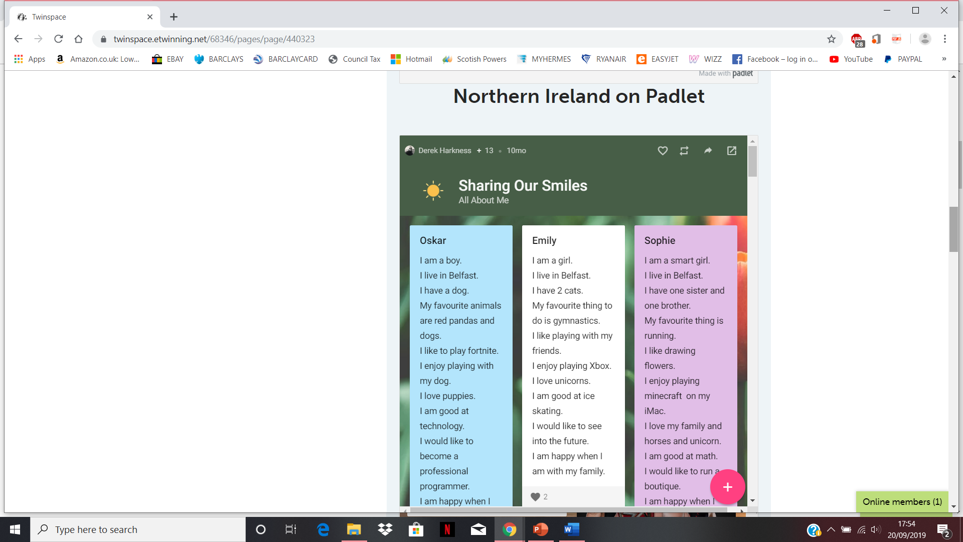
eTwinning Ambassadors ~ The Junior Version
Contributing to a padlet, liking and commenting on posts

Slide 9
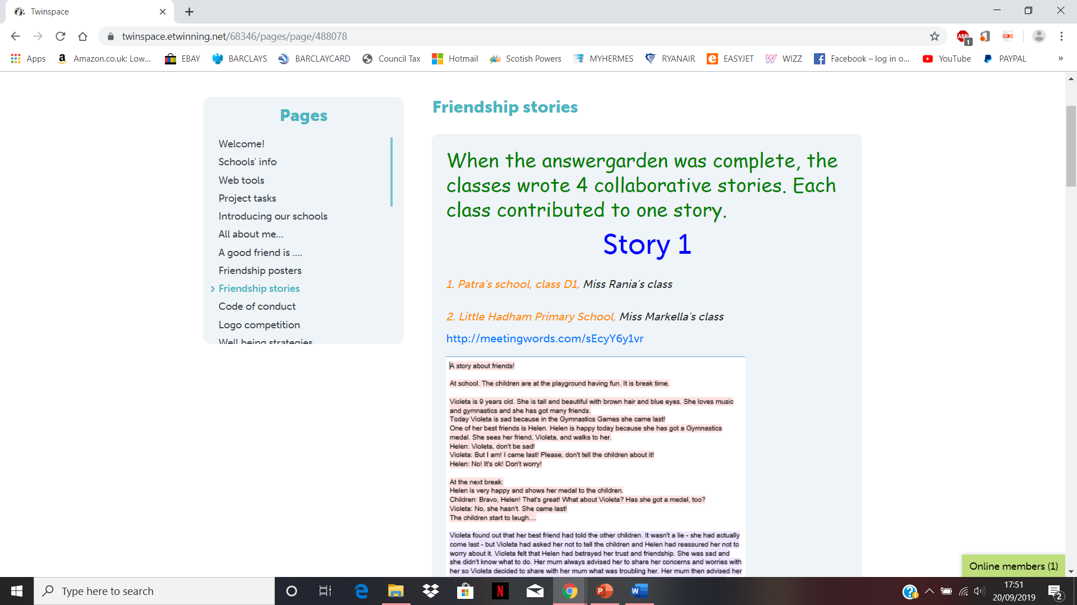
eTwinning Ambassadors ~ The Junior Version
Collaborative stories using meetingwords.com

Slide 10
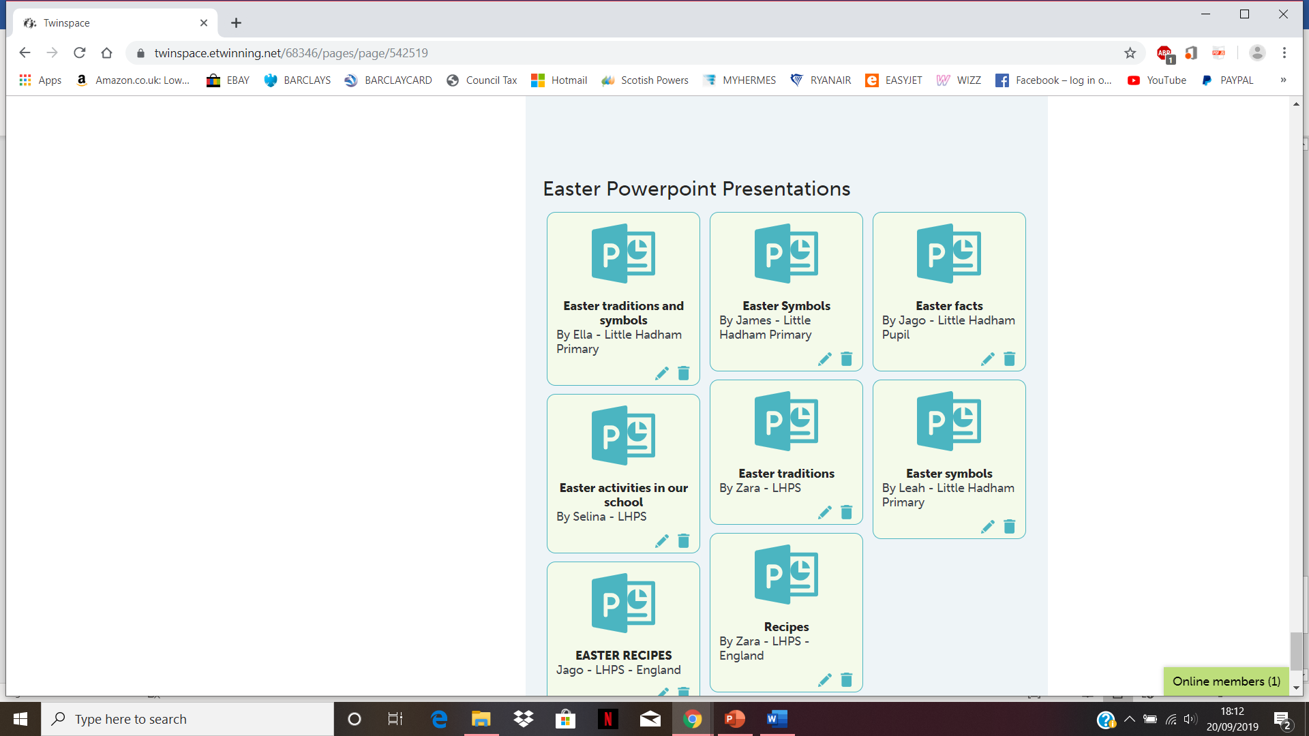
eTwinning Ambassadors ~ The Junior Version
Making and presenting PPT presentations

Slide 11
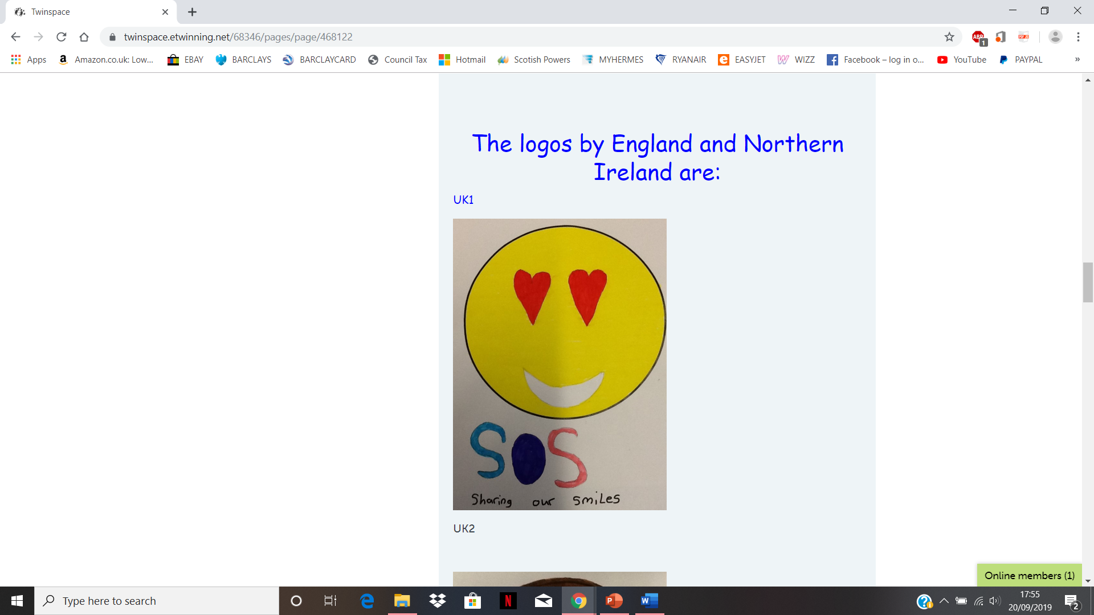
eTwinning Ambassadors ~ The Junior Version
Taking photos and uploading children’s work

Slide 12
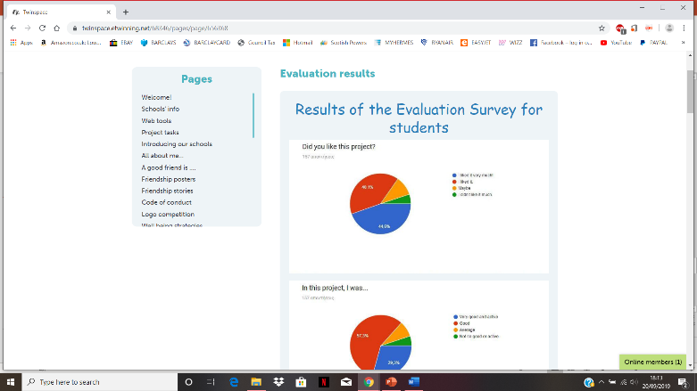
eTwinning Ambassadors ~ The Junior Version
Enabling children to participate in online questionnaires

Slide 13
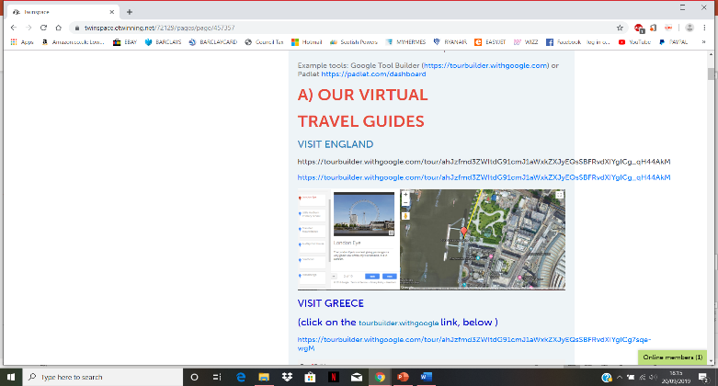
eTwinning Ambassadors ~ The Junior Version
Making materials e.g. Travel guide

Slide 14
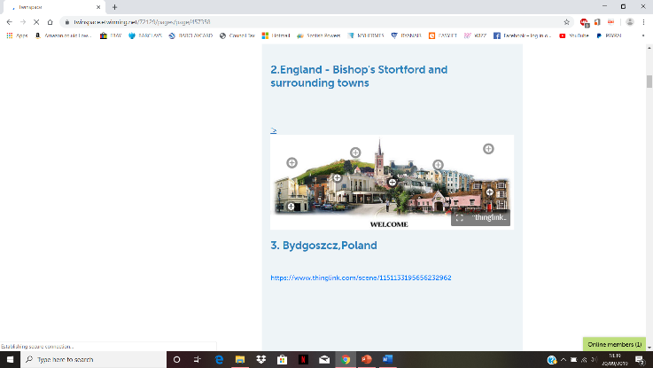
eTwinning Ambassadors ~ The Junior Version
Making materials e.g. Thinglink

Slide 15
eTwinning Ambassadors ~ The Junior Version
Junior eTwinning Ambassadors ~ benefits and outcomes
Enabling peer education
Empowering children / Pupil voice
Ensuring that more children participate in the projects
Getting involved, being inspired, becoming responsible
Building a culture of collaboration
Contributing to the ‘Ethos’ of the school
Raising curricular standards ~ ICT!
Contributing to ISA and/or ICT awards such as NAACE or Digital Schools!
Raising awareness of eSafety!

Slide 16
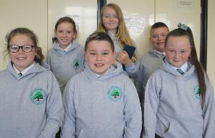
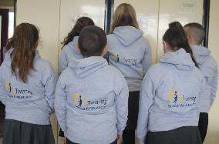
eTwinning Ambassadors ~ The Junior Version
Junior eTwinning Ambassadors ~ ICT tools
Meetingwords.com
Padlet.com
Thinglink.com/edu
PPT presentations
Dash and Dot
Explaineverything.com
Photos app to create videos – use Vimeo, iMovie

Slide 17
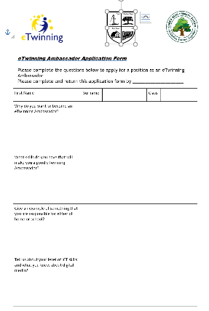
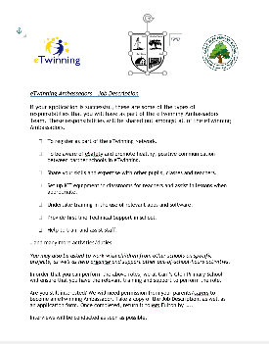
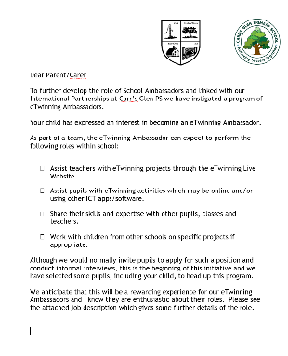
eTwinning Ambassadors ~ The Junior Version
Junior eTwinning Ambassadors ~ next steps

