Slide 1
TRANSNATIONAL MEETING IN LATVIA ERASMUS+ KA2 PROJECT “Information and Educational Materials for Refugees and Immigrants” 06.11.2017

Slide 2
Proficiency Assessment of Eligibility for the Job. Evaluation of the method. Summary.
06.11.2017- 10.11.2017

Slide 3
1. Professional competence assessment;
2. Capacity for labour;
3. Evaluation of the impact of the labour safety system organization on the employee.

Slide 4
1. Professional competence assessment. Scores
Maximal score of component “professional competence” is 3 points, minimum – 0.025 points.
Professional competence can be evaluated as:
High - if it shows at least 1.91 points;
Sufficient - if it shows at least 0.91 points;
Insufficient – if it shows less than 0.91 points.

Slide 5
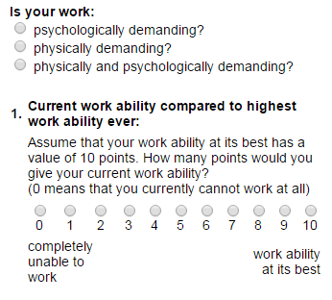
2. Capacity for labour
http://www.arbeitsfaehigkeit.uni-wuppertal.de/

Slide 6
2. Capacity for labour Scores
WAI points | Work ability | Points, aligned to fit The Method
7 -27 | Low | 0
28 - 36 | Moderate | 0.5
37 - 43 | Good | 2
44 - 49 | Excellent | 3

Slide 7
3. Evaluation of the impact of the environmental studies on the knowledge level about possible workplace and place of residence
Points with the index „O” – refer to the minimum knowledge about information on tourism objects, events and routes in Latgale
Points with the index „S” - refer to the most important Latgale and Livani cultural heritage
Points with the index „R” – refer to the requirement of advisory nature, the so-called “good practice” , workshops, skills in a tipical Latgalian crafts.

Slide 8
3. Evaluation of the impact of the environmental studies on the knowledge level about possible workplace and place of residence Scores.
Explanation of results:
Evaluation of the impact of the environmental studies on the knowledge level about possible workplace and place of residence is:
Optimal, if OSR index is more than 83%, that gives 2.5 points;
Acceptable, if OSR index is between 66% - 82%, that gives 2 points;
Unacceptable, is OSR index is less than 66%, that gives 0 points.

Slide 9
Proficiency Assessment of Eligibility for the Job . Total score
Total score | Proficiency Assessment | Explanation
8 – 8.5 | Excellent | Risk reduction measures are not necessary, man has found himself both in the professional field as well as in the specific workplace
6.41 – 7.9 | High | Risk reduction measures are not necessary, professional level is high, but it is necessary to control external factors that may affect the person
3.5 - 6.4 | Medium | Risk reduction measures are necessary according to the weak parts of the formula used
0.91 - 3.4 | Low | With a score like this, changes are required, it is dangerous to continue to do what the analyzed person is doing.
0 - 0.9 | Insufficient | Person is unprepared, person must stop doing his job immediately .

Slide 10
Results
The method is easy to use; the necessary output data are easily accessible, the method application does not require additional financial investment, which is essential for Latvian conditions.
Interpretation of the results makes it easy to identify what improvements are needed, because it reveals “weak stages”, allow you setting priorities for action, revealing what measures needed to be planed first so that the work environment is more safe and healthy, because the main aim of the labour safety system is to provide a safe working environment to employees, protecting them from injuries, diseases and accidents.
It should be taken into account that poor health related to professional activity, including diseases caused or aggravated by unfavourable working conditions is a heavy burden on workers, companies and social security systems.

