Slide 1
ENJOY A HEALTHY LIFESTYLE
Dott.ssa Maria Letizia Leonardi
Biologa nutrizionista

Slide 2
NUTRITION
It provides the necessary “fuel” to carry out synthethic chemical reactions of new compounds (ANABOLISM) and of degradation (CATABOLISM)
Nutrients interact with our METABOLISM = growth, repair and maintenance.

Slide 3
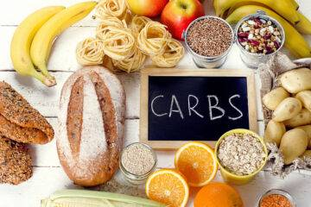
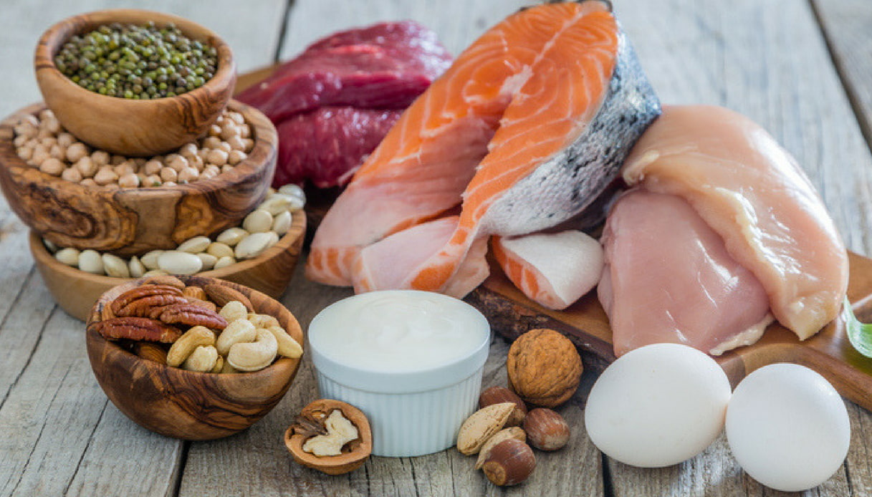
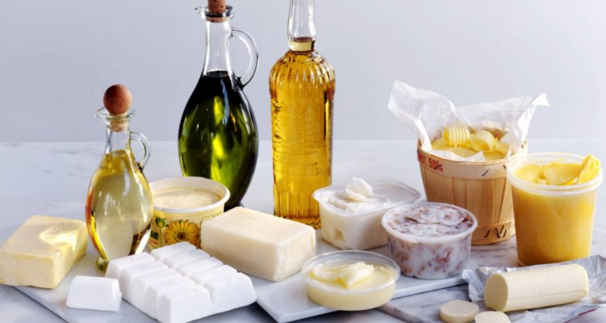
What is food?
Food is a mixture of substances called nutrients
CARBS
PROTEINS
FATS

Slide 4
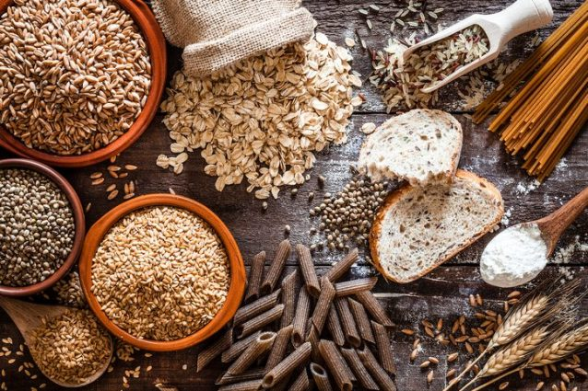
CARBS
Provide energy
Store energy
They can be split into two categories: Sugars and Starches

Slide 5
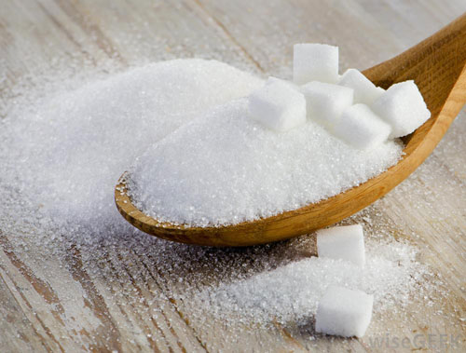
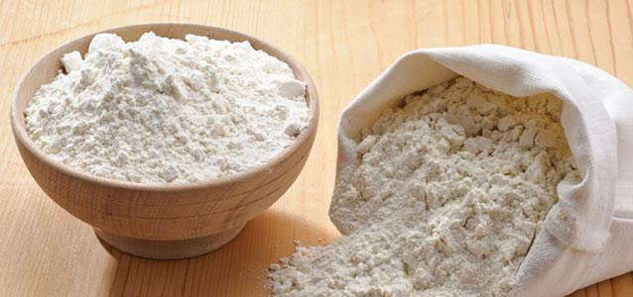
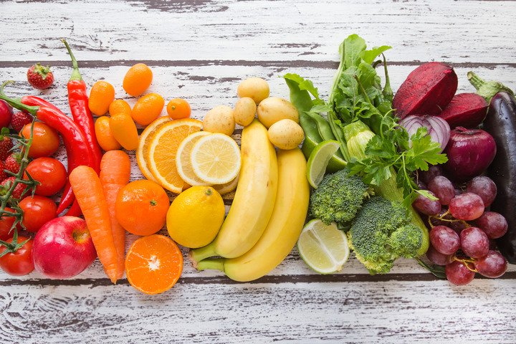
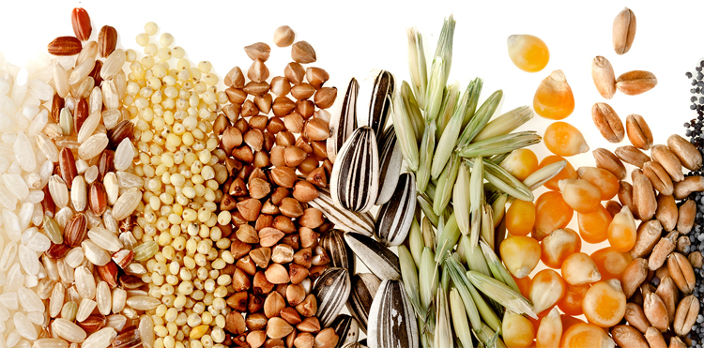
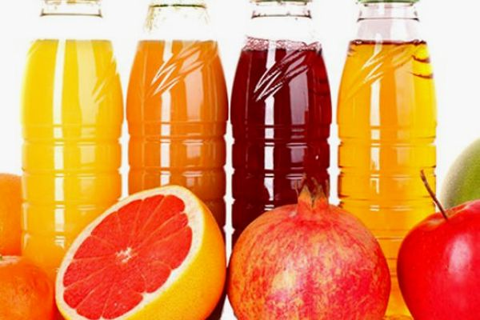
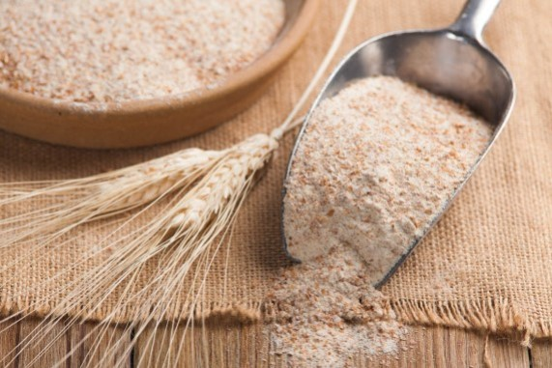
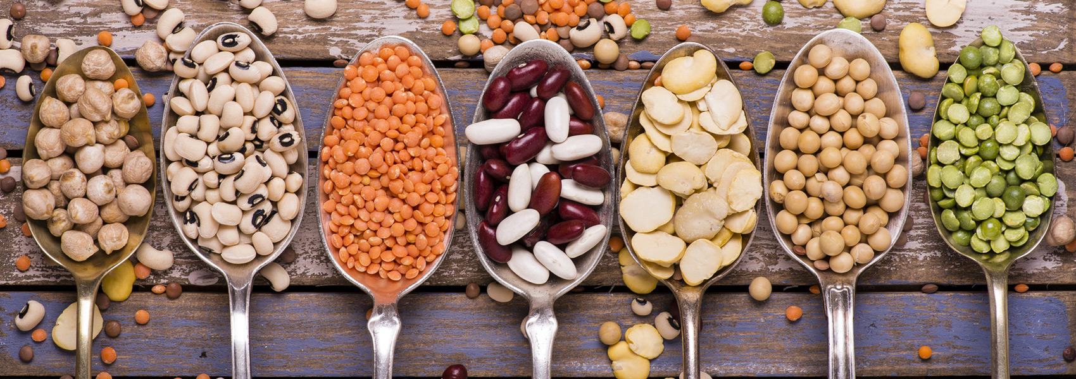
CARBS
SIMPLE SUGARS
- They can be found in sugar, in products containing refined flour, in cakes and sweets, in soft drinks, in fruit juices, etc.
If you eat too many of them they are metabolized as fat and lead to an increase in blood sugar
COMPLEX CARBOHYDRATES
They can be found in fruit, vegetables, legumes, cereal, potatoes and products containing wholemeal flour ...
They are rich in fiber and they are to be preferred to simple sugars.

Slide 6
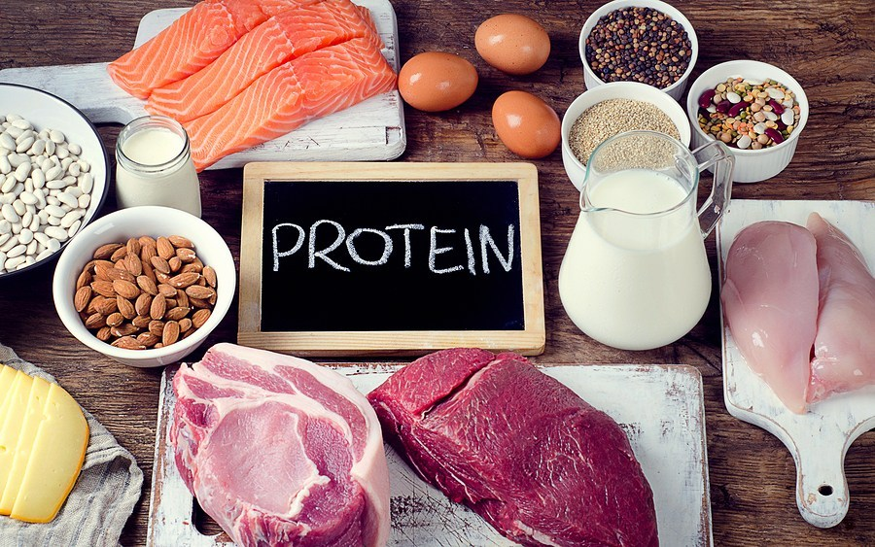
PROTEINS
Important functional structure: muscles, bones, nails, skin, hair.
Regulatory and transport functions in biochemical reactions
Immune, protection and hormone functions.
They are divided into two big categories: animal origin proteins and vegetable origin proteins

Slide 7
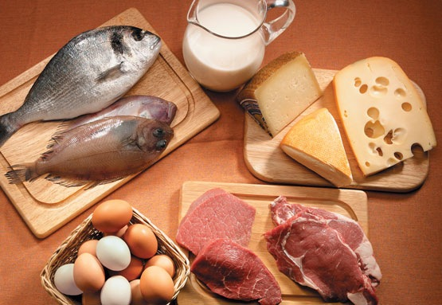
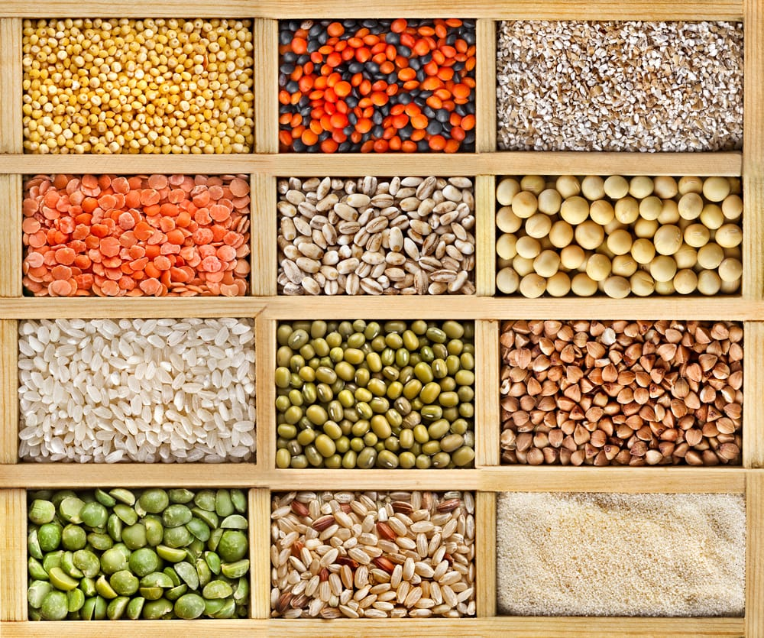
PROTEINS
ANIMAL origin
They can be found mainly in meant, fish, eggs, cheese and dairy products.
They are of a high biological value because formed by amino acids that our body is not able to synthesize.
VEGETABLE origin
They can be found mainly in cereal, in some vegetables and in legumes.
Compared to the ones of animal origin, they lack some essential amino acids and are not very digestible.

Slide 8
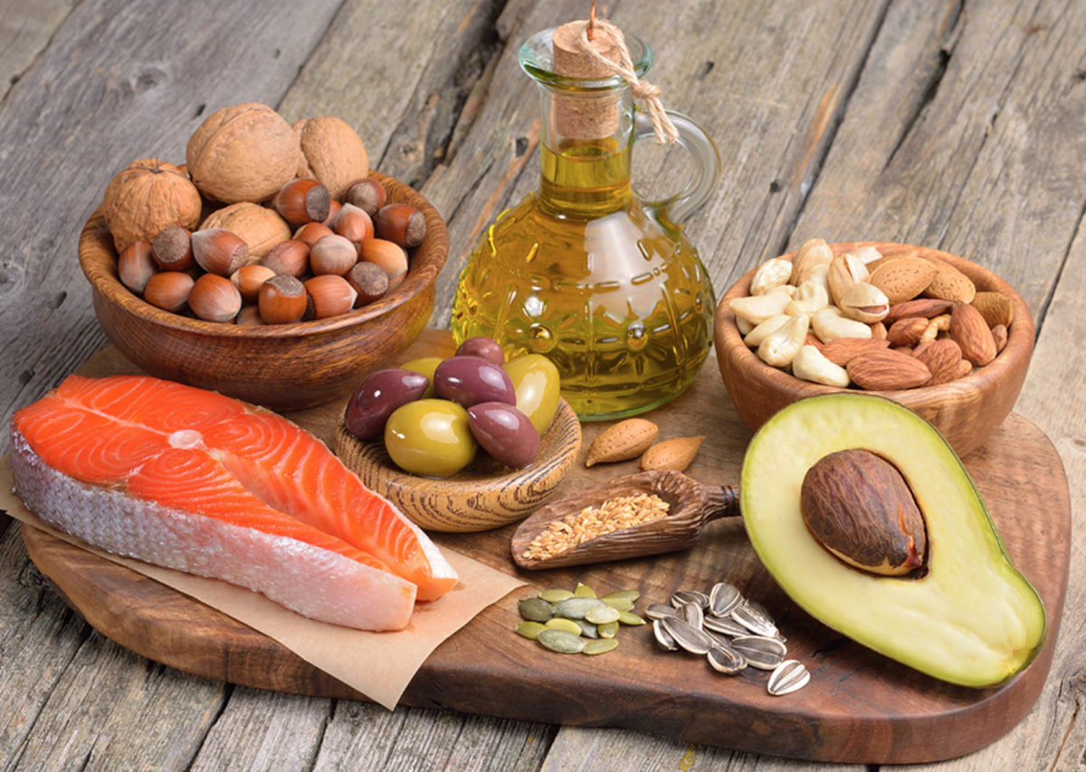
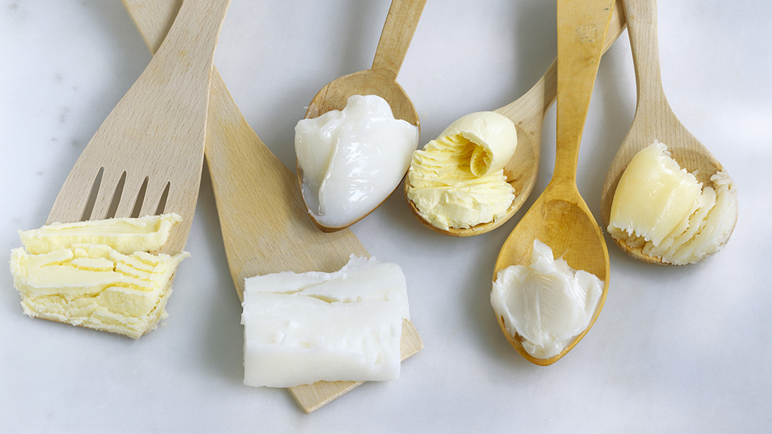
FATS
They have a great energetic power
They store and provide energy
They constitute cellular membranes and support tissues and organs
They are precursors of many hormones
They can be divided into animal or vegetable fats

Slide 9
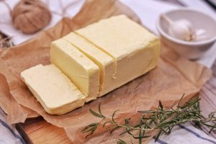
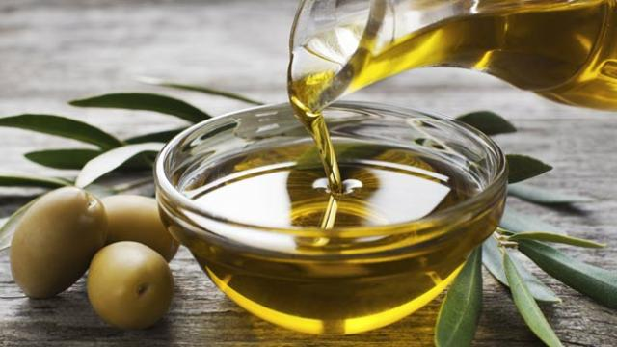
FATS
ANIMAL origin
They can be found in butter, lard, bacon, cream ...
They are rich in saturated fats, they should be used in moderation
Eating too much of these can lead to an increase of fats in blood (cholesterol and triglycerides) and increased body fat.
VEGETABLE origin
They are extracted from fruit or seeds like olive oil, peanut oil, sunflower oil, coconut etc..
They are rich in good fat acids
If used in moderation they provide benefits
It is better to use vegetable fats than animal fats

Slide 10
Mediterranean Diet

Slide 11
Mediterranean Diet
It’s not a simple diet, in 2010 UNESCO declared it Intangible Heritage of Humanity
A bit of History
It dates back to a food model adopted by the people that overlook the Mediterranean Sea since the sixties. The American physiologist Ancel Keys compared diets in seven countries (Finland, Japan, Greece, Italy, The Netherlands, the USA and Yugoslavia) in the study called “Seven Countries Study”.
The study reported that among the people of the Mediterranean Sea area, the mortality rate from cardiovascular pathologies was much lower than for other countries.

Slide 12
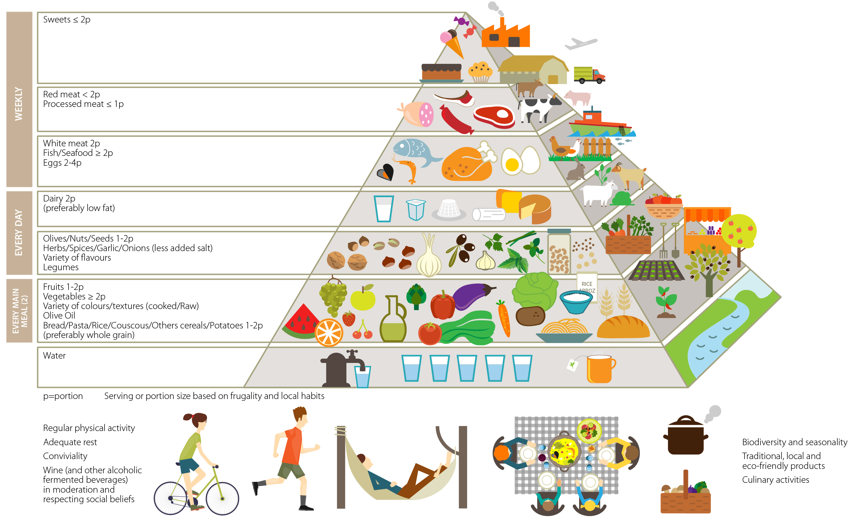
Food Pyramid
New Pictorial Proposal for an Environmental, Sustainable Mediterranean Diet

Slide 13
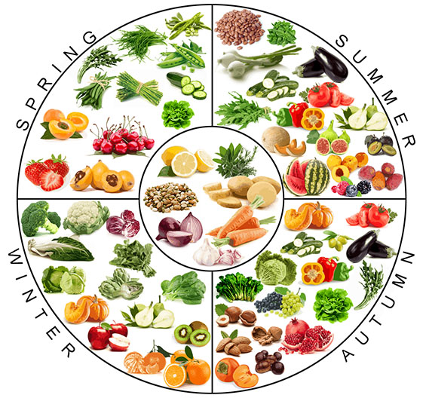
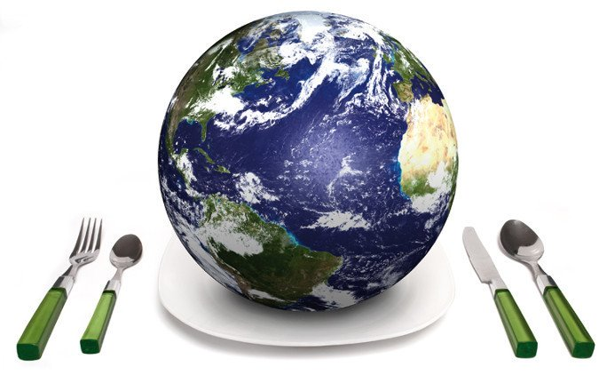
Food Pyramid
Seasons and territories
friendship
frugality
sustainability

