Slide 1
Mobility in Terni
4th - 8th November 2019

Slide 2
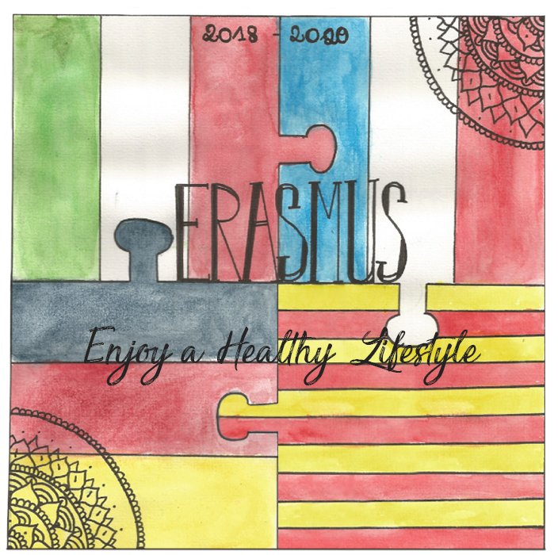
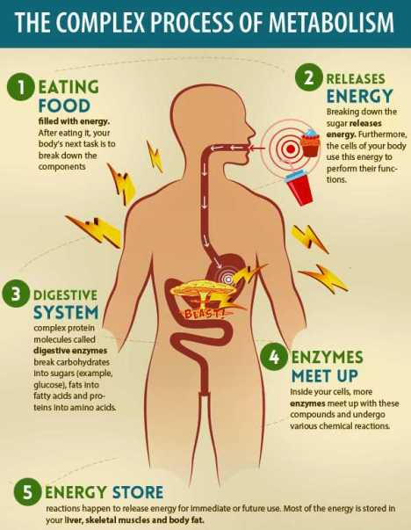
What is metabolism?
Leaflet: digital or paper
eTwinning

Slide 3
Meeting fencing champions
Interview: writing questions in your notebook and in eTwinning and videos

Slide 4
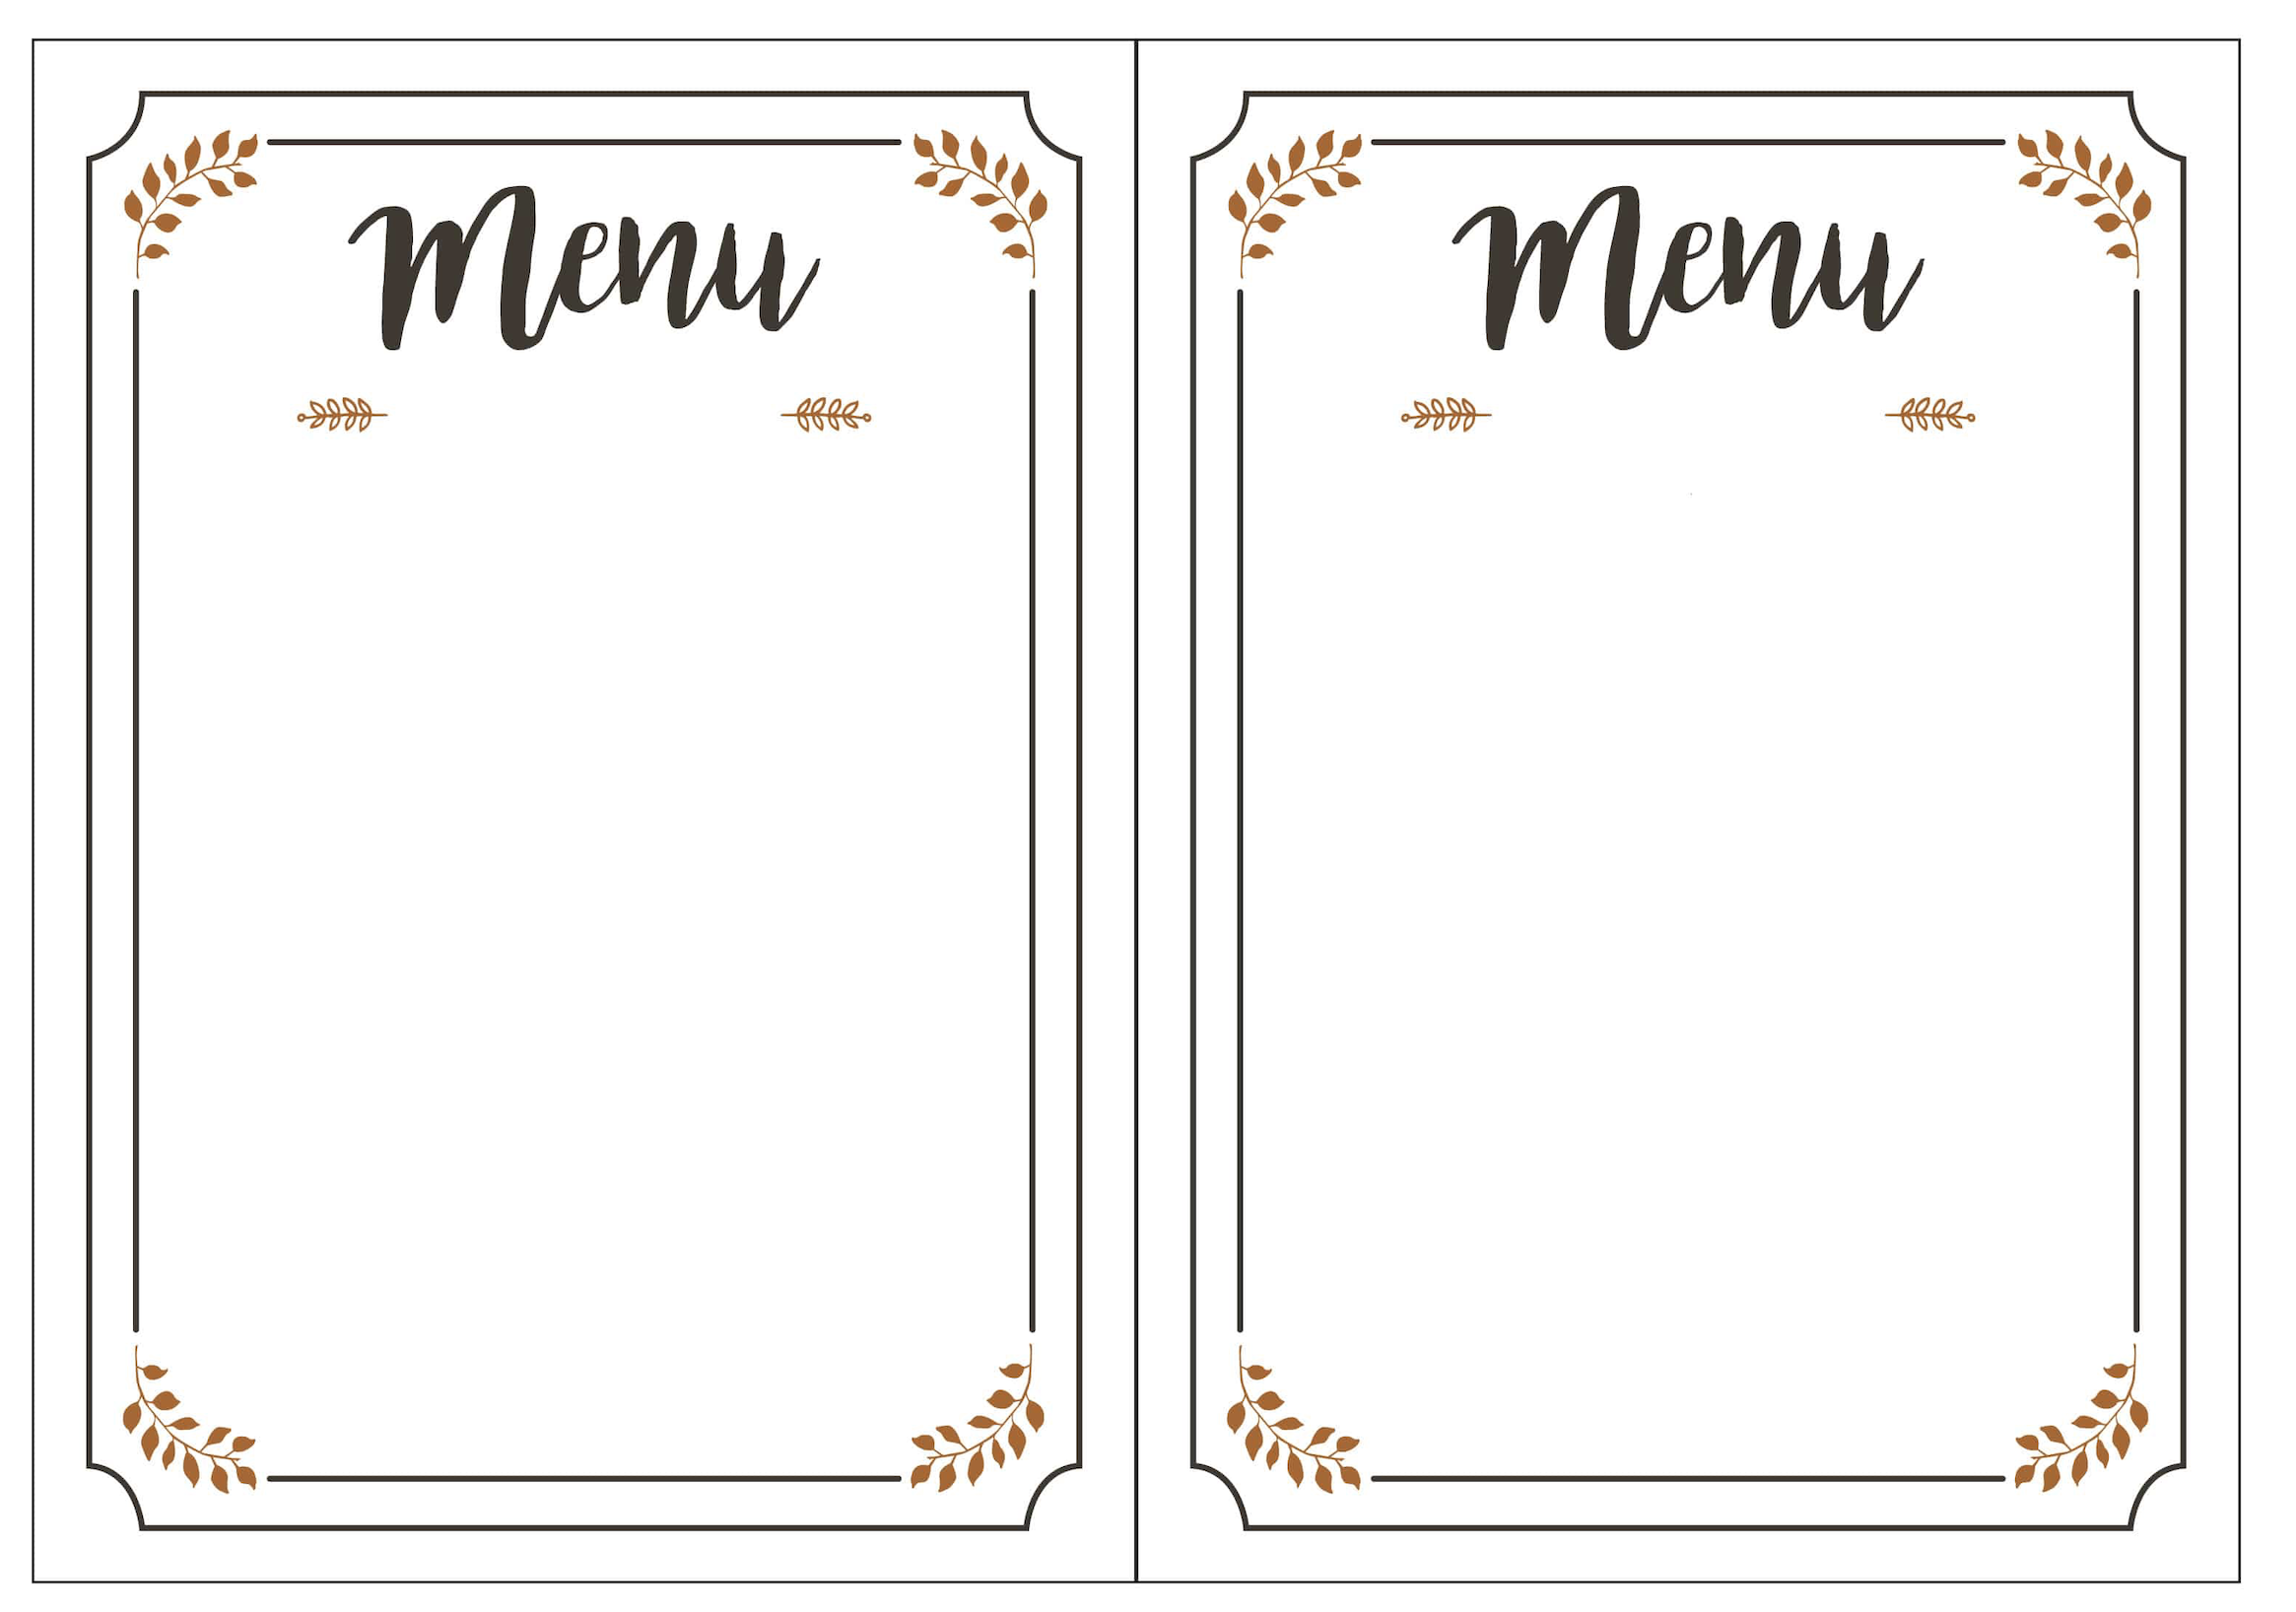
Meeting with nutritionists
Ideal menus: digital or paper and in eTwinning

Slide 5
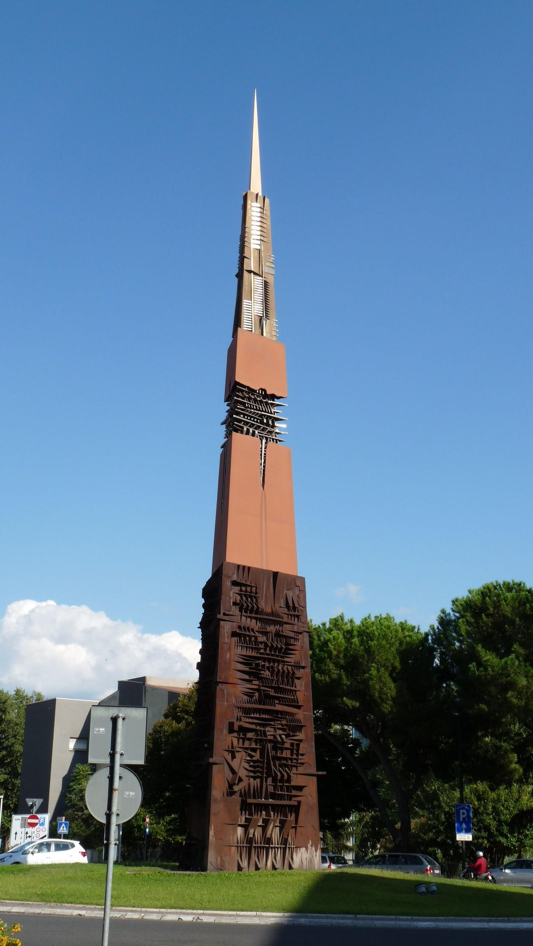
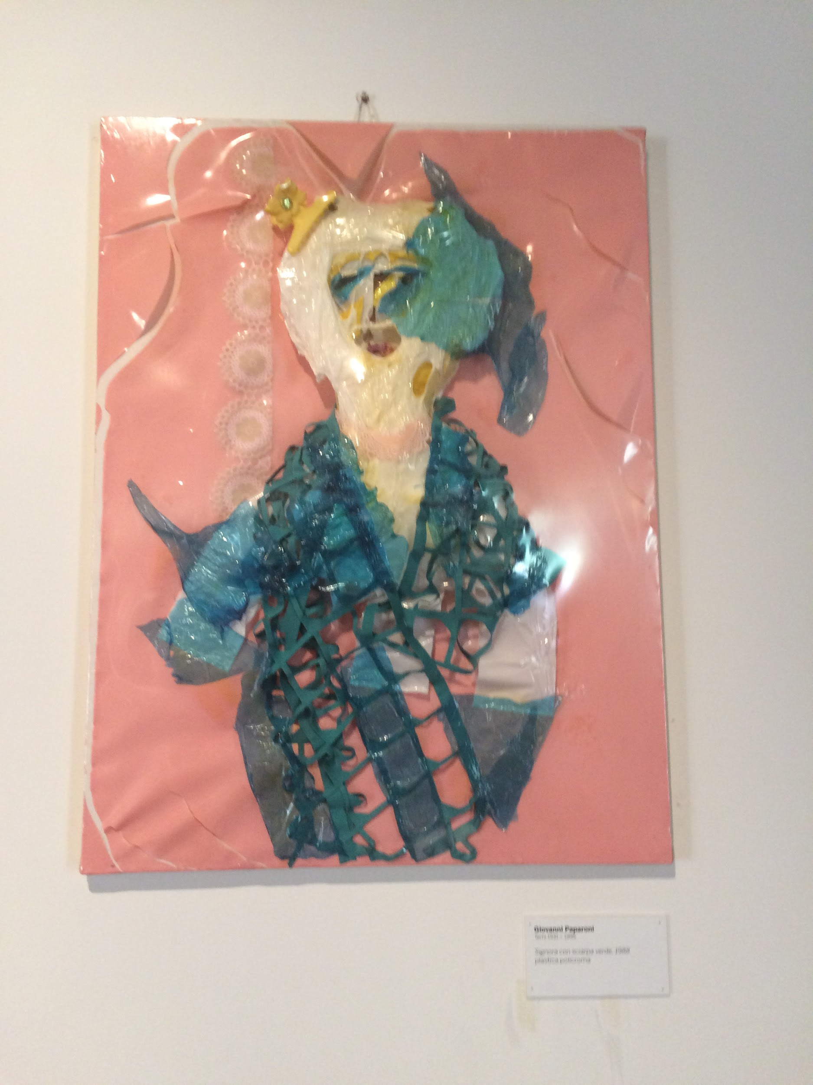
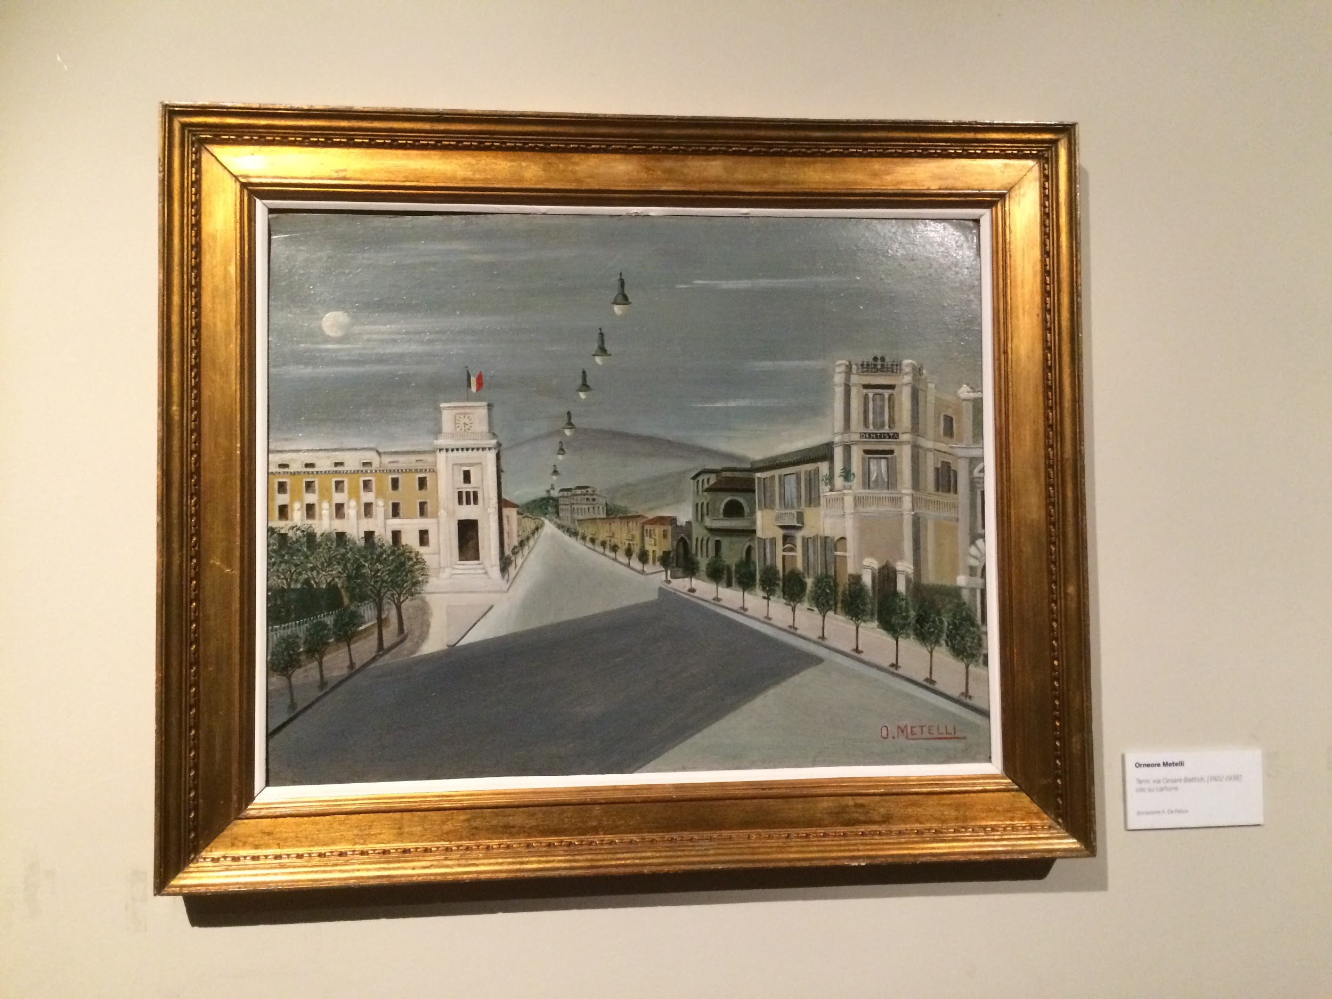

Slide 6
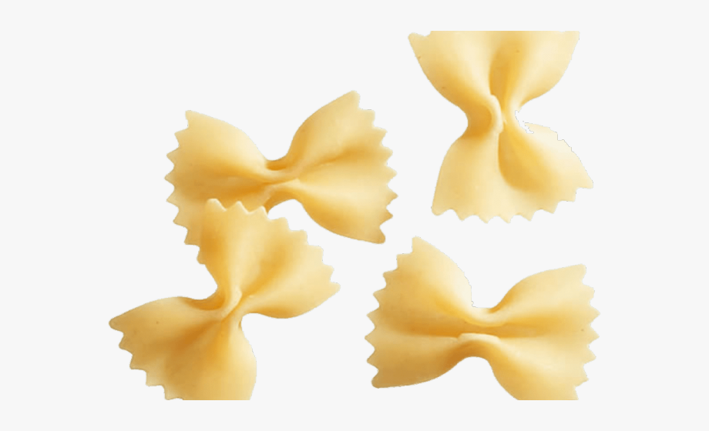
Team 1 “Farfalle”
Alessandro Montanucci
Matilde Marziali
Gaia Tini Brunozzi
Damien Forster
Leticia Radic
Joana Canal Garcia
Carolina Narciso

Slide 7
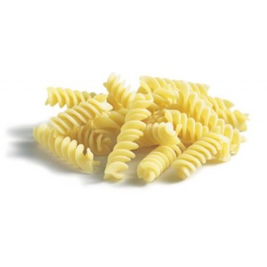
Team 2 “Fusilli”
Cecilia Murgante
Matteo Piantoni
Elena Sofia Lausi
Lucile Bordier
Matilda Eichler
Pau Monne Mor
Juliette Coquard

Slide 8
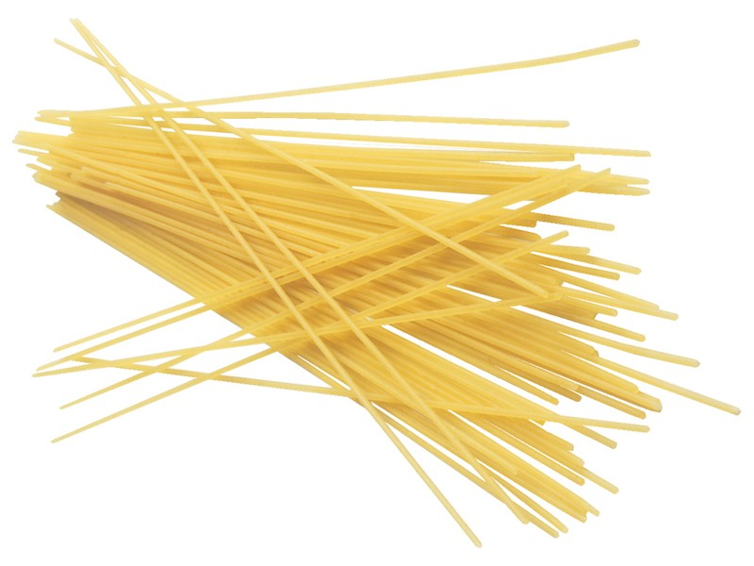
Team 3 “Spaghetti”
Sofia Verlengia
Chiara Maria Di Giulio
Simonetta Clericò
Manon Fournerot
Sonja Hocke
Pau Izquierdo Fauria
Gabriele Piccioni

Slide 9
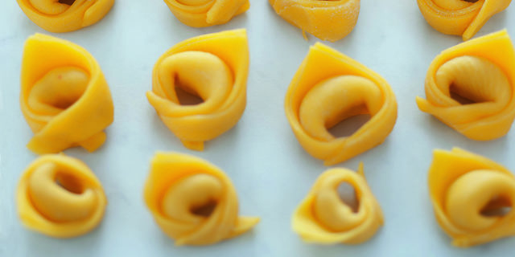
Team 4 “Tortellini”
Benedetta Befani
Giulio Amoroso
Emma Venanzi
Juliette Sonzogno
Lina Sophia Ummethun
Maria Sanchez
Daniel Gil

Slide 10
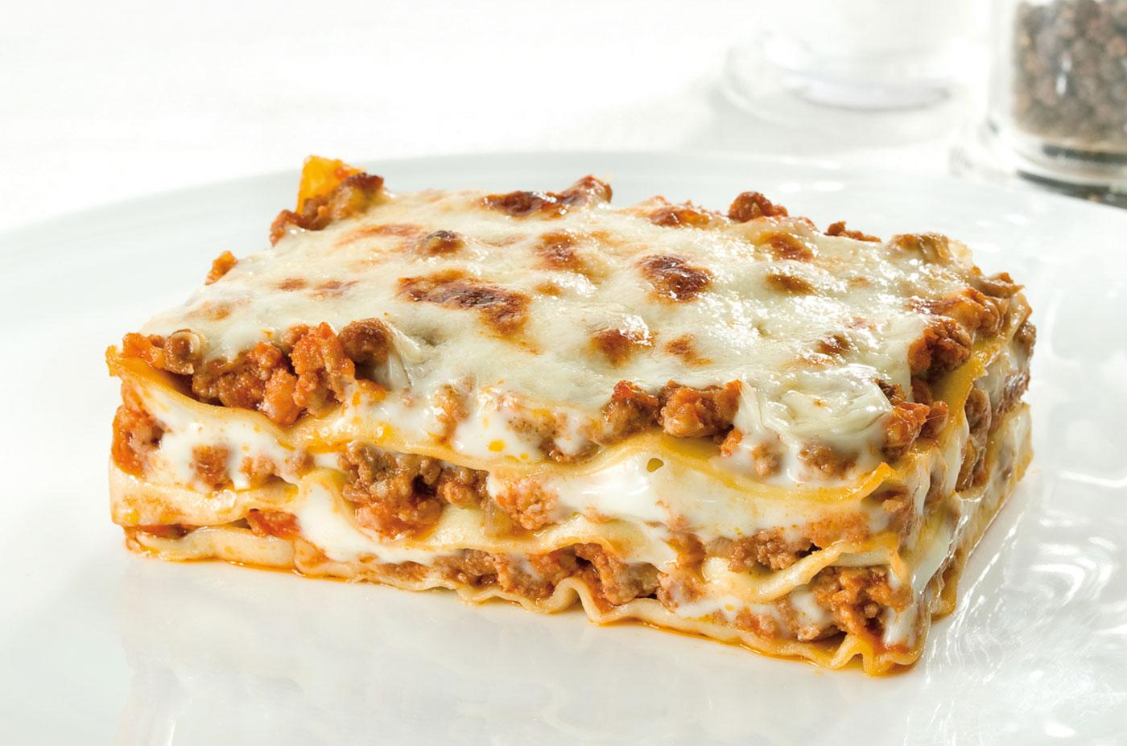
Team 5 “Lasagne”
Piergiuseppe Scialpi
Giulia De Giorgis
Flaminia De Santis
Fanny Colfort
Ella Maria Klotchkov
Celia Nogueras Pascual
Alessandro Piantoni

Slide 11
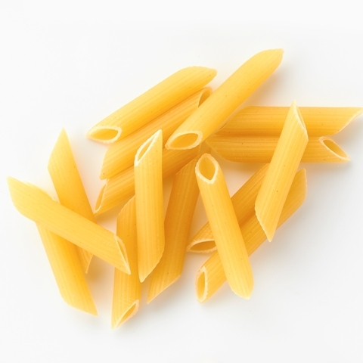
Team 6 “Penne rigate”
Alessandro Mangoni
Gaia Piccioni
Giulia Di Blasi
Robin Bouvier
Fiona Kramer
Julia Pujol
Lucia Sampalmieri

Slide 12
Happy Erasmus plus week!

