Slide 1
Erasmus + 1ª Mobilitat: Troyes-França
Reunió informativa
Torrefarrera, 20/02/2019

Slide 2
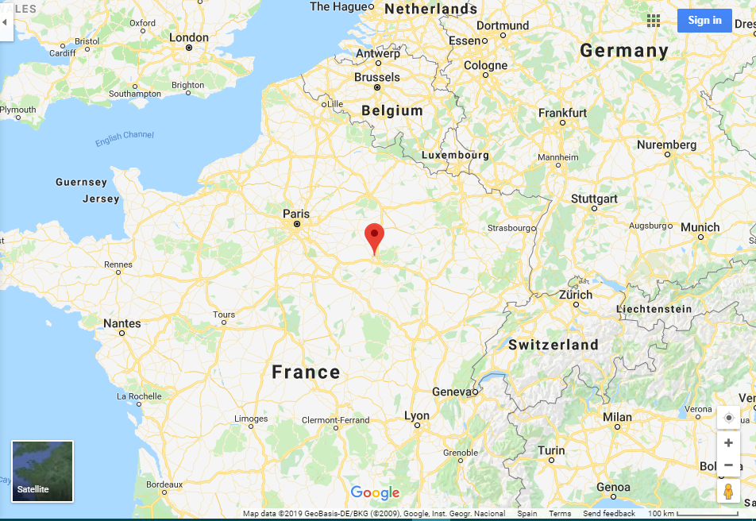
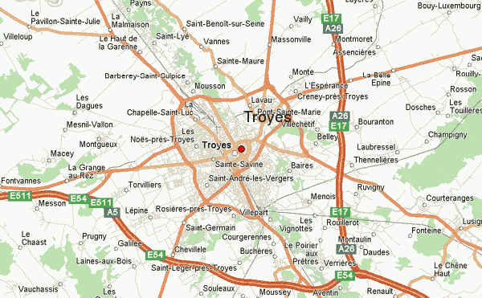

Slide 3
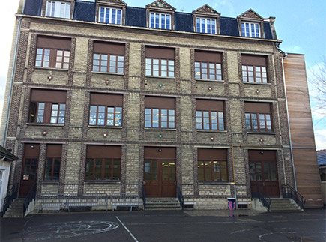
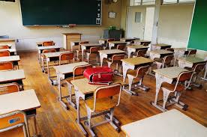
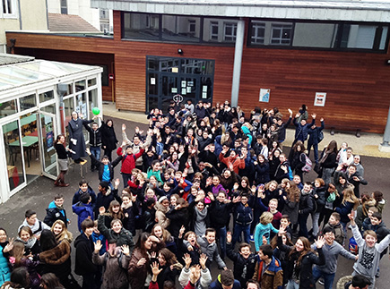
École Privée Louis Brisson
Ste Savine - Troyes

Slide 4
PLA DE MOBILITAT
4 a 8 de març de 2019 (dilluns a divendres)
PROGRAMA DE TREBALL
All the mindful activities achieved during this program will lead to the creation of brochures about managing stress as a final task.
Monday March 4th
Depending on your arrival time at school :
Germany : 1:30 pm Spain : 2:30 pm Italy : 6:00 pm
The taxi will have your name on a sign and will pick you up after your baggage claim
Guided tour of the school
Refreshments snacks
Ice-breaking games
Pick-up by host families

Slide 5
Tuesday March 5th
Each student will receive a well-being journal
- 8:30 : Welcome ceremony
- 9:30 : Voting for the logos and snacks
- 10:00 : International Teams : ice-breaking activity
- 10:30 : Mindful workshops : Meditation
Sophrology
Origami
Calligraphy
- 12:00 - 13:45 : Lunch at the cafeteria + well-being journals activities
- 13:45 : Mindful visit of Troyes : Theme : FOCUS
Teamwork with questionnaires
- 16:45 : Host families
Wednesday March 6th
Mindful visit of Paris - Theme : The five senses
8:00 : Departure
Eiffel Tower
Cruise on the river Seine
Several mindful activities will take place during the day.

Slide 6
Thursday March 7th
- 8:30 - 9:00 : Well-being journal
- 9:00 : Team games
- 10:00 – 12:00 : Preparation of the brochures “Manage your stress”
- 12:00 - 13:45 : Lunch at the cafeteria + well-being journals activities
- 13:45 : Designing of the brochures on the computer with the art teacher and the librarian.
(Meanwhile the 8 teachers from the different countries will work on the reports)
- 16:45 : Host families
Friday March 8th
- 8:30 - 9:00 : Well-being journal
- 9:00 – 10:00 : Workshops about five senses
Time of your departure from the school :
Italy : 1:00 pm Germany : 2 pm Spain : 4:30pm

Slide 7
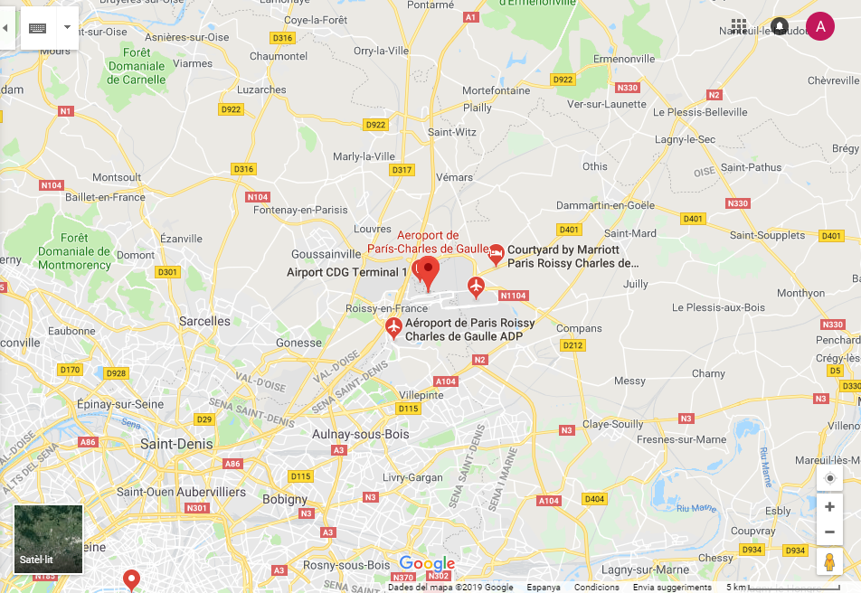
AEROPORT

Slide 8
EQUIPATGE
Equipatge de mà estàndard (56x45x25 cm - 10Kg- incloent anses i rodes) per pujar a cabina de passatgers. Cap accessori. Porteu una motxilla petita dins la maleta.
Els líquids només es poden dur a bord en contenidors de 100 ml com a màxim, en una bossa de plàstic transparent, amb tancament hermètic, d'un litre de capacitat i de 20 x 20 cm. El seu equipatge s'examinarà a l'aeroport.
No porteu ampolles de beguda quan passeu el control!

Slide 9
DOCUMENTACIÓ
DNI actualitzat.
Passaport
Targeta Sanitària Europea (INSS, també possible per telèfon a 901166565, de 9 a 20h, o per Internet).
Permís de Mossos d’Esquadra. Demanen lloc i dates.
Els professors recollirem Passaports, Targetes Sanitàries i Permís de Mossos de tot l’alumnat.
Reserva per imprevistos: 60€

Slide 10
Detalls vols
Dilluns 4 Març: Barcelona (BCN) – Paris (Charles de Gaulle) Easy Jet, volEZY3916
09:50 Terminal 2C – 12:00 Terminal 2D
Divendres, 8 Març: Paris (Charles de Gaulle) - Barcelona (BCN) Easy Jet, vol EZY3921
20:45 Terminal 2D – 22:30 Terminal2C

Slide 11
GRÀCIES PER LA VOSTRA ATENCIÓ

