Slide 1
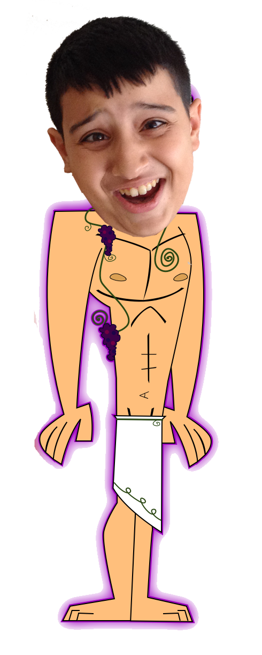
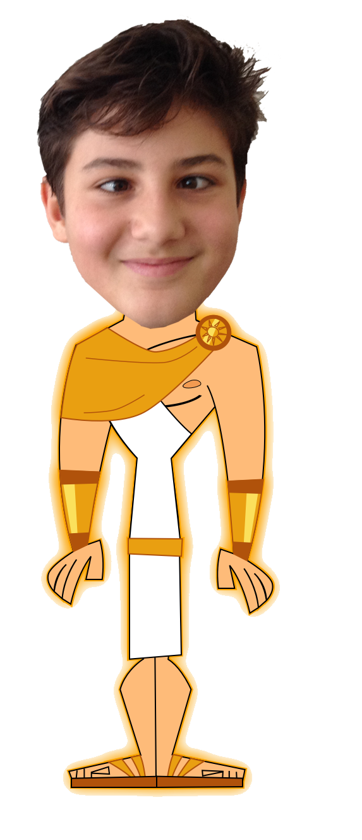
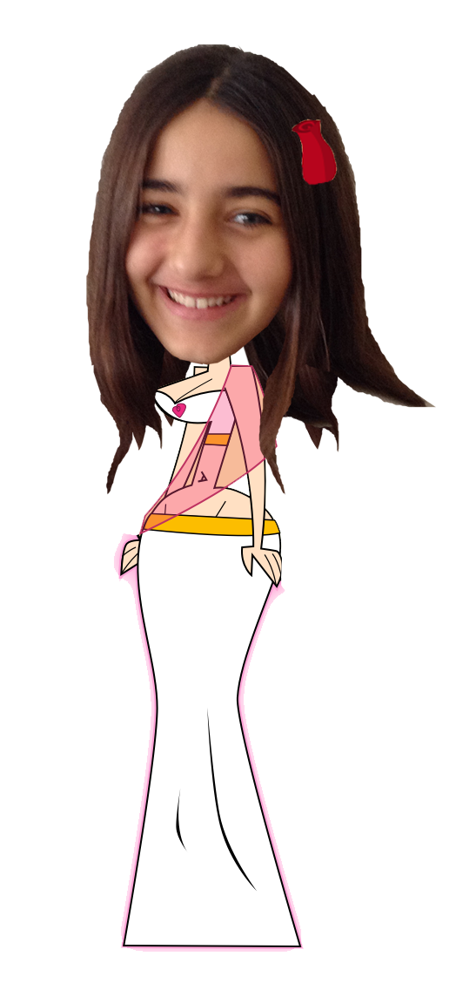
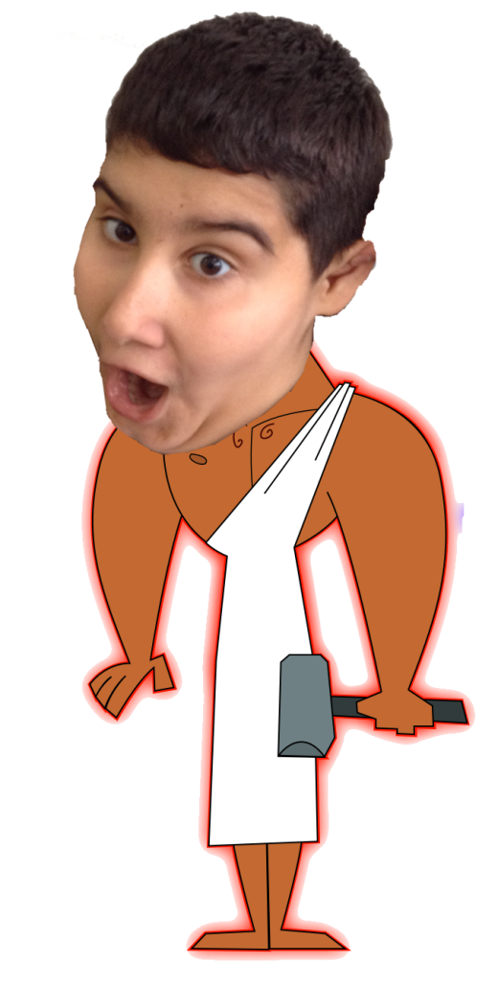

Slide 2
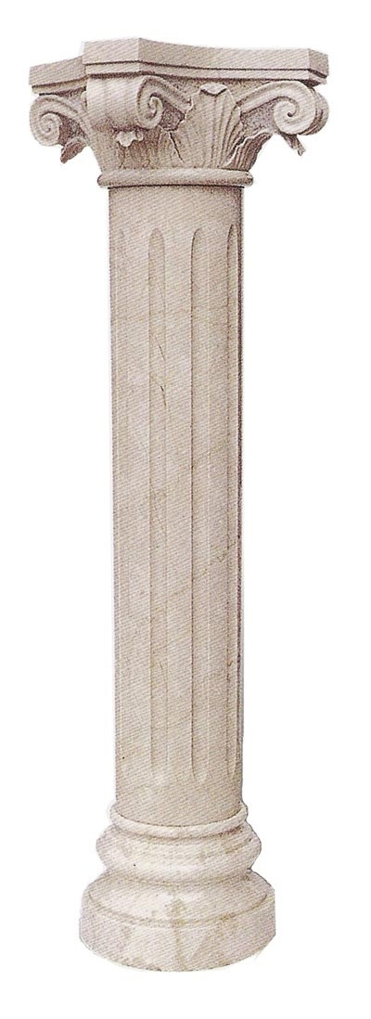
What is my name?
Apollo
B) HADES
C) ARES

Slide 3
A

Slide 4
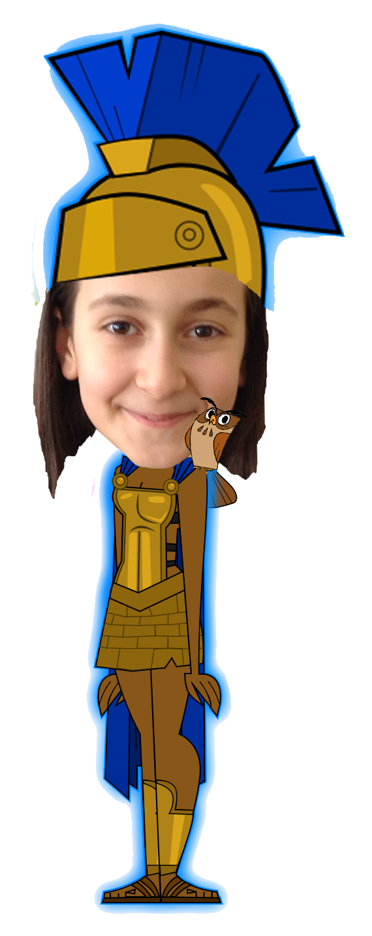
What is my name?
Apollo
B) Athena
C) NIKE

Slide 5
B

Slide 6
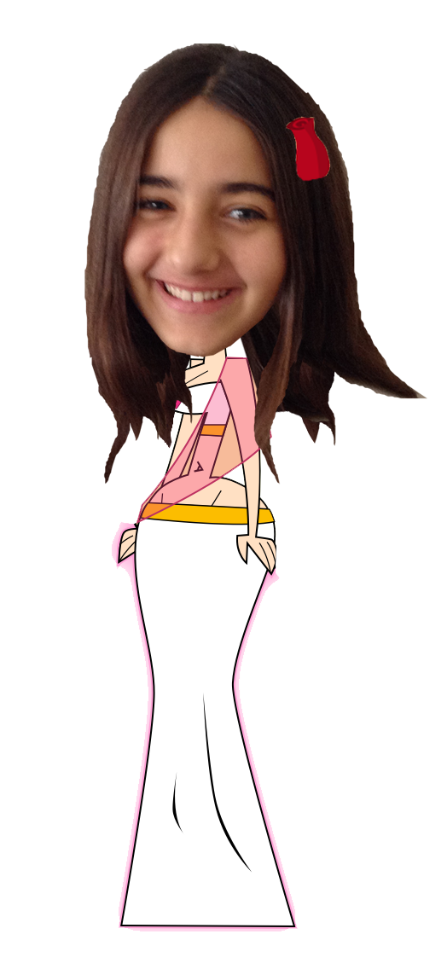
What is my name?
ApHRODITE
B) HERA
C) DEMETER

Slide 7
A

Slide 8
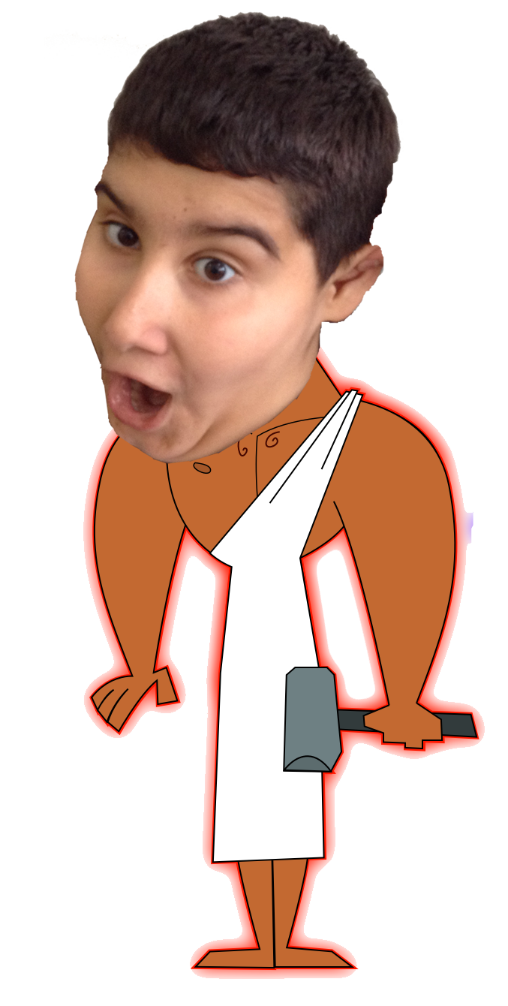
What is my name?
ZEUS
B) HERMES
C) HEPHAESTUS

Slide 9
C

Slide 10
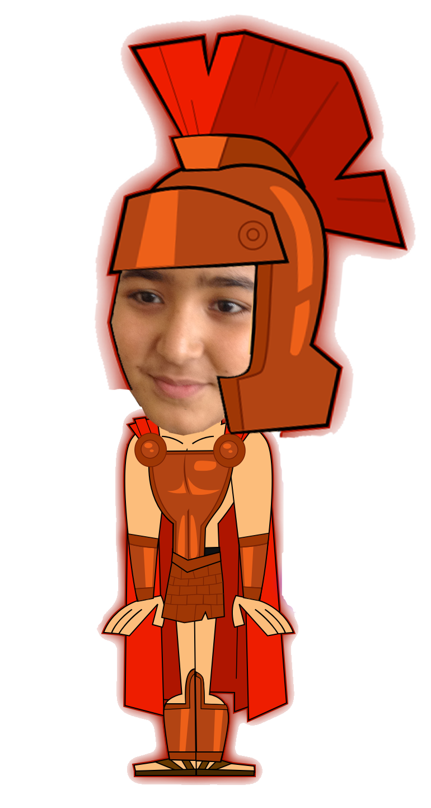
What is my name?
ARES
B) POSEIDON
C) EROS

Slide 11
A

Slide 12
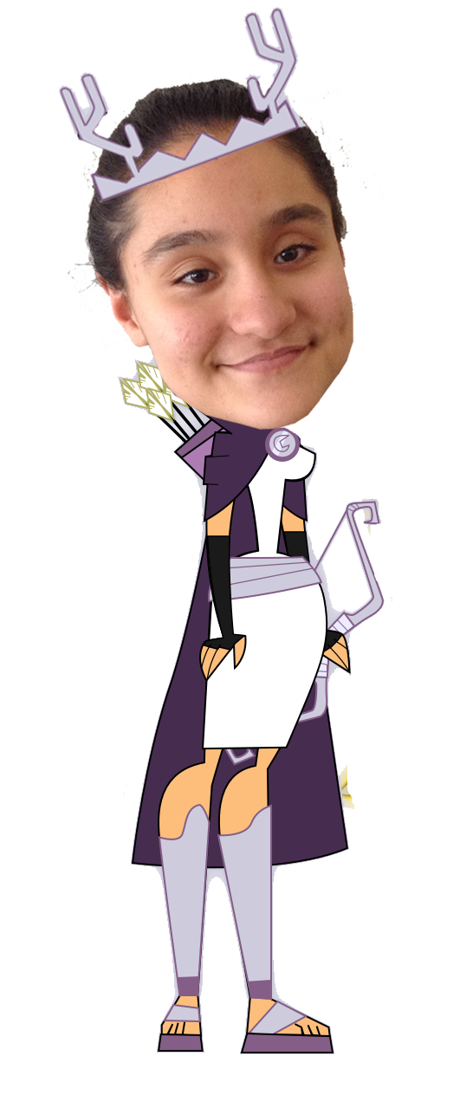
What is my name?
HERA
B) ARTEMIS
C) HESITA

Slide 13
B

Slide 14
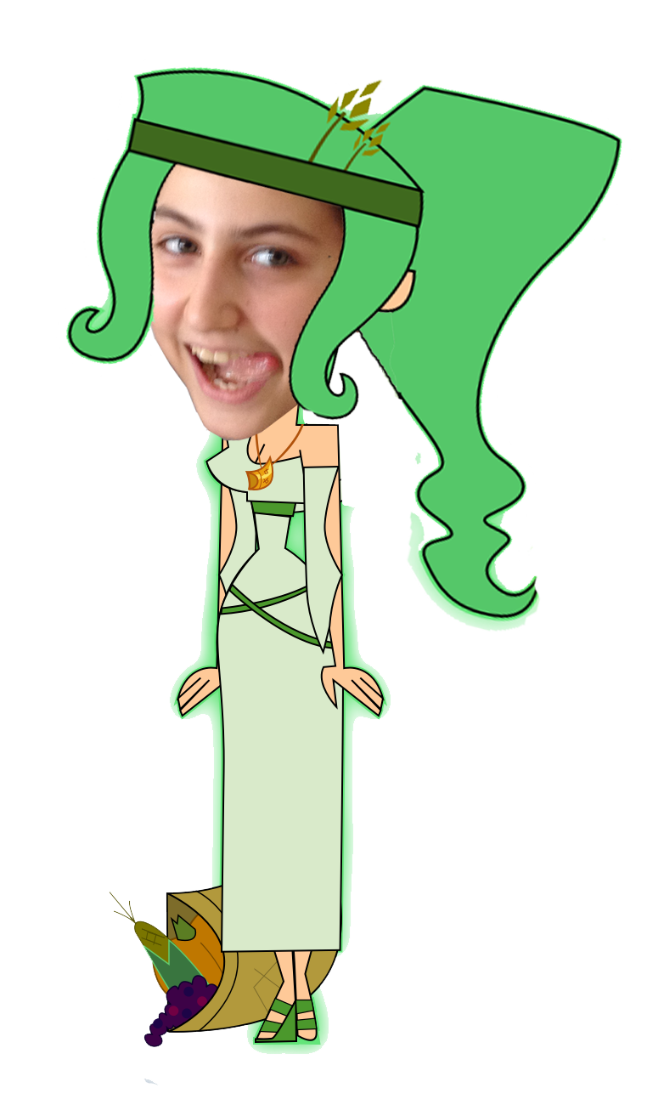
What is my name?
HERA
B) Athena
C) DEMETER

Slide 15
C

Slide 16
What is my name?
DIONYSUS
B) HADES
C) ARES

Slide 17
A

Slide 18
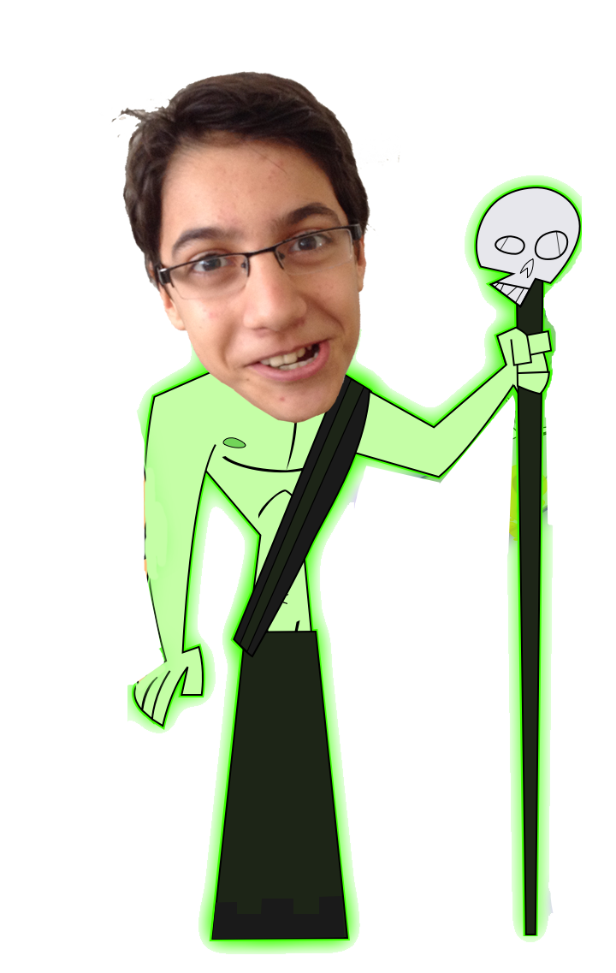
What is my name?
Apollo
B) HERMES
C) HADES

Slide 19
C

Slide 20
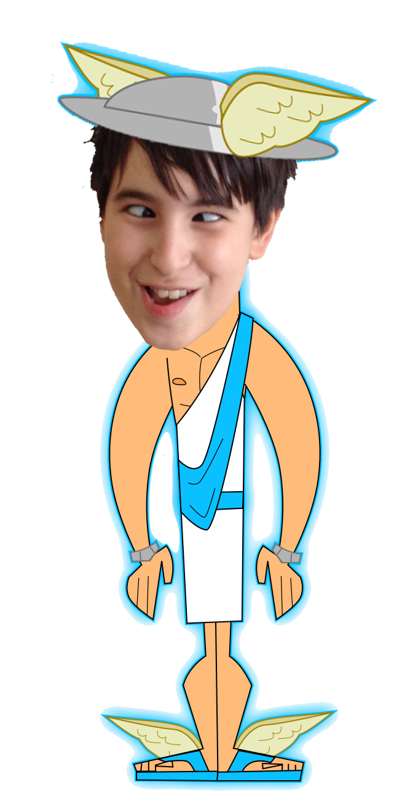
What is my name?
HERMES
B) ZEUS
C) POSEIDON

Slide 21
A

Slide 22
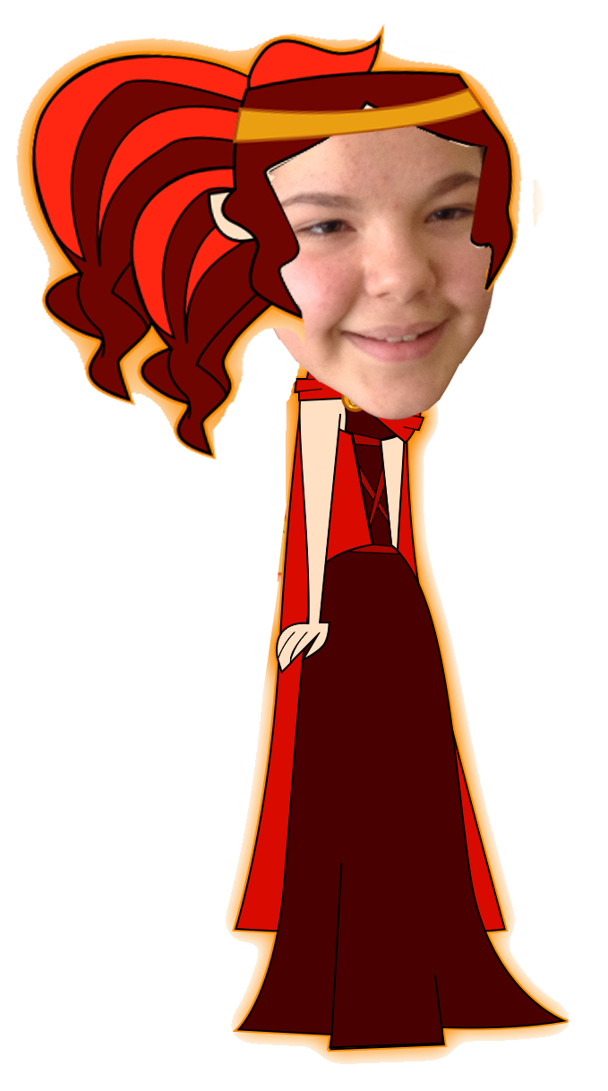
What is my name?
APRODITE
B) HESITA
C) NYX

Slide 23
B

Slide 24
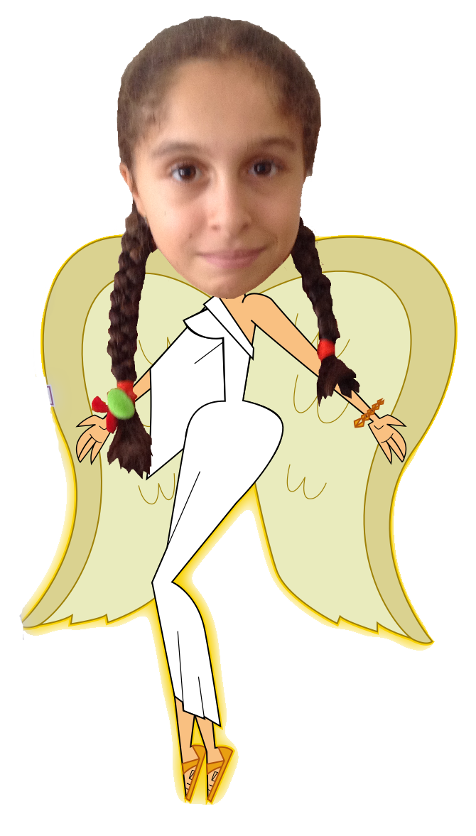
What is my name?
DEMETER
B) Athena
C) Nıke

Slide 25
C

Slide 26
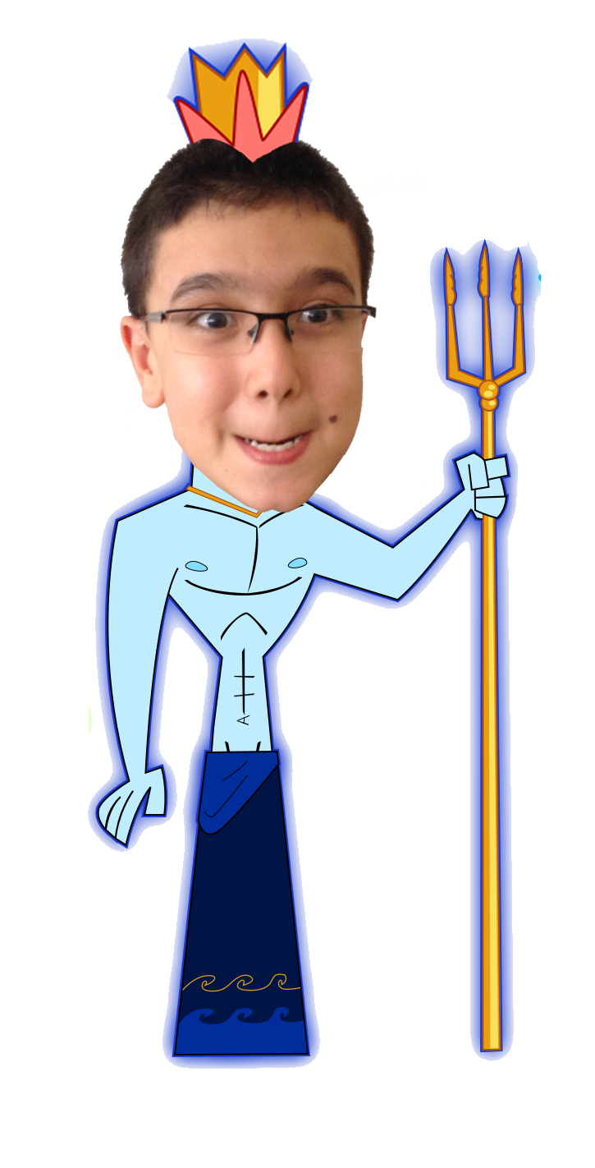
What is my name?
POSEIDON
B) PAN
C) HADES

Slide 27
A

Slide 28
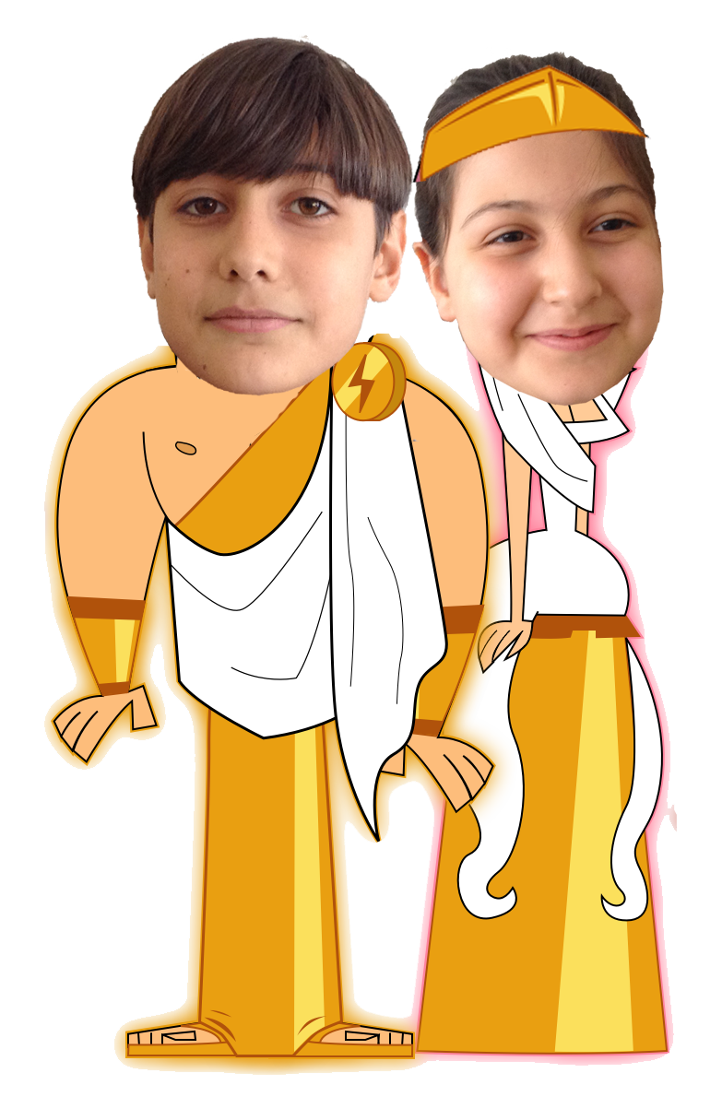
What ARE OUR nameS?
A) PAN AND DEMETER
B) ZEUS AND HERA
C) ARTEMIS AND HERMES

Slide 29
B

Slide 30
What is my name?
NYX
B) NIKE
C) PERSEPHONE

Slide 31
A

Slide 32
What is my name?
ATHENA
B) ARTEMIS
C) PERSEPHONE

Slide 33
C

Slide 34
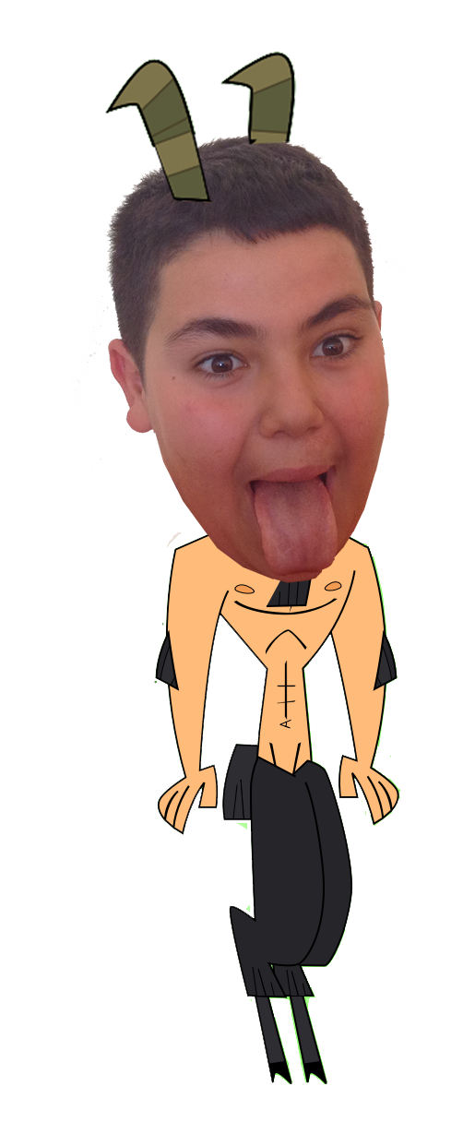
What is my name?
A) ZEUS
B) PAN
C) HERCULES

Slide 35
B

