Slide 1
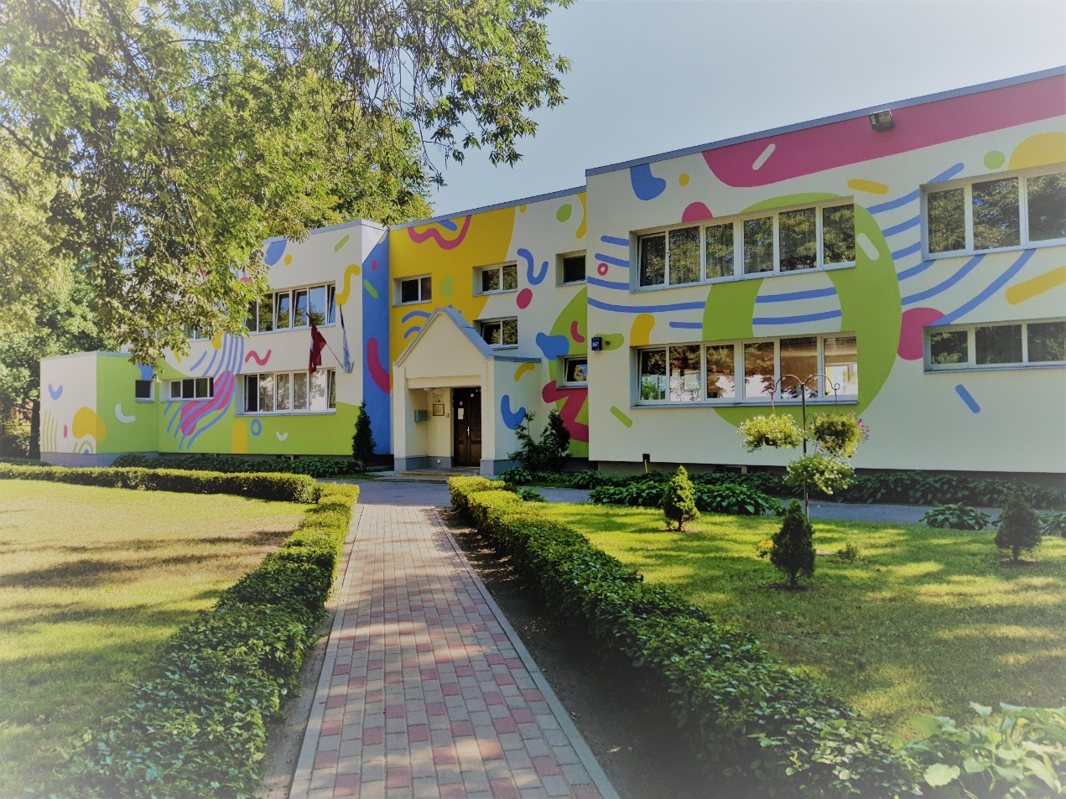
WE ARE THE KINDERGARTEN «PĒRLĪTE»
Latvia, Riga

Slide 2
We are working from 7th December, 1988. Kindergarten has 11 groups with 227 children. 57 teachers and other staff members everyday take care about kids.

Slide 3
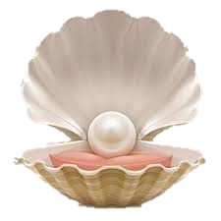
«PĒRLĪTE» – MEANS A PEARL
OUR MAIN VALUE ARE OUR KIDS – OUR PEARLS.
EVERYDAY OUR TEAM WORKS TO GIVE FOR CHILDREN THE BEST WAY FOR DEVELOPMENT.
AND WE GROW, CREATE, FILLING REALITY WITH COLORS.

Slide 4
Our principles of work are:
TOLERANCE;
EMPATHY;
COOPERATION;
RESPONSIBILITY;
SELF-DEVELOPMENT.

Slide 5
THANK YOU FOR ATTENTION

